Slide 1

Ansible & Connect
SEAT
Pollock
June 2020

Slide 2
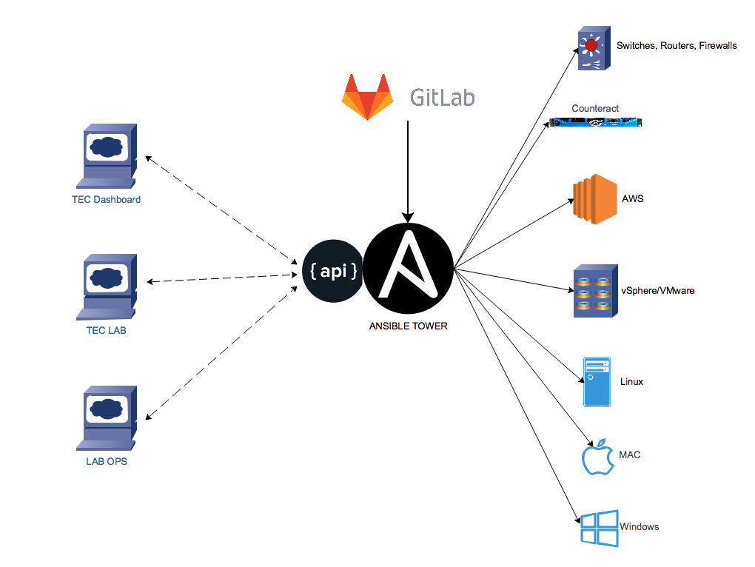
Ansible Tower Orchestration
Ansible Playbooks control infrastructure
Control code updates through git repo
Deploy playbooks through tower (sync to git)
Tower provides alerting, credential management, and scheduling as required
Web UI’s and other task just call the Ansible Tower REST API, parameters are passed tower, & then the playbook.

Slide 3
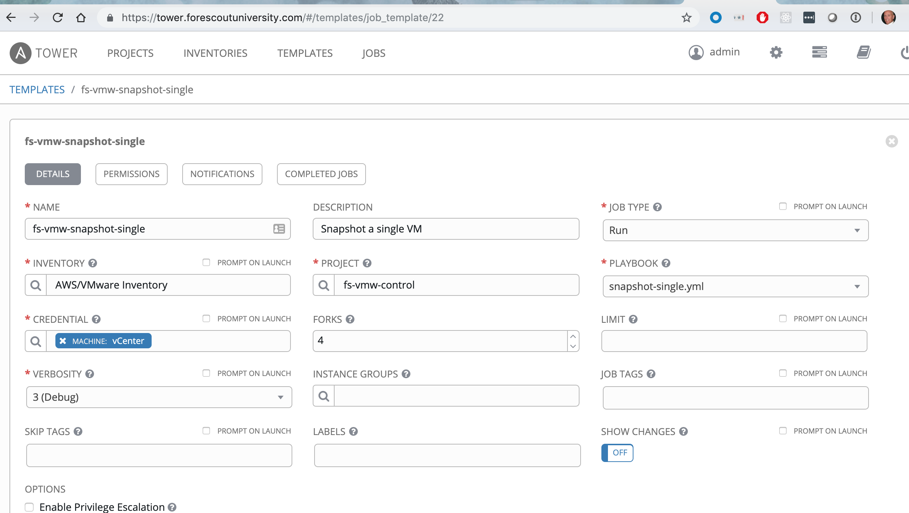
Tower maps API to Ansible playbook

Slide 4
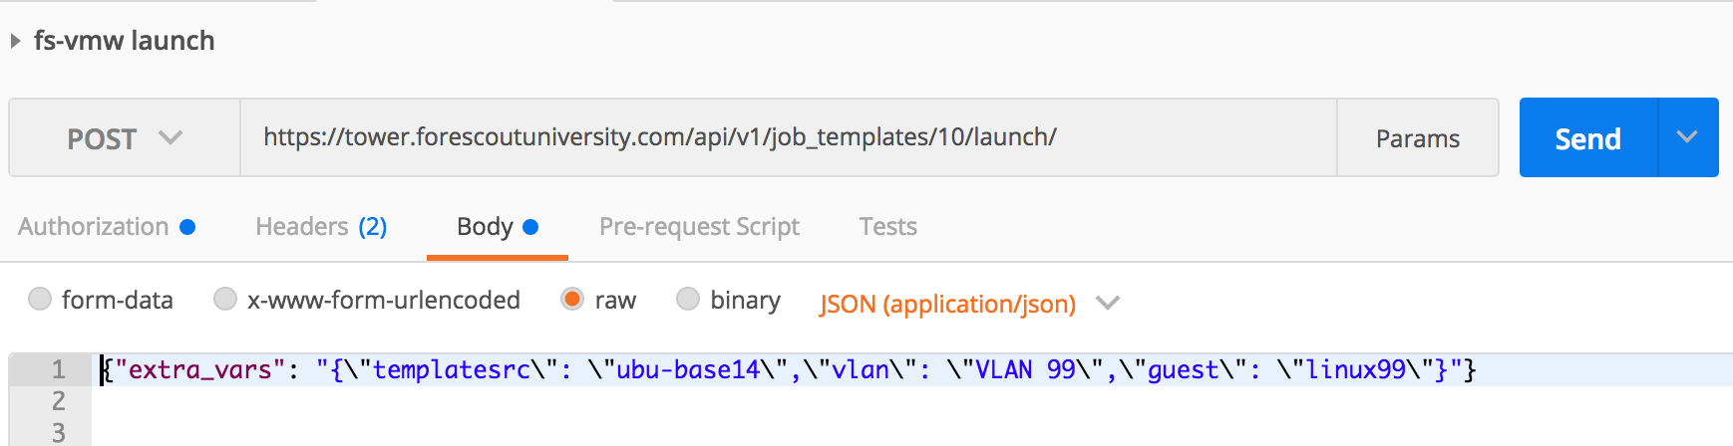
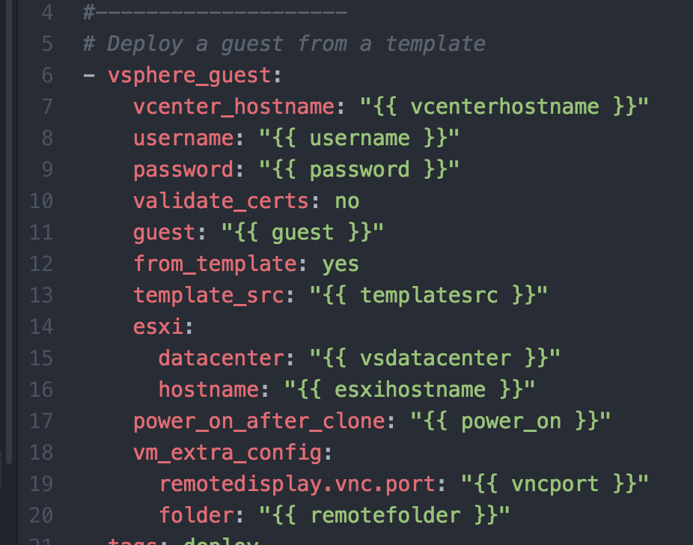
Variables passed to playbook via API
Tower Template ID
extra_vars is a dictionary entry passed in the body of POST that maps to the variables supported in the playbook. (overrides)

Slide 5
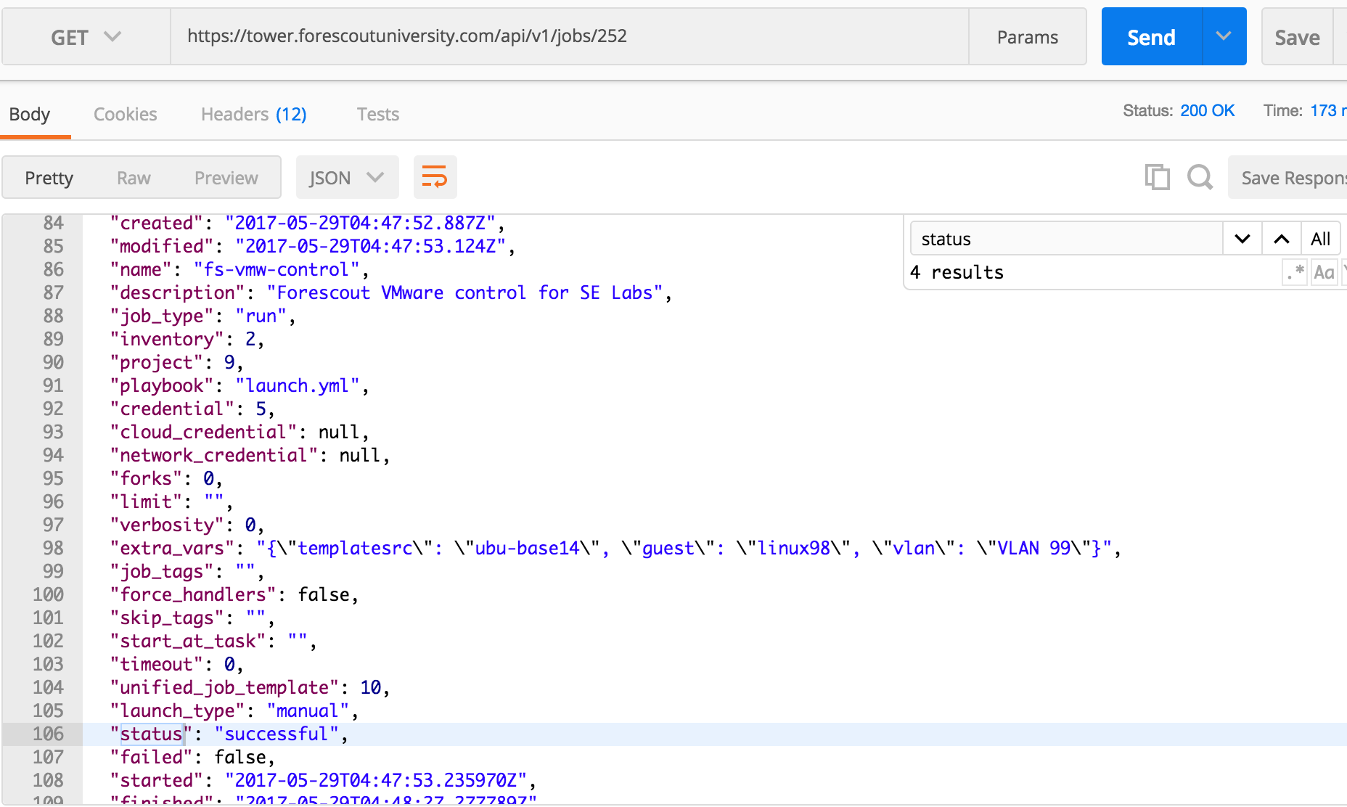
Job Status
When a job is launched, ID is returned (252)
we can then query the ID for job status
With the tower API

Slide 6
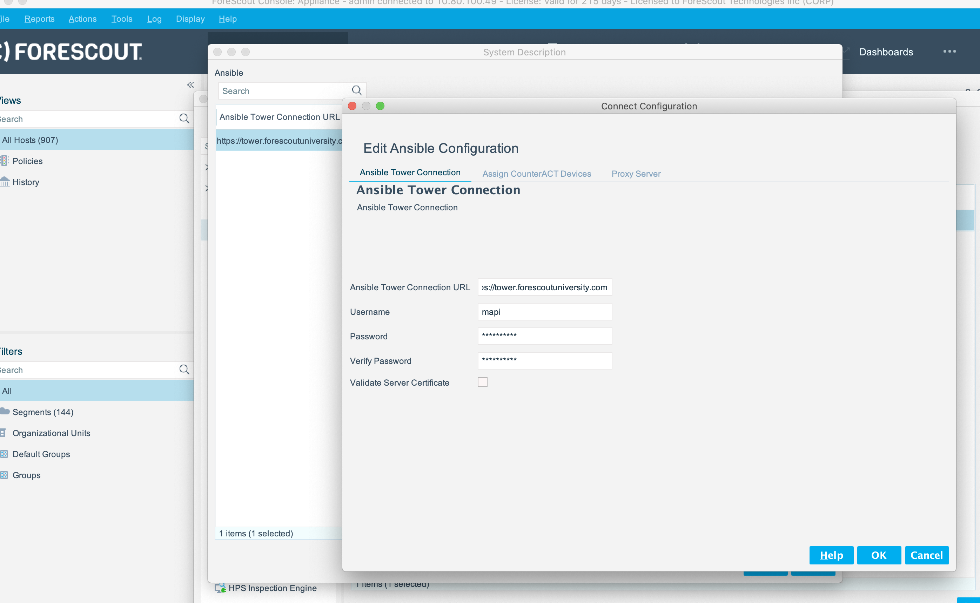
Connect system.conf captures Tower credentials

Slide 7
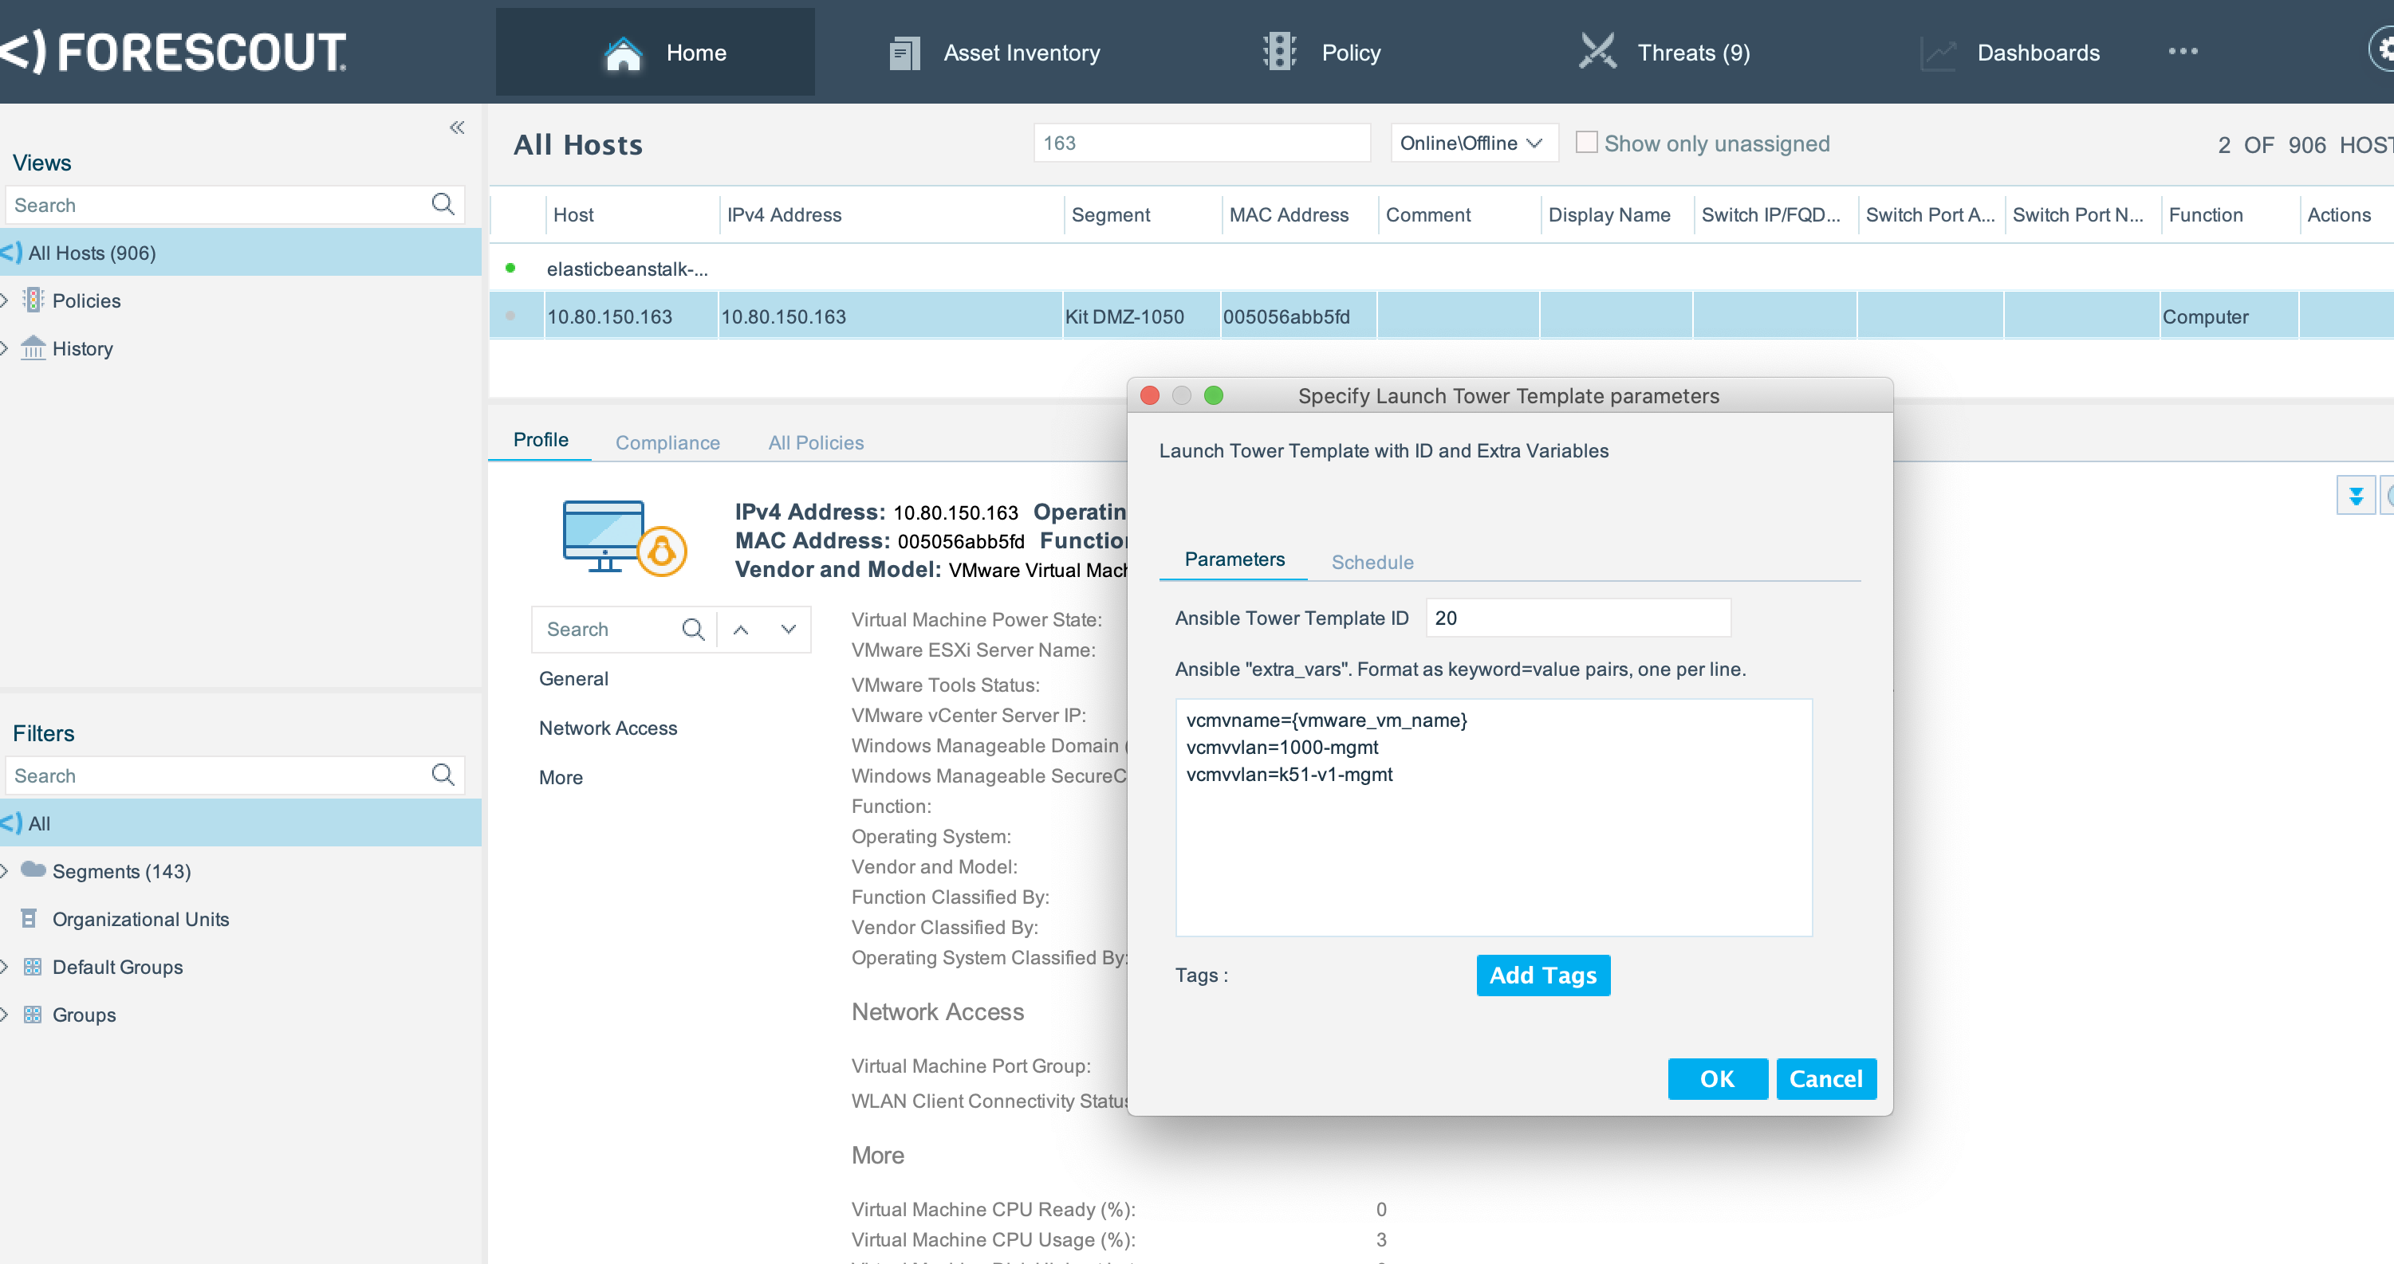
Variables passed to Tower API
Reference the Tower Template ID
variables can be literal, or use "tags" referencing the properties of the current endpoint.

Slide 8
Use Cases
Anything that you can write an Ansible playbook for, you can wire into tower and execute from eyeSight.
There hundreds of Ansible integrations: https://docs.ansible.com/ansible/latest/modules/list_of_all_modules.html
You can duplicate the functionality of many of the existing plugins, so be careful...
Security (the playbooks that can be executed on Tower) are controlled by the credentialing of the Tower user on the eyeSight.
Some easy examples:
Change power state on VMware VM (you can do this with the plugin as well)
Change port group on VMware VM (not done with plugin)
In reference to some security alarm, snapshot the VM for later inspection
There are many more... configure a cisco switch or port, provision a linux machine (vmware, aws, azure, local) for any app you can think of, alter UFW acl's, add/remove users, ssh keys... backup your AWS infrastructure, deploy terraform plans...

