Slide 1
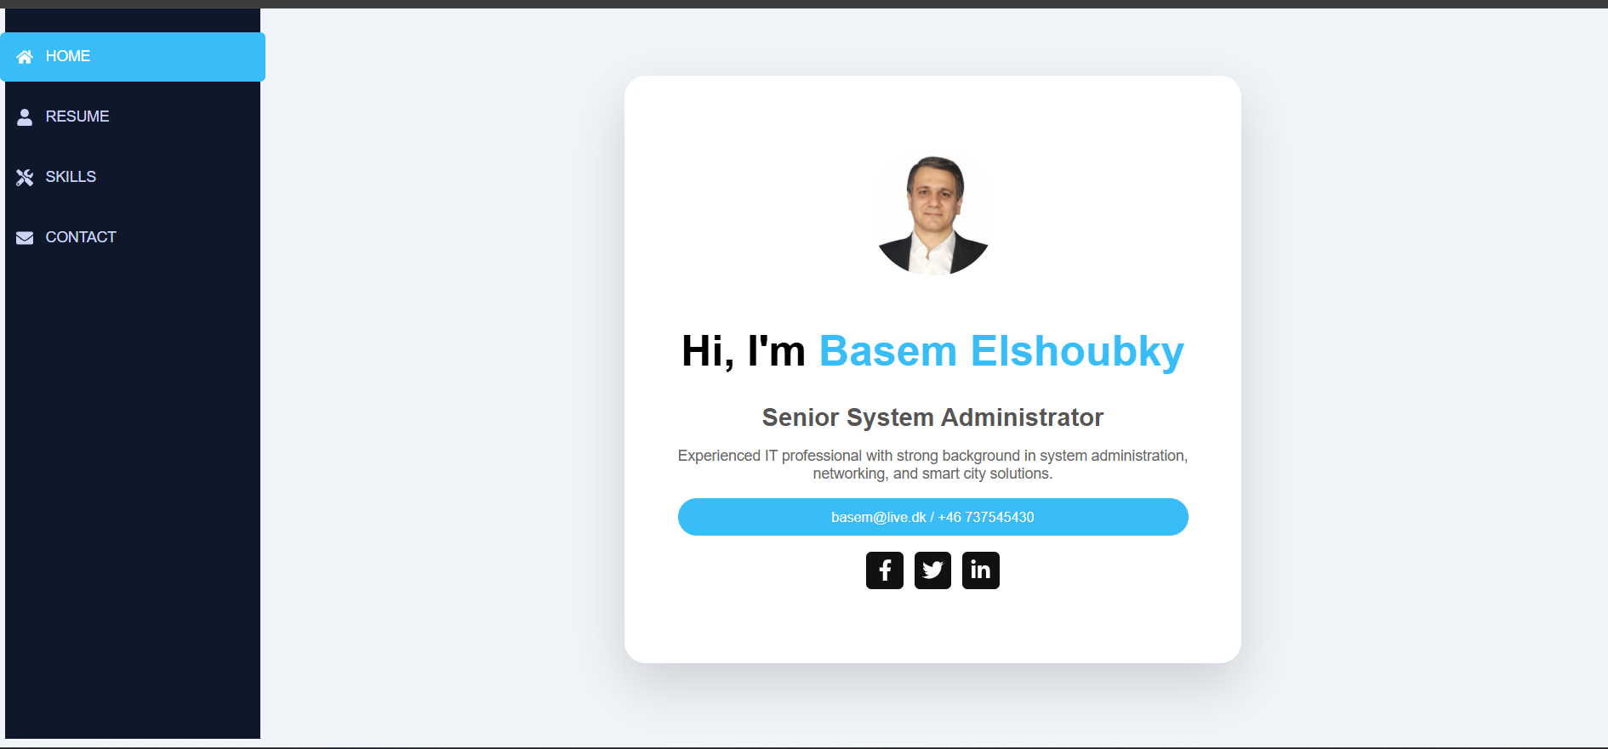
CV Website Project
Basem Elshoubky
React Portfolio Application

Slide 2
Project Overview
Personal CV Website
Built with React
Single Page Application
Interactive UI

Slide 3
Technologies
React.js
JavaScript
CSS
React Icons
Framer Motion

Slide 4
Architecture
main.jsx → App.jsx
App.jsx → Controller
Sidebar → Navigation
Components → Pages
🎯 Architecture Summary
User
↓
Sidebar (UI)
↓
App State (useState)
↓
Conditional Rendering
↓
Components (Pages)
↓
Styled UI

Slide 5
Navigation Flow
User Click → Sidebar → setActive()
→ Conditional Rendering
→ Display Page

Slide 6
Components
components/
│
├── Sidebar.jsx
├── Home.jsx
├── Resume.jsx
├── Skills.jsx
├── Contact.jsx

Slide 7
Resume Section
Timeline Layout
Structured Experience
Animated UI

Slide 8
Skills Section
Card-based design
Dynamic rendering
Progress bars

Slide 9
Contact Section
Contact Info
Interactive Form
Controlled Inputs

Slide 10
Key Concepts
Component-based design
useState
Conditional rendering
Reusable components

Slide 11
Live Demo
Demo of the application

Slide 12
Challenges
State management
UI structure
Component design

Slide 13
Conclusion
Built full CV website
Applied React concepts
Ready for real-world use

