Slide 1
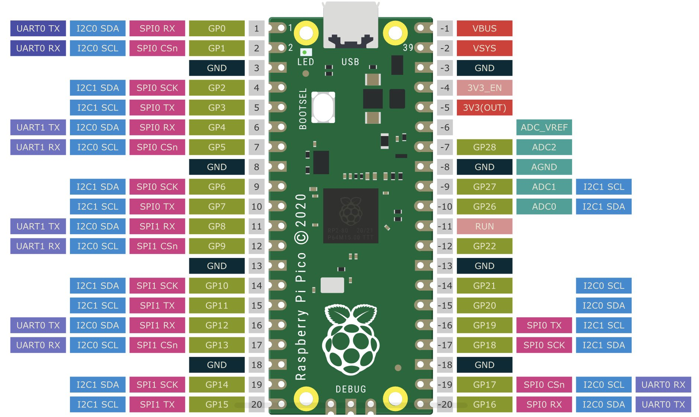
Pinout and Pin Usage
OLED Display
Sw4
Sw3
SD Card
Sw2
LED
Sw1
Encoder SW
SD Card
Rotary sw Encoder + SW
Raspberry Pi Pico

Slide 2
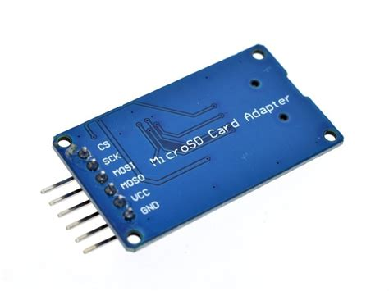
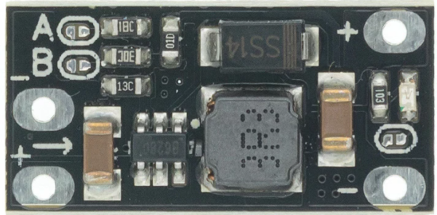
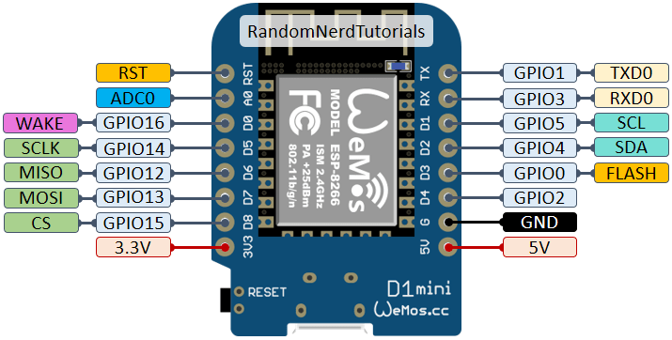
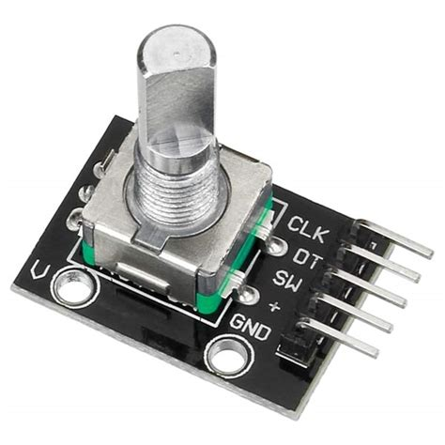
Power Supply
Input
Voltage Booster
[ Step-Up 5V Out ]
ENC_SW
ENC_DT
OL_SCL
SD_SCLK
OL_SDA
SD_MISO
ENC_CLK
SD_MOSI
LED_DIN
SD_CS
Output

Slide 3
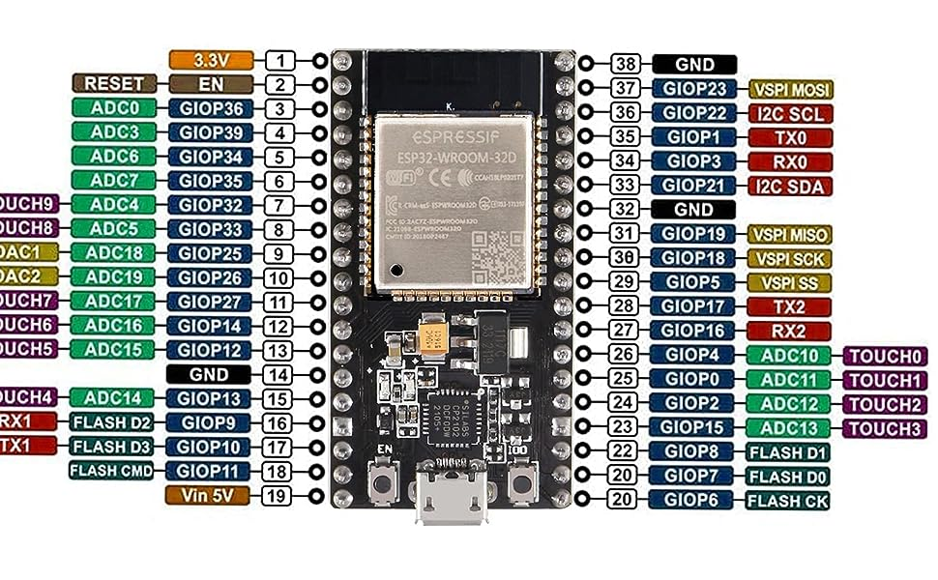

Slide 4
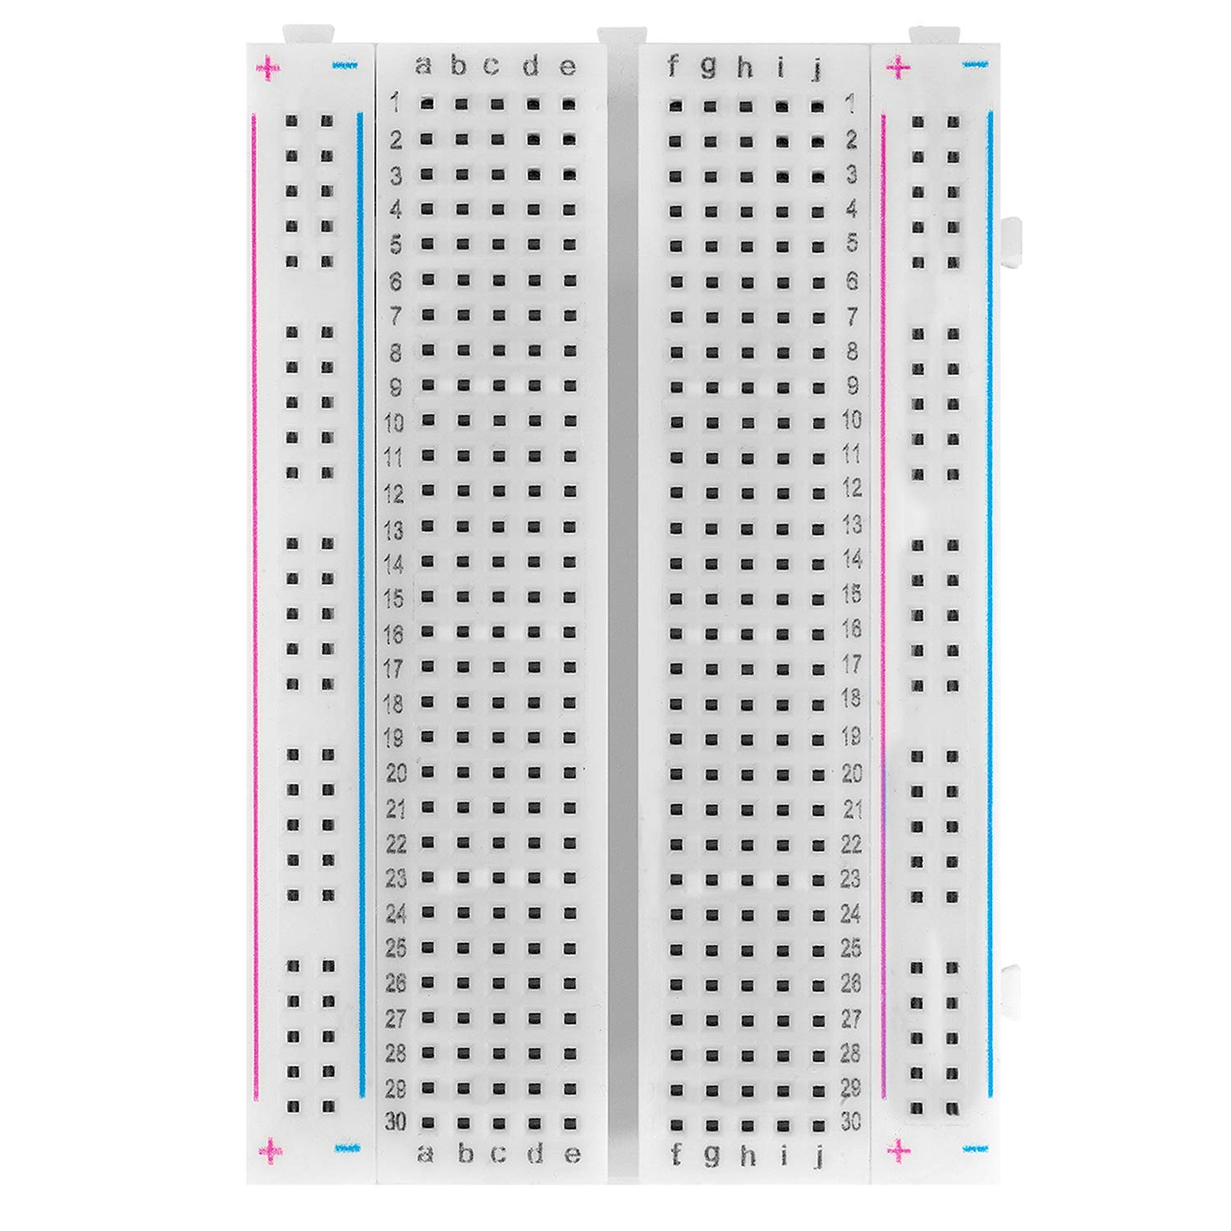
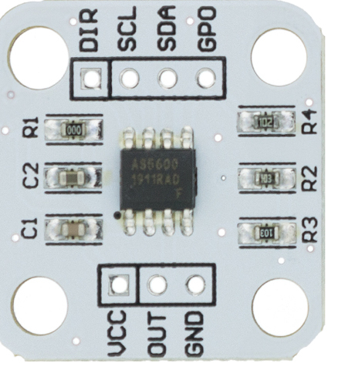
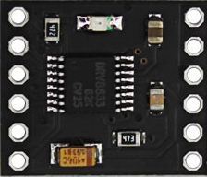
DIR
SCK
SDA
PGO
DIR
PO
OUT
SCK
SDA
S1
S2
x
SCL
SDA
GND
VCC
SCK
SDA
RX
TX
GND
PWM
Poti
STOP
DIR
SCK
SDA
PGO

