Slide 1
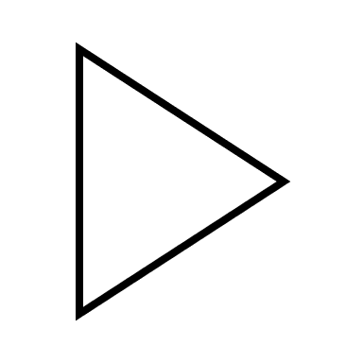




+ 3 sec
upcomming Notes
MIDI Player 1
MIDI Player 2
foreshadowing
MIDI File
current Notes
signaling

