Slide 1
Optimized placement of PV panels by using ensembling approach for rooftop segmentation
FINAL YEAR PROJECT 2021-2022
TEAM 18

Slide 2

TEAM MEMBERS
Shruthi M - 2018103592
Gayathri M - 2018103535
Jayapriya M - 2018103029
PROJECT GUIDE
Prof Dr. P. Uma Maheshwari

Slide 3
Title
Names
Introduction
Overall Objectives
Lit Survey (6)
Architectural diagram
List of modules, module design diagram, IP/OP for each modules
Performance measures
Dataset
Reference

Slide 4
INTRODUCTION
A lot of fossil fuel gets wasted in generating electricity and it is highly anticipated that if this continues, there would be dearth of electricity in the next few decades. Potential tapping of renewable resources from solar, wind energy is of great interest.
However, traditional approaches such as online assessment and utilities interconnection filings are time consuming and costly, and involve a lot of human effort where concerned people have to go to the site to look into the rooftop area to determine the installation of PV panels.
As a first step, to eliminate and reduce the manual work of profiling rooftop, we use an automated approach to segment rooftops. Using aerial images to identify objects on the earth’s surface has attracted great attention and aerial image segmentation has gained importance in recent years.
However the variety and intricate look of the buildings in mixed backdrops has made it difficult for automatic detection of building objects from remote sensing data.
In our project, we employ automated approach for the detection of the usable rooftop of a building with the input satellite imagery.
We aim to segment the input rooftop images by using various deep learning models such using ensembling approach to identify the type of roof and use maximum fitting approach to output rooftop images with PV panels installed.
Notes:
Introduction - Shruthi Performance Measures - All 3
Overall Objectives - Gayathri
Architecture Diagram - All 3
As we all know, the primary source for generating electricity is fossil fuels. However, it is highly anticipated that these would get replenished in the forthcoming years. People are naturally turning towards other forms of energy such as the renewable resources which includes solar, wind power. We see a lot of houses with solar panels fitted these days. However, traditional approach of going to the site, inspecting the rooftops involves a lot of manual effort, human resources and cost. To automate and reduce the cost of the resources, our project aims to identify the optimized placement of PV panels in order to capture maximum sunlight and hence utilise maximum energy for consumption. Maximum utilisation of solar power energy is possible when the rooftops are entirely utilised. More clear the segmentation of rooftops, much better the results of alignment of panels. And to achieve this, we need to perform aerial semantic segmentation. Using aerial images to identify objects on the earth’s surface has attracted great attention and aerial image segmentation has gained importance in recent years. However the variety and intricate look of the buildings in mixed backdrops has made it difficult for automatic detection of building objects from remote sensing data. And not just that, our segmentation should be able to segment flat and tilted rooftops as panel placements vary for the above two.
Maximum utilisation of solar power energy is possible when the rooftops are entirely utilised. However, manual inspection is a tedious process. Hence, we have decided to come up with automation to segment aerial rooftop images, thereby classifying the type of roofs as flat or tilted and then applying a maximum fit algorithm for the same.

Slide 5
OVERALL OBJECTIVES
To estimate the placement of photovoltaic panels on the rooftop for an aerial satellite image, the following steps are to be performed:
Perform aerial semantic rooftop segmentation to segment and classify the rooftops.
Use different approaches for semantic rooftop segmentation:
U-Net Baseline model.
DeepUNet model.
U-Net with watershed transformation.
Perform ensembling on the above semantic segmentation techniques to get a multi-class segmented image.
Use maximum fitting algorithm to find the optimized no of solar panels based on type of roof to maximize energy consumption.

Slide 6
LITERATURE SURVEY
S.NO | CITATION | METHODOLOGY | ADVANTAGES | LIMITATION
1. | An aerial image segmentation approach based on enhanced multi-scale convolutional neural network, 2019 Xiang Li, Yuchen Jiang, Hu Peng and Shen Yin in 2019 IEEE International Conference on Industrial Cyber Physical Systems (ICPS) | 1. Segmentation model is performed using an encoder-decoder architecture. 2. A U-Net is constructed as the main network, and the bottom convolution layer of U-Net is replaced by a set of cascaded dilated convolution with different dilation rates. 3. Add an auxiliary loss function after the cascaded dilated convolution | 1. From the aspect of design and training, the approach does not involve manual features and does not require specific preprocessing or post-processing, which can reduce the influence of subjective factors 2. The auxiliary loss function helps to make the network converge faster and optimize. | 1. Segmentation of large buildings work well but boundaries and middle parts are misaligned. 2. The bulges on the boundaries are lost and edges are not detected properly. 3. The algorithm performs well in one of the subset (countryside and forest) but does not perform well when tested on a different subset.

Slide 7
LITERATURE SURVEY
S.NO | CITATION | METHODOLOGY | ADVANTAGES | LIMITATION
2. | Convolutional Neural Network Based Solar Photovoltaic Panel Detection in Satellite Photos, 2017 Vladimir Golovko, Sergei Bezobrazov, Alexander Kroshchanka and Anatoliy Sachenko in 9th IEEE International Conference on Intelligent Data Acquisition and Advanced Computing Systems: Technology and Applications | 1. Collect data from Google Maps. 2. Perform pre-processing techniques like image resizing, image sharpening. 3. Train a 6 layer CNN model. | 1. Here, the authors have used the low-quality satellite imagery (Google Maps photos), instead of the high resolution color satellite orthoimagery that enables decreasing the requirements for the approach. 2. Simple 6 layer CNN model. | 1. Better segmentation could have been performed by training with other CNN models. 2. Bad quality satellite images have led to inaccurate classification. 3. No validation on the dataset as in some cases solar panels look similar to roof tops.

Slide 8
LITERATURE SURVEY
S.NO | CITATION | METHODOLOGY | ADVANTAGES | LIMITATION
3. | Deep Convolutional Neural Network Application on Rooftop Detection for Aerial Imagery, 2019 Mengge Chen, Jonathan Li, in Journal of Computational Vision and Imaging Systems | 1. It is primarily based on Mask R-CNN with 3 stages. 2. Feature extraction is based on existing deep learning model. 3. RPN (Regional Proposal Network) is used to find RoI. 4. Object classification is then performed. | 1. Efficient and feasible approach to extract detached house from aerial images. 2. RoIAlign method is used instead of RoIPool for better feature extraction. | 1. Edges of the building are not detected properly. 2. Training data was less and hence less accuray. 3. Comparatively less precision with other new state of art models.
4. | Solar Potential Analysis Of Rooftops Using Satellite Imagery, 2019 Akash Kumar, Delhi Technology University, in ArXiv abs/1812.11606 | 1.Dataset is manually collected for India. 2.Adaptive Edge Detection and Contours are focused to segment out rooftop boundaries and obstacles present inside them along with polygon shape approximation. | 1.Provides a comparative analysis of the solar potential of the building. 2. Several types of the rooftop are considered to learn the intra-class variations. | 1.The image quality of satellite imagery is very deficient hence the edges are not detected properly. 2.There are some outliers that are plotting solar panels outside the building rooftop area.

Slide 9
LITERATURE SURVEY
S.NO | CITATION | METHODOLOGY | ADVANTAGES | LIMITATION
5. | On Building Classification from Remote Sensor Imagery Using Deep Neural Networks and the Relation Between Classification and Reconstruction Accuracy Using Border Localization as Proxy, 2019 Bodhiswatta Chatterjee, Charalambos Poullis in 2019 16th Conference on Computer and Robot Vision (CRV) | 1. ICTNet: a novel network with the underlying architecture of a fully convolutional network, infused with feature re-calibrated Dense blocks at each layer. 2. It is combined with dense blocks, and Squeeze-and-Excitation (SE) blocks. 3. Reconstruction is done by extruding the extracted boundaries of the buildings and comparative analysis is made between the two. | 1. Has addressed the task of using few parameters to process large chunks of data. 2. With no 3D information on the buildings, the authors have used the building boundaries as a proxy for the reconstruction process. 3. Has got better overall IoU compared to other methods. | 1. There is no loss function for the reconstruction accuracy. 2. Need extensive hardware specifications to train the model.

Slide 10
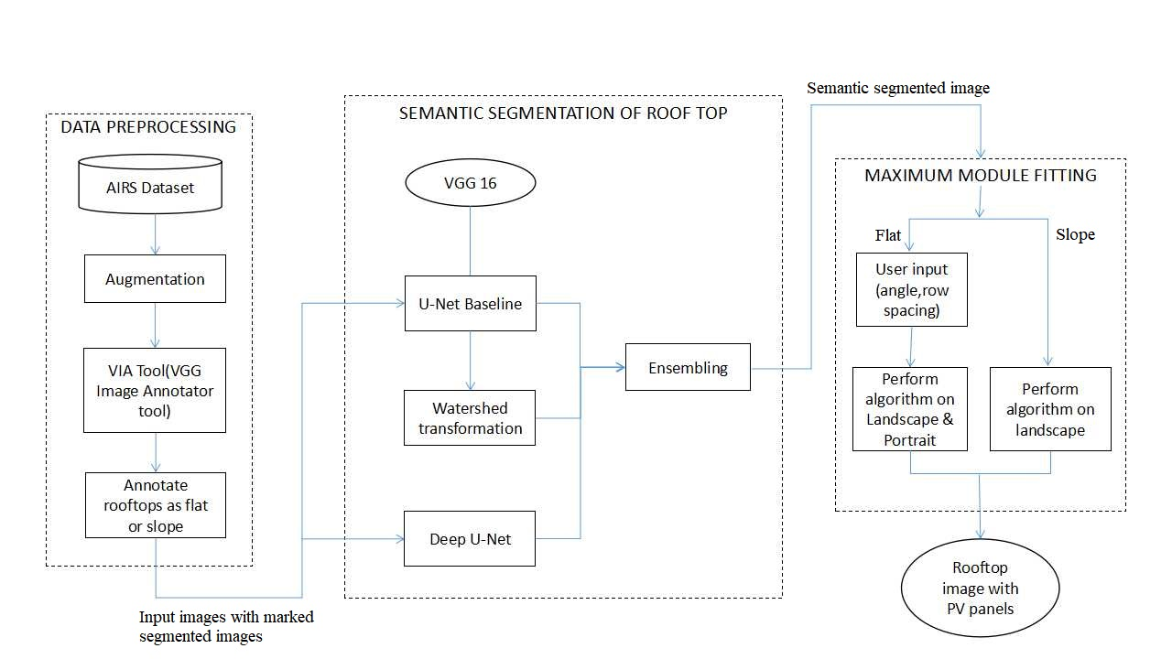
ARCHITECTURE DIAGRAM
Notes:
The first step is data pre-processing:
We use the AIRS dataset - The AIRS (Aerial Imagery for Roof Segmentation) dataset provides a wide coverage of aerial imagery with 7.5 cm resolution and over 220k buildings. AIRS dataset covers almost the full area of Christchurch, the largest city in the South Island of New Zealand. It contains around 800 images in training set, 90 each in testing and validation set. To further increase the size of dataset, we perform data augmentation. (This includes rotation, flipping, cropping etc - explain when asked about the methods that will be used). We use the VIA annotator tool to label the training satellite aerial rooftops as flat or tilted. The dataset is now fed to the model for training.
The 3rd module uses the maximum module fitting algorithm. Based on the semantically segmented images in the previous case, we take certain decisions based on the type of roof. In case of flat roof tops, we take in the tilt angle with which the PV needs to be fitted along with row spacing. The tilt angle is influential only for the case of the flat roofs because pitched roofs already have a fixed azimuth and tilt which PV module should comply with (mainly because of wind force and safety reasons). Explain row spacing as discussed and landscape ad portrait too.

Slide 11
ARCHITECTURE DIAGRAM
The above block diagram gives a high level overview on the 3 modules.
The 1st module contains annotating the AIRS dataset using the VIA software. This is fed to the next module to segment the rooftop images.
We combine 3 models (U-Net, Deep U-Net and U-Net with watershed transformation) using ensembling approach and give the multi-class segmented image .
Based on the segmented roofs, we set a size for solar panels that gets overlaid on the rooftop image. The no of panels to be fitted needs to be maximized in order to get maximum efficiency and this is done with the help of maximum fitting algorithm.

Slide 12
LIST OF MODULES
Module I - Data pre-processing.
Module II - Rooftop segmentation using ensembling methods.
Module III - Maximum Fitting Module.

Slide 13
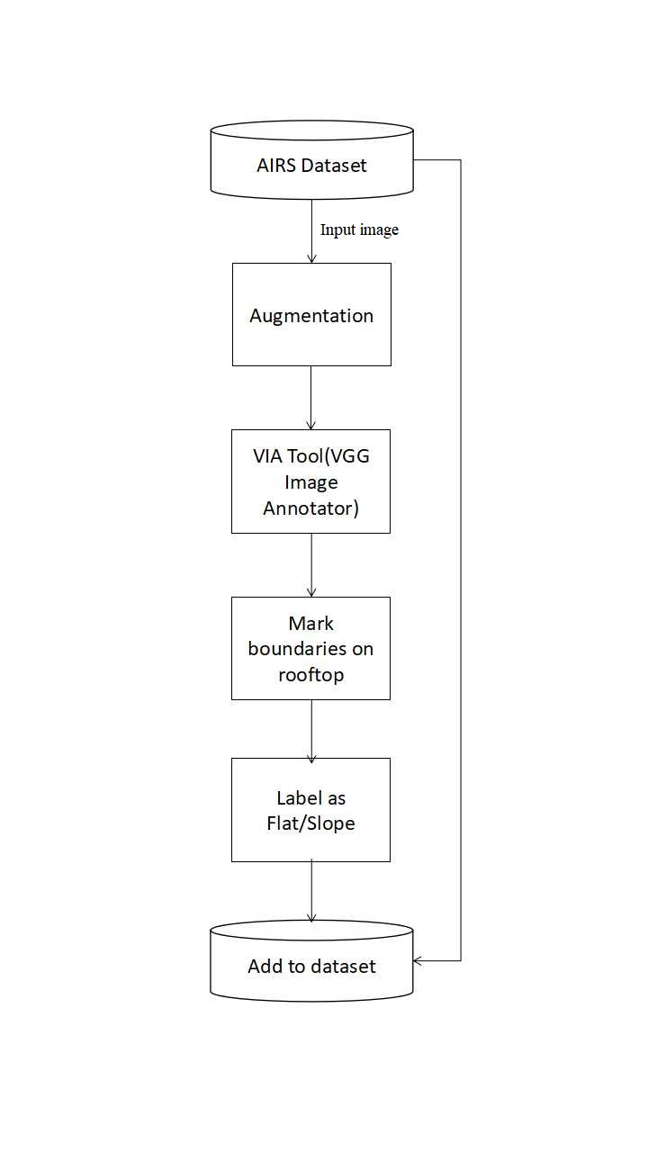
MODULE DESIGN
MODULE I - DATA PRE-PROCESSING
INPUT: AIRS Dataset
OUTPUT: Masked segmented images
We use AIRS dataset and select around 1k images from the dataset.
Using VIA tool, we annotate each of the input rooftop images as flat or tilted.
This is done by using the software and marking boundaries on the rooftop and assigning labels.
The masked image along with input is stored in a new database.

Slide 14
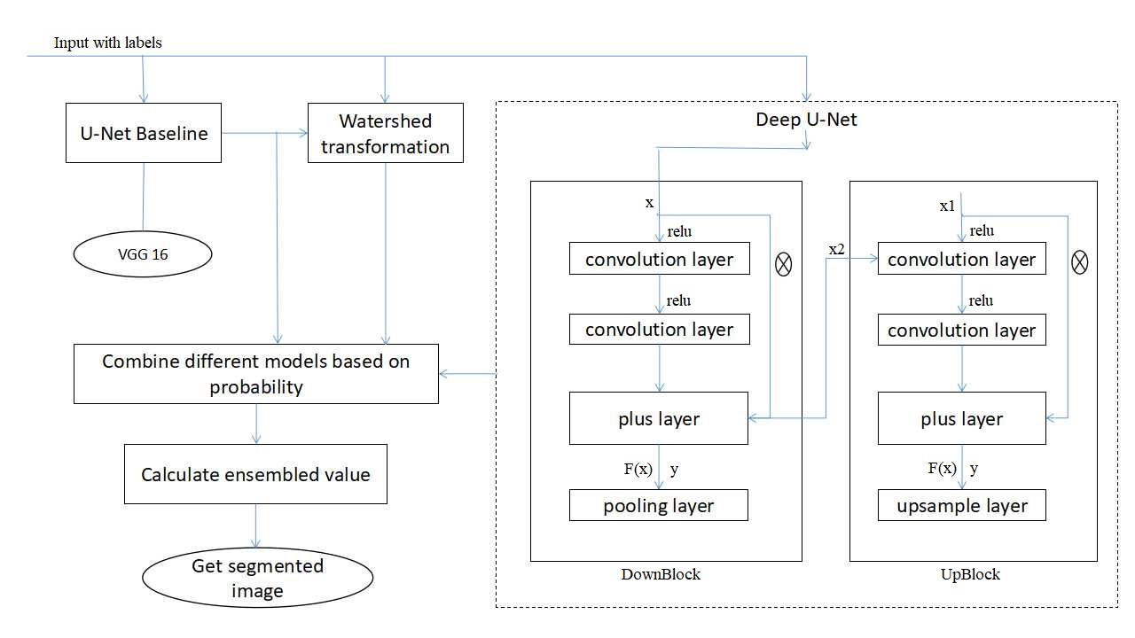
MODULE DESIGN
MODULE II - SEMANTIC ROOFTOP SEGMENTATION USING ENSEMBLING METHODS
INPUT: Newly annotated AIRS dataset
OUTPUT: Multi-class segmented image

Slide 15
MODULE DESIGN
MODULE II - SEMANTIC ROOFTOP SEGMENTATION USING ENSEMBLING METHODS
The input images are fed to 3 models.
The first model uses U-Net for multi-class image segmentation. It is trained usingVGG16 as the backbone.
As a next step, the binary segmented U-Net image can be integrated with watershed transformation. This brings us to the second model.
In the 3rd model, we use Deep U-Net. Here, we have 2 blocks namely the Downblock and Upsampling block.
The DownBlock has two convolutional layers that are concatenated through the ReLU layer. It is then passed to max pooling layer. The output of DownBlock is passed to next DownBlock and also to the UpBlock.
The UpBlock is similar to the DownBlock except that here we have the upsampling layer instead of the max pooling layer.

Slide 16
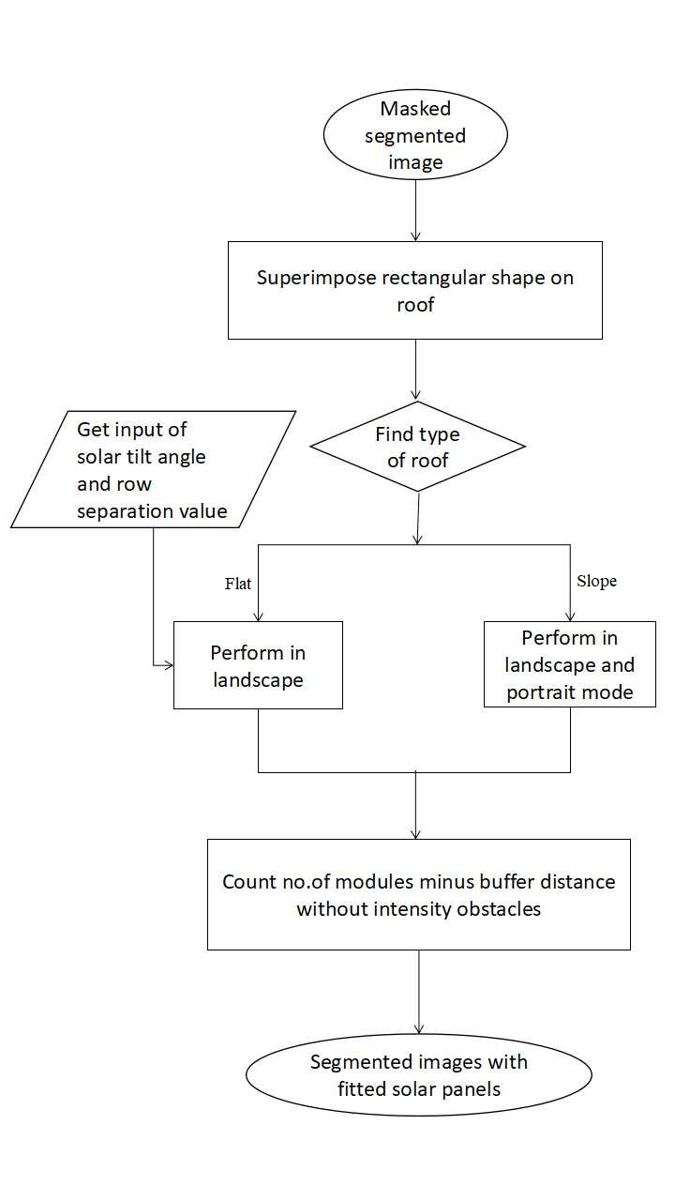
MODULE DESIGN
MODULE III - MAXIMUM FITTING MODULE
INPUT: Masked segmented image.
OUTPUT: Segmented image with solar panels of specific size fitted.
The masked segmented image stored in the new database is taken and the roofs are superimposed with rectangular shape.
Then the type of the roof is determined as flat or slope.
If the type of the roof is flat, we get user input(solar tilt angle and row separation value) and perform maximum fitting algorithm on landscape mode.
If the type of the roof is slope, we perform maximum fitting algorithm on landscape and portrait mode.
The buffer distance without intensity obstacles is subtracted from the count of number of modules.
The segmented images are fitted with the solar panels.

Slide 17

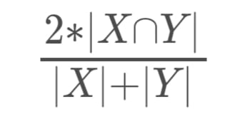
PERFORMANCE MEASURES
IoU - Intersection over Union /Jaccard Coefficient
To quantify the accuracy of our model to predict size for solar PV arrays, we use Jaccard coefficient which is widely used in prior work to measure the similarity between detected regions and ground truth regions. Jaccard Similarity Index(JSI) measures the similarity for the two sets of pixel data, with a range from 0% to 100%. The higher the percentage, the more precise prediction. It is defined as follows:
where r_{d} denotes the detected region for a solar PV array, and r_{g} indicates the groundtruth region for a solar PV array
DICE Coefficient
We use DICE coefficient to compare the pixel-wise agreement between a predicted segmentation and its corresponding ground truth. DICE coefficient is 2 times the area of overlap divided by the total number of pixels in both the images.The formula is given by
where X is the predicted set of pixels and Y is the ground truth.

Slide 18

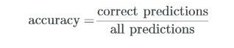
PERFORMANCE MEASURES
MCC - Matthews Correlation Coefficient
We use the MCC , a standard measure of a binary classifier’s performance, where values are in the range −1.0 to 1.0, with 1.0 being perfect roof segmentation, 0.0 being random roof segmentation, and −1.0 indicating roof segmentation is always wrong. The expression for computing MCC is below, where TP is the fraction of true positives, FP is the fraction of false positives, TN is the fraction of true negatives, and FN is the fraction of false negatives, such that TP+FP+TN+FN= 1.
Accuracy
Accuracy is the percentage of correct predictions for the test data. It can be calculated easily by dividing the number of correct predictions by the number of total predictions.

Slide 19
DATASET
AIRS Dataset - The AIRS (Aerial Imagery for Roof Segmentation) dataset provides a wide coverage of aerial imagery with 7.5 cm resolution and over 220k buildings.
AIRS dataset covers almost the full area of Christchurch, the largest city in the South Island of New Zealand during the flying seasons of 2015 and 2016, and the supplied images are ortho-rectified DOMs with RGB channels.
It contains around 800 images in training set, 90 each in testing and validation set.
We select around 1000 images from residential areas and use the VIA tool to annotate the type of roofs and combine both the images to form an annotated dataset.

Slide 20
REFERENCES
[1] Q. Li, Y. Feng, Y. Leng and D. Chen, " SolarFinder: Automatic Detection of Solar Photovoltaic Arrays," 2020 19th ACM/IEEE International Conference on Information Processing in Sensor Networks (IPSN), 2020, pp. 193-204, doi: 10.1109/IPSN48710.2020.00024.
[2] Edun, Ayobami & Harley, Joel & Deline, Chris & Perry, Kirsten. (2021). Unsupervised azimuth estimation of solar arrays in low-resolution satellite imagery through semantic segmentation and Hough transform. Applied Energy. 298. 10.1016/j.apenergy.2021.117273.
[3] B. Chatterjee and C. Poullis, "On Building Classification from Remote Sensor Imagery Using Deep Neural Networks and the Relation Between Classification and Reconstruction Accuracy Using Border Localization as Proxy," 2019 16th Conference on Computer and Robot Vision (CRV), 2019, pp. 41-48, doi: 10.1109/CRV.2019.00014.
[4] V. Golovko, S. Bezobrazov, A. Kroshchanka, A. Sachenko, M. Komar and A. Karachka, "Convolutional neural network based solar photovoltaic panel detection in satellite photos," 2017 9th IEEE International Conference on Intelligent Data Acquisition and Advanced Computing Systems: Technology and Applications (IDAACS), 2017, pp. 14-19, doi: 10.1109/IDAACS.2017.8094501.
[5] Kumar, Akash & Sreedevi, Indu. (2018). Solar Potential Analysis of Rooftops Using Satellite Imagery. ArXiv abs/1812.11606.

Slide 21
REFERENCES
[6] Chen, Mengge and Jonathan Li. “Deep convolutional neural network application on rooftop detection for aerial image.” ArXiv abs/1910.13509 (2019): n. Pag.
[7] Peiran Li, Haoran Zhang, Zhiling Guo, Suxing Lyu, Jinyu Chen, Wenjing Li, Xuan Song, Ryosuke Shibasaki, Jinyue Yan. (2021). Understanding rooftop PV panel semantic segmentation of satellite and aerial images for better using machine learning. Advances in Applied Energy, Elsevier. Volume 4, 100057, ISSN 2666-7924. doi: 10.1016/j.adapen.2021.100057.
[8] Qi, Chen & Wang, Lei & Wu, Yifan & Wu, Guangming & Guo, Zhiling & Waslander, Steven. (2018). Aerial Imagery for Roof Segmentation: A Large-Scale Dataset towards Automatic Mapping of Buildings. ISPRS Journal of Photogrammetry and Remote Sensing, Elsevier. Volume 147, pp. 42-55.
[9] Cai, Yuwei & He, Hongjie & Yang, Ke & Fatholahi, Sarah Narges & Ma, Lingfei & Xu, Linlin & Li, Jonathan. (2021). A Comparative Study of Deep Learning Approaches to Rooftop Detection in Aerial Images. Canadian Journal of Remote Sensing. 47. 1-19. 10.1080/07038992.2021.1915756.
[10] Srinivasan Iyengar, Stephen Lee, David Irwin, Prashant Shenoy, and Benjamin Weil. 2018. WattHome: A Data-driven Approach for Energy Efficiency Analytics at City-scale. In Proceedings of the 24th ACM SIGKDD International Conference on Knowledge Discovery & Data Mining.

Slide 22
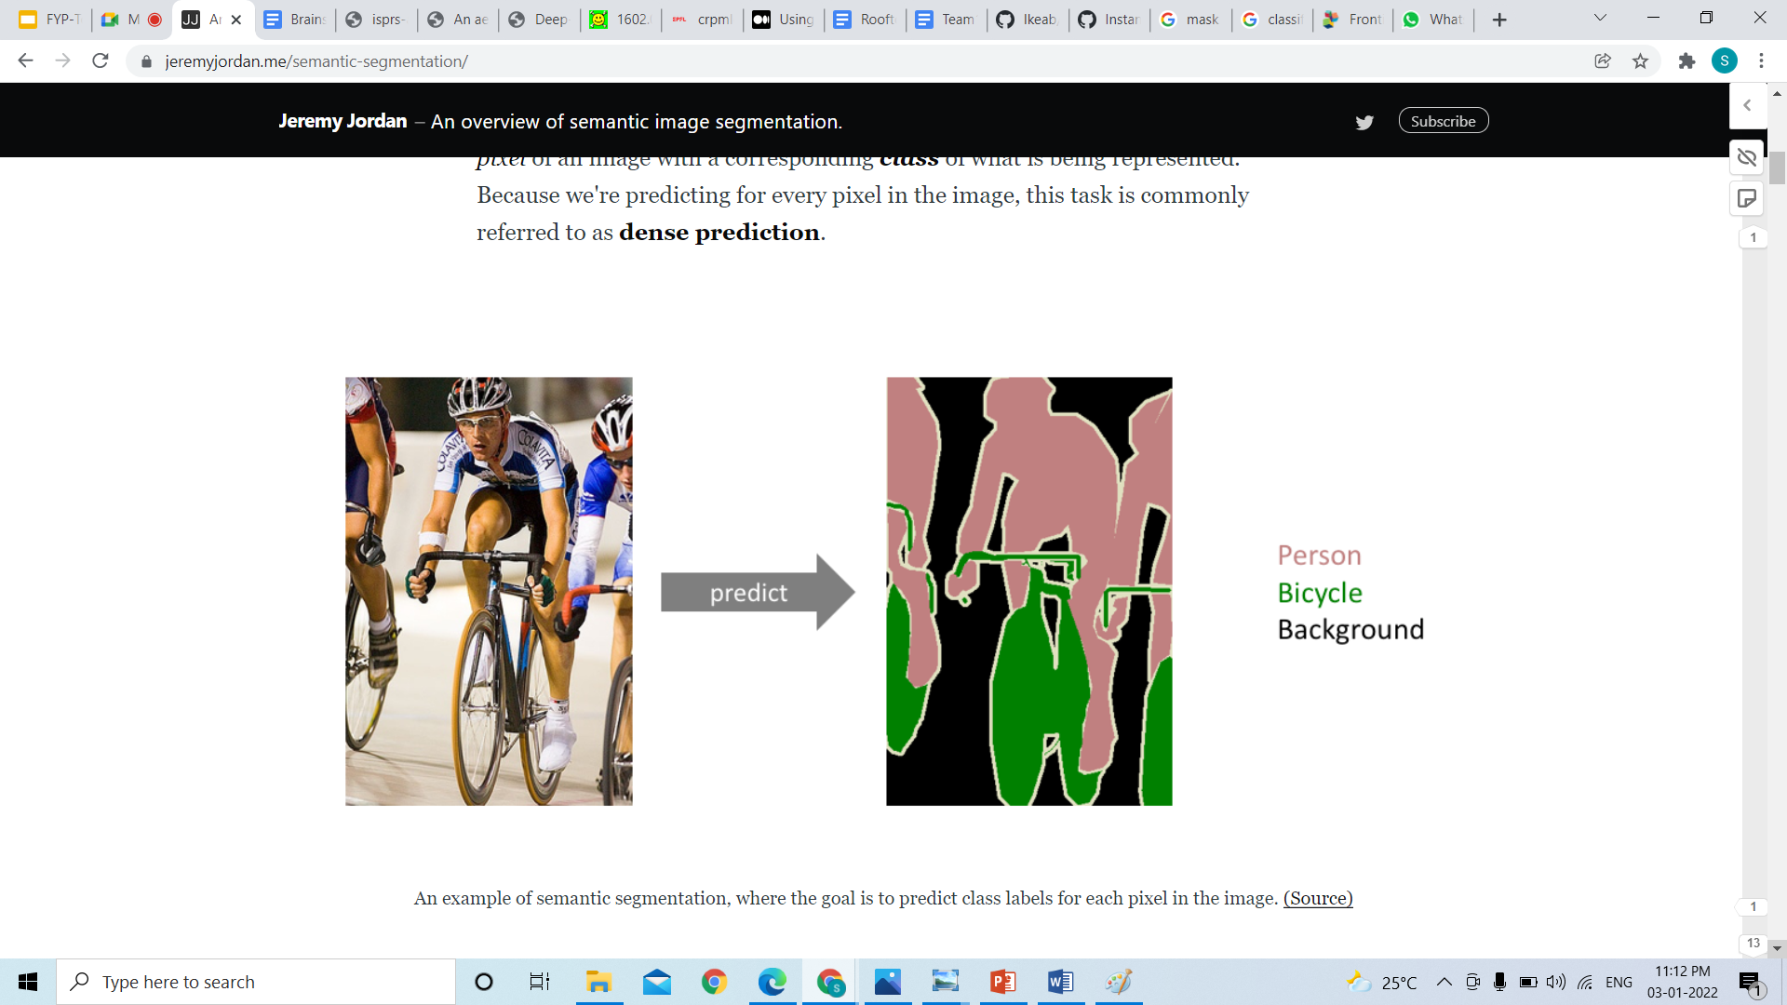

Slide 23
