Slide 1
Presentation on Human Rights
TE-3 Group A Batch 1
Roll no- 1 to 5

Slide 2
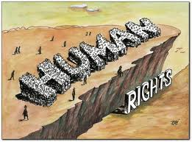
What are human rights?
The license to do what we please?
Human rights are “rights and freedom to which all humans are entitled.
Human rights are rights inherent to all human beings, whatever our nationality, place of residence, sex, national or ethnic origin, colour, religion, language, or any other status. We are all equally entitled to our human rights without discrimination.

Slide 3

Why human rights are important?
Human Rights are very important. Human rights should be the same for all people no matter what their background is, their race, origin. etc. People deserve to be accepted like we are. They have their rights which are the same as ours and they should be respected.

Slide 4

The Origin……
It commemorates the day in 1948 the United Nations General Assembly adopted the United declaration of Human Rights.
Human Rights Day is observed by the international community every year on 10 December.
The formal inception of Human Rights Day dates from 1950, after the Assembly passed resolution 423 (V) inviting all States and interested organizations to adopt 10 December of each year as Human Rights Day.

Slide 5

What are the right’s in India?
The Constitution offers all citizens, individually and collectively, some basic freedoms. These are guaranteed in the Constitution in the form of six broad categories of Fundamental Rights, which are justifiable. Article 12 to 35 contained in Part III of the Constitution deal with Fundamental Rights.
right to equality, including equality before law, prohibition of discrimination on grounds of religion, race, caste, sex or place of birth, and equality of opportunity in matters of employment

Slide 6

right to freedom of speech and expression
right against exploitation, prohibiting all forms of forced labour, child labour and traffic in human beings
right to freedom of conscience and free profession, practice, and propagation of religion
right of any section of citizens to conserve their culture, language or script, and right of minorities to establish and administer educational institutions of their choice; and
right to constitutional remedies for enforcement of Fundamental Rights.

Slide 7

Issues for human right in India?
Women
HIV/Aids
Child Labor
Democracy
LGBT right
Human Trafficking
Religious Violence
Caste Related Issues

Slide 8

Commission For Human Rights in India
National Human Rights Commission, New Delhi, India
The National Human Rights Commission (NHRC) of India is an autonomous statutory body established on October 12, 1993 ^{[1]}, under the provisions of The Protection of Human Rights Act, 1993 ^{[2]}(TPHRA).

Slide 9

Commission For Human Rights at International Level
The United Nations Commission on Human Rights (UNCHR) was a functional commission within the overall framework of the United Nations from 1946 until it was replaced by the UN Human Right Council

Slide 10
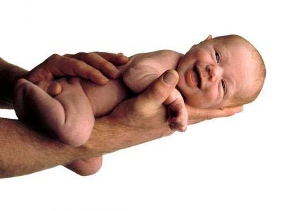
Right to life
The right to life is one that has any human being by the simple fact exist and be alive, is considered a fundamental human right
Life is the most important right for humans. Life has several factors of human life in their body shapes and psychological, social life of the people through which they perform work in common and life of nature that relates to human beings with other living species.

Slide 11

Right to freedom of worship
Freedom of religion or religious freedom is a fundamental right that relates to the choice of each individual to freely choose their religion, choose no (irreligion), or not to believe or validate the existence of a God (atheism and agnosticism ) And to exercise that belief publicly, without being a victim of oppression, discrimination, or attempt to change.
This concept goes beyond mere religious tolerance allows, as an

Slide 12
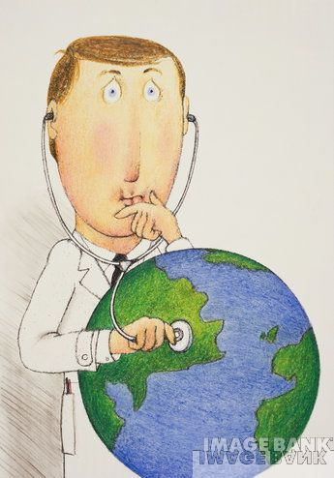
Right to health
Instruments of international protection of ESCR applicable in the Latin American ESC rights enshrined in international instruments The right to health in the international system of protection of human rights Briefly, the complexity of the obligations of ESCR. Legal requirement, content and responsibilities under law to health Minimum obligations regarding the right to health Essential elements and indicators of EFFICIENCY of the right to health

Slide 13
Economic Rights
Social rights include all those human rights which allow citizens to meet their social needs, (e.g., food, fair wage, jobs, maternity leaves..)
Economic rights include all those human rights which give us enough
economic resources to meet our basic needs.
Economic rights also protect us from bad and unfair treatment in our workplaces.
Cultural rights include all those human rights which allow citizens to
maintain and promote their culture, (e.g., ancestral domain, type of schooling, develop cultural activities)

Slide 14
UNDHR
Civil Rights
Political Rights (human rights which allow citizens to
participate fully in the political systems of their nations)
right to life
right to believe (religion)
right to your own opinion
right to free speech
right to marry
right to race, cultural background, disability or belief
right to information
right to privacy
right to citizenship
right to move about freely in one’s country
right detention or exile
right to a fair trial
right to vote in elections
right to freely form or join political parties
right to be an independent country
right to stand for public office
right to freely disagree with views and policies of political

Slide 15
Rights & Responsibilities
Rights go hand in hand with responsibilities.
If a person has the right to education, that person also has the responsibility to grasp the opportunity and to learn!
If a person has the right to health care, that person must play his or her role in ensuring a healthy lifestyle.

Slide 16
Some Responsibilities
A responsibility towards oneself to live healthily and happily;
A responsibility to be courteous to other people, including parents, educators and people from other cultures and beliefs.
A responsibility to make a positive contribution to the well-being of the community in which one lives.
A responsibility to be a good citizen.
A responsibility to contribute towards the well-being of the wider community and the environment.

Slide 17
Right to an education
The right to education is a human right recognized and understood as setting the right to free compulsory primary education for all children, an obligation to developsecondary education accessible to all young people, as well as equitable access toeducation top, and a responsibility to provide basic education to individuals who have not completed primary education.

Slide 18
Women’s Rights
Children’s Rights
The Convention includes: (UNICEF)
Are entitlements and freedoms claimed for women and girls of all ages
Issues commonly associated with notions of women's rights include, though are not limited to, the right:
to bodily integrity and autonomy;
to vote (suffrage);
to hold public office; to work; to fair wages or equal pay;
To own property;
To education;
to serve in the military;
to enter into legal contracts; and
to have marital, parental and religious rights.
Article 1: Definition of the child
Article 2: Non-discrimination
Article 3: Best interests of the child
Article 4: Protection of rights
Article 5: Parental guidance
Article 6: Survival and development
Article 7: Registration, name, nationality, care
Article 8: Preservation of identity
Article 9: Separation from parents
Article 10: Family reunification

Slide 19
Children’s Rights
Every child is endowed with the dignity and worth of a human being from the moment of his conception, as generally accepted in medical parlance, and has, therefore, the right to be born well.
Every child has the right to a wholesome family life that will provide him with love, care and understanding, guidance and counseling, and moral and material security.
Ever child has the right to a well-rounded development of his personality to the end that he my become a happy, useful, and active member of society.
The gifted child shall be given the opportunity and encouragement to develop special talents.
The emotionally disturbed or socially maladjusted child shall be treated with sympathy and understanding, and shall be entitled to treatment and competent care.
The physically or mentally handicapped child shall be given treatment, education , and care required by his particular condition.

Slide 20
4. Every child has the right to a balanced diet, adequate clothing, sufficient shelter, proper medical attention, and all the basic physical requirements of a healthy and vigorous life.
5. Every child has the right to be brought up in an atmosphere of morality and rectitude for the enrichment and the strengthening of his character.
6. Every child has the right to an education commensurate with his abilities and to the development of his skills for the improvement of his capacity for service to himself and to his fellowmen.
7. Every child has the right to full opportunities for safe and wholesome recreation and activities, individual as well as social, for the wholesome use of his leisure hours.
8. Every child has the right to protection against exploitation, improper influences, hazards, and other conditions pr circumstances prejudicial to his physical, mental, emotional, social, and moral development.
9. Every child has the right to live in a community and a society that can offer him an environment free from pernicious influences and conducive to the promotion of his health and cultivation of his desirable traits and attributes.

Slide 21
10. Every child has the right to the care, assistance, and protection of the State, particularly when his parents or guardians fail or are unable to provide him with his fundamental needs for growth, development, and improvement.
11. Every child has the right to an efficient and honest government that will deepen his faith in democracy and inspire him with the morality of the constituted authorities both in their public and private lives.
12. Every child has the right to grow up as a free individual, in an atmosphere of peace, understanding, tolerance, and universal brotherhood, and with the determination to contribute his share in the building of a better world.

Slide 22
Women’s Rights
2010 UN Entity for Gender Equality and Empowerment of Women (UNWomen.org)
Grounded in a vision of equality, works for the:
elimination of discrimination against women and girls;
empowerment of women; and
achievement of equality between women and men as partners and beneficiaries of development, human rights, humanitarian action and peace and security.

Slide 23
Women’s Rights
Commission on the Status of Women- has elaborated international guidelines and laws for women’s equality and non-discrimination
1979 Convention on the Elimination of Discrimination against Women
Committee on the Elimination of Discrimination against Women (CEDAW)
monitors the 1979 Convention, considers reports, assesses progress, etc.

Slide 24
Women in National Parliaments

Slide 25
What causes this issue?
This happens because of religious beliefs, poverty, and racism. In Africa the problem is mostly because of poverty. In South America the problem is poverty and racism. In Asia the problem is poverty and beliefs. And in the Middle East the problem is racism and religious beliefs.

Slide 26
Who is involved?
The main countries with human rights problems are in the Middle East. In some countries, women aren’t even allowed to drive! There are also smaller problems all over the world that involve human rights. The UN is also involved because they are trying to help these people without equal rights so that they will have their rights. The people who make the rules in countries so that not everyone has equal rights are involved because they are the cause of the problem of people having fewer rights than others.

Slide 27
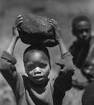
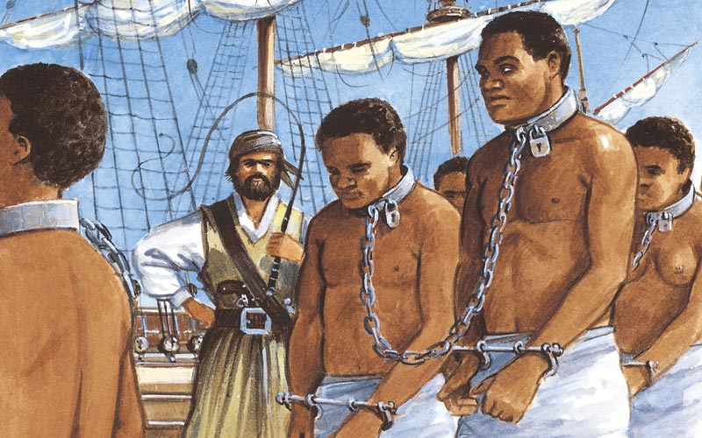
Who is affected and how?
The ones who are affected are the people who don’t have human rights because of poverty or racism and many other reasons. Poverty because, if they are poor they might not be able to afford medical treatment but most of all proper education. Racism because they might not get a job because of their skin color or any other reason.

Slide 28
Conclusion.
The Human Rights are the one side of a coin that gives them their desire freedom and the another side is the responsibility which they have to pay in return of these freedom…..
For Ex– If we have the human right to live safely, so it’s also our responsibility not to suffer other life.

Slide 29
Human rights are the result of the search for equity between men in the world. His promotion has led us to see each other equally, but unfortunately there are still forms of action that do not allow the free development of the individual. But not only that, but also a way of life, which translates to freedom of opinion, action, including achieving a peaceful interaction of individuals within a society.

Slide 30
Thank you.

