Slide 1


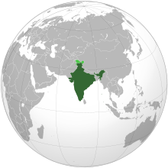


Indian Constitution

Slide 2
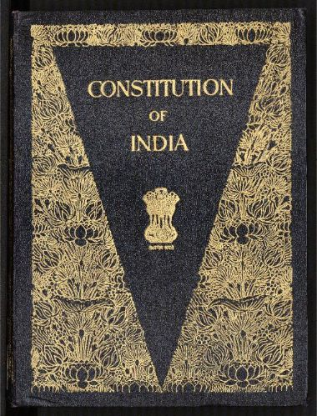
CONTENTS
1.What Is Constitution Anyway?
2.Why Do We Need Constitution?
3.The Framing of Constitution of India.
4.The Preamble to Constitution of India.
5.What Is The constitution of India?
6.Main Characteristics of Constitution of India.
7.Conclusion

Slide 3



1.What Is Constitution Anyway?
Almost everything we do is governed by some set of rules. There are rules for games (like- soccer), for social clubs and for adults in the workplace. There are also rules imposed by morality and custom that play an important role in telling us what we should and should not do.
For example- In the game of soccer, a referee has "full authority to enforce the Rules or Law of the Game on the Players”, when a player do something against the Rules referee takes action like send-off a player, as shown in images below.
Should
Should not
Red-card

Slide 4


1.What Is Constitution Anyway?
Some rules that are made by the legislatures (also known as Lok sabha/Rajya Sabha in India), for there own country, are called “Law”.
We need Laws in Society so our society can regulate and work properly. They are designed to protect us and our property and to ensure that everyone in society behaves the way that the community expects them too.
Laws tell us what to expect as a consequence of our actions. Laws have been the glue that has kept society together. Without laws there would be complete anarchy.

Slide 5


1.What Is Constitution Anyway?
In General-
The Constitution is the supreme law of the land. All other laws have to conform to the Constitution. The constitution contains laws concerning the government and its relations with the people.
A constitution is concerned with 2 main aspects:-
The relation between the different levels of government and
Between the government and the citizens.
Constitution
...
…
Government
The People

Slide 6
1.What Is Constitution Anyway?
II) Technical Definitions-
A constitution is a set of fundamental principles or established precedents according to which a state or other organization is governed. These rules together make up, i.e. constitute, what the entity is. When these principles are written down into a single collection or set of legal documents, those documents may be said to comprise a written constitution.
or
The document containing laws and rules which determine and describe the form of the government, the relationship between the citizens and the government, is called a Constitution.

Slide 7
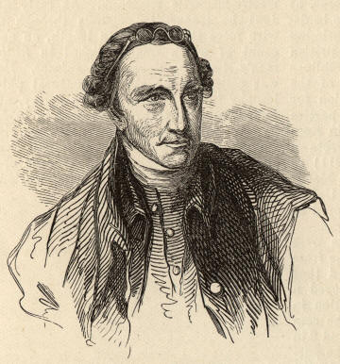
1.What Is Constitution Anyway?
III) An observation-
“The Constitution is not an instrument for the government to restrain the people, it is an instrument for the people to restrain the government.” --Patrick Henry
Patrick Henry (1736-1799)

Slide 8
CONTENTS…….
1.What Is Constitution Anyway?
2.Why Do We Need Constitution?
3.The Framing of Constitution of India.
4.The Preamble to Constitution of India.
5.What Is The constitution of India?
6.Main Characteristics of Constitution of India.
7.Conclusion

Slide 9
2.Why Do We Need Constitution?
In General-
We need a constitution to govern a country properly.
The constitution defines the nature of political system of a country.
sometimes we feel strongly about an issue that might go against our larger interests and the constitution helps us guard against this.
All the 3 organs of government (executive, legislature and judiciary) functions within the constitution. All the 3 organs of government, including ordinary citizens, derive their power and authority (i.e. Fundamental Right) from the constitution. If they act against it, it is unconstitutional and unlawful.
So constitution is required to have authoritative allocation of power and function, and also to restrict them within its limit.

Slide 10
2. Why Do We Need Constitution?
To perform following Functions we need Constitution-
The first function of a constitution is to provide a set of basic rules that allow for minimal coordination amongst members of a society.
The second function of a constitution is to specify who has the power to make decisions in a society. It decides how the government will be constituted.
The third function of a constitution is to set some limits on what a government can impose on its citizens. These limits are fundamental in the sense that government may ever trespass them.
The fourth function of a constitution is to enable the government to fulfill the separations of a society and create conditions for a just society.

Slide 11
CONTENTS
1.What Is Constitution Anyway?
2.Why Do We Need Constitution?
3.The Framing of Constitution of India.
4.The Preamble to Constitution of India.
5.What Is The constitution of India?
6.Main Characteristics of Constitution of India.
7.Conclusion
.

Slide 12
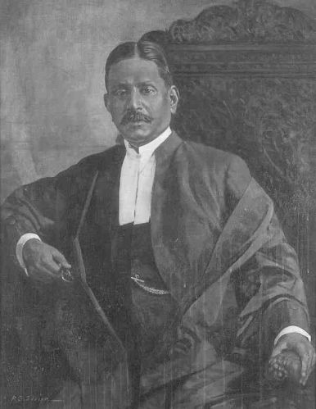
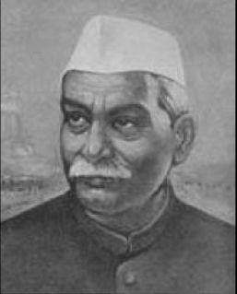
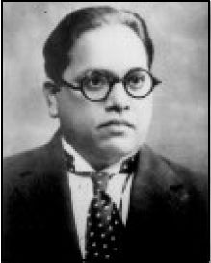
3.The Framing of Constitution of India.
Dr. Sachchidananda Sinha was the first president (temporary) of the Constituent Assembly when it met on December 9, 1946. Later, Dr. Rajendra Prasad became the President of the Constituent Assembly and Dr. Bhimrao Ambedkar became the Chairman of its drafting committee on December 11,1946 .
First president (temporary) Dr. Sachchidananda Sinha (Left) on December 9, 1946. Dr. Rajendra Prasad (Middle) the President of the Constituent Assembly and Dr. Bhimrao Ambedkar (Right) the Chairman of its drafting committee as on December 11,1946 .

Slide 13
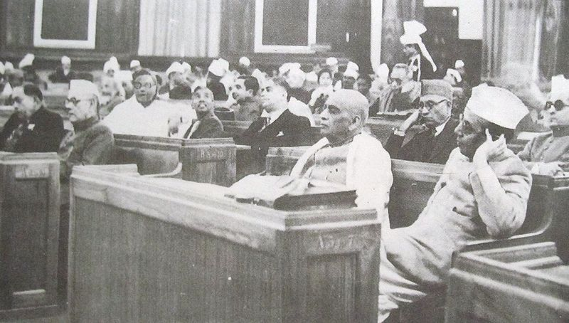
3.The Framing of Constitution of India.
First day (December 9, 1946) of the Constituent Assembly.
From right: B. G. Kher and Sardar Vallabhai Patel;
K. M. Munshi is seated behind Patel.

Slide 14
3.The Framing of Constitution of India.
For the time being till the constitution was made, India would be governed in accordance with the Government of India act 1935.
The Assembly met in sessions open to the public, for 166 days, spread over a period of 2 years, 11 months and 18 days before adopting the Constitution.
It was finally passed and accepted on Nov 26, 1949. In all the 284 members of the Assembly signed the official copies (Original) of the Indian Constitution.
After many deliberations and some modifications over 111 plenary sessions in 114 days, the 308 members of the Assembly signed two copies (Final) of the document (one each in Hindi and English) on 24 January 1950
Same day the Assembly unanimously elected Dr, Rajendra Prasad as the President of India. which came into effect on Jan 26, 1950, known and celebrated as the Republic Day of India.

Slide 15
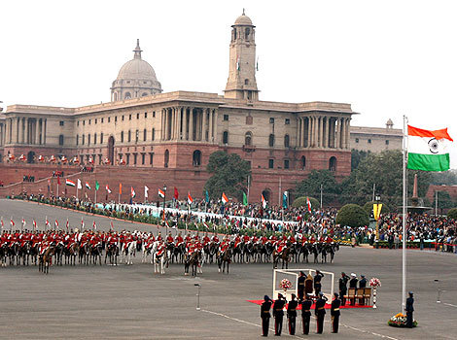

3.The Framing of Constitution of India.
The 63rd Republic Day Celebrations on 26th January 2012 at New Delhi, India

Slide 16
CONTENTS
1.What Is Constitution Anyway?
2.Why Do We Need Constitution?
3.The Framing of Constitution of India
4.The Preamble to Constitution of India.
5.What Is The constitution of India?
6.Main Characteristics of Constitution of India.
7.Conclusion
.

Slide 17
4.The Preamble to Constitution of India.
The Preamble to the Constitution of India is a brief introductory statement that sets out the guiding purpose and principles of the document.
WE, THE PEOPLE OF INDIA, having solemnly resolved to constitute India into a SOVEREIGN SOCIALIST SECULAR DEMOCRATIC REPUBLIC and to secure to all its citizens: JUSTICE, social, economic and political; LIBERTY of thought, expression, belief, faith and worship; EQUALITY of status and of opportunity; and to promote among them all FRATERNITY assuring the dignity of the individual and the unity and integrity of the Nation; IN OUR CONSTITUENT ASSEMBLY this twenty-sixth day of November, 1949, do HEREBY ADOPT, ENACT AND GIVE TO OURSELVES THIS CONSTITUTION.

Slide 18
4.The Preamble to Constitution of India.
The first words of the Preamble - "We, the people" - signifies that power is ultimately vested in the hands of the People of India. So far the Preamble has been amended only once in 1976 by 42nd amendment (change) which inserted the words Socialism, Secularism and Integrity. A brief description of these concepts are as follows (in the order they come in Preamble)-
Sovereign- It means free to follow internal and external Policies.
Secular- It means no particular Religion is preferred.
Socialist- It means no concentration of Power and Money.
Democratic- It means rule by elected representative of the People of India.
Republic- It means no room for hereditary ruler or monarch.

Slide 19
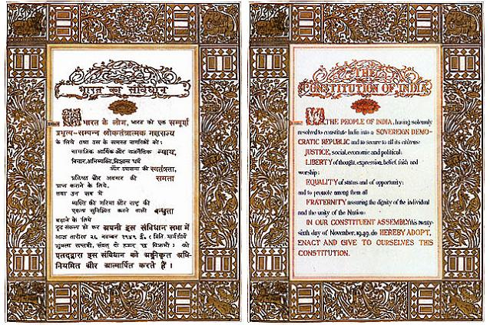
4.The Preamble to Constitution of India.
The preamble-page, along with other pages of the First and original Book of Constitution of India, was designed (Art) and decorated (Frames) solely by renowned painter Beohar shakha.
Hindi (Left) and English (Middle) versions of Preamble as available in the First book of Constitution of India (Right).

Slide 20
CONTENTS
1.What Is Constitution Anyway?
2.Why Do We Need Constitution?
3.The Framing of Constitution of India
4.The Preamble to Constitution of India.
5.What Is The constitution of India?
6.Main Characteristics of Constitution of India.
7.Conclusion

Slide 21
5.What Is The constitution of India?
(i) Constitution of India In General:-
Constitution of India is considered to be the supreme law of the country, as it puts forth the framework of fundamental political principles. It establishes the structure, procedures, powers and duties of the government and mentions the fundamental rights, directive principles and duties of citizens.
The Constitution declares India as a Sovereign, Socialist Democratic, and Republic with a parliamentary form of government.
The Indian Constitution shows Federal as well as Unitary System.
1. Federal System- powers are divided and/or shared between state and central governments
2. Union System- power concentration in central government with weak state Government

Slide 22
5.What Is The constitution of India?
Both features are listed below:-
(ii) Structure of Constitution of India:-
The Constitution, in its current form (March 2011),
consists of 1 preamble, 25 parts containing 450 articles, 12 schedules, 2 appendices and 97 amendments to date. Although it is federal in nature it also has a strong unitary bias.
Constitution of India
Fundamental Rights
Directive Principles
Preamble
1
Parts
25
Fundamental Duties
Articles
450
Amendments
97
Schedules
12
Appendices
2

Slide 23
5.What Is The constitution of India?
(iv) The Basic Principles of the Constitution of India:-
A careful study of the Constitution will show that there are at least eight basic principles which are embodied in it and which form the foundation of the political system in India. These are:
(1) Popular sovereignty,
(2) Socialism,
(3) Secularism,
(4) Fundamental rights,
(5) Directive Principles of State Policy,
(6) Judicial independence,
(7) Federalism and
(8) Cabinet government.

Slide 24

5.What Is The constitution of India?
Fundamental Rights are different from other rights available to us. While ordinary legal rights are protected and enforced by ordinary law, Fundamental Rights are protected and guaranteed by the constitution of the country.
The Constitution of India recognizes certain basic fundamental rights for every citizen of India, such as:-
Right to Equality
Right to Freedom
Right to Freedom of Religion
Right against Exploitation
Cultural & Educational Rights
Right to Constitutional Remedies

Slide 25



5.What Is The constitution of India?
Ordinary rights may be changed by the legislature by ordinary process of law making, but a fundamental right may only be changed by amending the Constitution itself. Besides this, no organ of the government can act in a manner that violates them.
Any infringement of fundamental rights can be challenged by any citizen of India in the court of law. The Constitution of India also prescribes some fundamental duties on every citizen in India.

Slide 26
5.What Is The constitution of India?
Fundamental Duties (Part IV Article 51A )- These Fundamental rights have been provided at the cost of some fundamental duties. These are considered as the duties that must be and should be performed by every citizen of India. These fundamental duties are defined as: It shall be the duty of every citizens of India: -
To abide by the Constitution.
To uphold & protect the sovereignty, unity and integrity of India.
To Cherish & follow the noble ideas which inspired our national struggle for freedom
To defend the country & render national service when called upon to do so.
To promote harmony & the spirit of common brotherhood.
To value & preserve the rich heritage of our composite culture.
To protect & improve the national environment.
To develop the scientific temper, humanism and the spirit of inquiry and reform.
To safeguard public property & to abjure violence.
To strive towards excellence in all spheres of individual & collective activity, so that the nations constantly rises to higher levels of endeavor & achievement.

Slide 27

5.What Is The constitution of India?
(vi) Checks and Balances:-
The Indian Supreme Court and Election Commission are recognized as the bedrock of Indian democracy; these two bodies stand up to the enormous powers that the constitution invests in the central government in general and to the unbridled powers of the Indian prime minister in particular.
The checks and balances that are provided by the constitution also smooth out the strained relations between the central government and the states by limiting the central government's ability to interfere in the states' affairs. Usually, either the state government or a political party may file an appeal or a writ petition in the Supreme Court against a policy or practice of the union or a state.

Slide 28
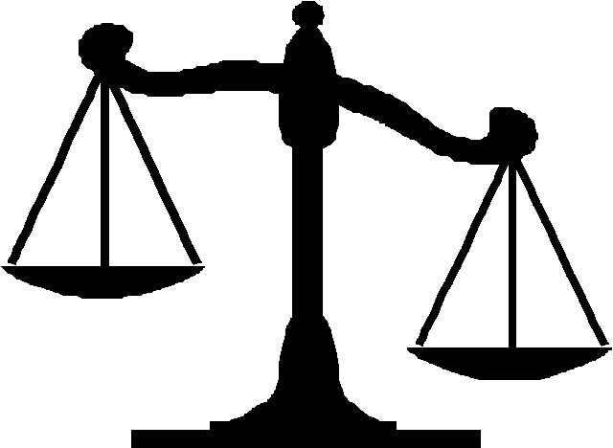
5.What Is The constitution of India?
Although India's constitution follows the British parliamentary system, it is the constitution and not the parliament of India that reigns supreme. As in the United States, the Indian courts interpret the constitution and adjudicate the laws passed by the parliament.
Although the parliament has the authority to amend the constitution, India's courts have made sure that the parliament does not change its fundamental structure, which guarantees economic opportunities, social justice, and religious and political freedom to all its citizens. Although political corruption and coercion are rampant in India—as they are in other developing countries—the courts are judiciary guarantors of India's freedom from oppression.

Slide 29
CONTENTS
1.What Is Constitution Anyway?
2.Why Do We Need Constitution?
3.The Framing of Constitution of India
4.The Preamble to Constitution of India.
5.What Is The constitution of India?
6.Main Characteristics of Constitution of India.
7.Conclusion
.

Slide 30
6.Main Characteristics of Constitution of India.
The Constitution of India has some distinct and unique features as compared to other constitutions to the world. As Dr. B.R. Ambedkar, the Chairman of the Drafting Committee puts it, the framers had tried to accumulate and accommodate the best features of other constitutions, keeping in view the peculiar problems and needs of our country. Main Characteristics of Constitution of India are:-
Longest written constitution.
Partly Rigid and Partly Flexible
A Democratic Republic
Parliamentary System of Government
A Federation
Fundamental Rights
Directive Principles of State Policy
Fundamental Duties
Secular State
An Independent Judiciary
Single Citizenship

Slide 31
CONTENTS
1.What Is Constitution Anyway?
2.Why Do We Need Constitution?
3.The Framing of Constitution of India
4.The Preamble to Constitution of India.
5.What Is The constitution of India?
6.Main Characteristics of Constitution of India.
7.Conclusion
.

Slide 32
7.Conclusion
A Constitution symbolizes independence of a country. Framework and structure for the governance of a free country are provided in the Constitution. The Constituent Assembly prepared the draft of the Constitution by keeping the ‘Objectives Resolution’ as the backdrop which reflected the aspirations of the people of India.
The framing of the Constitution was completed on November 26, 1949 when the Constituent Assembly formally adopted the new Constitution. The Constitution came into force with effect from January 26, 1950.
The Constitution begins with a Preamble which declares India to be a Sovereign, Socialist, Secular, Democratic, Republic. The Preamble also mentions the goals of securing justice, liberty and equality for all its citizens and promotion of natio-nal unity and integrity on the basis of fraternity among the people assuring dignity of the individual.

Slide 33
7.Conclusion
The Constitution of India has several distinctive features. It is the lengthiest Constitution in the world and it is a combination of rigidity and flexibility. The Constitution provides for a quasi-federal (It means a federal set up where despite having two clear sets of government – central and the states, more powers are given to the Central Government.) set up with a strong centre.
There is a clear division of powers between the Centre and the States. The Supreme Court of India, is the apex court of India which will resolve the disputes between the centre and state or between the states.
India has a parliamentary democracy. The Council of Ministers headed by the Prime Minister enjoys the real powers and is responsible to the Parliament. The Indian Constitution provides for Fundamental Rights which are justifiable. Ten Fundamental Duties have also been added to the Constitution. The Directive Principles of State Policy give a concrete shape to the welfare concept.

Slide 34
7.Conclusion
It is time to undertake a study of Indian Federalism with a view to valuate the trends, frictions and difficulties which have developed in the area of inter-governmental relations and to seek to evolve ways and means to meet the challenging task of making the Indian federation a more robust, strong and workable system so that the country may meet the tasks of self-improvement and development.
The responsibility lies on not only the jurists and policy framers, but also the citizens of the country to work in a harmonious manner for the development of the country.

Slide 35


JAI HIND
JAI HIND

