Slide 1


Capstone Project
Chicken Dataset
Future Spark
8 September 2022

Slide 2
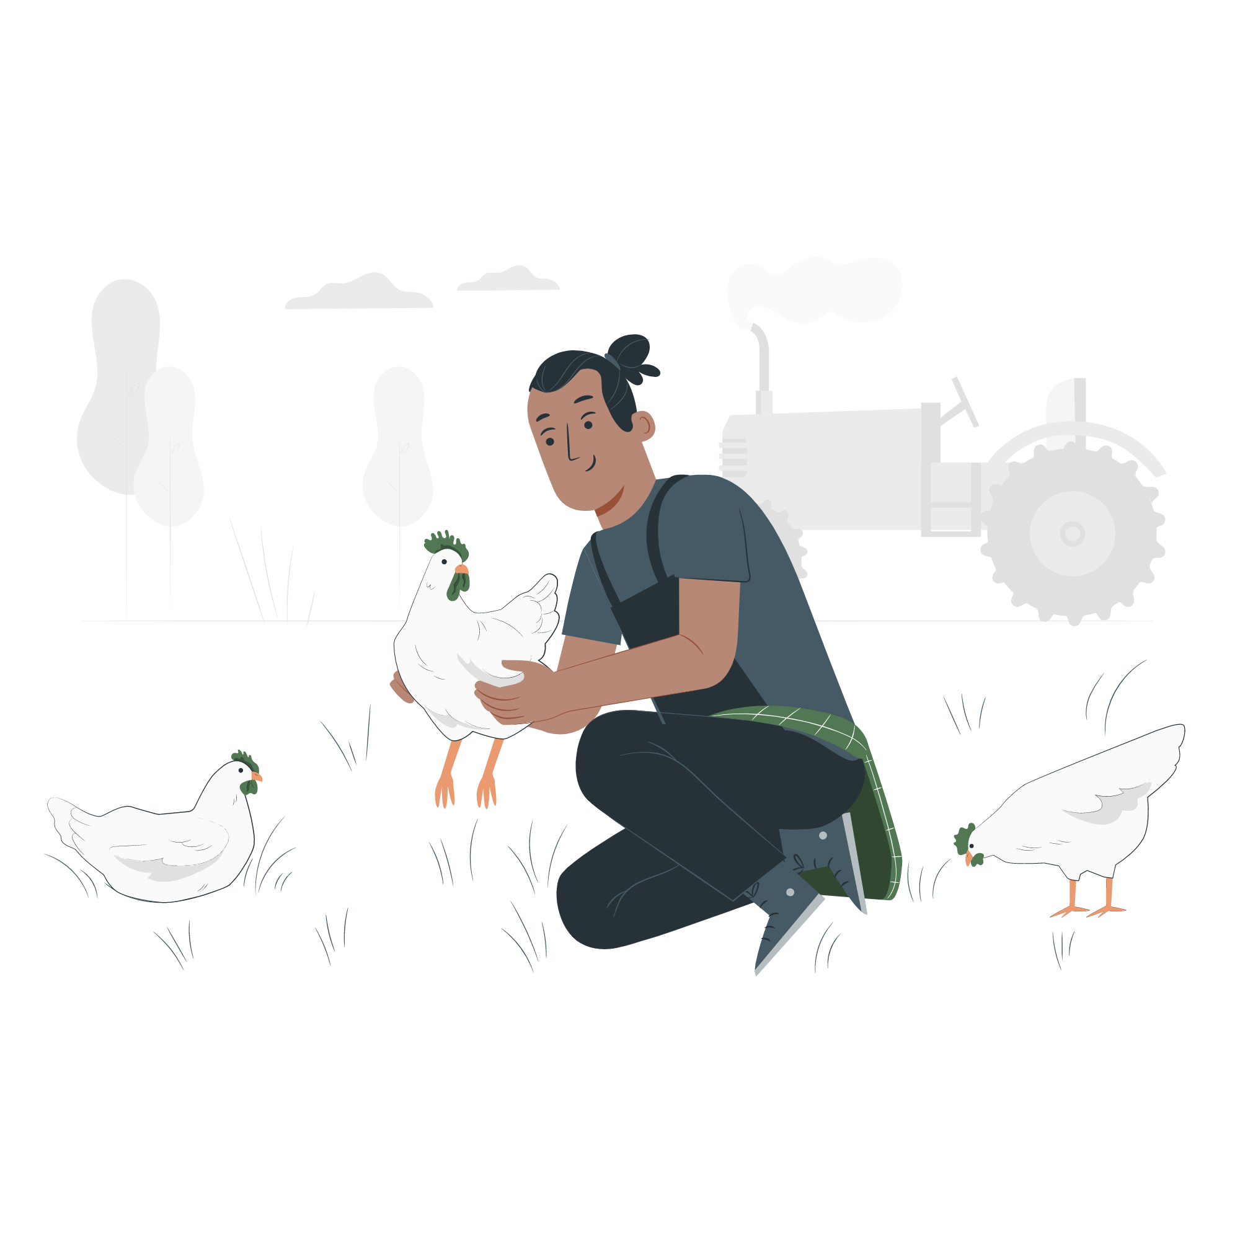
TABLE OF CONTENT
01
02
03
04
INTRODUCTION
DATASET
DASHBOARD
JUPYTER NOTEBOOK
05
CONCLUSION
8 September 2022

Slide 3
01
INTRODUCTION
8 September 2022

Slide 4
EXPAND THE 2030 VISION
VISION
The Vision is to build the best future for the Saudi Arabia, based on three pillars represents a unique competition for country advantages
Leading, Investment, Strategic Location
…
FOOD SECURITY IN SAUDI ARABIA
A sustainable environment and natural resources that achieve water security, contribute to food security and improve the quality of life.
8 September 2022

Slide 5


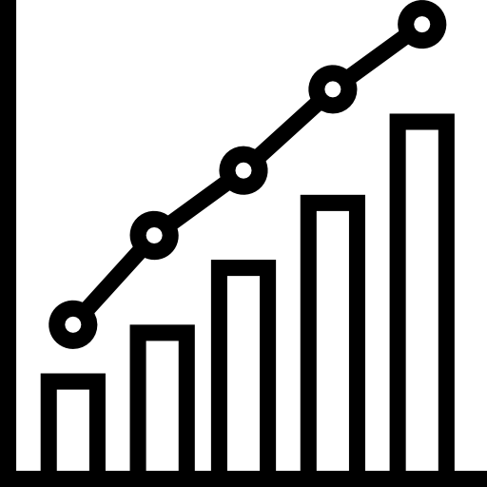


MISSION
EXPANDING
ADVANCING
INCREASING
AVAILABILITY
GROWTH
8 September 2022

Slide 6
02
DATASET
8 September 2022

Slide 7

ABOUT ENTAJ
It is a trademark of a Saudi food production company since 2004, and it is one of the leading poultry producers in the Saudi Arabia, producing more than 90 million chickens annually.
8 September 2022

Slide 8
CHICKEN DATASET
DATASET
This data is about a poultry production company, it covers the poultry information from December 2021 until August 2022, it has 109 columns and 2,131 rows
8 September 2022

Slide 9

03
DASHBOARD
8 September 2022

Slide 10

DASHBOARD
Power BI
8 September 2022

Slide 11

04
MODELS
8 September 2022

Slide 12


JUPYTER NOTEBOOK
8 September 2022

Slide 13
05
CONCLUSION
8 September 2022

Slide 14
CONCLUSION
With the vision of food security for Saudi Arabia, Saudi Arabia aspires by the year 2030 to reach food self-sufficiency, And poultry is a required food source
Real data required a lot of work and effort to improve and to build models on it
8 September 2022

Slide 15
THANK YOU!
QUESTIONS?
Asail Najdi
Bashair Alshammri
Ethar Almahamoud
Ghaith Alkhashan
Haifa Altheeb
Khalid Alharbi
8 September 2022

