Slide 1


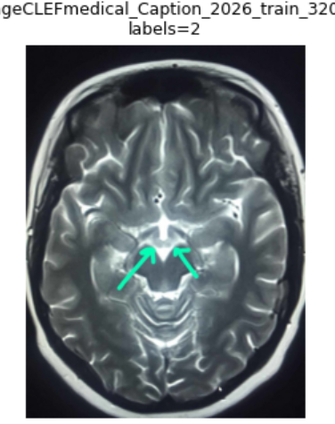
FINAL PROJECT DEFENSE
Frequency-Aware Multi-Head Learning for Long-Tailed Medical Concept Detection
Hybrid Vision–Language Approach for Concept-Based Medical Caption Generation
Prepared by: Bashar Alsaleh
Supervisors: Dr. Riad Sonbol • Eng. Zeinab Baghdadi
Syrian Private University — Faculty of Artificial Intelligence Engineering
0.5725
4th
0.5441
Official test score
Final rank
Validation Micro-F1
ImageCLEFmed Caption 2026
Concept Detection Task
3-fold internal validation
Hybrid Vision–Language Approach • Concept Detection
Defense date: 02/06/2026
1/17

Slide 2
Presentation Roadmap
A concise path from task formulation to official results and final conclusions.
1
Problem & task framing
Why concept detection matters for medical caption generation.
2
Dataset challenge
Sparse multi-label targets and severe long-tail imbalance.
3
Related work & method evolution
Positioning against prior systems, then baseline → graph head → final Swin model.
4
Final system
Architecture, training strategy, and per-head calibration.
5
Results, benchmarks & contribution
Internal validation, official ranking, comparison with references, and final conclusions.
Hybrid Vision–Language Approach • Concept Detection
2/17

Slide 3
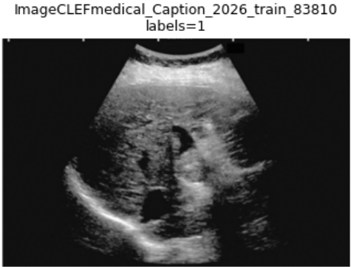
1) Problem Framing: From Radiology Images to Medical Concepts
The project focuses on concept detection as the semantic bridge toward caption generation.
Concept detector
Downstream captioning
Predict a multi-label set of UMLS Concept Unique Identifiers (CUIs) for each image.
Use predicted concepts as an interpretable semantic layer before generating text.
Input
Output
Research challenge
A radiology image that may contain multiple anatomical structures, modalities, or findings.
A sparse set of clinically relevant UMLS-aligned concepts.
Large label space, rare concepts, severe imbalance, and decision thresholds that strongly influence the final predicted concept set.
Hybrid Vision–Language Approach • Concept Detection
3/17

Slide 4
2) Task Definition and Evaluation Logic
The task is a large-scale multi-label classification problem with calibrated decision boundaries.
Task formulation
Evaluation focus
Given an image x, predict a binary vector over K = 2,646 medical concepts. Multiple labels may be active for the same image.
Micro-F1
Primary global score
Why not single-label?
Precision / Recall
Reliability vs. completeness
Radiology images commonly contain several co-occurring concepts, so softmax-style exclusive classification is not suitable.
Macro / macro_nz
Sensitivity to rare concepts
Coverage
How many concepts are predicted at least once
Decision thresholding
Model probabilities must be converted into binary concepts; threshold choice controls precision, recall, and coverage.
Final system selection balanced official Micro-F1 with additional analysis of long-tail behavior.
Hybrid Vision–Language Approach • Concept Detection
4/17

Slide 5
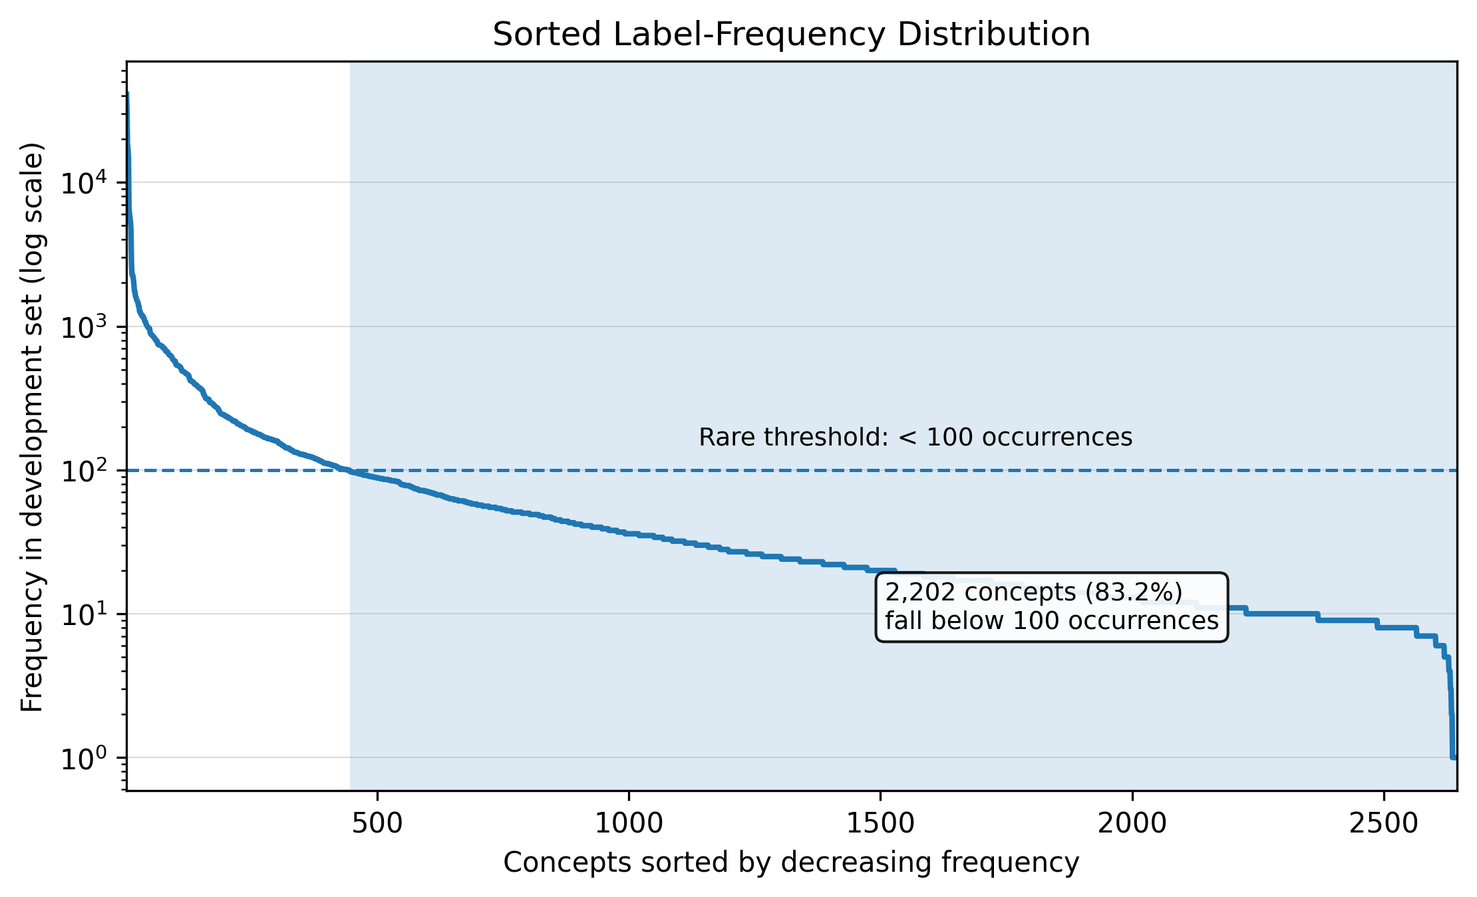
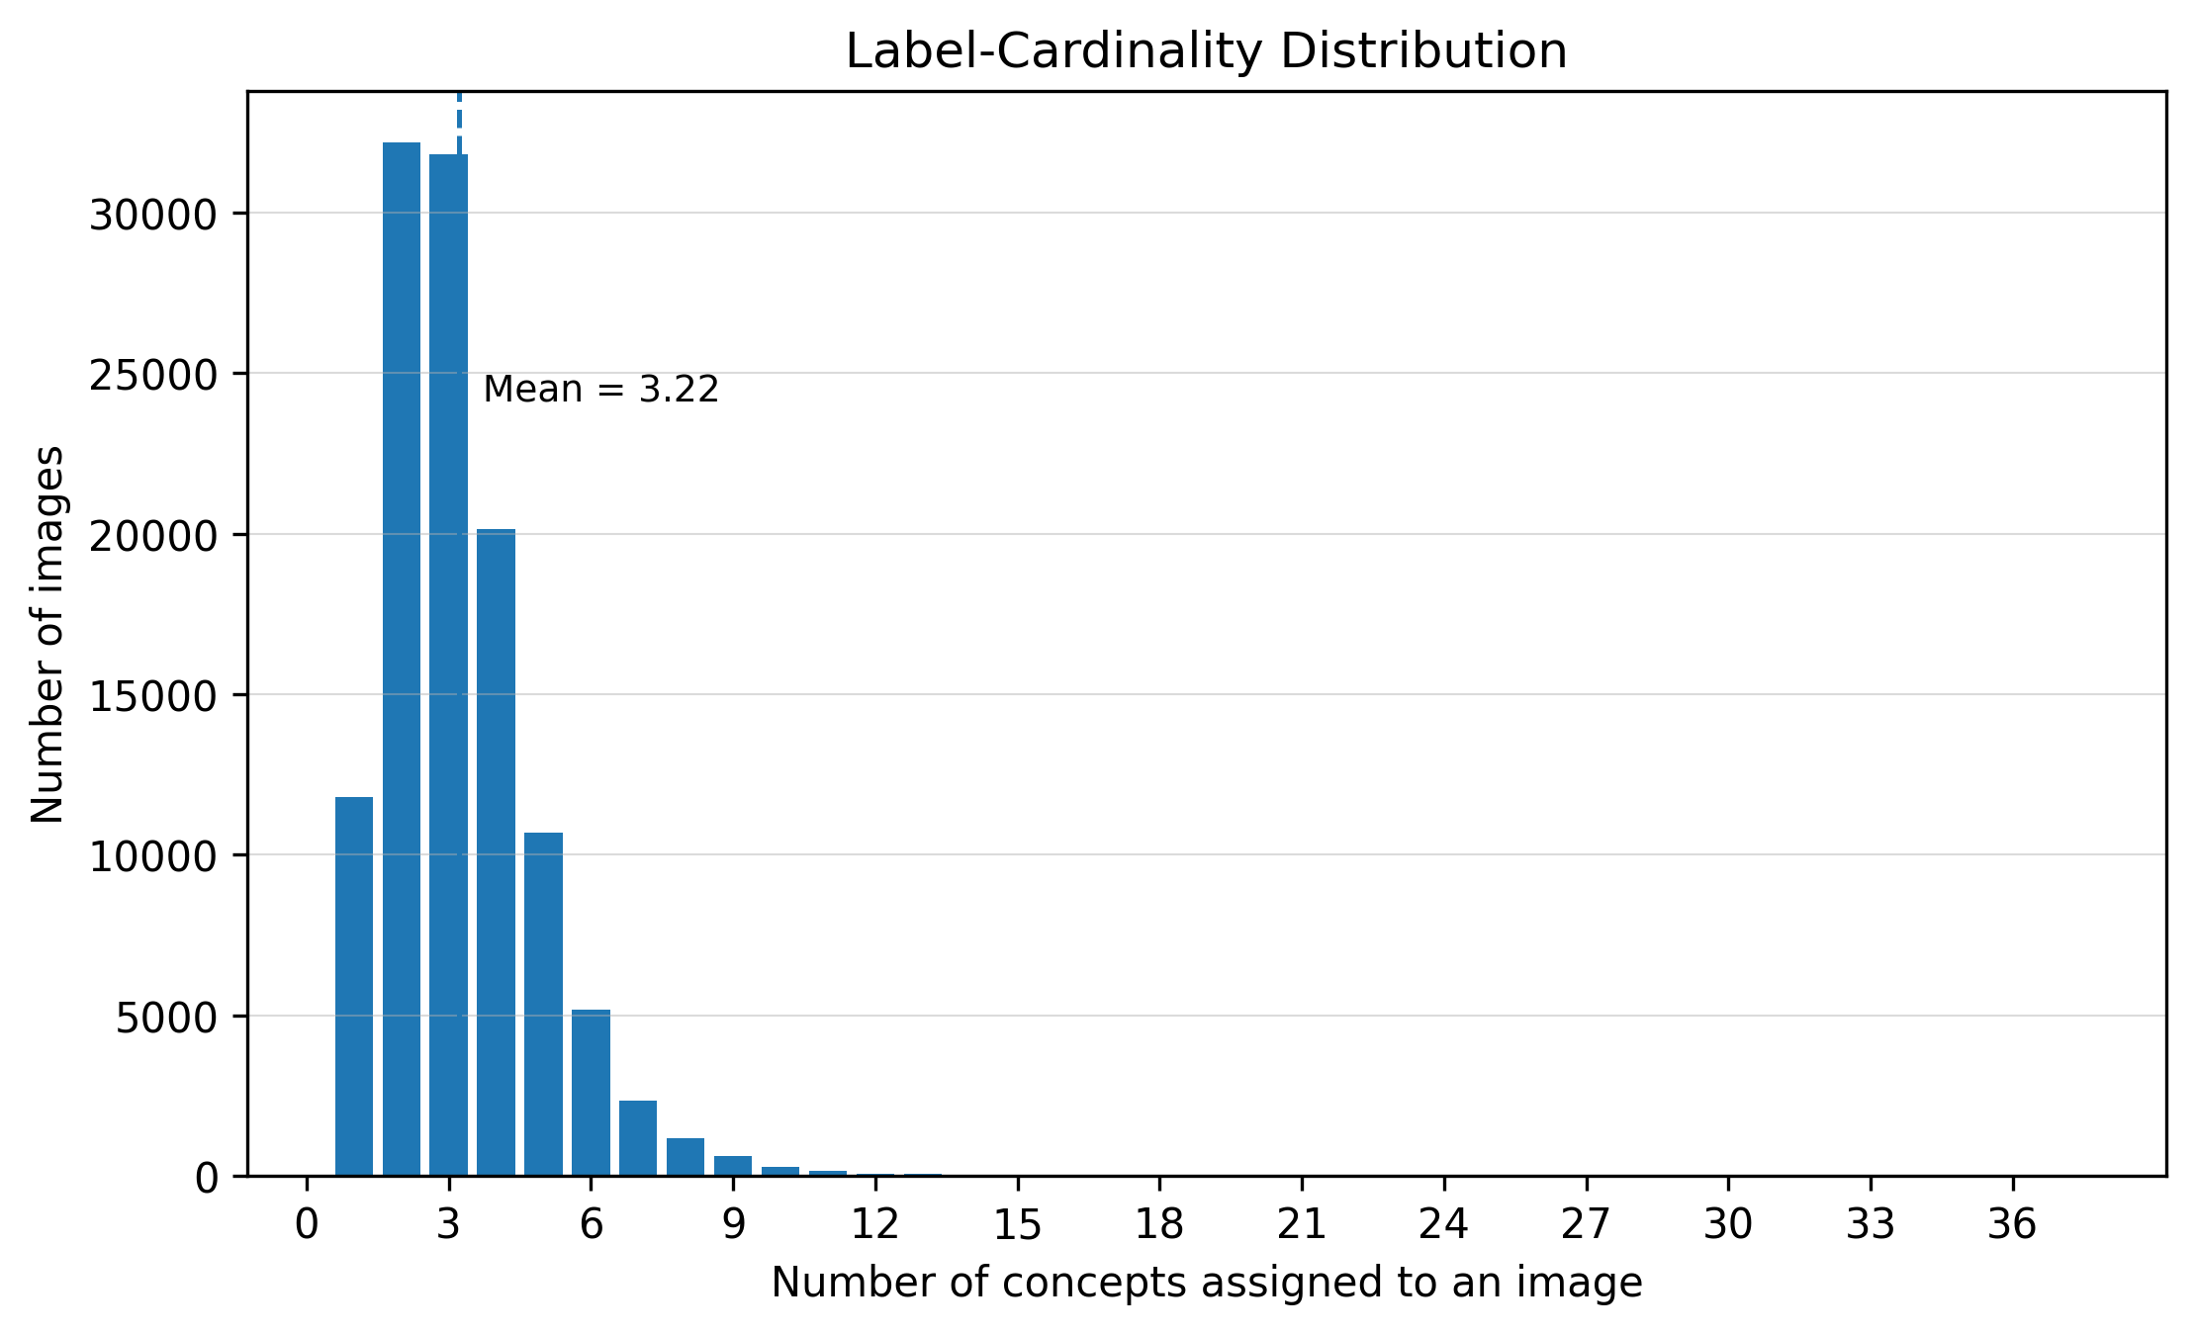
3) Dataset Characteristics: Large, Sparse, and Long-Tailed
The dataset statistics explain why imbalance-aware design was necessary.
116,604
2,646
3.22
0
83.2%
development radiology images
unique UMLS concepts
average labels / image
empty-label images
rare concepts <100
2,202 concepts
Key implication: the model needs both rare-label learning support and calibrated inference, not only a stronger visual backbone.
Hybrid Vision–Language Approach • Concept Detection
5/17

Slide 6
4) Expanded Related Work Landscape
A broader literature view shows how our project combines medical concept detection, modern visual backbones, and long-tail learning.
Medical imaging benchmarks
ImageCLEF concept detection
Vision backbones
Long-tail learning
ChestX-ray8, CheXpert, PadChest
2024–2026 caption/concept tasks
DenseNet → Swin Transformer
Focal, CB Loss, ASL, logit adjustment
Reference area | Representative work | Core contribution | Remaining gap / how we respond
Medical image benchmarks | ChestX-ray8; CheXpert | Large-scale multi-label radiology learning and uncertainty-aware evaluation | Mostly chest-focused label spaces; our task uses 2,646 UMLS concepts across modalities
CNN visual baselines | DenseNet / CheXNet | Strong reusable image features; reliable baseline for radiology classification | Limited explicit long-tail handling; we retain baseline lessons but move to Swin + frequency heads
Ontology-aligned labels | UMLS; PadChest | Standardized biomedical labels and clinically meaningful concept representation | Ontology resources motivate semantics, but do not solve the prediction imbalance
ImageCLEFmed tasks | ImageCLEFmedical 2024–2026 | Concept prediction as a structured step toward caption generation | Full-vocabulary long-tail concept detection remains difficult and central
Challenge-style CNN systems | Santamato et al.; Sahni et al. (2025) | Transfer-learning/CNN baselines on ImageCLEF-style concept prediction | Reported results are below our final validation/official scores
Vision transformers | Swin Transformer | Hierarchical shifted-window attention captures local and contextual image evidence | Backbone strength alone is insufficient without imbalance-aware output design
Imbalance-aware losses | Focal Loss; Class-Balanced Loss; ASL | Reduce dominance of easy negatives and frequent labels in sparse multi-label learning | We combine ASL with sampling, frequency decomposition, and per-head thresholds
Long-tail recognition | Decoupled classifiers; logit adjustment | Show that representation and classifier behavior should be treated carefully under imbalance | We adapt this idea by decomposing the medical label space into frequency-aware heads
Positioning statement: our contribution is not only using a stronger backbone; it aligns representation learning, label-space structure, and threshold calibration with the long-tailed medical concept vocabulary.
Hybrid Vision–Language Approach • Concept Detection
6/17

Slide 7
5) Experimental Evolution: A Progressive Research Pipeline
The final system was reached through a sequence of validated modeling stages.
Stage 1
Stage 2
Stage 3
Stage 4
DenseNet baseline
DenseNetGraphHead
SwinGraphHead
Final SwinMultiHead
Global threshold and top-k calibration
Label co-occurrence graph + ASL + EMA
Transformer backbone and rare/common split
Frequency-aware heads + per-head thresholds
≈0.466
0.5372
0.5405–0.5426
0.5441
Research logic: each stage answered a specific question before moving to the next design choice.
Calibration can change behavior without retraining.
Label relationships and frequency structure both matter.
The final approach combines representation strength with label-space decomposition.
Hybrid Vision–Language Approach • Concept Detection
7/17

Slide 8
6) Lessons from Early Models: Calibration Was Not Optional
The baseline stages clarified why thresholding and label structure became central to the final model.
DenseNet baseline
Validation Micro-F1 Progress
Provided a strong starting point but still favored frequent concepts under a single global decision strategy.
0.5405
0.5441
0.5372
Threshold search
Micro-F1
Micro-F1, top-k, and hybrid rules demonstrated that predicted label cardinality strongly affects performance.
0.4660
GraphHead insight
DenseNet
baseline
DenseNet
GraphHead
SwinMultiHead
coverage-opt
SwinMultiHead
micro-opt
Explicit label relations improved validation performance and motivated structured output design.
Structural changes raised validation Micro-F1 from ≈0.466 to 0.5441.
Hybrid Vision–Language Approach • Concept Detection
8/17

Slide 9
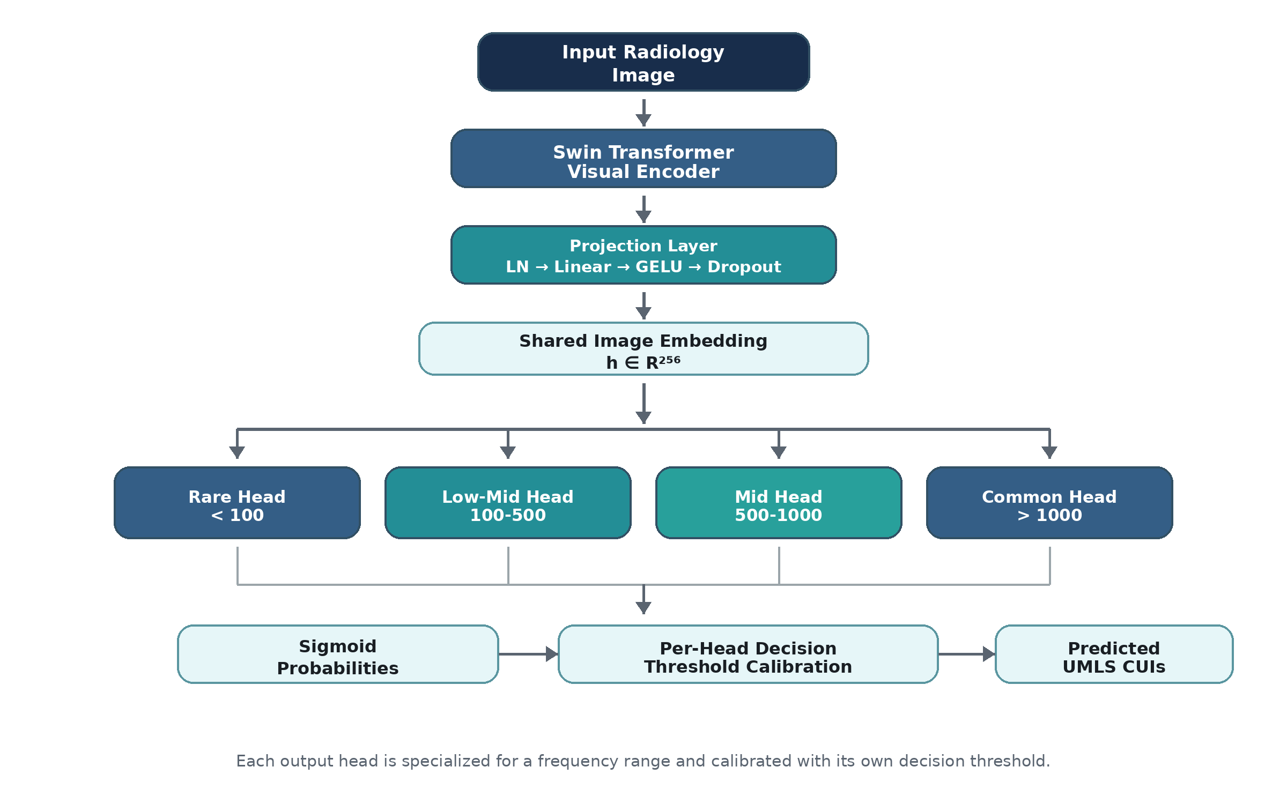
7) Final System: Frequency-Aware Swin Multi-Head Model
The final architecture aligns the classifier structure with the observed label-frequency distribution.
Shared visual encoder
Swin Base Patch4 Window7 224 extracts hierarchical visual features from each radiology image.
Compact embedding
A projection layer maps visual features into a 256-dimensional shared representation.
Four specialized heads
Rare, low-mid, mid, and common concept groups are predicted with dedicated heads.
Per-head thresholds
Each group receives its own calibrated decision threshold for final CUI prediction.
Hybrid Vision–Language Approach • Concept Detection
9/17

Slide 10
8) Training and Calibration Protocol
Reproducibility comes from a fixed validation protocol and explicit operating-point analysis.
Input
224 × 224
Epochs
25; min 12; patience 6
Validation
3-fold multilabel stratified
Batching
32 × grad accum 2 = 64
Optimizer
AdamW
Stabilization
Mixed precision + EMA 0.999
LR / Backbone LR
1e-4 / 2e-5
Loss
ASL + frequency-group weights
Training folds → cached validation probabilities → per-head threshold sweep → micro-opt & coverage-opt operating points
The final prediction rule is calibrated after validation inference; it is not an arbitrary default threshold.
Hybrid Vision–Language Approach • Concept Detection
10/17

Slide 11
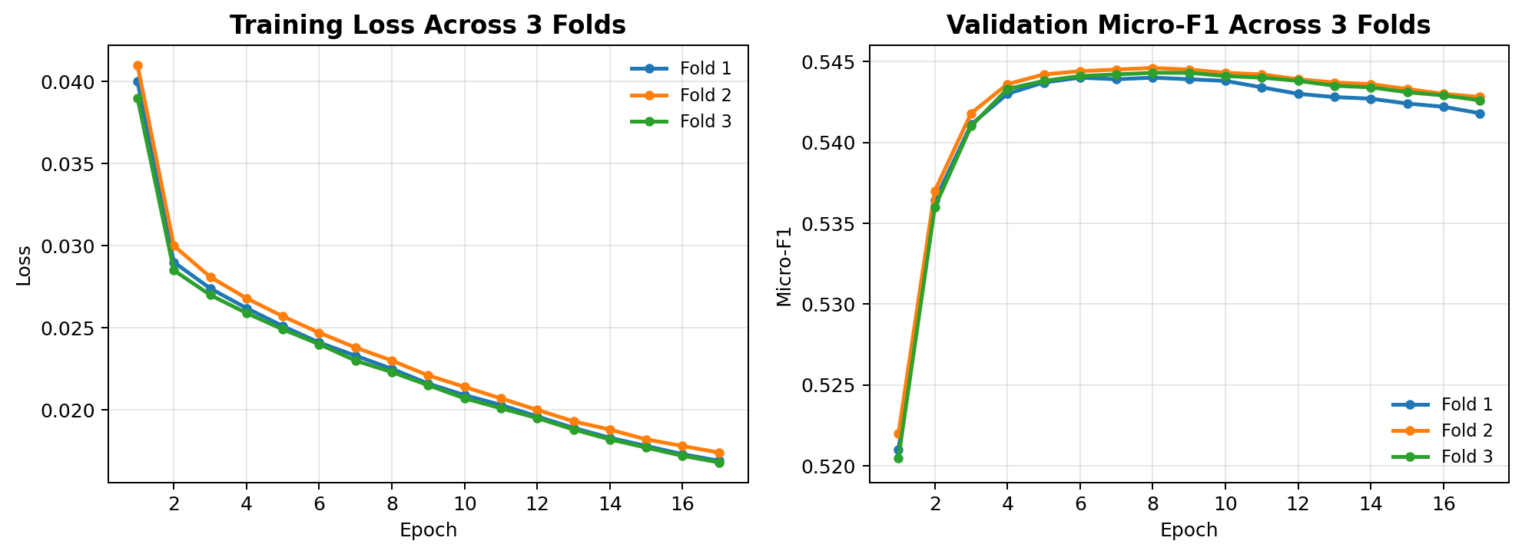
9) Internal Validation: Two Operating Points, One Model
The final model supports both score-oriented and coverage-oriented configurations.
0.5441 ± 0.0004
0.5405 ± 0.0009
65.7 → 105
0.5725
Micro-F1 optimized
Coverage-oriented
Concept coverage
Official score
best global validation score
+26.1% macro_nz
broader semantic output
hidden test set
Per-head calibrated thresholds
Head
Micro-opt
Coverage-opt
Rare <100
0.417
0.283
Low-mid 100–500
0.417
0.367
Mid 500–1000
0.450
0.400
Common >1000
0.450
0.433
Training loss decreases consistently across the three folds, while validation Micro-F1 rapidly converges and remains tightly clustered around the final operating region.
Hybrid Vision–Language Approach • Concept Detection
11/17

Slide 12
10) Official Challenge Result: Competitive Top-4 Performance
The final submitted run was evaluated on the hidden official test set.
Final leaderboard excerpt
Official hidden-test performance
Rank
Team
Score
1
b_wang94
0.5790
0.5725
4th
0.9419
2
archimedes
0.5781
3
y_zhang
0.5763
official score
final rank
secondary score
4
quocthai91206
0.5725
4
basharderar (our team)
0.5725
This confirms that the frequency-aware decomposition generalized beyond internal validation to the official challenge test set.
Only 0.0065 below the top score
Hybrid Vision–Language Approach • Concept Detection
12/17

Slide 13
11) Broader Comparison with Reference Systems
The final system surpasses several reported reference baselines while remaining close to the strongest official 2026 submissions.
0.5725
Official hidden-test score
4th
Final rank
0.5441 ± 0.0004
Best internal validation
final submitted system
Concept Detection Task
micro-F1 optimized
Reference / system | Reported setting | Reported result | Professional comparison to our work
CheXNet / DenseNet (2017) | Chest X-ray CNN baseline; smaller label space | Pneumonia F1 ≈ 0.435 | Contextual baseline only; our official 0.5725 is higher but on a different task/protocol
Santamato et al. (2025) | ImageCLEF-style full concept prediction with CNN transfer learning | F1 ≈ 0.26 on thousands of concepts | Clearly surpassed; supports the difficulty of full long-tail concept detection
Sahni et al. (2025) | ROCOv2/ImageCLEF CNN baselines (ResNet/DenseNet/Inception) | F1 up to 0.4686 | Surpassed by both our validation 0.5441 and official score 0.5725
DenseNet baseline (ours) | Calibrated CNN baseline + threshold/top-k analysis | ≈ 0.466 micro-F1 | Improved by moving from global calibration to structured frequency-aware learning
DenseNetGraphHead (ours) | Graph-based label modeling + ASL + EMA | 0.5372 ± 0.0004 | Important structural gain, but still below final SwinMultiHead
Final SwinMultiHead (ours) | Frequency-aware heads + ASL + EMA + per-head calibration | 0.5441 ± 0.0004 val | Strongest internal configuration; validates the final design choices
Official submitted system (ours) | Hidden test evaluation in ImageCLEFmed Caption 2026 | 0.5725; rank 4 | Competitive top-4 result; only 0.0065 below the top score
Top official reference | b_wang94 on the same 2026 hidden test | 0.5790 | Direct official benchmark; our system remains very close to the best score
Note: cross-paper scores may differ by dataset, year, and protocol; the official 2026 hidden-test leaderboard is the strongest direct comparison.
Main message: the final model surpasses reported CNN-style baselines and reaches a competitive top-4 position on the official ImageCLEFmed Caption 2026 Concept Detection leaderboard.
Hybrid Vision–Language Approach • Concept Detection
13/17

Slide 14
12) Interpretation: Why the Final Design Worked
The strength of the final system comes from combining representation, imbalance-aware training, and calibrated decisions.
Representation
Label-space decomposition
Swin Transformer captures local and contextual image evidence needed for radiology concepts.
Frequency-based heads reduce competition between rare and common labels.
Imbalance-aware objective
Calibration
ASL and group loss weights reduce the dominance of easy negatives and frequent concepts.
Per-head thresholds adapt the final decision boundary to each frequency group.
Core message: the final model is not only a stronger backbone; it is a frequency-aware prediction strategy.
Hybrid Vision–Language Approach • Concept Detection
14/17

Slide 15
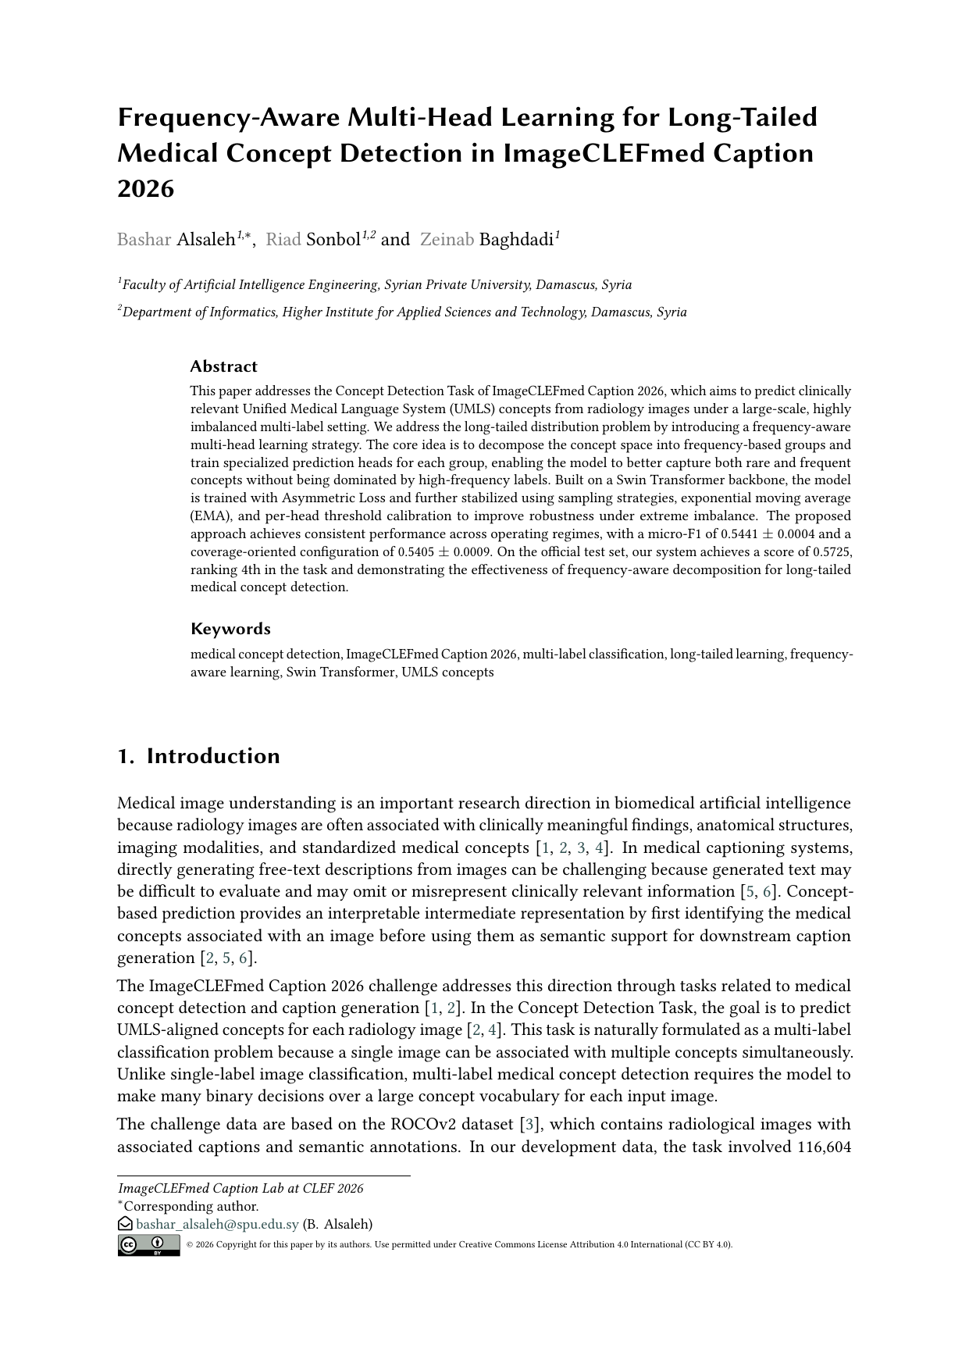
13) Final Deliverables and Reproducibility
The project produced a complete research pipeline, official submission, thesis report, and public artifacts.
Working Notes paper
Thesis report
Submitted to CLEF/ImageCLEF Working Notes using CEURART format.
Expanded graduation report updated with final rank and supervisor edits.
GitHub repository
Official challenge run
Code, project materials, and documentation are publicly available.
Final submission achieved score 0.5725 and rank 4th.
Trained checkpoints
Reproducibility statement
Final three-fold checkpoints released through GitHub Releases.
Dataset is not redistributed due to challenge restrictions; model artifacts are released.
Project repository: github.com/BasharDerar/ImageCLEFmed-2026-Concept-Detection
Hybrid Vision–Language Approach • Concept Detection
15/17

Slide 16
14) Limitations and Future Work
The final system is competitive, but rare medical concept detection remains a challenging research direction.
Current limitations
Future directions
Very rare concepts still have limited positive supervision.
UMLS ontology relations are not explicitly modeled.
Concept co-occurrence is only partially captured through shared features and frequency heads.
Threshold calibration improves behavior but does not create new visual evidence.
Ontology-aware concept modeling using UMLS relationships.
Consultive learning between frequent and rare concept branches.
Medical vision-language pretraining or contrastive representation learning.
Graph-based refinement over predicted concepts before caption generation.
Research continuation: improve rare-concept handling while preserving the strong global Micro-F1 behavior validated in the challenge.
Hybrid Vision–Language Approach • Concept Detection
16/17

Slide 17
Closing Summary
✓
A complete multi-label concept-detection pipeline was designed, trained, calibrated, and evaluated.
Thank you
✓
The final SwinMultiHead model directly addresses long-tail imbalance using frequency-aware label-space decomposition.
Questions?
✓
The system achieved 0.5725 on the official hidden test set and ranked 4th in the Concept Detection Task.
✓
The work produced a thesis report, CEUR Working Notes submission, public code, and trained checkpoints.
Hybrid Vision–Language Approach • Concept Detection
17/17

