Slide 1
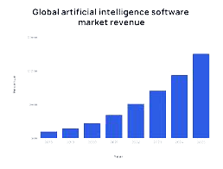

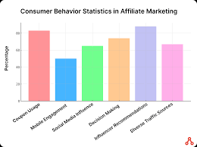
What do you want add here this a example
What do you want to add here this a example
What do you want add here this a example
What do you want add here this a example
A
C
B
A

