Slide 1
Chapter 2(Part 1)
Database Environment

Slide 2
Chapter 2 (Part 1) - Objectives
Purpose of three-level database architecture.
Contents of external, conceptual, and internal levels.
Purpose of external/conceptual and conceptual/internal mappings.
Meaning of logical and physical data independence.
Distinction between DDL and DML.
A classification of data models.

Slide 3
Objectives of Three-Level Architecture
Three –level architecture is to separate each user’s view of the database from the way the database is physically represented.

Slide 4
Objectives of Three-Level Architecture
There are several reasons/objectives why this separation is desirable:
All users should be able to access same data.
  But have different customized view of the data.
  Each user should be able to change the way he/she views the data.

Slide 5
Objectives of Three-Level Architecture
A user’s view is immune to changes made in other views.
Users should not need to know physical database storage details.

Slide 6
Objectives of Three-Level Architecture
DBA should be able to change database storage structures without affecting the users’ views.
Internal structure of database should be unaffected by changes to physical aspects of storage i.e. The changeover to a new storage device.
DBA should be able to change conceptual structure of database without affecting all users.

Slide 7
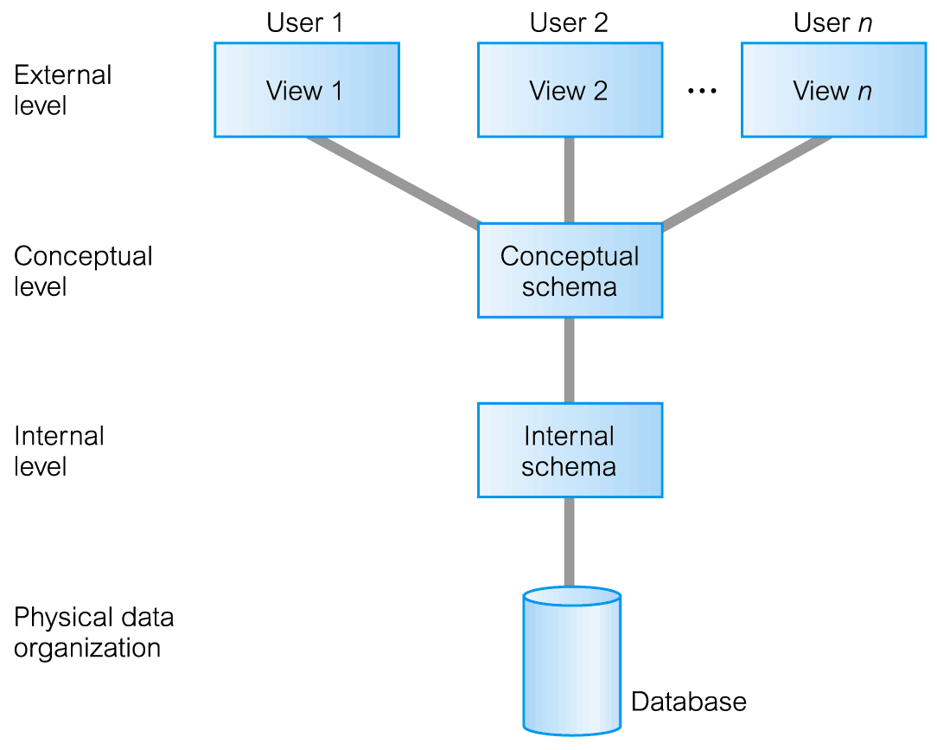
ANSI-SPARC Three-Level Architecture

Slide 8
ANSI-SPARC Three-Level Architecture
External Level
  Users’ view of the database.
  Describes that part of database that is relevant to a particular user.
Conceptual Level
  Community view of the database.
  Describes what data is stored in database and relationships among the data.

Slide 9
ANSI-SPARC Three-Level Architecture
  Conceptual schema describes the logical structure of entire database .
  It is complete view of the data requirements of the organization that is independent of any storage considerations.
  The conceptual schema represent:
    All entities, their attributes and their relationships.
    The constraints on the data.
    Security & integrity information etc.

Slide 10
ANSI-SPARC Three-Level Architecture
Internal Level
  Physical representation of the database on the computer.
  Describes how the data is stored in the database.
  The internal level is concerned with such things as:
    Storage space allocation for data & indexes.
    Record description for storage
    Record placement
    Data compression & data encryption techniques.

Slide 11
SCHEMAS, MAPPINGS, INSTANCES
Database schema:
  Overall description of the Database is called database schema.
  There are three different schemas according to the level of abstraction. (as already discussed)
  DBMS is responsible for mapping between these three schemas & it also checks consistency of schemas .

Slide 12
SCHEMAS, MAPPINGS, INSTANCES
Conceptual/internal mapping:
  to find the actual record (combinations) in physical storage that constitute a logical record in the conceptual schema.
External/conceptual mapping:
  map names in the user’s view onto the relevant part of the conceptual schema.
Database instance: the data in the DB at any particular point in time.

Slide 13
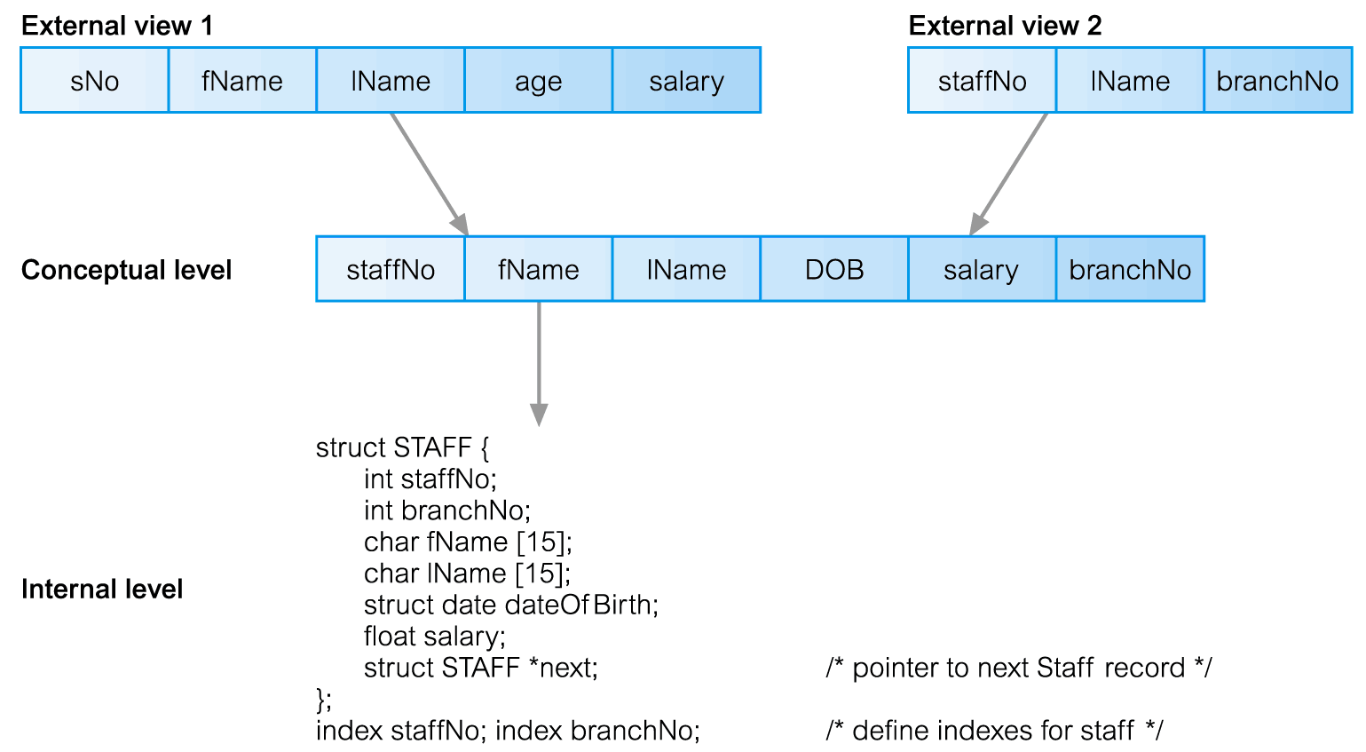
Differences between Three Levels of ANSI-SPARC Architecture

Slide 14
Data Independence
A major objective for three-level architecture is to provide data independence;
  Which means upper levels are unaffected by changes to lower levels.
  There are two kinds of data independence:
    Logical data independence
    Physical data independence

Slide 15
Data Independence
Logical Data Independence
  Refers to immunity of external schemas to changes in conceptual schema.
  Conceptual schema changes (e.g. addition/removal of entities).
  Should not require changes to external schema or rewrites of application programs.

Slide 16
Data Independence
Physical Data Independence
  Refers to immunity of conceptual schema to changes in the internal schema.
  Internal schema changes (e.g. using different file organizations, storage structures/devices).
  Should not require change to conceptual or external schemas.

Slide 17
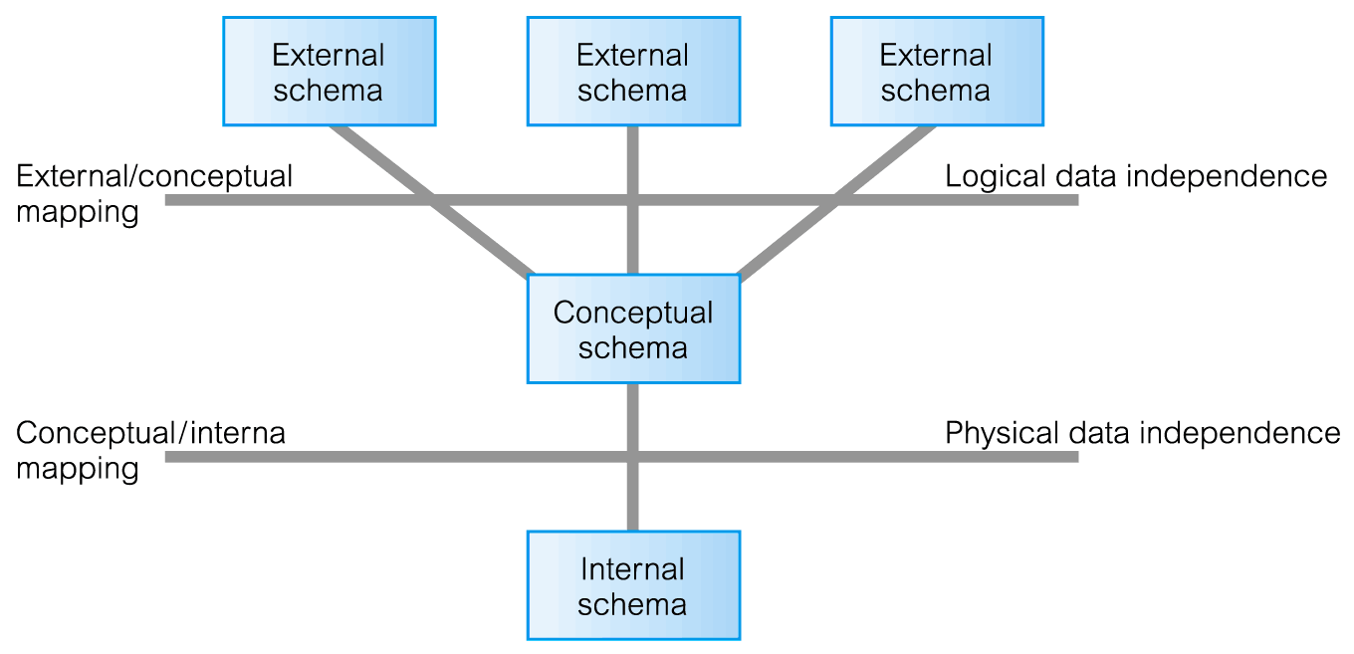
Data Independence and the ANSI-SPARC Three-Level Architecture

Slide 18
Database Languages
Data Definition Language (DDL)
Data Manipulation Language (DML)
Fourth Generation Languages (4GLs)
Data Definition Language (DDL)
  Allows the DBA or user to describe and name entities, attributes, and relationships required for the application
  plus any associated integrity and security constraints.

Slide 19
Database Languages
Data Manipulation Language (DML)
  Provides basic data manipulation operations on data held in the database.
  Data manipulation operations include the following:
    Insertion of new data into database;
    modification of stored data in the database;
    Retrieval of data contained in the database;
    Deletion of data from the database;

Slide 20
Database Languages
  We can distinguish between two-types of DML:
    Procedural DML
    Non-Procedural DML
Procedural DML
  A language that allows the user to tell the system what data is needed and exactly how to retrieve the data.
Non-Procedural DML
  A language that allows the user to state what data is needed rather than how it is to be retrieved.

Slide 21
Data Model
Integrated collection of concepts for describing data, relationships between data, and constraints on the data in an organization.
Data Model comprises:
  a structural part;
  a manipulative part;
  possibly a set of integrity rules; which ensures that the data is accurate.

Slide 22
Data Model
Structural Part:
  Consisting of a set of rules according to which databases can be constructed.
Manipulated Part:
  Defining the types of operation that are allowed on the data(this includes the operations that are used for updating or retrieving data from the database & for changing the structure of database).

Slide 23
Data Model
Purpose
  To represent data in an understandable way.
Categories of data models include:
  Object-based data model
  Record-based data model
  Physical data model
Describe data at the conceptual
and external levels
Describe data at the internal level

Slide 24
Data Models
Object-Based Data Models
  These models use concepts of such as entities, attributes and relationships.
    Entity is the distinct object (a person, place, thing, event etc.).
    An attribute is a property that describes some aspects of the object that we wish to record.
    A relationship is an association between entities.
  Some of the most common types of object-based data model are:
    Entity-Relationship
    Semantic
    Functional
    Object-Oriented.

Slide 25
Data Models
Record-Based Data Models
  It is named so because the database is structured in fixed-format records of several types.
  Each record type defines a fixed number of fields, or
  attributes. Each field is usually of a fixed length (this simplifies
  the implementation).
  The three most widely accepted models are the
    Relational Data Model
    Network Data Model
    Hierarchical Data Model.

Slide 26
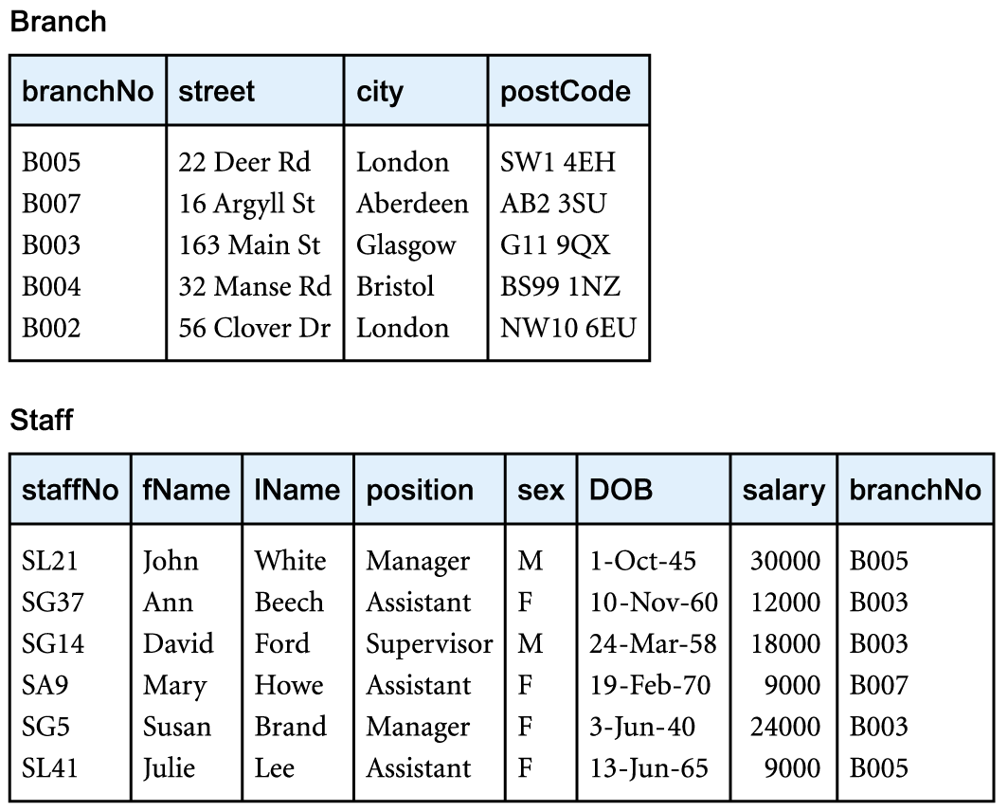
Relational Data Model

Slide 27
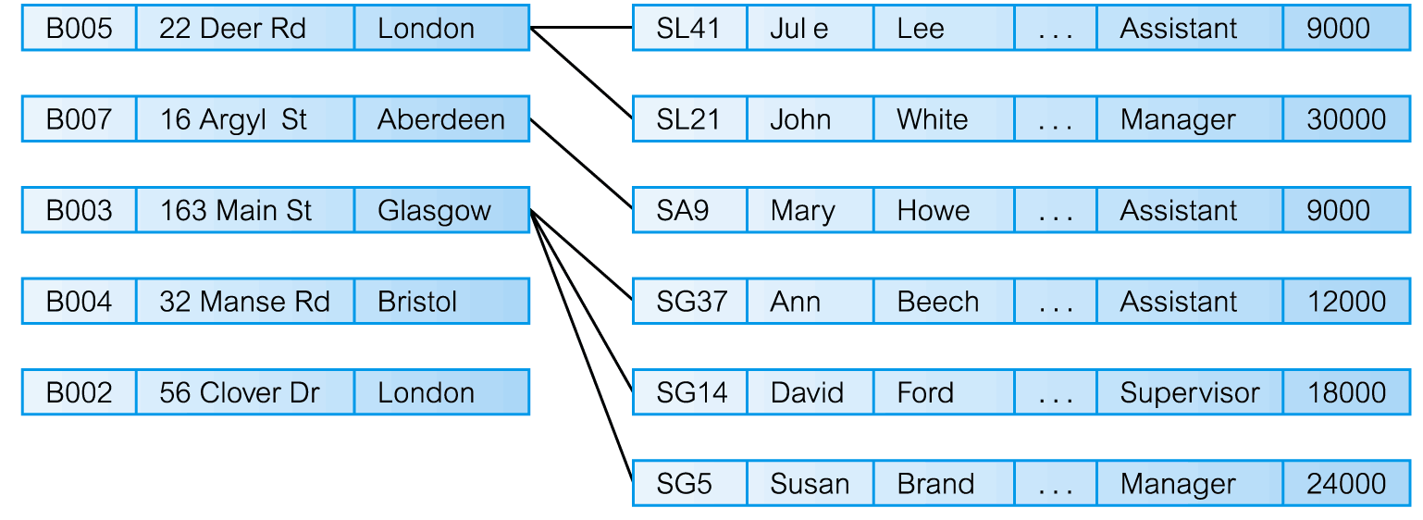
Network Data Model

Slide 28
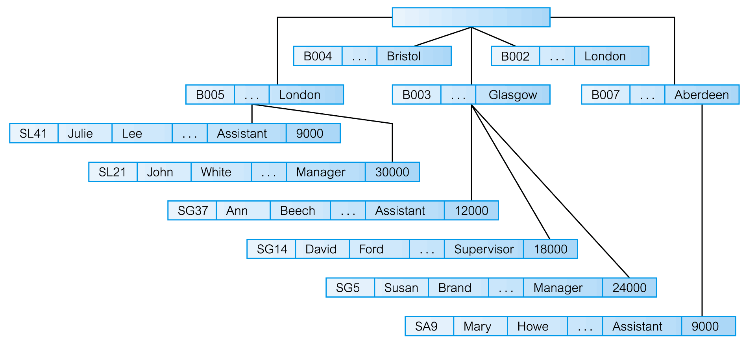
Hierarchical Data Model

Slide 29
Data Models
Physical data Models
  They describes how data is stored in the computer, representing information such as record structures, record orderings and access paths.

