Slide 1
Lecture 5
The Relational Model

Slide 2
Objectives
Brief history of Relational Model
Terminology of Relational Model.
How tables are used to represent data.
Connection between mathematical relations and relations in the relational model.
Properties of database relations.
How to identify CK, PK, and FKs.
Meaning of entity integrity and referential integrity.
Purpose and advantages of views.

Slide 3
Brief History of the Relational Model
The relational model was first proposed by E.F. Codd in his seminal paper ‘ A relational model of data for large shared data banks’ (Codd, 1970).
The Relational Model’ objectives were specified as follows:
  To allow a high degree of data independence. Application programs must not be affected by modifications to internal data representation, particularly by changes to file organizations, record ordering or access paths.

Slide 4
Brief History of the Relational Model
  To provide substantial grounds for dealing with data semantics, consistency, and redundancy problems. In particular , Codd’s paper introduced the concept of normalized relations, that is, relations that have no repeating groups.
  To enable the expansion of set-oriented data manipulation languages.

Slide 5
Relational Model Terminology
A relation is a table with columns and rows.
  Only applies to logical structure (External & Conceptual levels of ANSI-SPARC Architecture)of the database, not the physical structure.
Attribute is a named column of a relation.
  In relational models, relations are used to hold information about the objects to be represented in database.
  A relation is represented as a two-dimensional table in which the rows of the table correspond to individual records & the table columns correspond to attributes.

Slide 6
Relational Model Terminology
Domain is the set of allowable values for one or more attributes.
Tuple is a row of a relation.
Degree is the number of attributes in a relation.
Cardinality is the number of tuples in a relation.
Relational Database is a collection of normalized relations with distinct relation names.

Slide 7
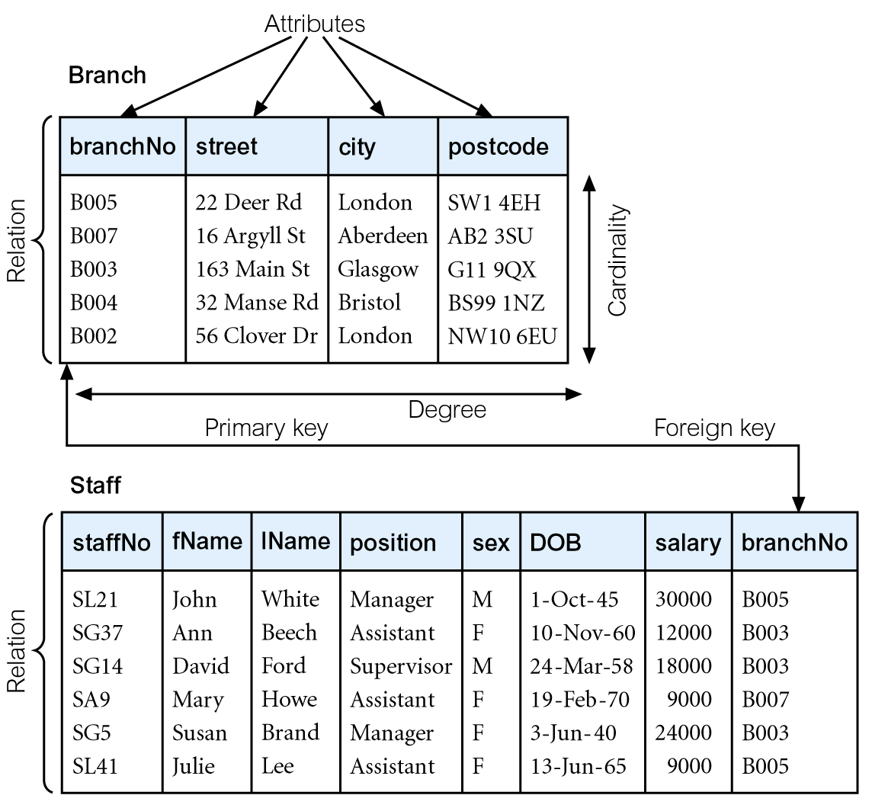
Instances of Branch and Staff Relations

Slide 8
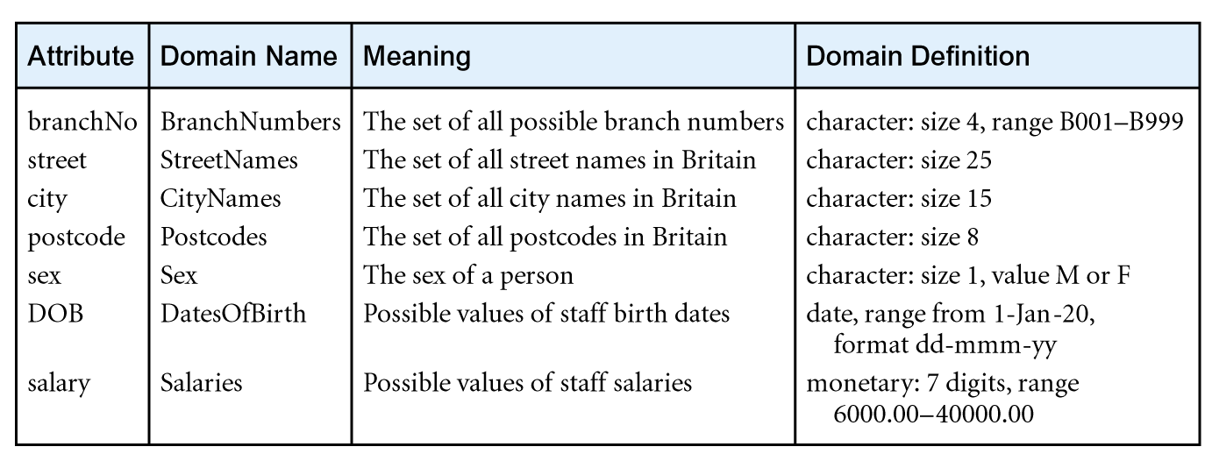
Examples of Attribute Domains

Slide 9
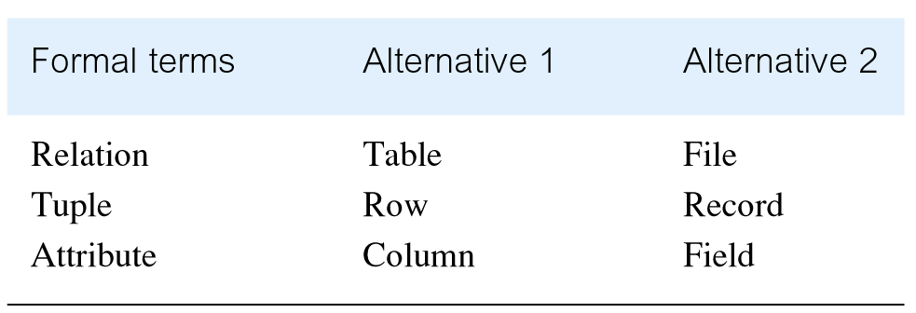
Alternative Terminology for Relational Model

Slide 10
Mathematical Definition of Relation
Consider two sets, D₁ & D₂, where D₁ = {2, 4} and D₂ = {1, 3, 5}.
Cartesian product, D₁ × D₂, is set of all ordered pairs, where first element is member of D₁ and second element is member of D₂.
    D₁ × D₂ = {(2, 1), (2, 3), (2, 5), (4, 1), (4, 3), (4, 5)}
Alternative way is to find all combinations of elements with first from D₁ and second from D₂.

Slide 11
Mathematical Definition of Relation
Any subset of Cartesian product is a relation; e.g.
  R = {(2, 1), (4, 1)}
May specify which pairs are in relation using some condition for selection; e.g.
  second element is 1:
  R = {(x, y) | x ∈D₁, y ∈D₂, and y = 1}
  first element is always twice the second:
  S = {(x, y) | x ∈D₁, y ∈D₂, and x = 2y}

Slide 12
Mathematical Definition of Relation
Consider three sets D₁, D₂, D₃ with Cartesian Product D₁ × D₂ × D₃; e.g.
  D₁ = {1, 3} D₂ = {2, 4} D₃ = {5, 6}
  D₁ × D₂ × D₃ = {(1,2,5), (1,2,6), (1,4,5), (1,4,6), (3,2,5), (3,2,6), (3,4,5), (3,4,6)}
Any subset of these ordered triples is a relation.

Slide 13
Mathematical Definition of Relation
Cartesian product of n sets (D₁, D₂, . . ., D_{n}) is:
  D₁ × D₂ × . . . × D_{n} = {(d₁, d₂, . . . , d_{n}) | d₁ ∈D₁, d₂ ∈D₂, . . . , d_{n}∈D_{n}}
usually written as:
  n
  XD_{i}
  ^{i = 1}
Any set of n-tuples from this Cartesian product is a relation on the n sets.

Slide 14
Database Relations
Relation schema
  A named relation defined by a set of attribute and domain name pairs.
  The common convention for representing a relation schema is to give the name of the relation followed by the attributes names in parentheses.
  Normally the primary key is underlined.
  For example:
  branch (branchno, street, city, postcode)
  Staff (staffno, fname, lname, sex, DOB, salary, branchno)

Slide 15
Database Relations
"Relation" = Table.
"Relation Schema" = Table definition.
for example, the "schema" for the Person "relation" is: Person(FirstName, LastName, Age, Gender, Address)
Relational database schema
  A set of relation schemas, each with a distinct name.

Slide 16
Properties of Relations
Relation name is distinct from all other relation names in relational schema.
Each cell of relation contains exactly one atomic (single) value.
Each attribute has a distinct name.
Values of an attribute are all from the same domain.

Slide 17
Properties of Relations
Each tuple is distinct; there are no duplicate tuples.
Order of attributes has no significance.
Order of tuples has no significance, theoretically.

Slide 18
Relational Keys
Superkey
  An attribute, or set of attributes, that uniquely identifies a tuple within a relation.
  For example, Given an employee table consisting of the columns:
  employeeID
  name
  job and
  departmentID
  we could use the employeeID in combination with any or all other columns of this table to uniquely identify a row
  in the table.
  Examples of superkeys in this table would be {employeeID, Name}, {employeeID, Name, job}, and
  {employeeID, Name, job, departmentID}.

Slide 19
Relational Keys
Candidate Key
  A candidate key would be any key which could be used as the primary key, which means that the combination of the columns, or just the single column would create a unique key.
  You would then need to determine which of these candidate keys would work best as your primary key.
  Simply the minimal super key is called candidate key

Slide 20
Relational Keys
Primary Key
  The Candidate key that is selected to identify tuples uniquely within the relation.
  An attribute (or combination of attribute) that uniquely identifies each row in a relation.
Alternate Keys
  Candidate keys that are not selected to be primary key.
Foreign Key
  An attribute in a relation of a database that serves as the primary key of another relation in the same database.

Slide 21
Integrity Constraints
Null
  Represents value for an attribute that is currently unknown or not applicable for tuple.
  Deals with incomplete or exceptional data.
  Represents the absence of a value and is not the same as zero or spaces, which are values.

Slide 22
Integrity Constraints
The two principal integrity rules for the relational model are:
Entity Integrity
  In a base relation, no attribute of a primary key can be null.
Referential Integrity
  If foreign key exists in a relation, either foreign key value must match a primary key value of some tuple in its home relation or foreign key value must be wholly null.

Slide 23
Integrity Constraints
General Constraints
  Additional rules specified by users or database administrators that define or constrain some aspect of the enterprise.

Slide 24
Views
Base Relation
  A named relation corresponding to an entity in conceptual schema, whose tuples are physically stored in database.
View
  The dynamic result of one or more relational operations operating on base relations to produce another relation.

Slide 25
Views
A virtual relation that does not necessarily actually exist in the database but is produced upon request, at time of request.
Contents of a view are defined as a query on one or more base relations.
Views are dynamic, meaning that changes made to base relations that affect view attributes are immediately reflected in the view.

Slide 26
Purpose of Views
It provides powerful and flexible security mechanism by hiding parts of database from certain users.
It permits users to access data in a customized way, so that same data can be seen by different users in different ways, at same time.
It can simplify complex operations on base relations.

Slide 27
Updating Views
All updates to a base relation should be immediately reflected in all views that reference that base relation.
If view is updated, underlying base relation should reflect change.

Slide 28
Updating Views
There are restrictions on types of modifications that can be made through views:
  Updates are allowed if query involves a single base relation and contains a candidate key of base relation.
  Updates are not allowed involving multiple base relations.
  Updates are not allowed involving aggregation or grouping operations.

Slide 29
Updating Views
Classes of views are defined as:
  theoretically not updateable;
  theoretically updateable;
  partially updateable.

