Slide 1
Student Entity
Primary Key
Student
Composite Attribute
StudName
StudId
Data of birth
Age
Derived
Attribute
FName
LName

Slide 2
Cardinality Ratio
M
N
Student
Grades
Course
supervisor
1
Supervision
Employee
supervisee
M
1
1
HeadOfSchool
Manages
School
HOS
Notes:
When entities of one entity set are considered, their cardinality ratio is placed near the figure of the other entity type. So, the procedure is:
take one (arbitrary) entity of one class,
answer the question: "What is the maximal number of the other class entities the perceived entity can be associated with",
if the answer is more than one, put N (or M) near the graphical representation of the other entity class,
other wise put one,
mind, cardinality ratio can't be less than 1 (otherwise the entities of the considered sets are not related)

Slide 3
Enhanced ER Data Model
Enhanced ER data model brings a number of new concepts:
  Supercalss / subclass relationship

Slide 4
Superclass / Subclass Relationship
An entity class can posses groups of such entities that contain some special properties, not immanent to the other ones
e.g.
  Person class contains many such groups like: students, employees, children, retired,…
  Student class may be divided into full time and part time students, or undergraduate, graduate, master, and doctorate students
To enhance the semantic power of the ER data model, there is a superclass / subclass relationship introduced

Slide 5
Superclass / Subclass Relationship
EmployeeID
Name
Position
Employee
Works_
for
M
1
Position
Department
Superclass
Project
1
Secretary
Programmer
M
Works_
on
TypeSpeed
NoOfLang
Subclass

Slide 6
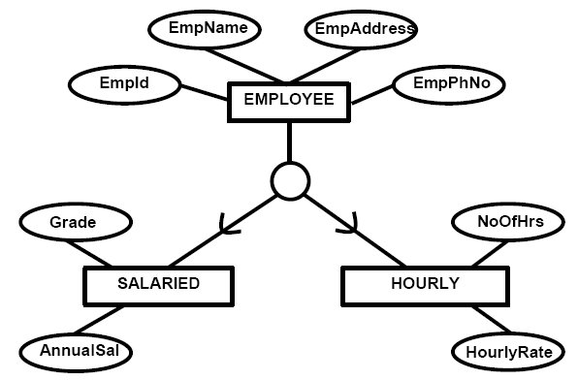
Superclass / Subclass Relationship
Entity Relationship Modelling

Slide 7
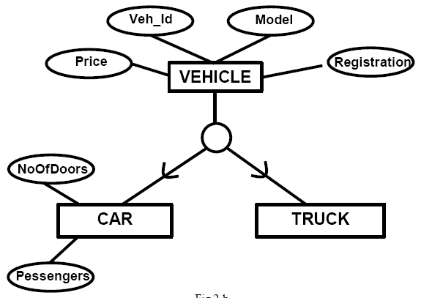
Superclass / Subclass Relationship
Entity Relationship Modelling

Slide 8
Superclass / Subclass Relationship
A subclass contains only specific attributes and may participate in relationship types by its own
A subclass is a specialization of its superclass
The superclass is generalization of all its subclasses
Specialization and generalization are inverses of each other
An instance of the subclass is also an instance of the superclass
These two instances represent the same real entity
A subclass instance inherits all the superclass attribute values and all relationship participations from its image in the superclass

Slide 9
Entity Type
Strong Entity Type (regular entity and associative entity)
  Entity type that is not existence-dependent on some other entity type.
Weak Entity Type
  Entity type that is existence-dependent on some other entity type.

Slide 10
Weak Entity Type Examples
M
Weak relationship type
Weak entity type
DepName
M
1
Dependent
Has
Employee

Slide 11
Transforming ER to Relational
Entities are mapped to relations.
e.g
Above entity “Student” will be transformed into Relation
Student (………..)
Student
Entity Relationship Modelling

Slide 12


Attributes
Simple attributes
E-R attributes map directly onto the columns/fields of relation
CUSTOMER relation
Entity Relationship Modelling

Slide 13
Composite attributes
Use only their simple component (attributes). In other words simple components of composite will be mapped as fields/columns of relation
Entity Relationship Modelling

Slide 14


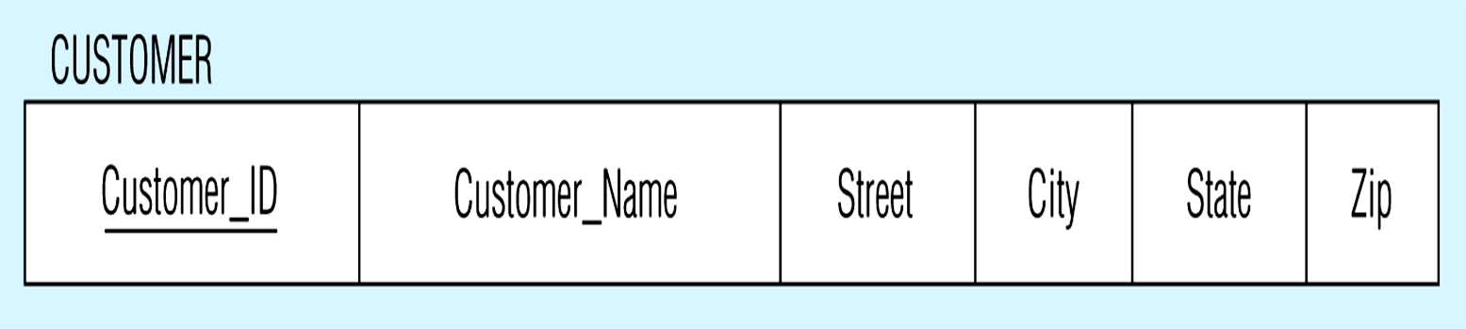
CUSTOMER relation with address detail
Entity Relationship Modelling

Slide 15
Multivalued Attribute
Separate relation will be created for each multivalued attributes with a foreign key taken from the superior entity
Entity Relationship Modelling

Slide 16


Multivalued attribute becomes a separate relation with foreign key
1–to–many relationship between original entity and new relation
In the above example a separate relation “Employee_Skill” is created for multivalued “Skill” with foreign key “Employee_ID” from Employee.
Entity Relationship Modelling

Slide 17
Weak Entities
Becomes a separate relation with a foreign key taken from the superior entity
  Primary key composed of:
    Partial identifier of weak entity
    Primary key of identifying relation (strong entity)
Entity Relationship Modelling

Slide 18
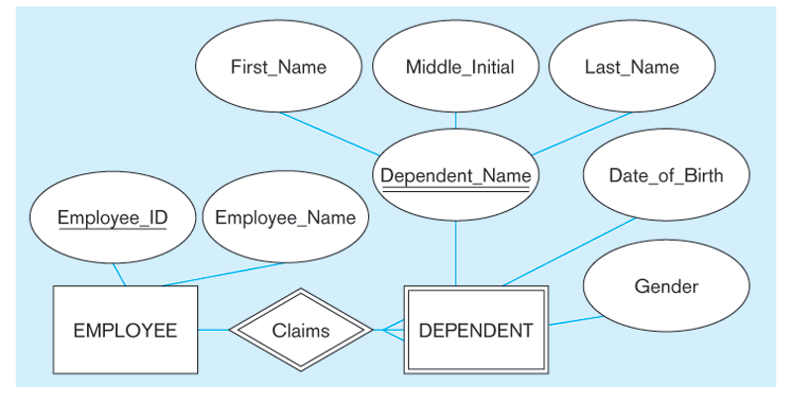
Entity Relationship Modelling

Slide 19
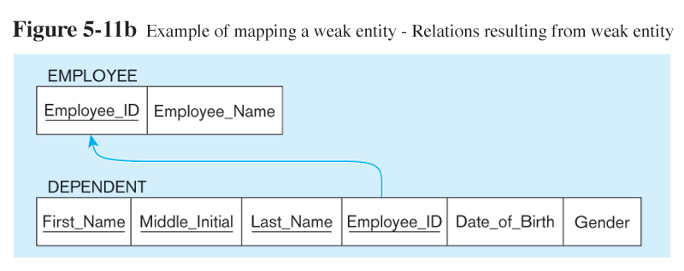
Previous ER model having week entity “Dependent” will be transformed into relational as follow.
NOTE: the domain constraint for the foreign key should NOT allow null value if DEPENDENT is a weak entity
Foreign key
Composite primary key
Entity Relationship Modelling

Slide 20
Associative Entity
Identifier Not Assigned
  Default primary key for the association relation is composed of the primary keys of the two entities (as in M:N relationship)
Entity Relationship Modelling

Slide 21
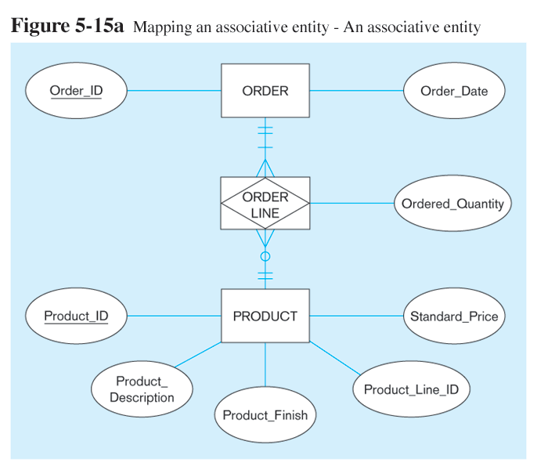
Entity Relationship Modelling

Slide 22
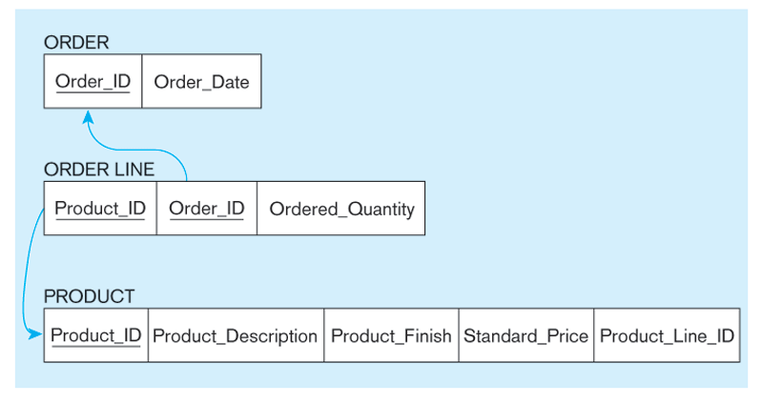
Entity Relationship Modelling

Slide 23
Relationship
Unary Relationship
One-to-Many Relationship
Recursive foreign key in the same relation
Entity Relationship Modelling

Slide 24
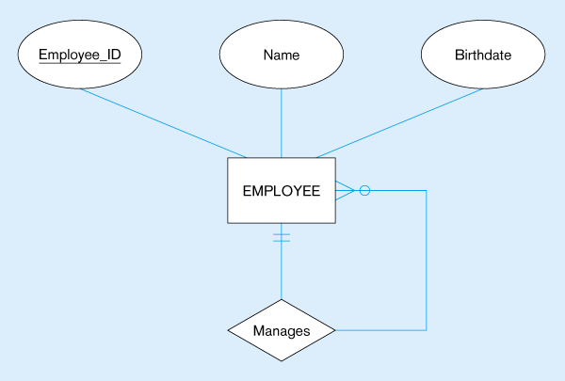

EMPLOYEE entity with Manages relationship
EMPLOYEE relation with recursive foreign key
Entity Relationship Modelling

Slide 25


Many-to-Many Relationship
Bill-of-materials relationships (M:N)
ITEM and COMPONENT relations
Entity Relationship Modelling

Slide 26
Binary Relationship
One-to-One Relationship
Primary key on the mandatory side becomes a foreign key on the optional side
Entity Relationship Modelling

Slide 27
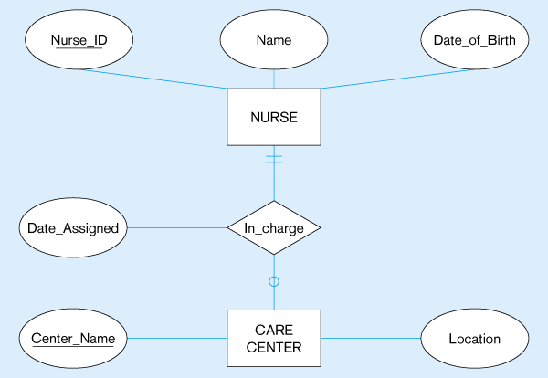
Entity Relationship Modelling

Slide 28
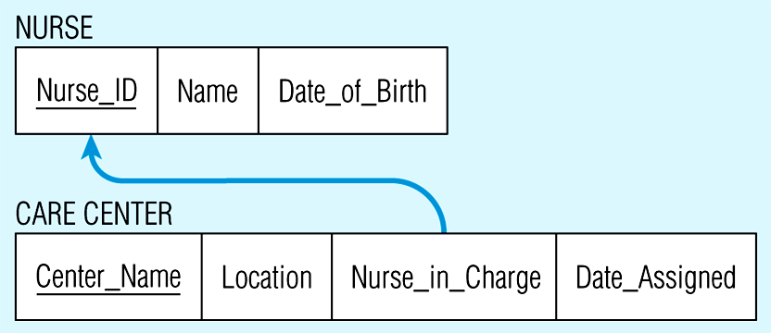
Entity Relationship Modelling

Slide 29
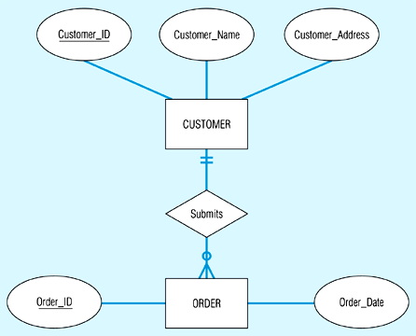
One-to-Many Relationship
Primary key on the one side becomes a foreign key on the many side
Entity Relationship Modelling

Slide 30
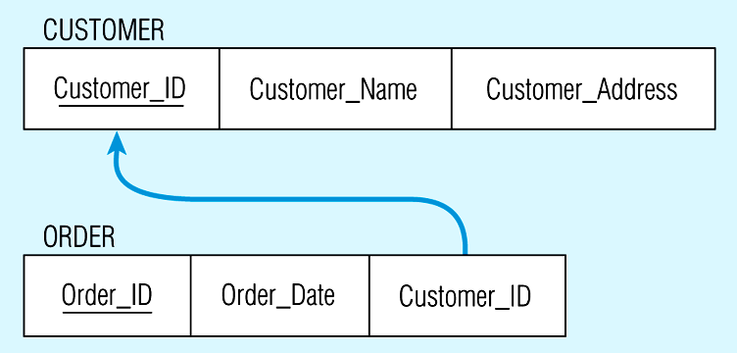
Again, no null value in the foreign key…this is because of the mandatory minimum cardinality
Foreign key
Entity Relationship Modelling

Slide 31
Many-to-Many Relationship
Create a new relation with the primary keys of the two entities as its primary key
Entity Relationship Modelling

Slide 32

The Supplies relationship will need to become a separate relation
Entity Relationship Modelling

Slide 33

Composite primary key
New intersection relation
Foreign key
Foreign key
Entity Relationship Modelling

Slide 34
Ternary/Quaternary Relationship
One relation for each entity and one for the associative entity
Associative entity has foreign keys to each entity in the relationship
Entity Relationship Modelling

Slide 35
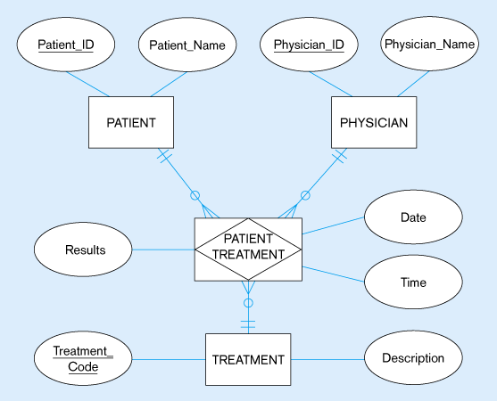
Entity Relationship Modelling

Slide 36
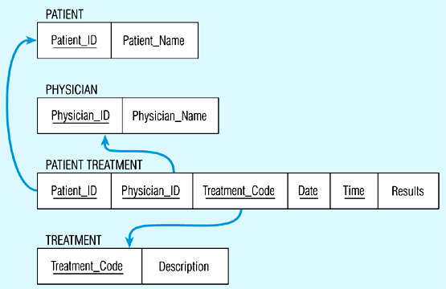
Remember that the primary key MUST be unique
Entity Relationship Modelling

Slide 37
Mapping Super type/Subtype Relationships
One relation for supertype and for each subtype
Supertype attributes (including identifier and subtype discriminator) go into supertype relation
Subtype attributes go into each subtype; primary key of supertype relation also becomes primary key of subtype relation
1:1 relationship established between supertype and each subtype, with supertype as primary table
Entity Relationship Modelling

Slide 38
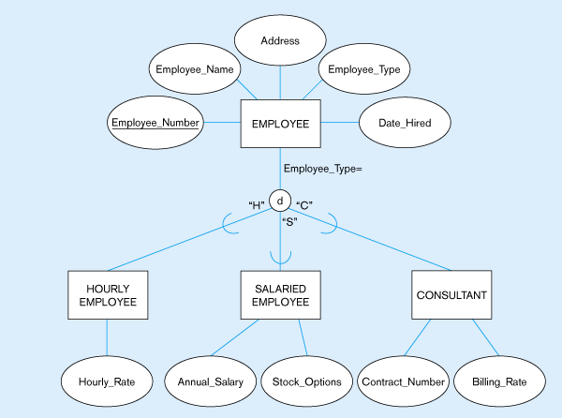
Entity Relationship Modelling

Slide 39
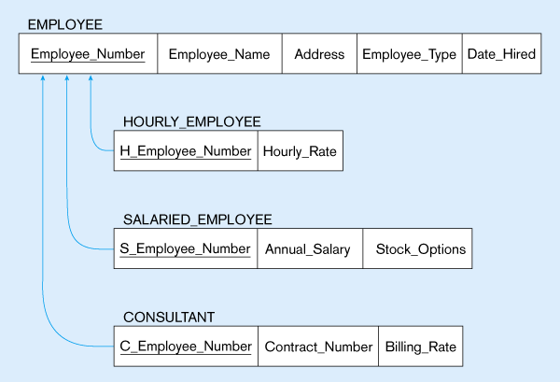
These are implemented as one-to-one relationships
Entity Relationship Modelling

