Slide 1
Language

Slide 2

What is language?

Slide 3

Best way for communication

Slide 4

Point 1:
Language helps express our feelings, desires,
and queries to the world around us.

Slide 5

Point 2:
Important in the increasingly integrated global
business community.

Slide 6
Point 3:
It provides additional job
security and
advancement opportunities
in uncertain economic times.

Slide 7
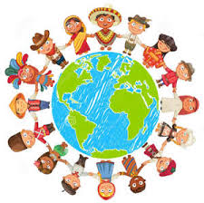
Point 4:
It helps us to learn about
other people and
cultures.

Slide 8

Point 5:
To travel around the world...

Slide 9

MESSAGE:
if we were to lose our own tongue, for example, if we were to grow up in a country which is not our own, someplace that is not our home, in my opinion, we would be losing a part of ourselves.

Slide 10
End…

