Slide 1
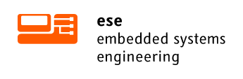
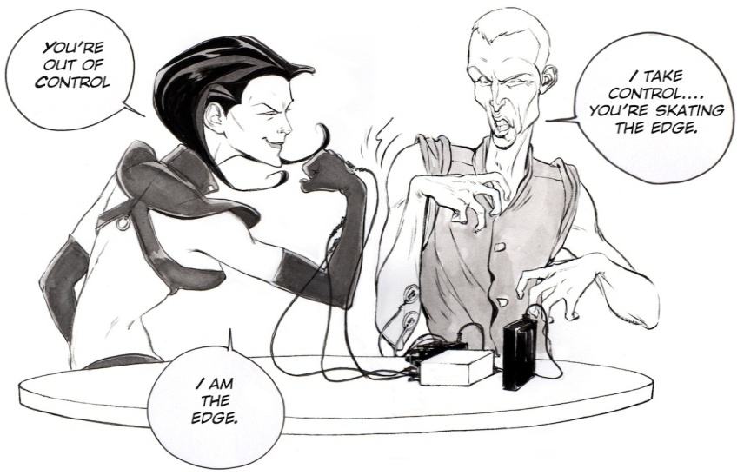
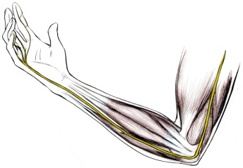


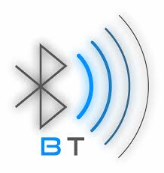
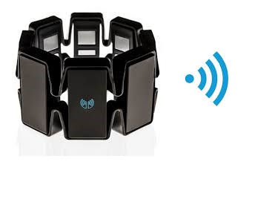
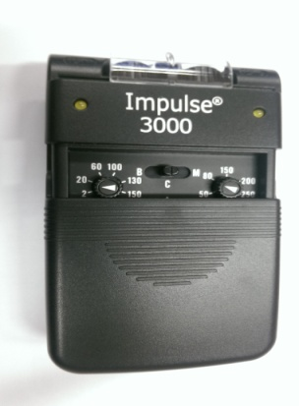
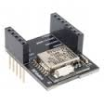
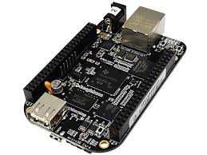
Human -Human Interface
Control
unit
The aim of the project is to control the arm movement of the other person using Brain signals.
EMG signal of the person’s arm is measured and sent to the control unit via Low energy
Bluetooth 4.0. and through control unit the signals are forwarded to the controlled unit.
Myo
Control
unit
Controlled
unit
Hardware
As a EMG detector Myo armband is used. Which measures raw EMG signal of a body.
Features:
Eight -EMG sensors
Nine –axis IMU containing gyroscope,
Three axis accelerometer and three axis magnetometer.
Low Energy Bluetooth 4.0
Myo
It is a dual channel Tens device. Its analog controls come with three modes of operation, which are Continuous, Burst and Modulation. The frequencies of this unit range between 2 to 150 Hz, and it has an adjustable impulse width that can range between 50 to 250 microseconds. The device intensity is continuously adjustable and can range from 0 to 90 mA peak.
Tens device
Rfduino contoller is used to trigger the tens device according to the recieved EMG signals.
Main features:
Bluetooth ,Tiny shape, and low supply voltage of 1.9v to 3.6 volt
Rfduiono
Beagelbone is used as a control unit and to visualize the Data recieved from Myo.
Specification:
Processor: Sitara AM3358BZCZ100, 1GH, 2000 MIPS
Memory : 4GB Onboard Flash, 512 MB SDRAM 800MHZ
Video out: 16b HDMI
Power Source: mini usb, 5v External DC
Beagelbone Black

