Slide 1
Analysis on Comprehensive Company Data on 2022 Fortune 1000

Slide 2
Team Members
Abdul Basheer Shaik-AP21110010203
Baladithya yenduluri-AP21110010210
Durga Mahesh Muthinti-AP21110010242

Slide 3
Table Of Contents
01
ABSTRACT
02
INTRODUCTION
03
HYPOTHESIS
04
SYSTEM REQUIREMENTS

Slide 4
Table Of Contents
05
Visualisation
06
ADVANTAGES
07
CONCLUSION

Slide 5
ABSTRACT
In this presentation, we provide a comprehensive examination of the 2022 Fortune 1000 companies, looking at important financial parameters, industry performance, regional distribution, and top-performing firms. The conclusions drawn from this investigation offer useful data regarding the state of the corporate landscape as well as insightful advice for investors and enterprises.

Slide 6
INTRODUCTION
The Fortune 1000 list is a famous rating of the most significant and prosperous US businesses, covering a range of markets and areas. In this talk, we go deep into data-driven exploration to glean important insights and expose the trends, patterns, and KPIs that characterise the status of corporate America.

Slide 7
HYPOTHESIS
First hypothesis: Variability in industry performance
We predict that the Fortune 1000 list will show a considerable variation in the performance of businesses across various industries. In a market environment that is always shifting, some industries may see faster growth and profitability while others may have difficulties.
Hypothesis 2: Unique Characteristics of Top Performers
The top-performing businesses on the Fortune 1000 list are predicted to have unique qualities and competitive advantages, which will contribute to their outstanding performance. Innovative company strategies, strong leadership, and a willingness to adopt new technologies are a few examples of these qualities.

Slide 8
SYSTEM REQUIREMENTS
Software:
Excel (for the CSV data)
Jupyter Notebook (for analysing and visualising data)
Hardware:
Processor (CPU) - Intel Core i5 (sixth generation or newer) or equivalent
Memory - 16 GB RAM
Storage - 500 GB internal storage drive

Slide 9
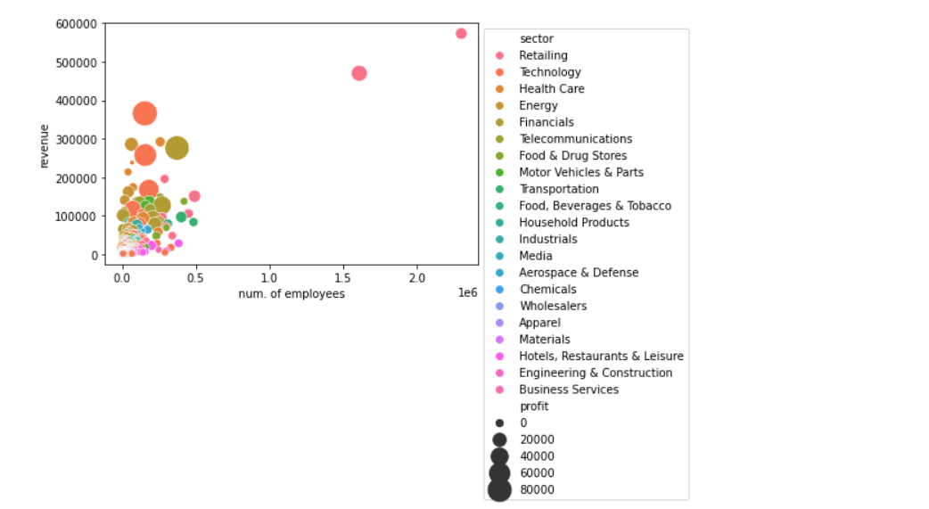
VISUALISATION

Slide 10
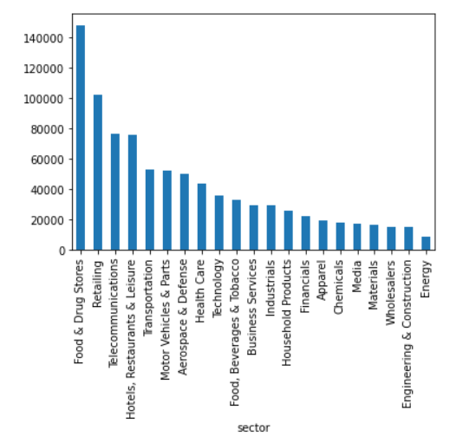
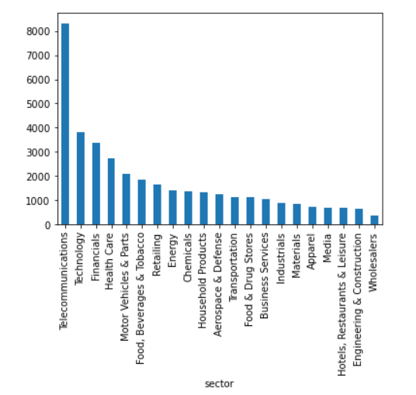
VISUALIZATION
Sector vs no of employees sector vs profit

Slide 11
ADVANTAGES
Informed Decision Making: Data-driven insights enable better business decisions.
Best Practices: Identify successful strategies from top-performing companies.
Benchmarking: Compare performance and set realistic goals.
Market Opportunities: Uncover potential growth areas and trends.
Risk Assessment: Proactively mitigate potential risks.
Smart Investments: Make informed choices in investment opportunities.
Geographical Expansion: Identify promising

Slide 12
CONCLUSION
Last but not least, the examination of the 2022 Fortune 1000 data has been really useful. Businesses benefit from having data-driven insights at their disposal for improved strategic planning and decision-making. A culture of excellence and innovation is promoted by identifying best practises from high achievers. It is possible to seize new chances by understanding industry trends. Efficiency and competitiveness are ensured by wise resource allocation.
Making wise decisions, lowering risks, and maximising rewards are advantageous to investors. Expansion plans are influenced by geographic understanding. Overall, this research gives stakeholders the skills they need to successfully navigate the evolving corporate landscape, fostering progress and prosperity.

