Slide 1
Flatiron School module 3 project
Liver Disease Machine Learning Project
Christian Lopez
Notes:
I’ll be presenting my module 3 project
I used the Indian Liver Patient Records dataset found in Kaggle

Slide 2
Problem statement:
Provide healthcare practitioners with actionable insights
Pin-point risks associated with liver disease
Identify at-risk patients
Notes:
To supply healthcare practitioners with valuable information that can be utilized in their day-to-day professional lives
Shed some light on possible risks associated with the disease and perhaps even ways to mitigate it
Try our best to identify those at most risk and intervene as soon as possible

Slide 3
Business value:
Development of preventive care
Allocation of valuable time and resources
Likelihood estimation of developing liver disease
Notes:
Develop a preventive care strategy to better deal with liver disease
Allows for the establishment of a strategic plan to deal with the issue at hand and a better way to allocate time and resources
We can generate a likelihood estimation using the data we are given

Slide 4
Methodology: OSEMN
Obtain: searched Kaggle for a dataset I could use
Scrub: cleaned and manipulated the data using Pandas
Explore: derived statistics and created visualizations using Matplotlib and Seaborn
Model: classification machine learning algorithms using Sklearn
iNterpret: drew conclusions from the data and evaluated meaning of results
Notes:
Obtain, scrub, explore, model, and interpret
Obtained from Kaggle
Scrubbed using Pandas
Explored using Matplotlib and Seaborn
Modeled using classification algorithms from Sklearn
Interpreted our conclusions using the statistics we obtained

Slide 5
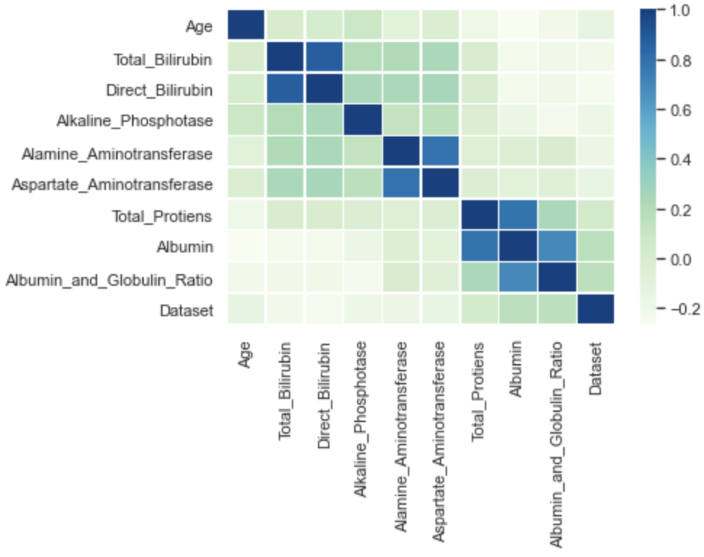
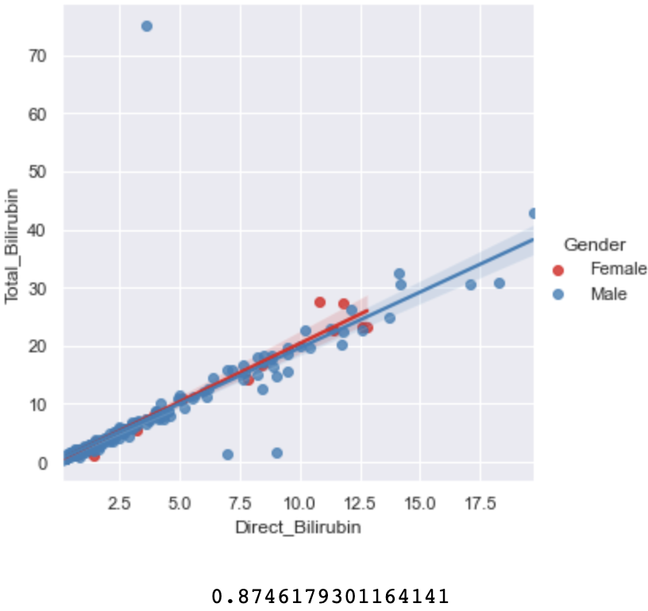
Recommendation 1:
Look carefully for underlying correlations between certain features
Healthcare practitioners may choose to administer certain tests and not others
This can help speed-up the diagnosis
Notes:
Identifying certain correlations streamlines the process and makes the job much easier for the healthcare provider
There were high correlations between total bilirubin vs. direct bilirubin, alamine aminotransferase vs. aspartate aminotransferase, total proteins vs. albumin, and albumin vs. albumin and globulin ratio
Total bilirubin vs. direct bilirubin = 0.87, alamine aminotransferase vs. aspartate aminotransferase = 0.79, total proteins vs. albumin – 0.78, and albumin vs. albumin and globulin ration = 0.69
This can aid practitioners during the process of choosing whether to administer certain tests or not, which can ultimately accelerate the diagnosing phase

Slide 6
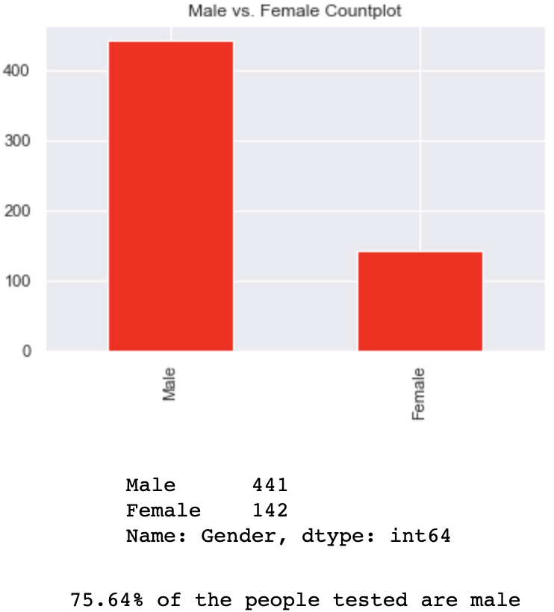
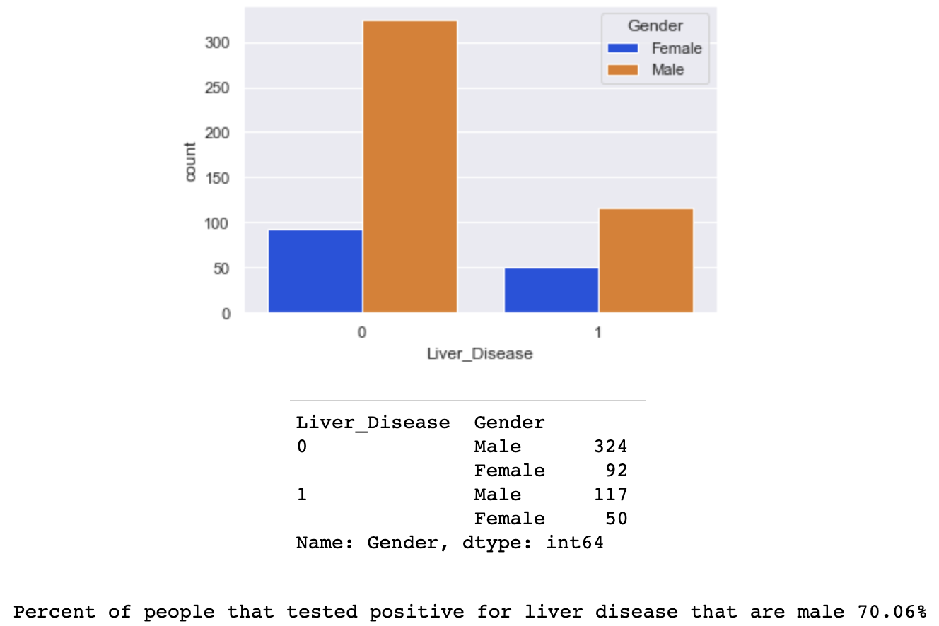
Recommendation 2:
Targeted preventive care for male patients
Create social awareness around liver disease
Identify demographics in jeopardy
Notes:
Males comprised most of the dataset by a vast amount. They made up 75.64% of the patients tested.
The disparity between genders is quite large
Males were significantly impacted by liver disease compared to females. They made up 70.06% of the patients that tested positive for the disease.
These types of discoveries can lead to targeted preventive care for male subjects when they come in for rudimentary check-ups or health issues
Healthcare facilities and various other organizations can take a step in addressing the issue-at-hand and make the public aware of the consequences that are associated with liver disease

Slide 7
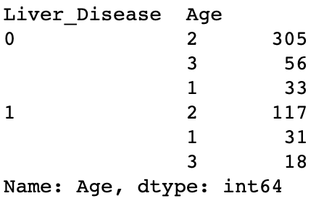
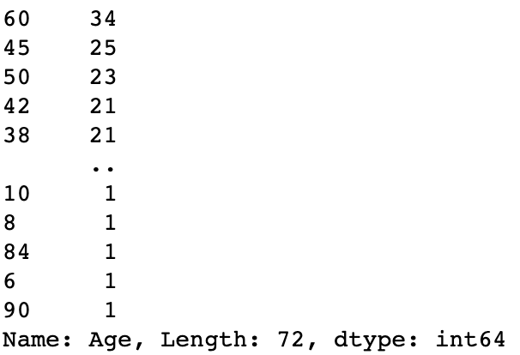
Recommendation 3:
Promote lifestyle change in the youth
Drive environment change
Chase away stigma and encourage check-ups
Notes:
Adults between the ages of 24-63 years old seem to be the most at danger. This group made up 70.48% of the patients testing positive.
This can be attributed to these adults being tested more often for liver disease than are young people and the elderly
Focus on testing the youth and improving their dietary intake, decreasing alcohol consumption, addressing pollution, decontaminating food, and eradicating drug use, we may arrive at a stage where we can prevent our youth from developing liver disease later in their lives
Healthcare practitioners need to encourage routine check-ups and visits to the doctor

Slide 8
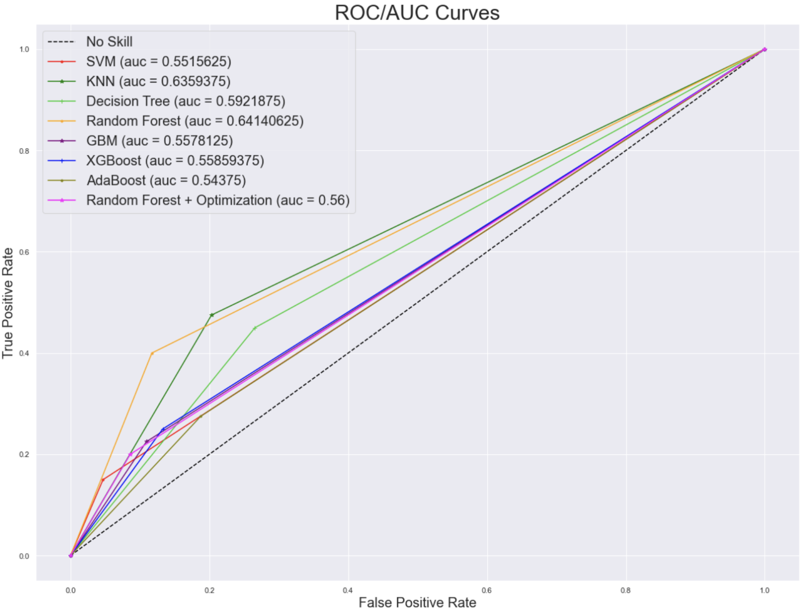
Random forest & random forest + randomsearchcv
Notes:
The default Random Forest classification algorithm proved to perform the best in terms of accuracy and AUC score compared to the rest of the models
It had an accuracy of about 0.77 and an AUC of about 0.64 on the test data
I then went ahead and performed a Random Forest + Optimization of hyperparameters and the metrics were worse with an accuracy of about 0.74 and an AUC of about 0.56
I would stick with the Random Forest model, adjust the hyperparameters some more, possibly even using GridSearchCV instead, and integrate some feature selection

Slide 9
Future work:
More research on data acquisition
Expand dataset with possible concatenation
Conduct feature selection
Notes:
For future work I would research more on the techniques used to acquire the data as it would shed more insight as to the validity of our findings
I would expand the dataset in order to train the model more efficiently, as increasing the number of observations usually elicits better results
I would also perform some feature selection to see whether that has any positive effect on the model metrics

Slide 10

Thank you
Notes:
- Thank you very much for your time

