Slide 1
TestNG

Slide 2
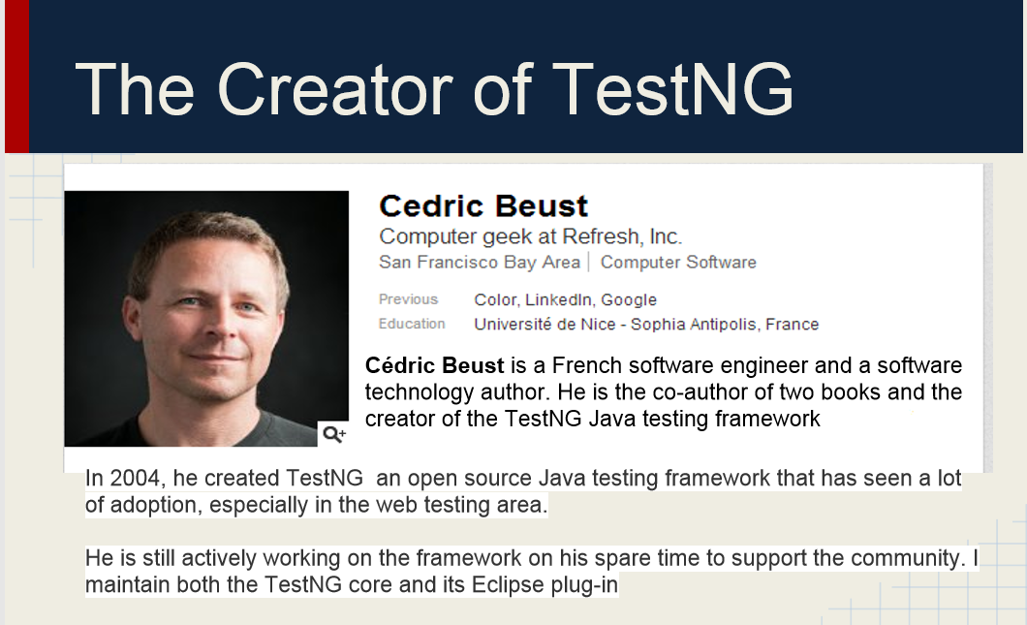

Slide 3
TestNG features
Annotations
Assertions
Groups
Data provider
Parallel execution
Test listener
Test reporting

Slide 4
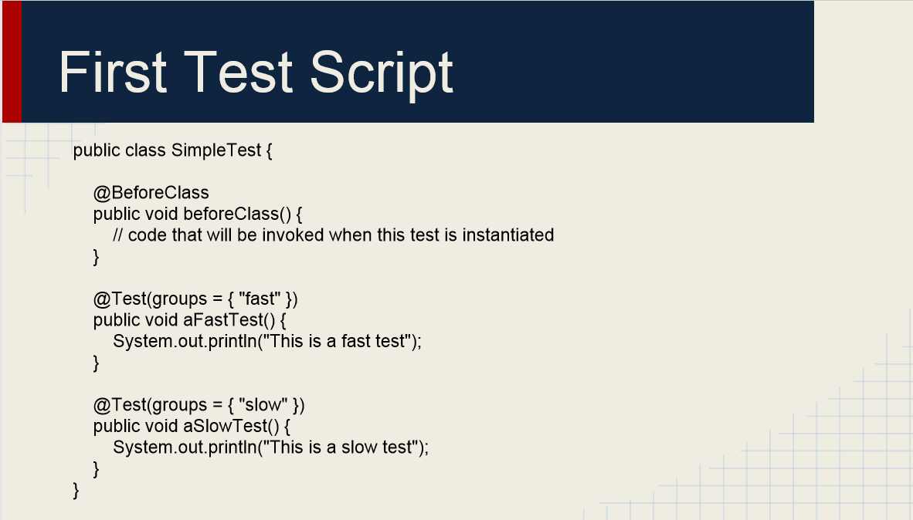

Slide 5
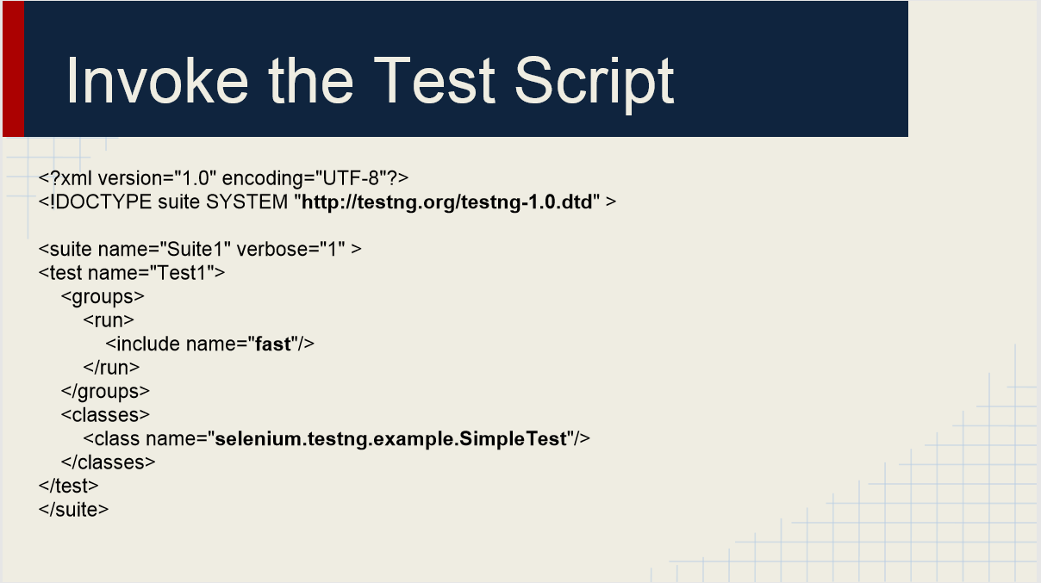

Slide 6
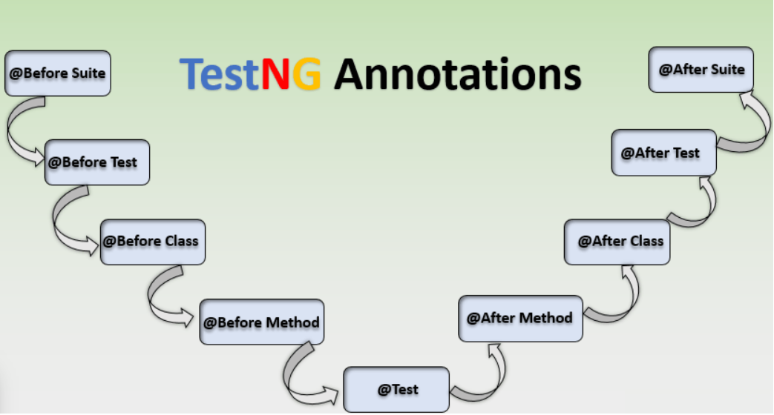

Slide 7
TestNG Assertions
assertTrue
assertFalse
assertEquals
assertNotEquals
assertNull
assertNotNull

Slide 8
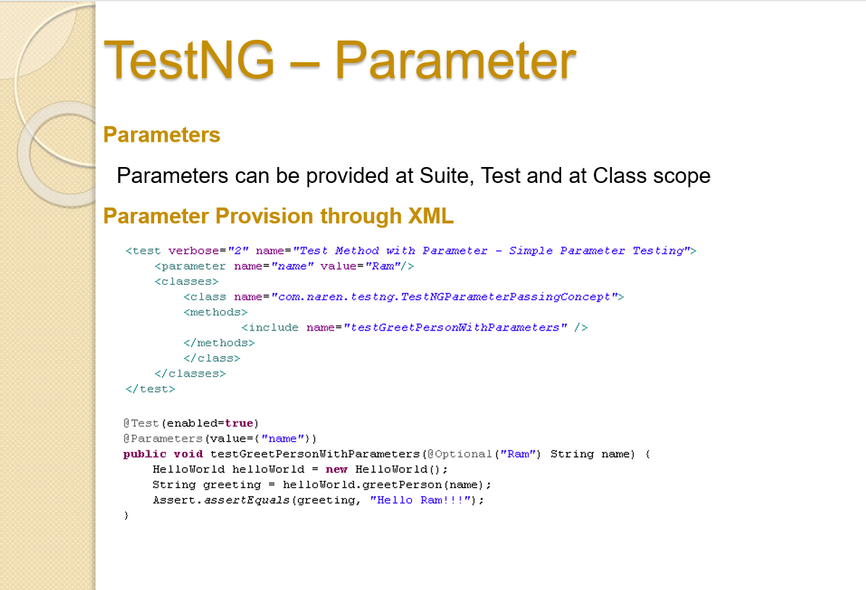

Slide 9
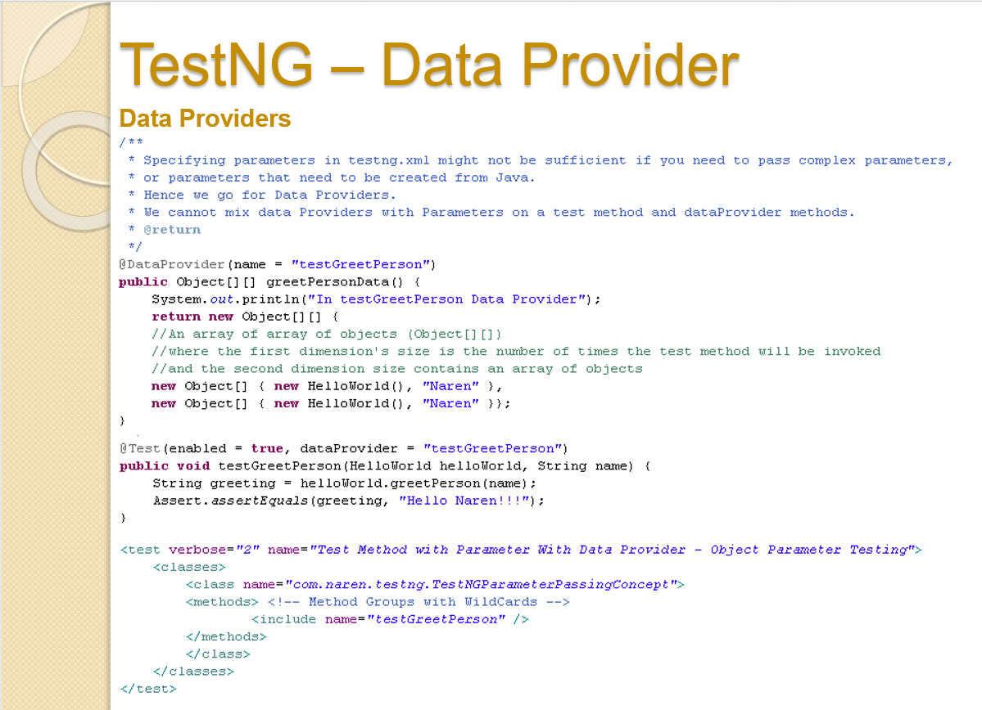

Slide 10
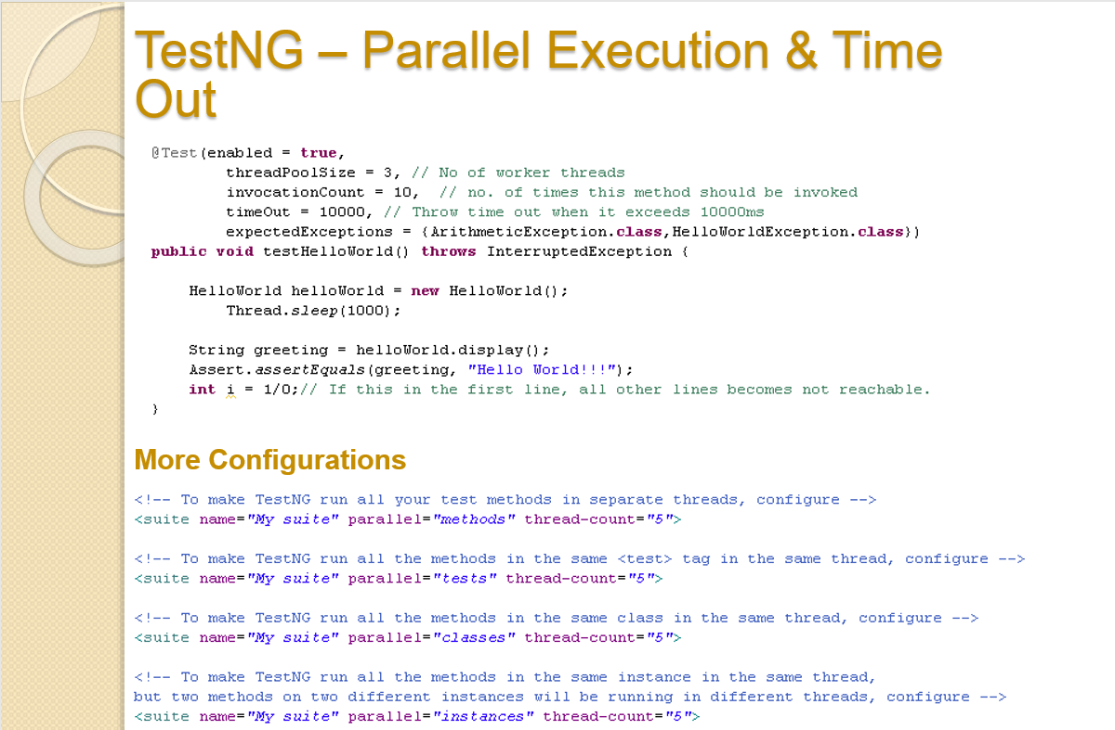

Slide 11
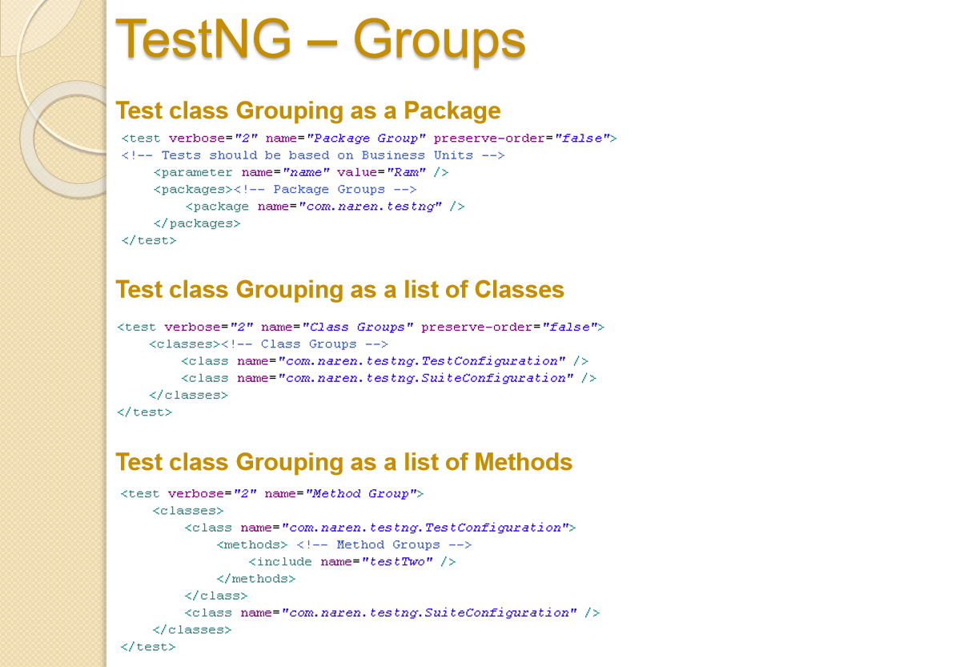

Slide 12
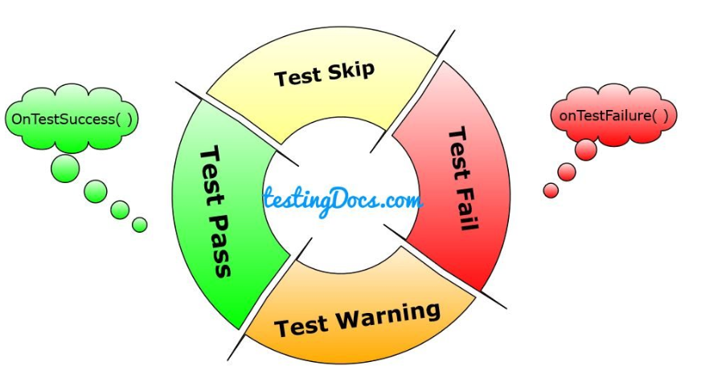
Test Listener

Slide 13
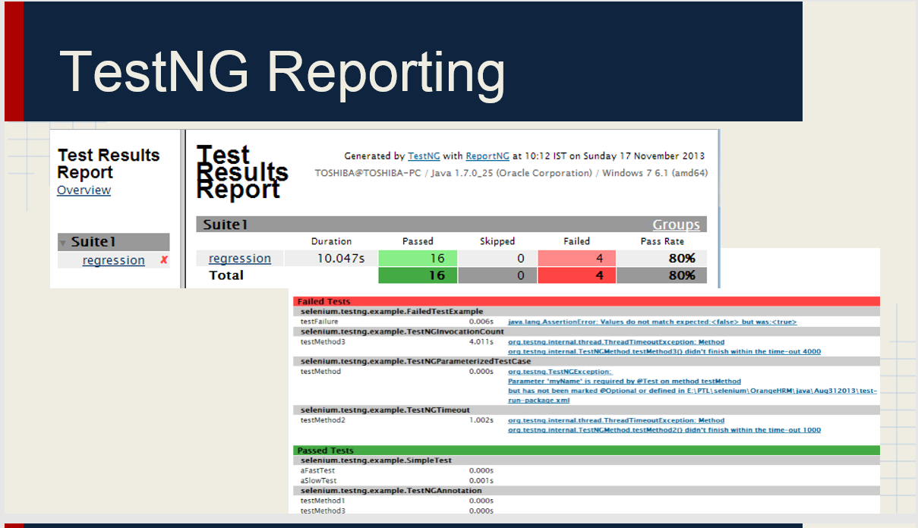

Slide 14
Important links
https://artoftesting.com/what-is-testng
https://artoftesting.com/testng-annotations
https://artoftesting.com/timeout-in-testng-selenium-webdriver-java
https://artoftesting.com/test-priority-in-testng-selenium-webdriver-java
https://artoftesting.com/run-selenium-test-in-parallel
https://artoftesting.com/soft-assertion-in-testng-selenium-webdriver-java
https://artoftesting.com/data-driven-framework-in-selenium-using-testng
https://artoftesting.com/rerun-failed-tests-in-testng-selenium-webdriver-java
https://github.com/skilledmonster/TestNG_Examples

