Slide 1
NBA DRAFT: Analyzing Criteria for Drafting Decisions Using Power BI Visualizations
BASHIR WARSAME

Slide 2
Investigating Data-Driven NBA Draft Strategies: Analyzing the Criteria Behind Team Selections. Leveraging recent NBA draft data, I developed a Power BI dashboard to visualize key factors influencing drafting decisions, shedding light on the disparities between first and second round picks

Slide 3
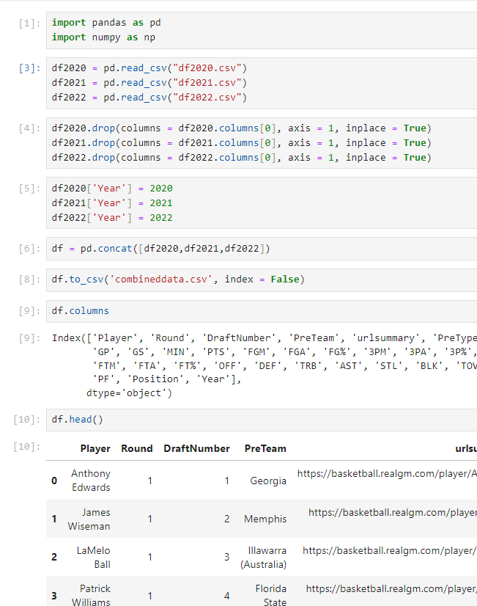
Importing data
Here I used draft data from three separate csv files and concatenated them into a single csv file in and dropped empty column and checked the new datasets schema.

Slide 4
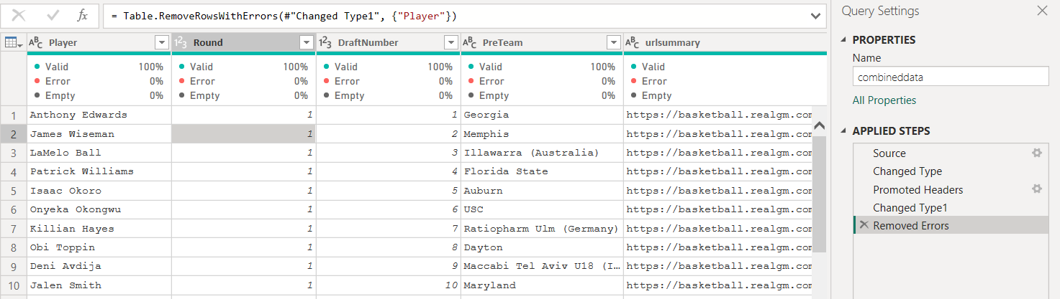
Due to the nature of sports data, it is already relatively clean therefore the amount of cleaning I did here was very little

Slide 5


Slide 10
Thank you For listening Any Questions?

