Slide 1


A Servo Controller for Brushed DC Motor
Presented by:
Bashir Tawfig Bashir Abugharsa (1181102921)
Supervisor:
Dr. Lo Yew Chiong
Moderator:
Dr. Cham Chin Leei

Slide 2

TABLE OF CONTENT
Background Overview
Scopes and Objectives
Problem Statement
Literature Review
Methodology
Result and Discussion
Timeline
Summary
Acknowledgement
References

Slide 3
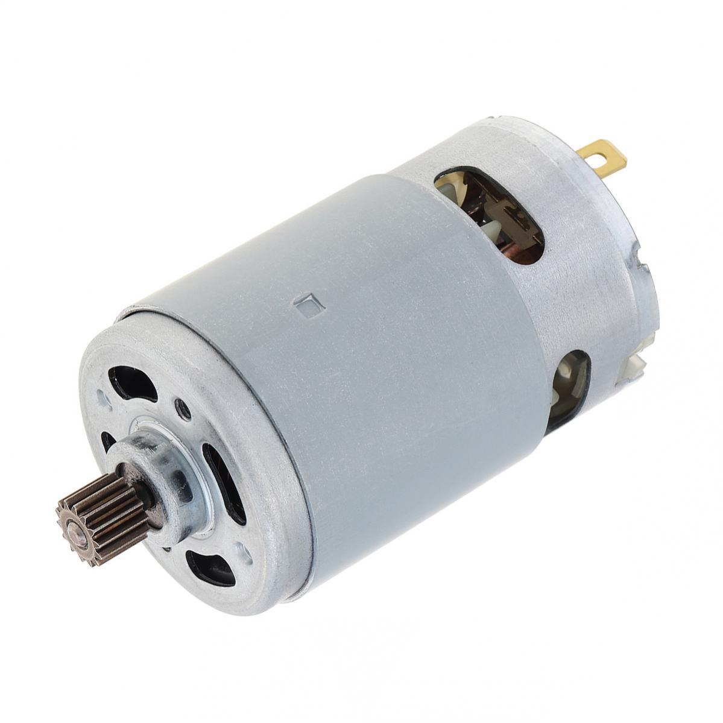
Background Overview
Brushed DC motors are integral in mechanical systems evolution due to their simple structure and cost-effectiveness.
They are favored for their DC power source compatibility, these motors are prevalent in mass-produced products.
However, advanced applications require precision that exceeds basic controller’s capabilities.
Servo Controller Solution Offers refined motor control via feedback mechanisms for precise, efficient operation.

Slide 4

Problem Statement
Precision Limitation: The basic mechanical design of Brushed DC motors hinders precise control using just standard driver circuits.
Control Challenges: Traditional circuits can't fine-tune speed and position accurately, failing in applications needing exact motion.
Performance Variables: External factors like load changes and power fluctuations affect motor performance, unaddressed by simple drivers.
Advanced Needs: High-precision tasks demand more than what basic control circuits provide, necessitating a sophisticated approach to motor control.

Slide 5
Project Scope
Goal: Develop a servo controller to upgrade the precision of Brushed DC motors in speed and positioning.
Driver Circuit Design: Create a PWM-controlled circuit via a microcontroller for effective power management.
PID Control System: Implement a PID closed-loop control integrated with the driver circuit for constant output regulation.
Dynamic Performance: Ensure the motor adheres to precise motion profiles, compensating for load changes and power inconsistencies.
Outcome: To achieve a higher standard of motor precision suitable for advanced, modern applications, enabling efficient and accurate operation under various conditions.

Slide 6
Objectives
Efficient Power Regulation: Design a driver circuit that minimizes energy waste and boosts motor performance.
User-Interactive Control: Implement a serial communication protocol for immediate, precise control adjustments.
Accurate Speed & Position Management: Develop a closed-loop system utilizing optical encoder feedback for precise motor handling.
Real-Time PID Control: Engineer a PID system for stable and accurate motor response.
Adaptive System Calibration: Establish a tuning methodology for optimal performance under diverse conditions and uses.

Slide 7
Literature Review

Slide 8
Methodology

Slide 9
Result and Discussion

Slide 10
Timeline

Slide 11
Summary

Slide 12
Acknowledgement

Slide 13
References

