Slide 1


A Servo Controller for Brushed DC Motor
Presented by:
Bashir Tawfig Bashir Abugharsa (1181102921)
Supervisor:
Dr. Lo Yew Chiong
Moderator:
Dr. Cham Chin Leei

Slide 2

TABLE OF CONTENT
Background Overview
Problem Statement
Project Scope
Project Objectives
Literature Review
Methodology
Future Implementation (FYP 2)
Result and Discussion
Project Timeline
Project Budget
Summary
References

Slide 3
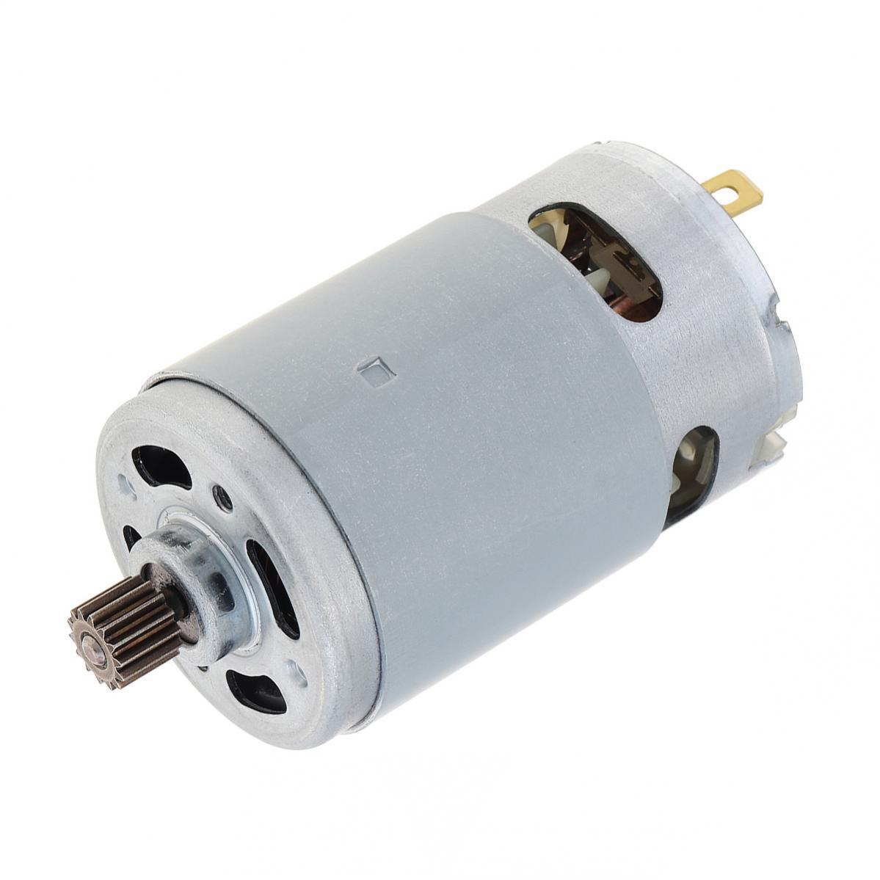
Background Overview
Brushed DC motors are integral in mechanical systems evolution due to their simple structure and cost-effectiveness.
They are favored for their DC power source. These motors are popular in mass-produced products.
However, advanced applications require precision that exceeds basic controller circuit capabilities.
Servo Controller Solution offers refined motor control via feedback mechanisms for precise operation.

Slide 4

Problem Statement
Precision Limitation: The basic mechanical design of Brushed DC motors hinders precise control using just standard driver circuits.
Performance Variables: External factors like load changes affect motor performance, which is unaddressed by simple drivers.

Slide 5
Project Scope
Goal: Develop a servo controller to improve the precision of brushed DC motors in speed and positioning.
Driver Circuit Design: Create a PWM-controlled circuit using a microcontroller for speed and direction control.
PID Control System: Implement a PID closed-loop control integrated with the driver circuit for more precise control.
Dynamic Performance: Ensure that the motor consistently follows precise movement while automatically adjusting for variations in load.

Slide 6
Project Objectives
User-Interactive Control: Implement a serial communication interface with servo controller.
Accurate Speed & Position Management: Develop a closed-loop system utilizing optical encoder feedback for precise motor handling.
Real-Time PID Control: Engineer a PID system for stable and accurate motor response.
Adaptive System: Establish a tuning methodology for optimal performance under diverse conditions and uses.

Slide 7
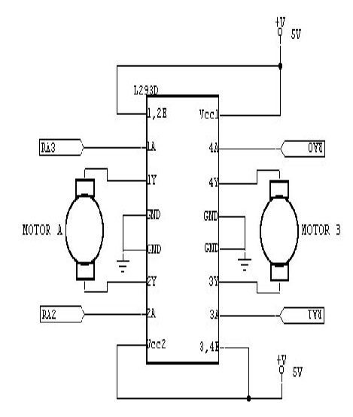
Literature Review
Motor Driver Circuit Design
Ayyanathan and Mariyammal[1] explore the use of Pulse Width Modulation (PWM) for controlling DC motor speed, employing an AT89S52 microcontroller and L293D IC. This method excels in providing precise speed and direction control over small DC motors in a cost-effective manner. However, the reliance on L293D IC limits its applicability to small motors, posing a challenge for more complex operational contexts.
Figure 1: Motor Driving IC

Slide 8
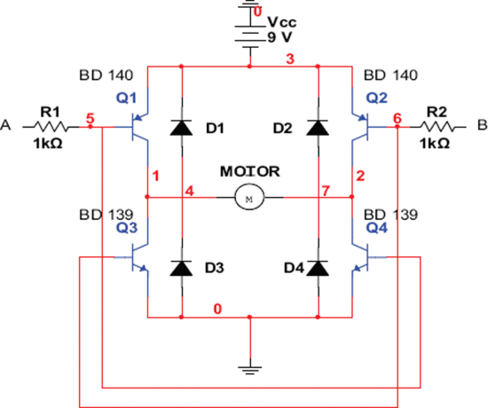
Literature Review
Motor Driver Circuit Design
V. Gupta [2] designed H-bridge motor driver circuit for wheeled mobile robots. The use of BJTs in this design provides a cost-effective solution, however, it falls short in terms of efficiency and power management compared to MOSFETs, which could affect its performance in more demanding robotic applications.
Figure 2:H- Bridge Motor Driver Circuit

Slide 9
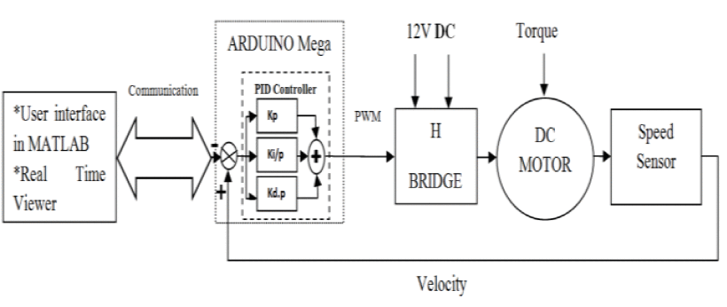
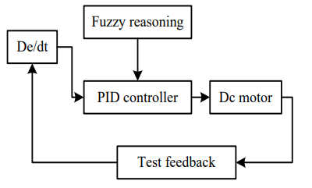
Literature Review
PID Controller Design
X. Zhang [3] used fuzzy logic with PID control to enhance the system’s adaptability and robustness. However, the use of fuzzy logic adds computational complexity.
Z. Adel, A. A. Hamou, and S. Abdellatif implemented a real-time PID control system on an Arduino Mega 2560, complemented by MATLAB for interface and real-time monitoring. However, their reliance on a speed sensor may limit the system's precision for applications demanding high accuracy.
Figure 3: A Closed-loop Motor Speed Control
Figure 4: A Closed-loop Motor Speed Control
Notes:
Fuzzy logic is a way to encode this experience - based knowledge in the form of logical rules.
Ziegler and Nichols tuning method
1. The Open-Loop Method (also known as the Process Reaction Curve Method)
This method involves the following steps:
Record the Process Reaction Curve:
Remove any existing controller from the loop, making the system open-loop.
Introduce a step change to the input and record the process output.
The response will typically show a delay time (L) before the output starts to change and a time constant (T) representing the time taken for the output to reach approximately 63.2% of its final steady-state value.
Calculate PID Parameters:
Based on the recorded L and T, calculate the PID parameters using the Ziegler-Nichols open-loop tuning formulas:
Kp = 1.2T / (K * L)
Ki = 2L
Kd = 0.5L
Where K is the process gain (the ratio of the change in output to the change in input).
2. The Closed-Loop Method (also known as the Ultimate Sensitivity Method)
This method is used when the process reaction curve method is not suitable, and it involves the following steps:
Set Up the System in Closed-Loop:
Set the integral and derivative gains to zero and gradually increase the proportional gain until the system starts to oscillate steadily. This is known as the ultimate gain (Ku).
Measure the Ultimate Period (Pu):
Record the period of oscillation (Pu), which is the time for one complete cycle of oscillation.
Calculate PID Parameters:
Based on Ku and Pu, calculate the PID parameters using the Ziegler-Nichols closed-loop tuning formulas:
Kp = 0.6 * Ku
Ki = 2 * Kp / Pu
Kd = Kp * Pu / 8

Slide 10
Methodology
Brushed DC Motor Driver Circuit
Microcontroller Firmware
Main Components
Tools

Slide 11
Methodology
Brushed DC Motor Driver Circuit
H-Bridge Configuration: Utilizes four power MOSFETs to form the brushed DC motor driver circuit.
Motor Control: H-Bridge circuit controls motor direction and speed via a PWM signal.
PWM Generation: A microcontroller is used for generating the PWM signal required for motor control.
Gate Driver IC: Manages the operation of MOSFETs.

Slide 12
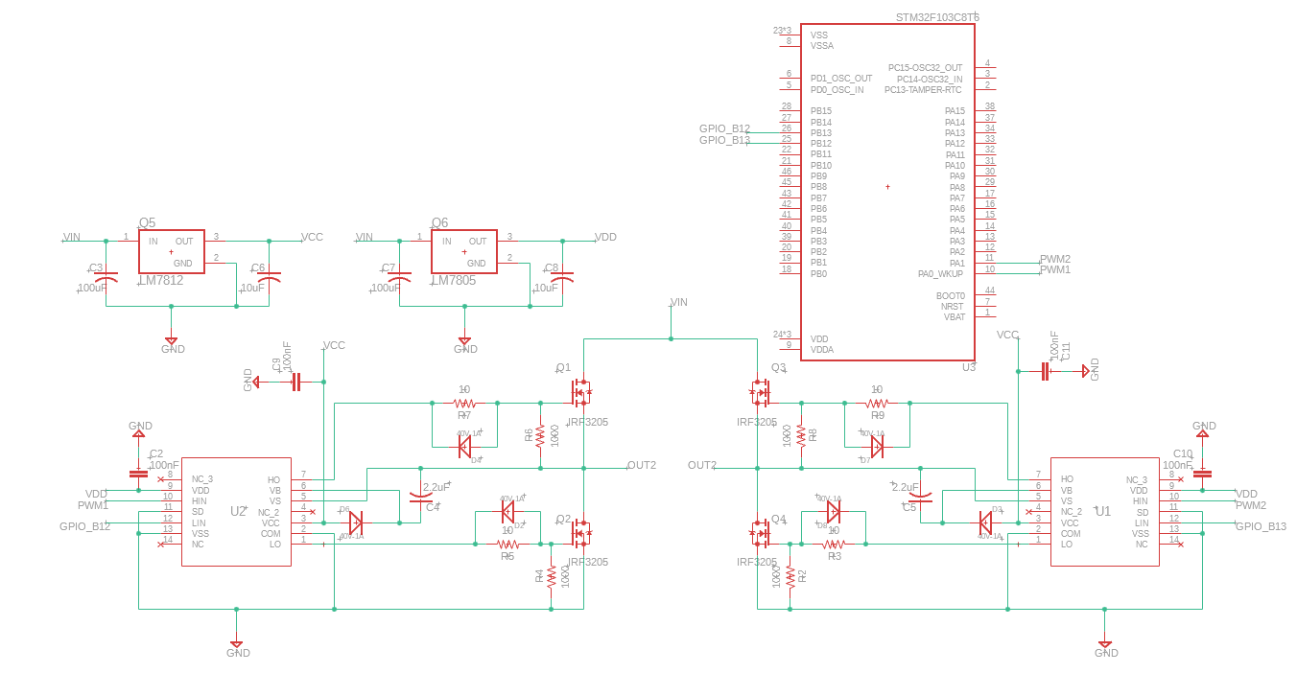
Methodology
Brushed DC Motor Driver Circuit

Slide 13
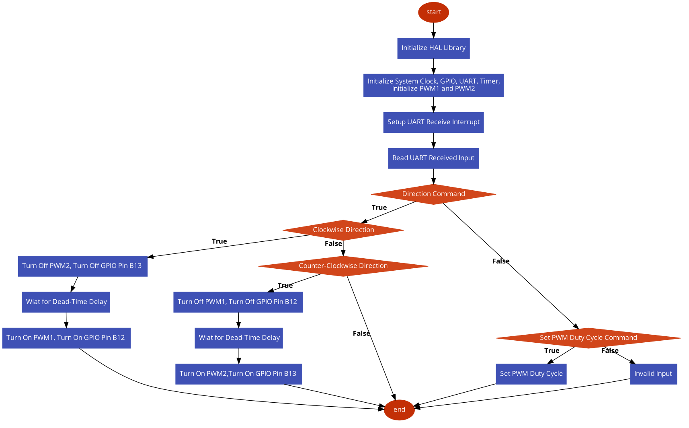
Methodology
Microcontroller Firmware

Slide 14
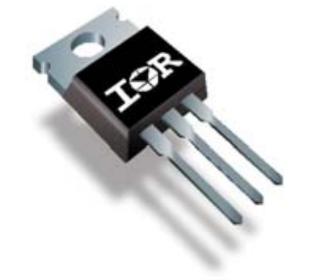
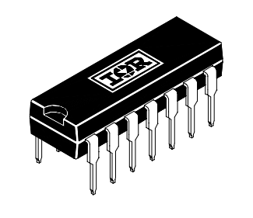
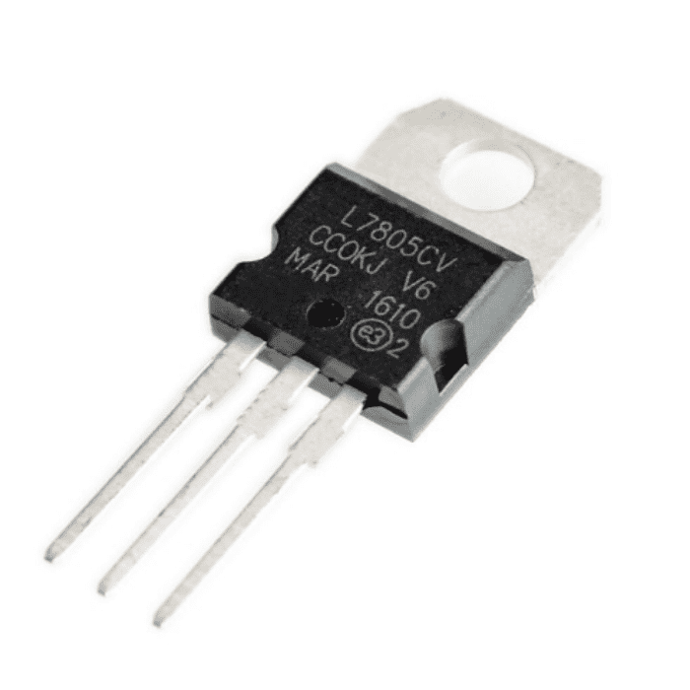
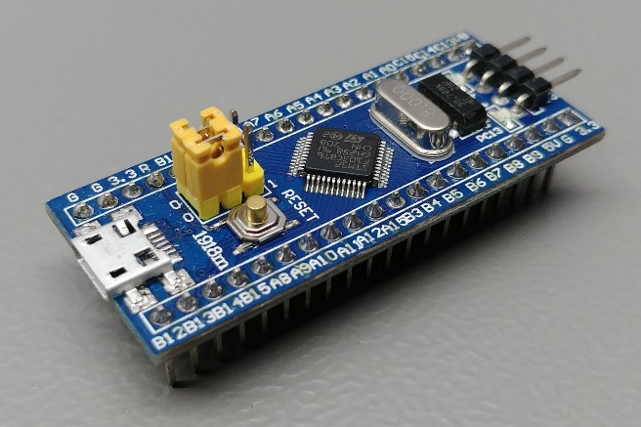
Methodology
Main Components
IRF3205 N-channel MOSFET
IR2110 MOSFET Gate Driver:
LM7805 & LM7812 Fixed Voltage Regulator
STM32f103 Microcontroller

Slide 15

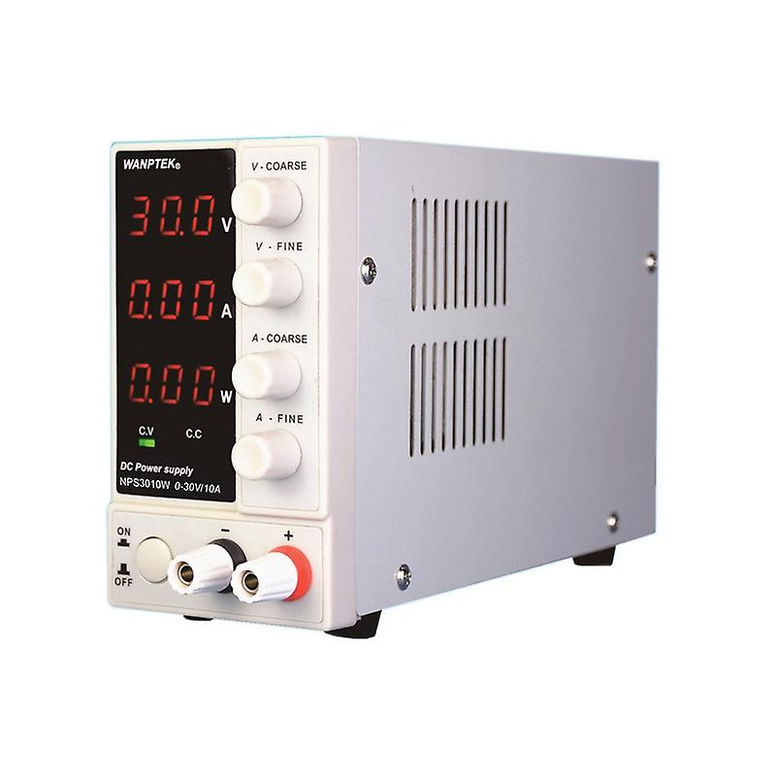
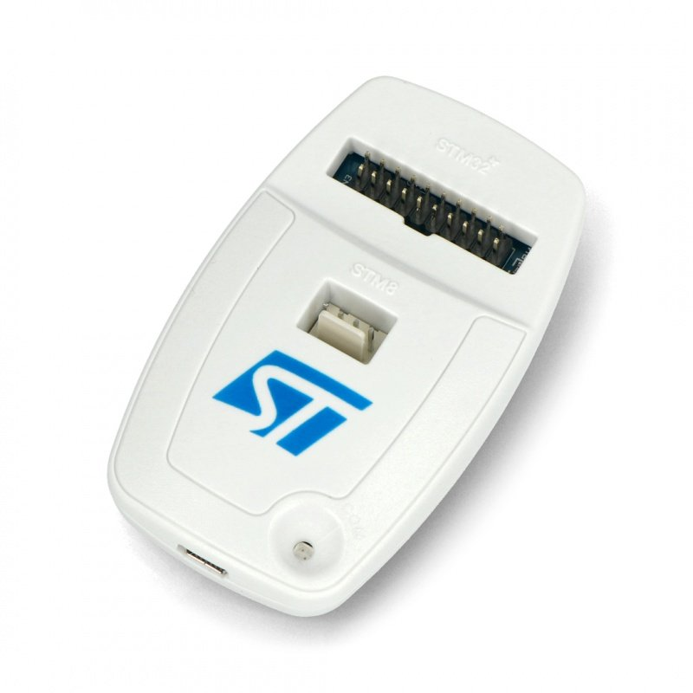
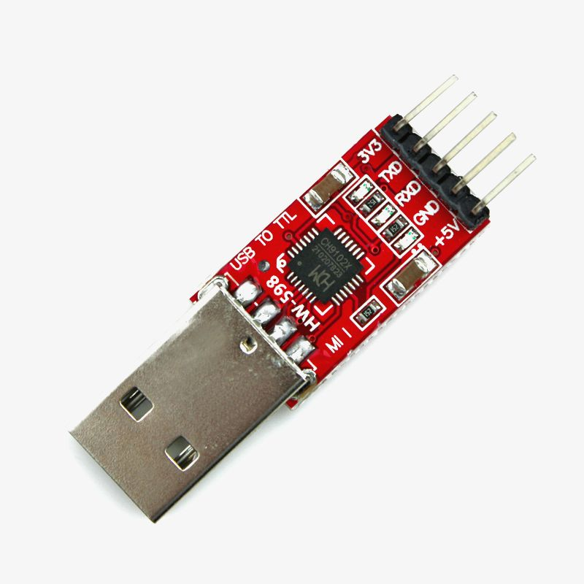
Methodology
Hardware Tools
Hantek Oscilloscope / Multimeter
Adjustable DC Power Supply
ST-Link Programmer
USB to TTL Adapter

Slide 16



Methodology
Software Tools
STM32CubeIDE
Arduino IDE Serial Monitor
Autodesk Fusion 360

Slide 17
Future Implementation (FYP 2)
Develop a real-time PID control system.
Use Optical Encoder as feedback loop.
Precisely adjust the PID controller for optimal speed and position accuracy.
Design a PCB for the motor driver circuit.
1
2
3
4

Slide 18
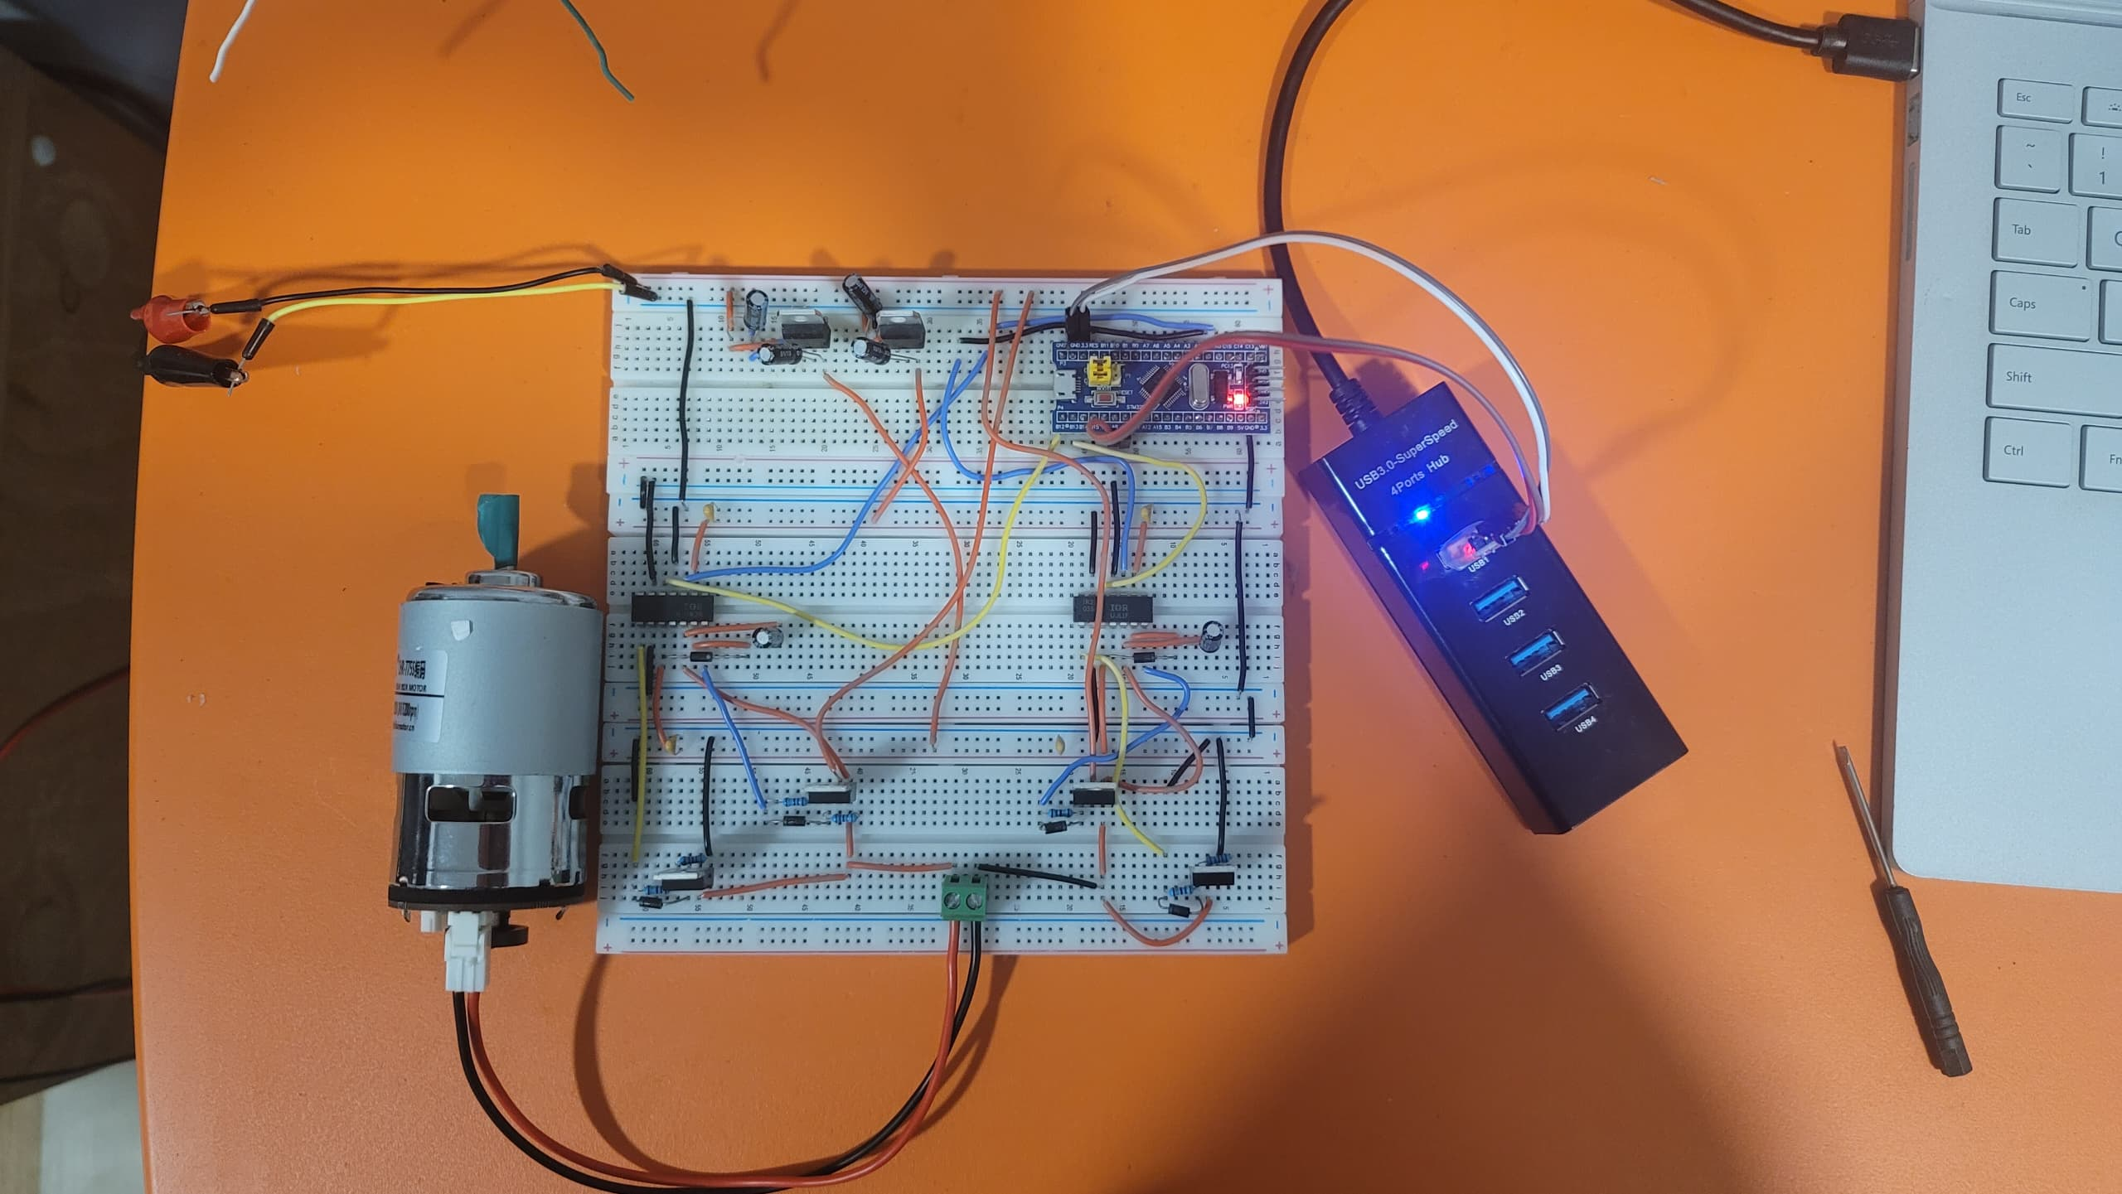
Result and Discussion
Brushed DC Motor Driver Circuit

Slide 19
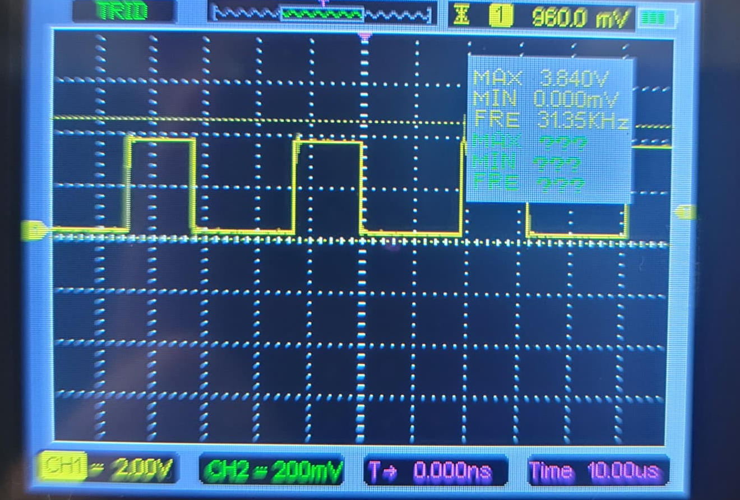
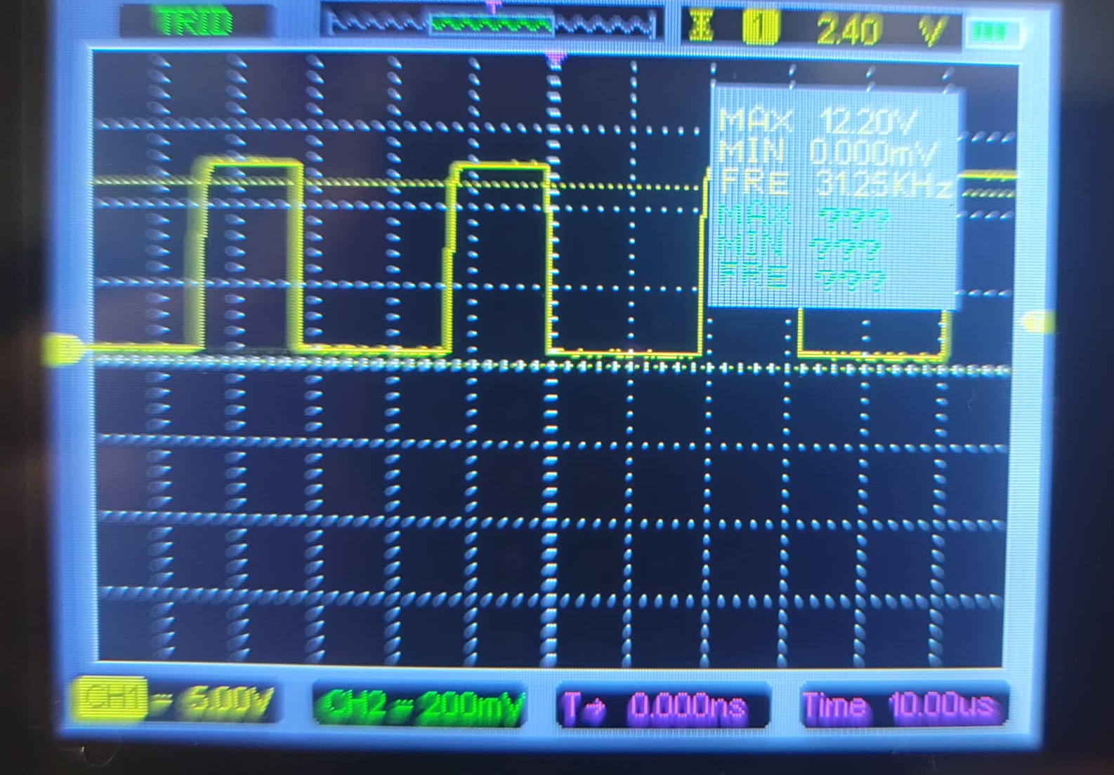
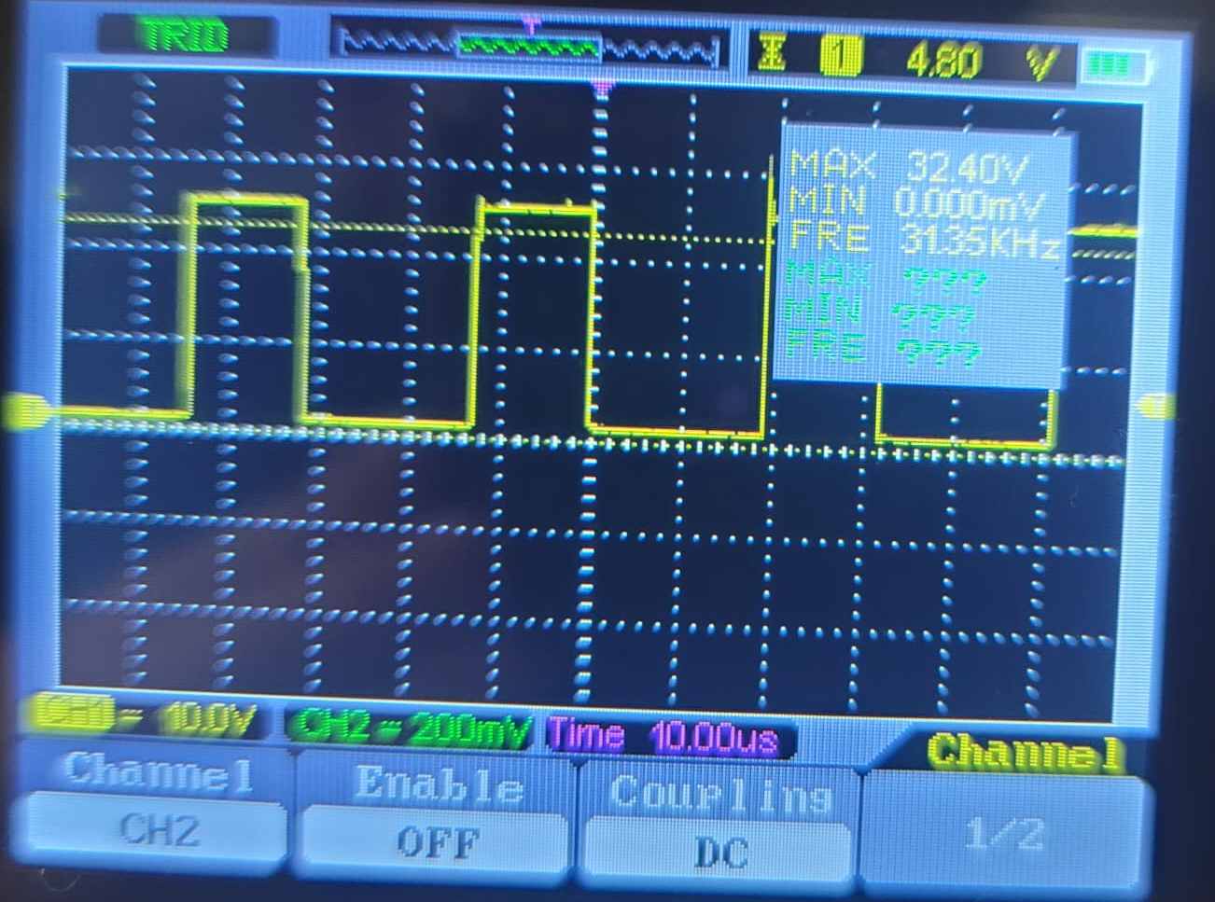
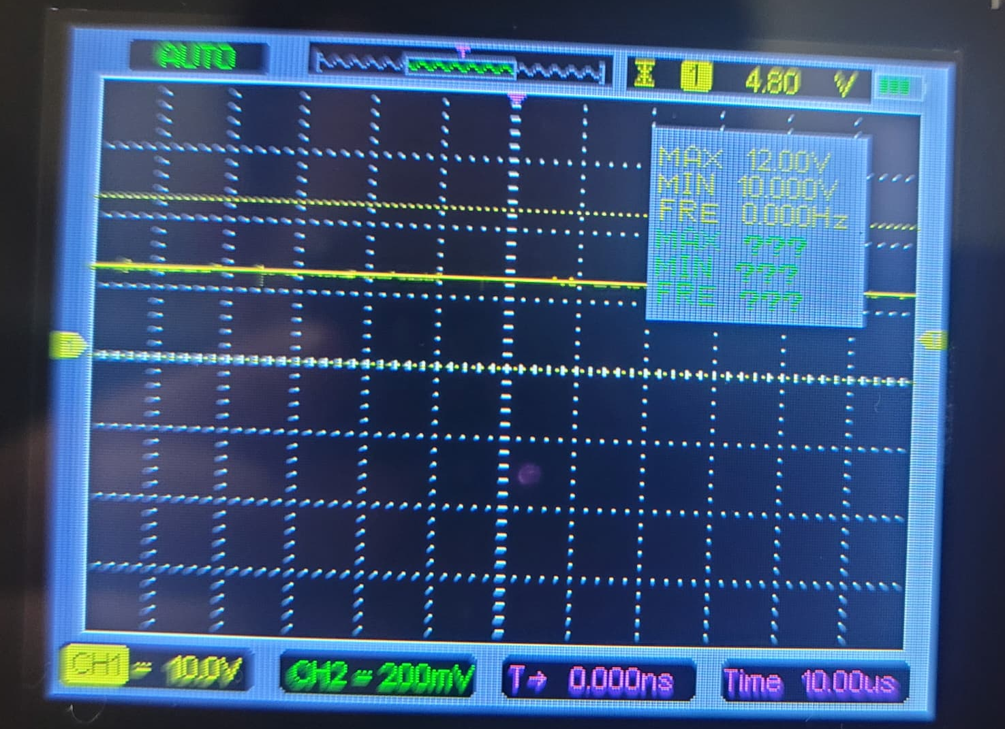
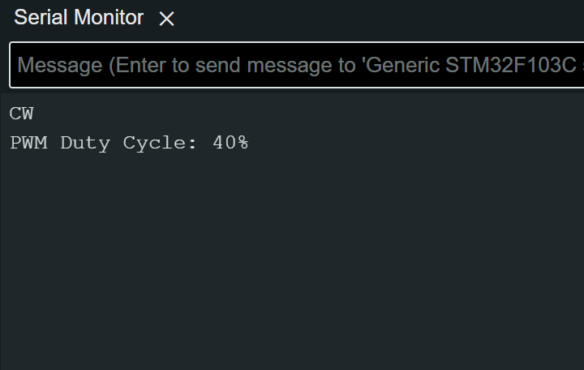
Result and Discussion
Motor at 40% PWM Duty Cycle
Microcontroller
High Side MOSFET VGS
Brushed DC Motor
Low Side MOSFET VGS
Serial Monitor

Slide 20
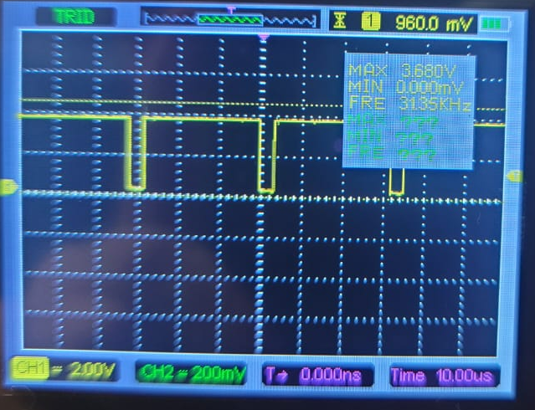
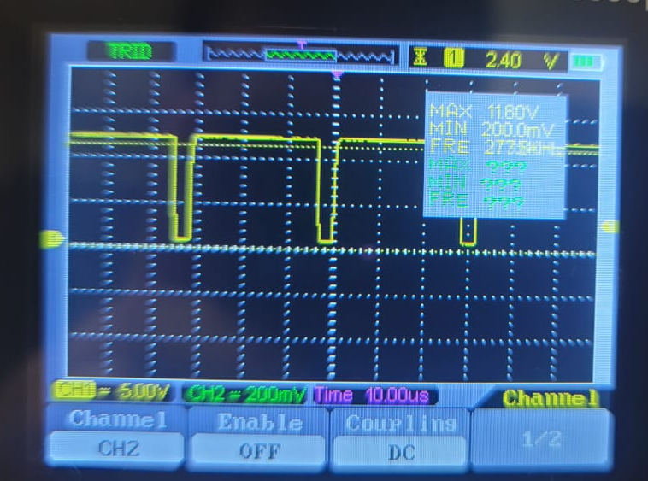
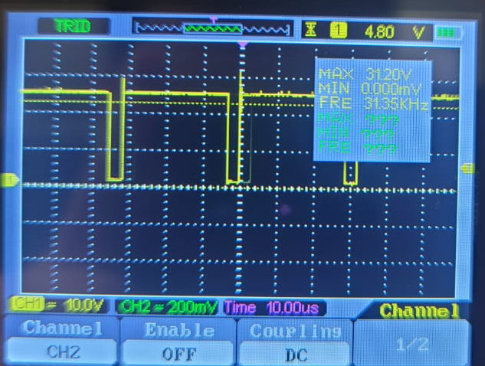
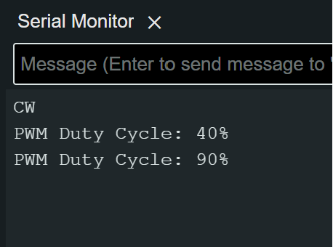
Result and Discussion
Motor at 90% PWM Duty Cycle
Microcontroller
High Side MOSFET VGS
Brushed DC Motor
Low Side MOSFET VGS
Serial Monitor

Slide 21
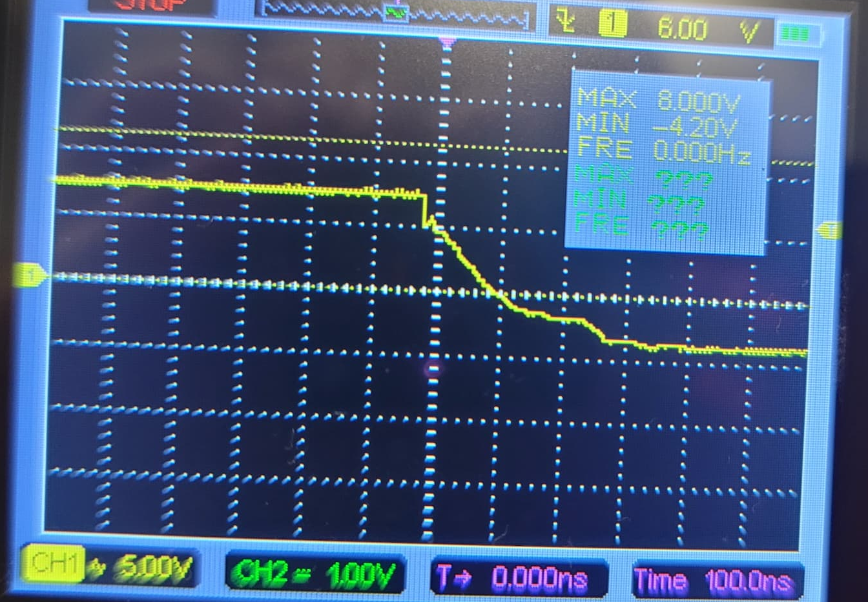
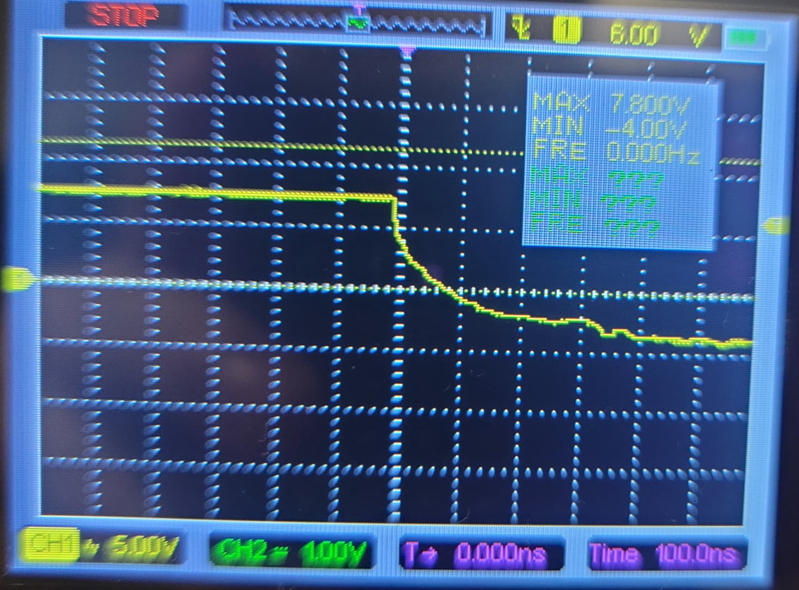
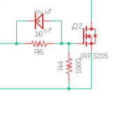
Result and Discussion
Gate Discharge Time with Diode
MOSFET Gate Discharge Time Diode
From the oscilloscope readings, it's evident that incorporating a diode at the MOSFET gate impacts the gate discharge time. With the diode in place, the gate discharges in about 300ns. Conversely, removing the diode results in a longer discharge time of 400ns. Therefore, the inclusion of a diode at the MOSFET gate contributes to a slight improvement in the gate's discharge efficiency.
Gate Discharge Time without Diode
Notes:
the resistor at the gate is there to prevent too much current from flowing into the gate during startup,
this helps prevent "ringing" at moderate to high switching frequencies (the resistor is not needed at low frequencies)
and also makes things easier for the driver.
Gate Resistor (Rg):
Controls Switching Speed: The gate resistor, in conjunction with the gate capacitance, forms an RC time constant that influences the MOSFET's switching speed. A carefully chosen resistor value can prevent the MOSFET from switching too fast, reducing Electromagnetic Interference (EMI) and voltage spikes that can occur due to parasitic inductances in the circuit.
Damps Oscillations: The resistor helps to damp any oscillations caused by the inductive and capacitive elements in the circuit, providing a more stable switching behavior.
Prevents Current Spikes: When the MOSFET is turned on, the gate capacitor needs to be charged quickly. The gate resistor limits the current spike into the gate, protecting the driving circuit (like a microcontroller or a driver IC) from sourcing or sinking excessive current.
Gate-to-Source Diode (Dgs):
Fast Turn-Off: In some high-speed switching applications, turning off the MOSFET as quickly as possible is crucial to prevent overheating and ensure efficient operation. A diode (often a Schottky diode due to its low forward voltage and fast recovery time) placed in parallel with the gate resistor (but in reverse bias concerning the gate-source voltage) can provide a path for the gate charge to be rapidly removed when the MOSFET is being turned off.
Protection Against Negative Voltage: The diode also protects the gate by preventing negative voltage from appearing at the gate, which could potentially damage the MOSFET. MOSFET gates are sensitive to voltage, and most MOSFETs have a maximum gate-source voltage rating (Vgs max), beyond which the gate oxide layer can be damaged.

Slide 22

Project Timeline

Slide 23
Project Budget
Part Name | Quantity | Unit Cost (RM)
LM7805 Voltage Regulator | 1 | 0.80
LM7812 Voltage Regulator | 1 | 0.80
IR2110 MOSFET Gate Driver | 2 | 3.59
IRF3205 Power MOSFET | 4 | 3.50
STM32F103C8T6 Blue Pill Board | 1 | 16.90
Metal Film Resistors | 8 | 0.10
1N5819 Diode | 6 | 0.20
2.2uF 50V Capacitor | 2 | 0.10
10uF 50V Capacitor | 2 | 0.10
100uF 25V Capacitor | 2 | 0.10
100nF Ceramic Capacitor | 4 | 0.10
Breadboard | 3 | 3.60
Total |  | 53.48

Slide 24
Summary
In conclusion, the project effectively developed a driver circuit for Brushed DC motors, allowing speed and direction control with PWM signal using microcontroller. Notably, the PID control aspect is planned for FYP part 2, promising to further refine motor operation. Future directions involve enhancing real-time control mechanisms, advancing the motor driver circuit design, and integrating optical encoder feedback for superior precision and performance.

Slide 25
Thank You

Slide 26
References
[1] Ayyanathan, Mariyammal. "DC Motor Speed Control Using PWM." 2018, vol. 3, pp. 2456-2165. [Online]. Available: https://www.researchgate.net/publication/338116979_DC_Motor_Speed_Control_Using_PWM
[2] V. Gupta, "Working and analysis of the H - bridge motor driver circuit designed for wheeled mobile robots," 2010 2nd International Conference on Advanced Computer Control, Shenyang, China, 2010, pp. 441-444, [Online]. Available: https://ieeexplore.ieee.org/document/5486818
[3] X. Zhang, "Design and implementation of fuzzy PID DC motor control system based on STM32," in 2023 IEEE International Conference on Control, Electronics and Computer Technology (ICCECT), Jilin, China, 2023, pp. 1129-1131, [Online]. Available: https://ieeexplore.ieee.org/document/10141000
[4] Z. Adel, A. A. Hamou and S. Abdellatif, "Design of Real-time PID tracking controller using Arduino Mega 2560for a permanent magnet DC motor under real disturbances," 2018 International Conference on Electrical Sciences and Technologies in Maghreb (CISTEM), Algiers, Algeria, 2018, pp. 1-5, [Online]. Available: https://ieeexplore.ieee.org/document/8613560

