Slide 1


A Servo Controller for Brushed DC Motor
Presented by:
Bashir Tawfig Bashir Abugharsa (1181102921)
Supervisor:
Dr. Lo Yew Chiong
Moderator:
Dr. Cham Chin Leei

Slide 2

TABLE OF CONTENT
Background Overview
Problem Statement
Project Scope
Project Objectives
Literature Review
Methodology
Future Implementation (FYP 2)
Result and Discussion
Project Timeline
Project Budget
Summary
References

Slide 3
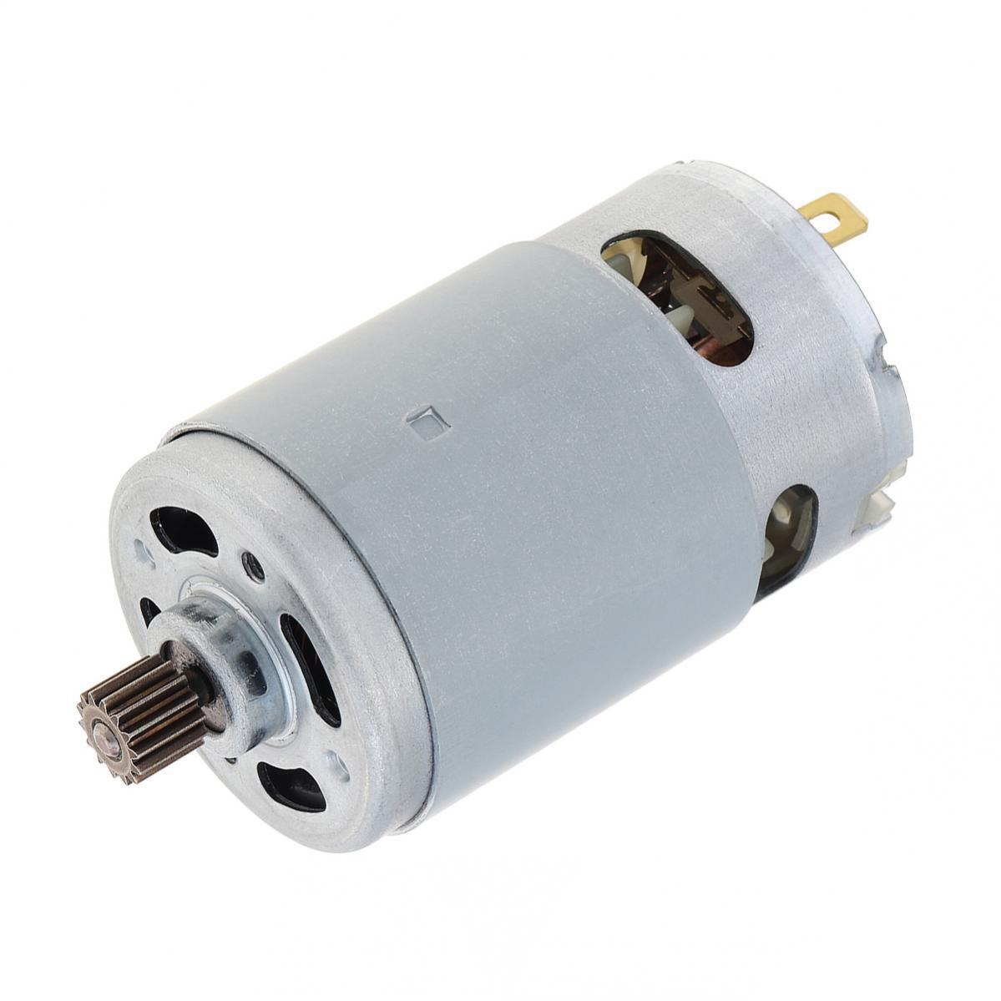
Background Overview
Brushed DC motors are integral in mechanical systems evolution due to their simple structure and cost-effectiveness.
They are favored for their DC power source. These motors are popular in mass-produced products.
However, advanced applications require precision that exceeds basic controller’s capabilities.
Servo Controller Solution Offers refined motor control via feedback mechanisms for precise operation.

Slide 4

Problem Statement
Precision Limitation: The basic mechanical design of Brushed DC motors hinders precise control using just standard driver circuits.
Control Challenges: Traditional circuits cannot fine-tune speed and position accurately, failing in applications needing exact motion.
Performance Variables: External factors like load changes affect motor performance, which is unaddressed by simple drivers.
Advanced Needs: High-precision tasks demand more than what basic control circuits provide, requiring a more advanced approach to motor control.

Slide 5
Project Scope
Goal: Develop a servo controller to improve the precision of Brushed DC motors in speed and positioning.
Driver Circuit Design: Create a PWM-controlled circuit using a microcontroller for speed control.
PID Control System: Implement a PID closed-loop control integrated with the driver circuit for more precise control.
Dynamic Performance: Ensure that the motor consistently follows precise movement while automatically adjusting for variations in load.
Outcome: To achieve a higher standard of motor precision suitable for advanced, modern applications, enabling efficient and accurate operation under various conditions.

Slide 6
Project Objectives
User-Interactive Control: Implement a serial communication protocol for immediate, precise control adjustments.
Accurate Speed & Position Management: Develop a closed-loop system utilizing optical encoder feedback for precise motor handling.
Real-Time PID Control: Engineer a PID system for stable and accurate motor response.
Adaptive System Calibration: Establish a tuning methodology for optimal performance under diverse conditions and uses.

Slide 7
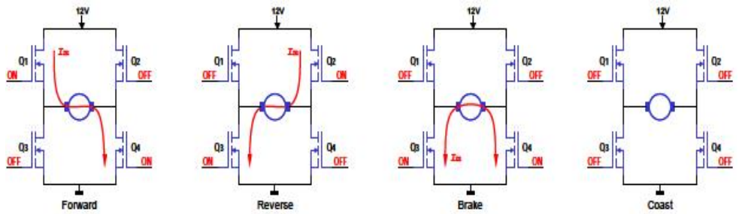
Literature Review
Motor Driver Circuit Design
Ayyanathan and Mariyammal[1] explore the use of Pulse Width Modulation (PWM) for controlling DC motor speed, employing an AT89S52 microcontroller and L293D IC. This method excels in providing precise control over small DC motors in a cost-effective manner. However, the reliance on L293D IC limits its applicability to small motors, posing a challenge for more complex operational contexts.
Figure 1: Bi-directional Rotation Using a Full-Bridge

Slide 8
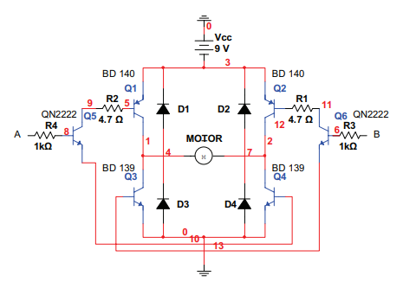
Literature Review
Motor Driver Circuit Design
V. Gupta [2] designed H-bridge motor driver circuit for wheeled mobile robots. The use of BJTs in this design provides a cost-effective solution, but it falls short in terms of efficiency and power management compared to MOSFETs, which could affect its performance in more demanding robotic applications.
Figure 2:H- Bridge Motor Driver Circuit

Slide 9
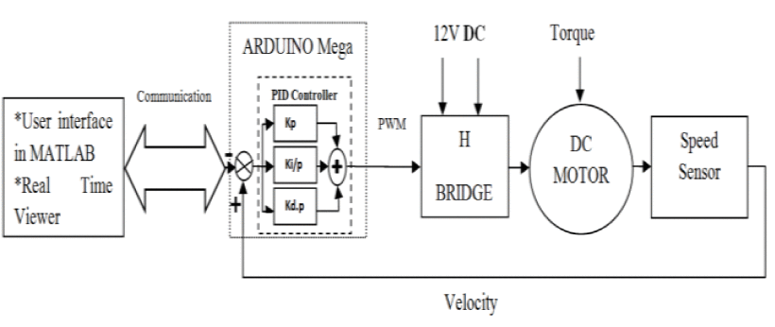
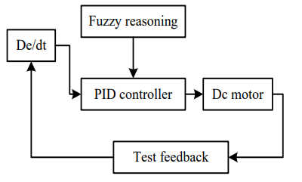
Literature Review
PID Controller Design
X. Zhang [3] used fuzzy logic with PID control to enhance the system’s adaptability and robustness. However, the use of fuzzy logic adds computational complexity.
Z. Adel, A. A. Hamou, and S. Abdellatif implemented a real-time PID control system on an Arduino Mega 2560, complemented by MATLAB for interface and real-time monitoring. However, their reliance on a speed sensor may limit the system's precision for applications demanding high accuracy.
Figure 3: A Closed-loop PMDC Motor Speed Control Scheme Based on PID Controller
Figure 4: H- Bridge Motor Driver Circuit

Slide 10
Methodology
Brushed DC Motor Driver Circuit
Microcontroller Firmware
Main Components
Tools

Slide 11
Methodology
Brushed DC Motor Driver Circuit
H-Bridge Configuration: Utilizes four power MOSFETs to form the brushed DC motor driver circuit.
Motor Control: H-Bridge circuit controls motor direction and speed via a PWM signal.
PWM Generation: A microcontroller is used for generating the PWM signal required for motor control.
Gate Driver IC: Manages the operation of MOSFETs.

Slide 12
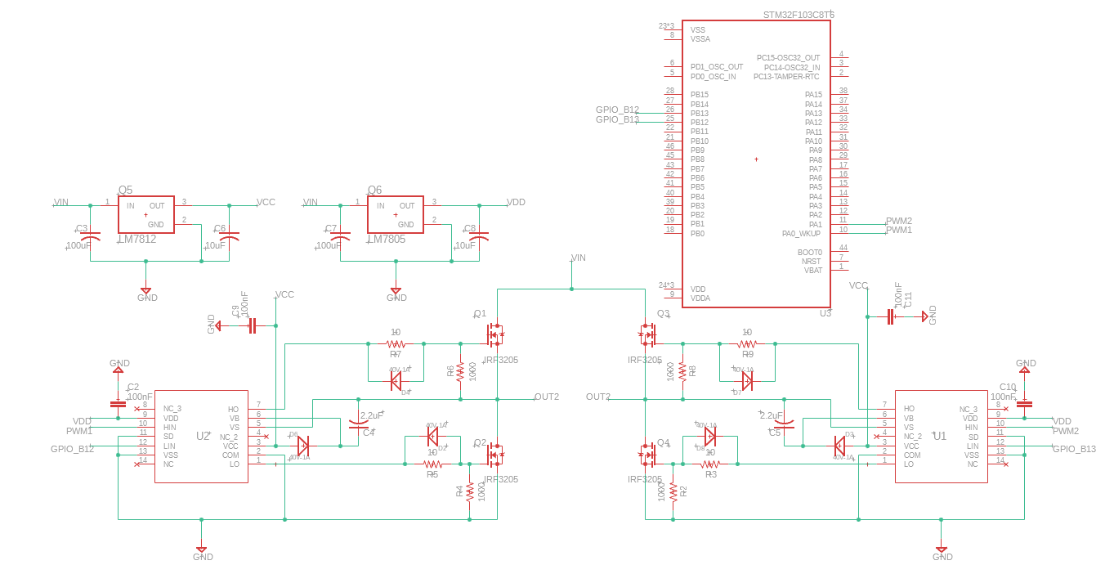
Methodology
Brushed DC Motor Driver Circuit

Slide 13
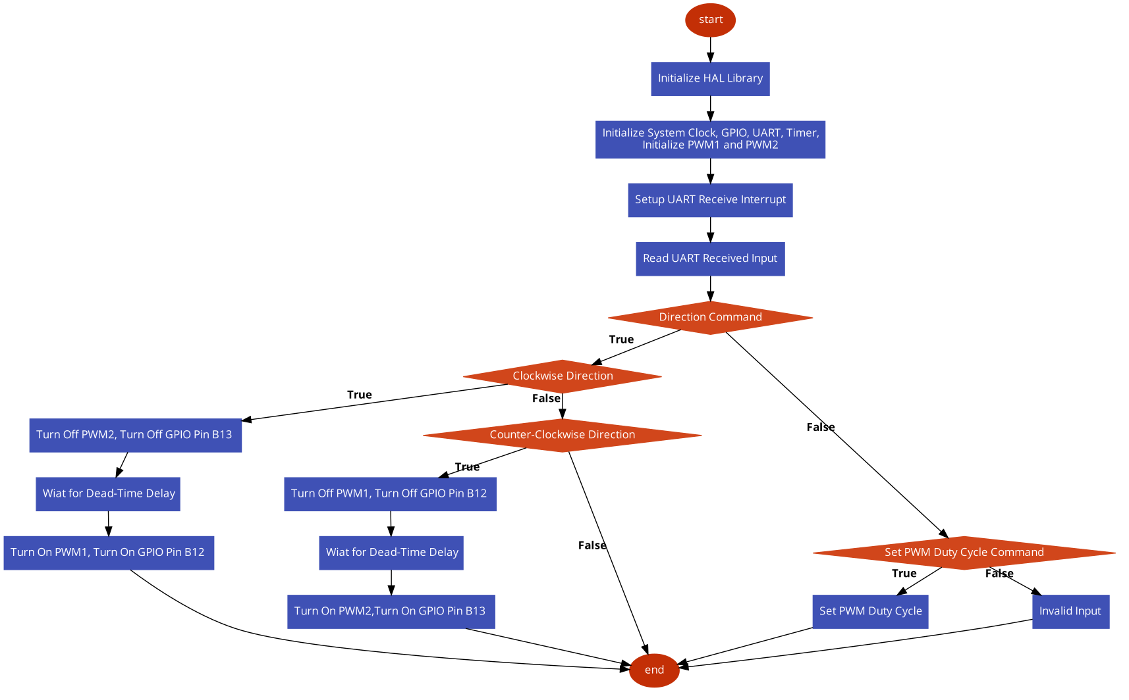
Methodology
Microcontroller Firmware

Slide 14
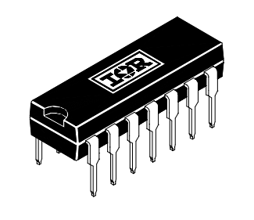
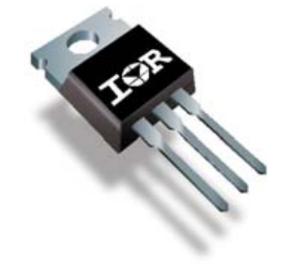
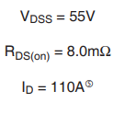
Methodology
Main Components
IRF3205 N-channel MOSFET
IR2110 MOSFET Gate Driver:
VOFFSET: 500V max.
IO+/- 2A / 2A.
VOUT 10 - 20V.
ton/off (typ.) 120 & 94 ns.

Slide 15
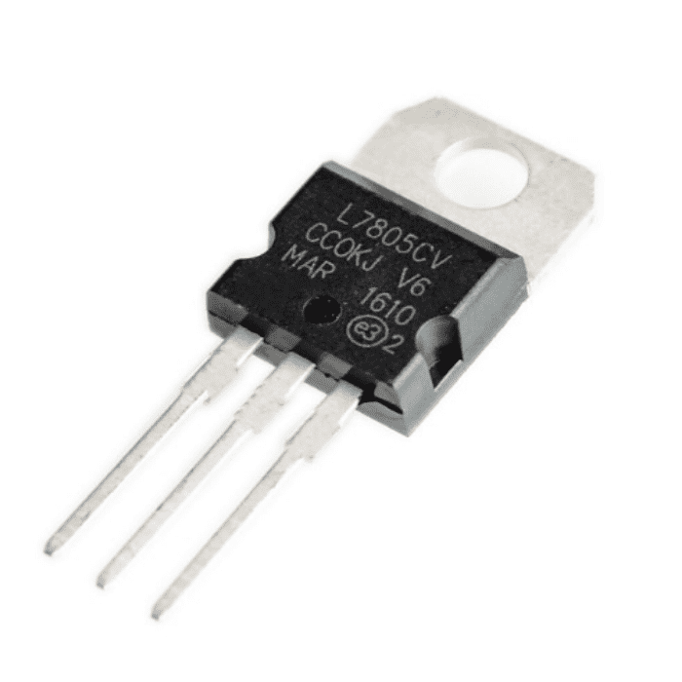
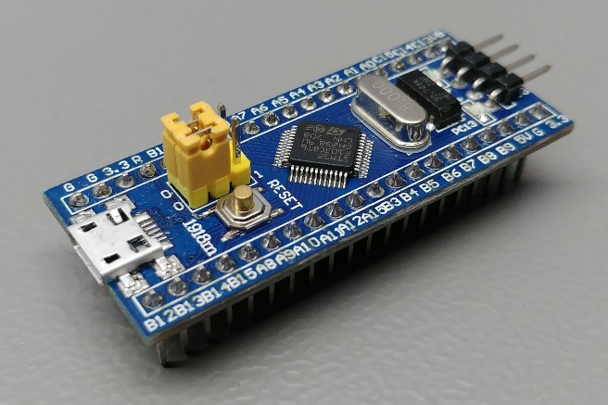
Methodology
Main Components
LM7805 & LM7812 Voltage Regulator
STM32f103 Microcontroller

Slide 16
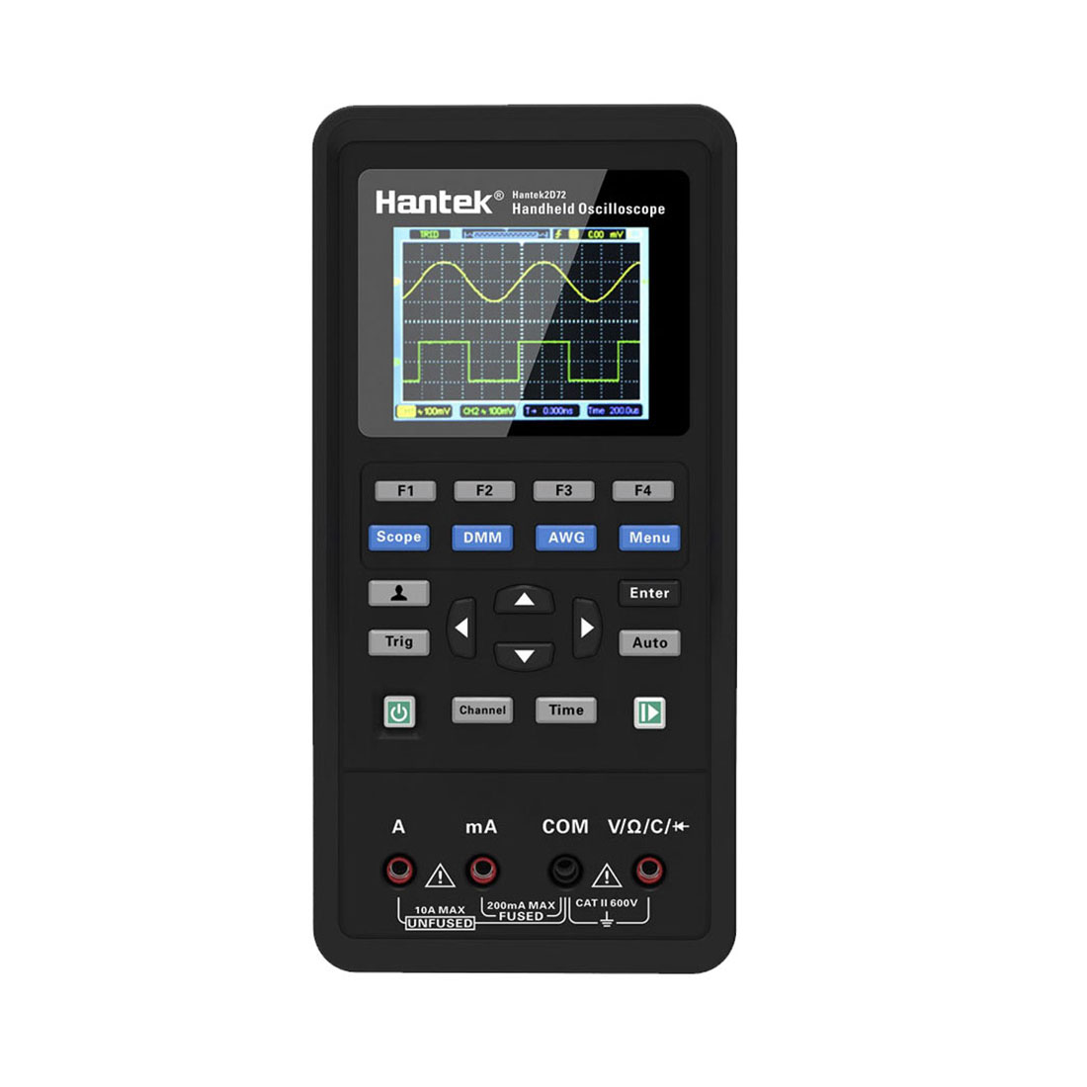
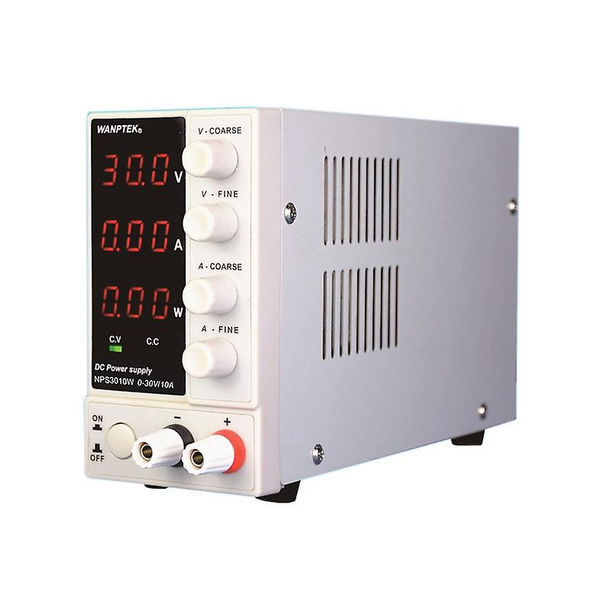
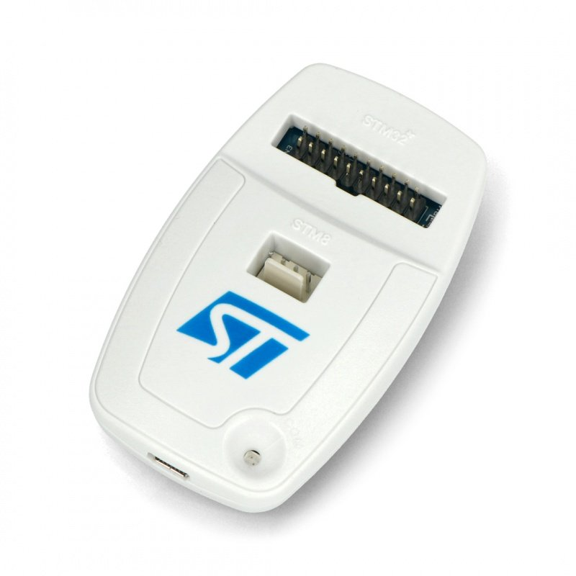
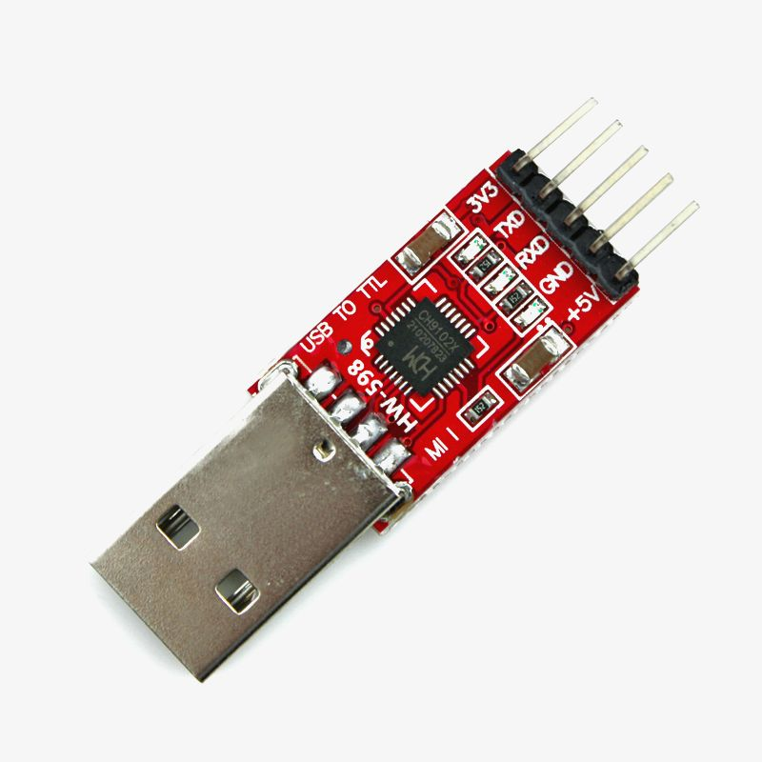
Methodology
Hardware Tools
Hantek Oscilloscope / Multimeter
Adjustable Power Supply
ST-Link Programmer
USB to TTL Adapter

Slide 17



Methodology
Software Tools
STM32CubeIDE
Arduino IDE Serial Monitor
Autodesk Fusion 360

Slide 18
Future Implementation (FYP 2)
Develop a real-time PID control system.
Use Optical Encoder as feedback loop.
Precisely adjust the PID controller for optimal speed and position accuracy.
Design a PCB for the motor driver circuit.
1
2
3
4

Slide 19
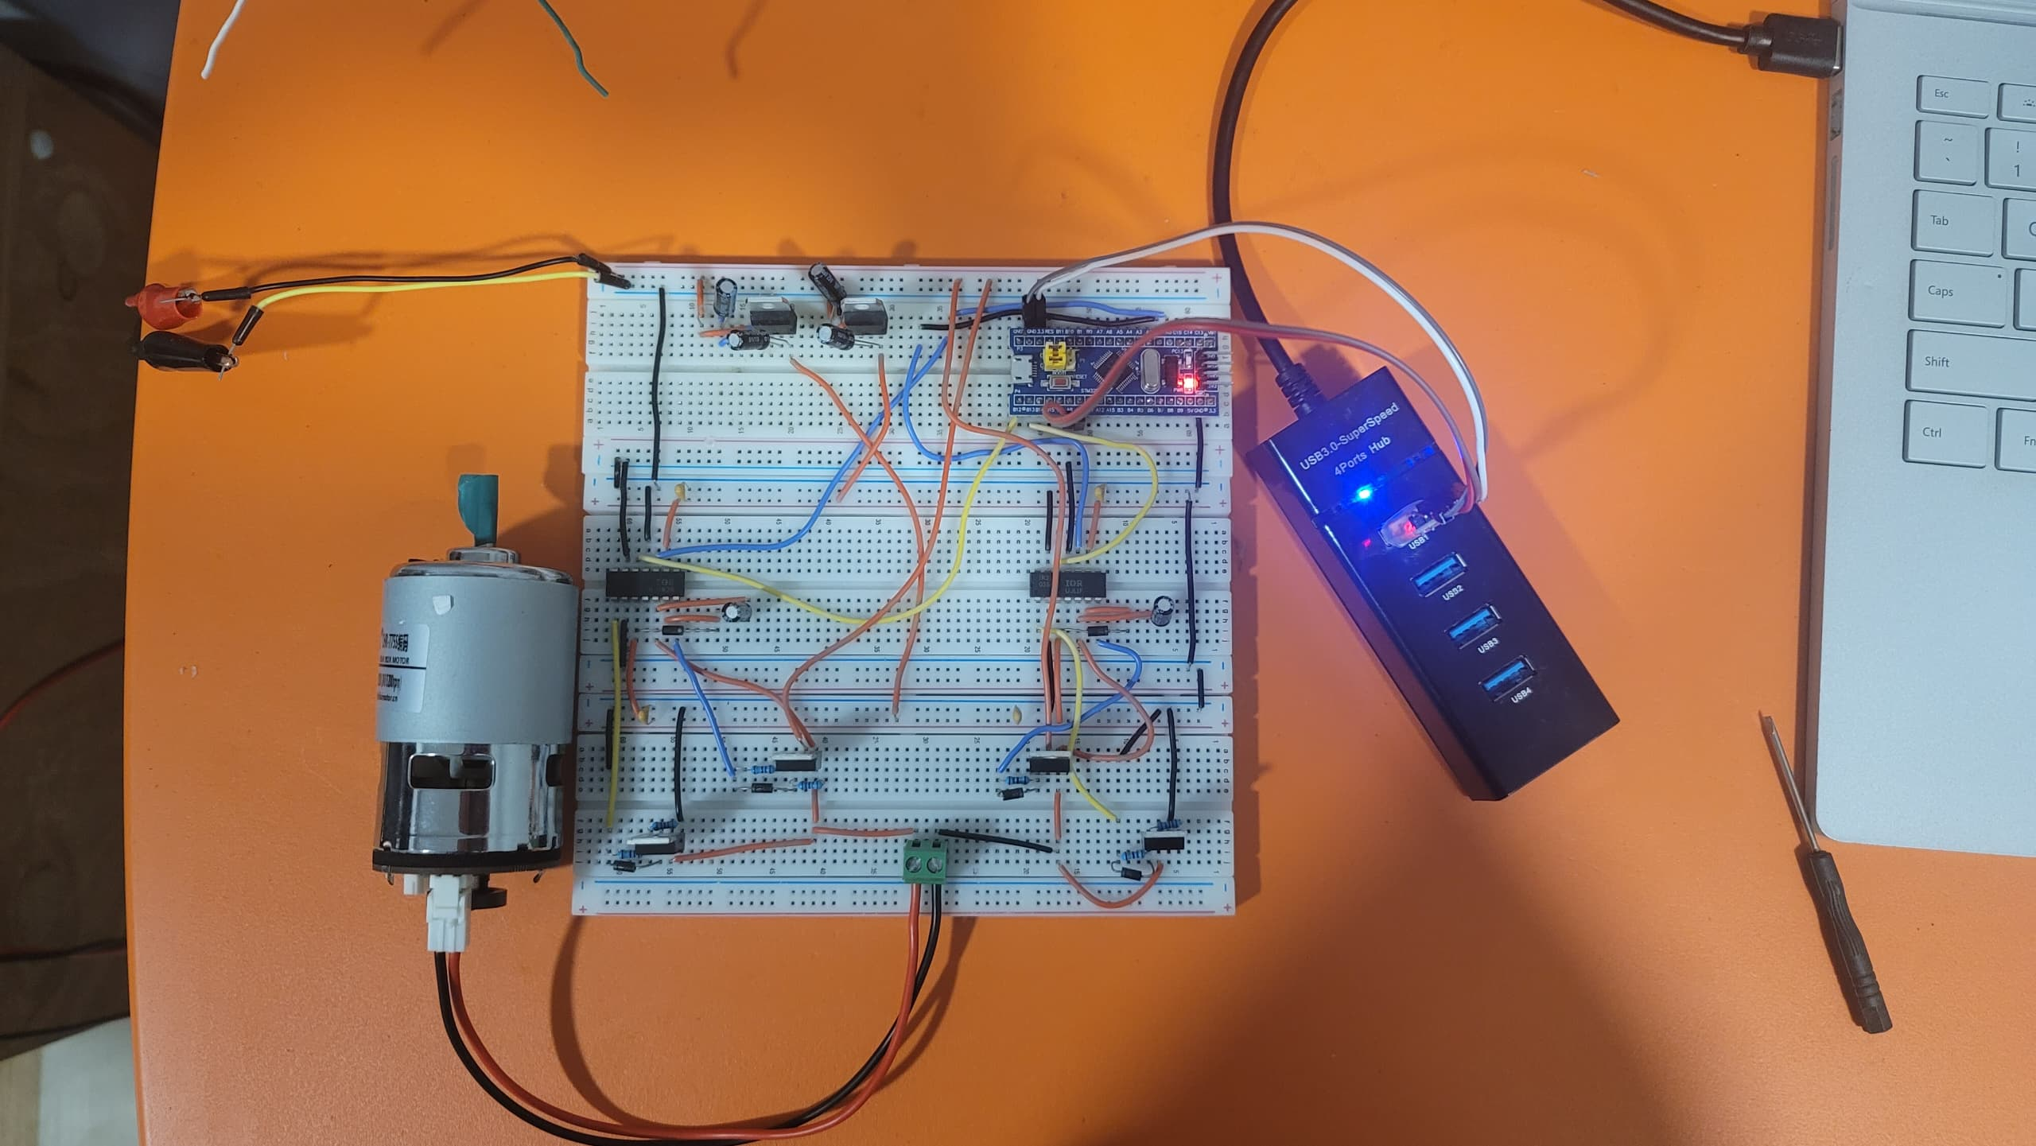
Result and Discussion
Brushed DC Motor Driver Circuit

Slide 20
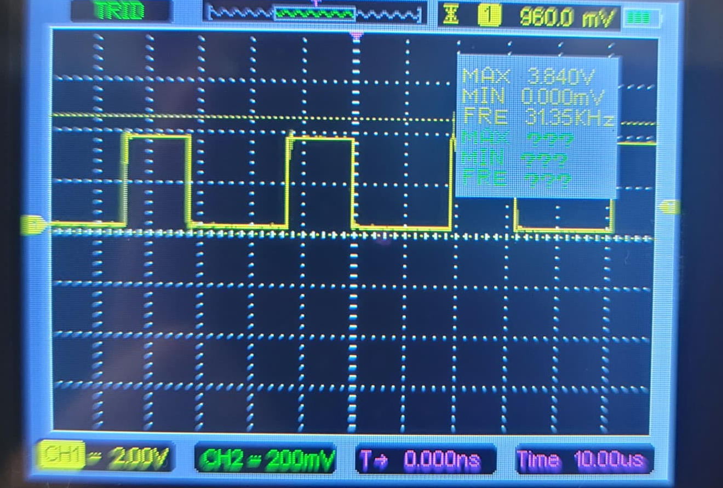
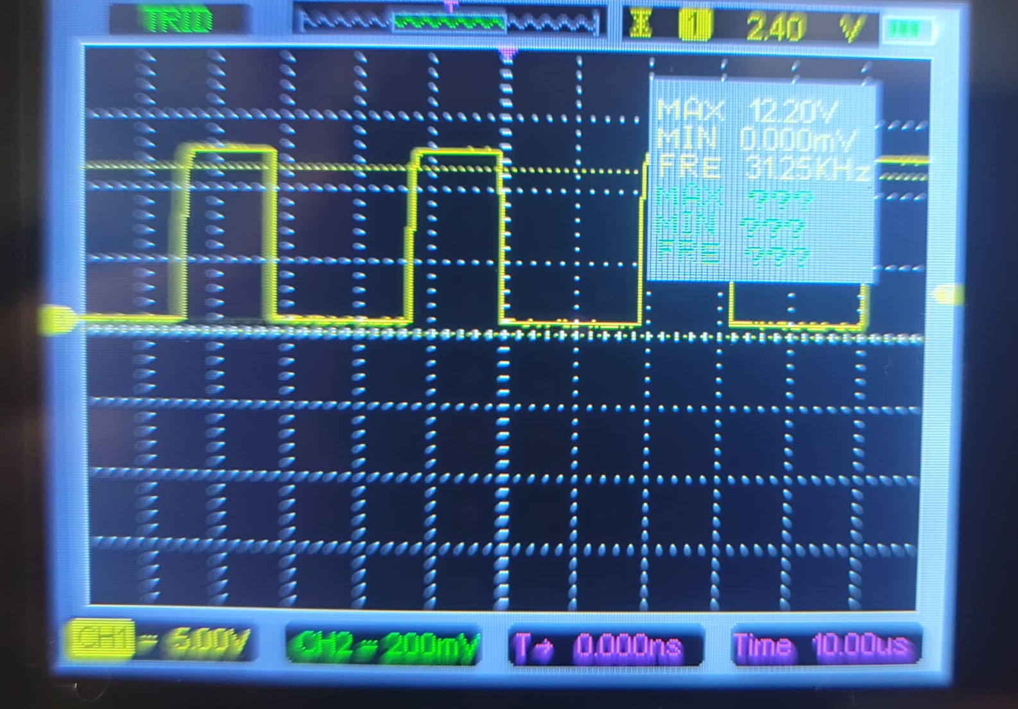
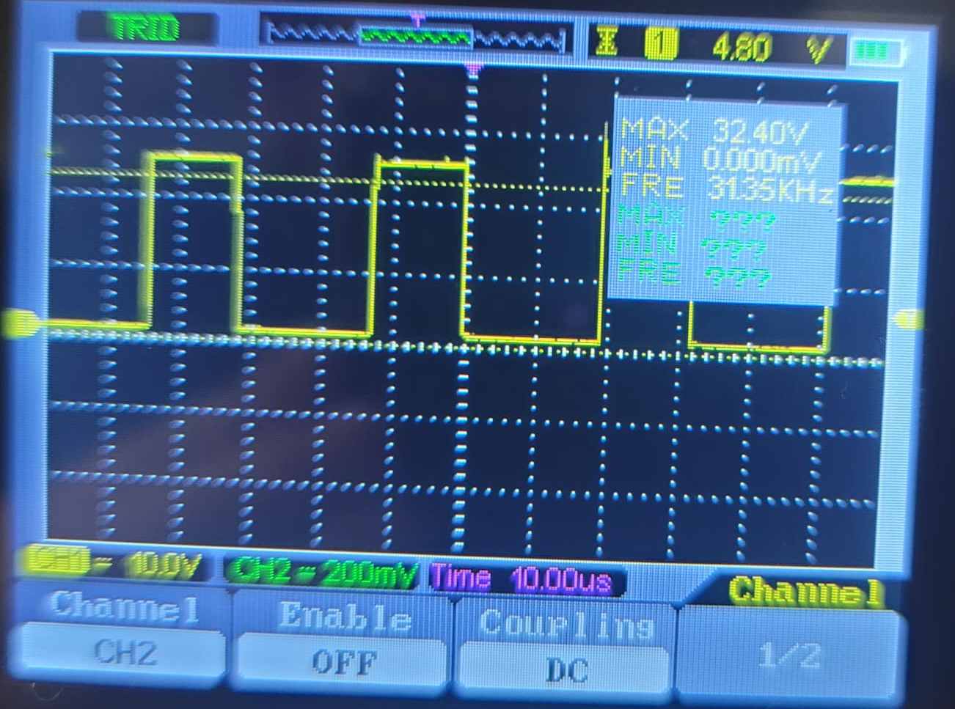
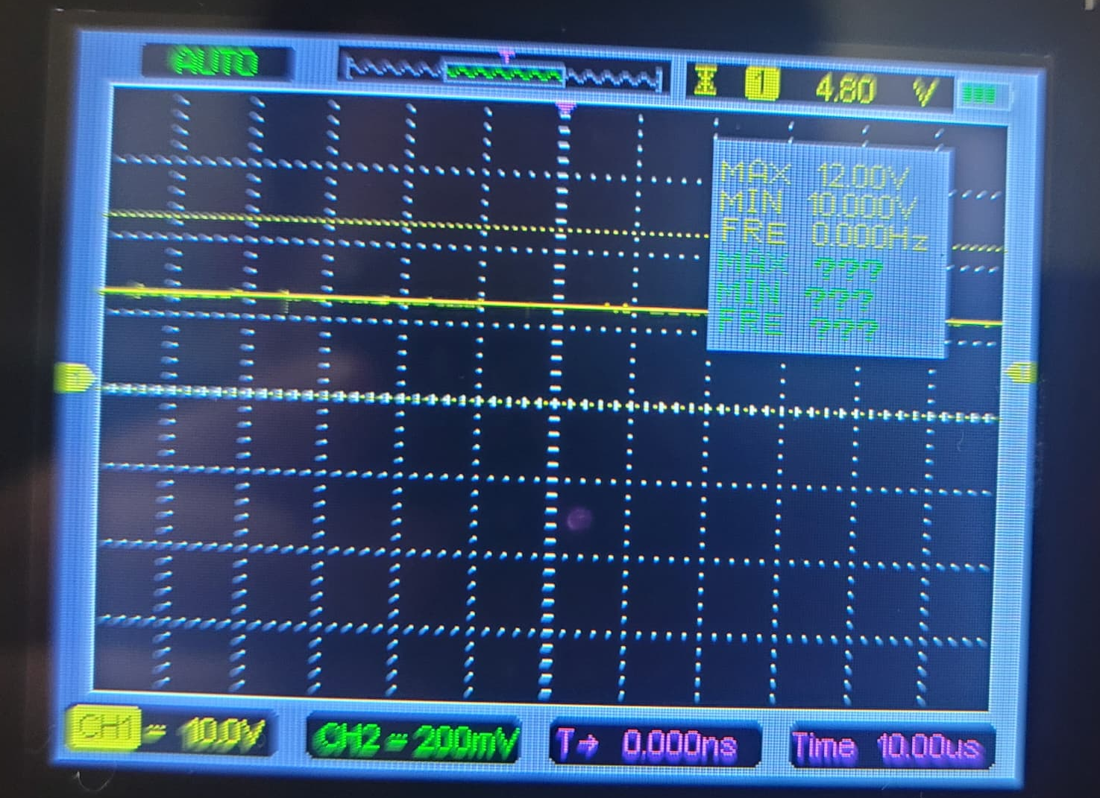
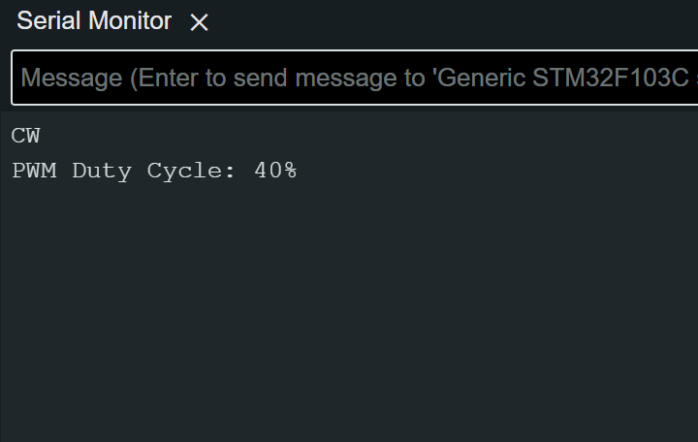
Result and Discussion
Motor at 40% PWM Duty Cycle
Microcontroller
High Side MOSFET VGS
Brushed DC Motor
Low Side MOSFET VGS
Serial Monitor

Slide 21
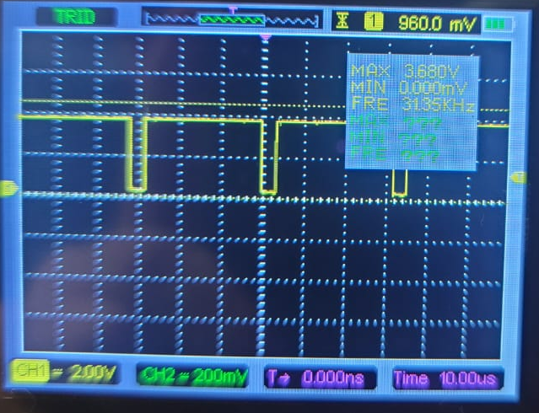
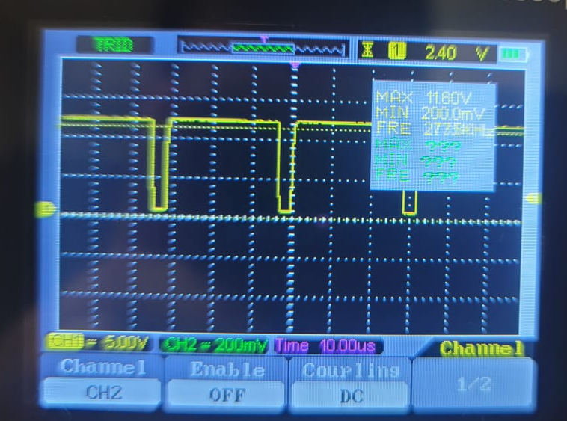
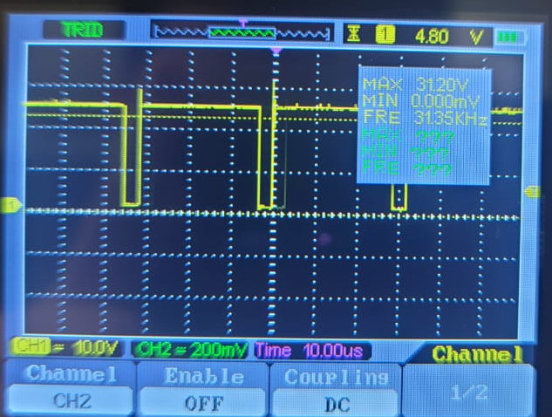
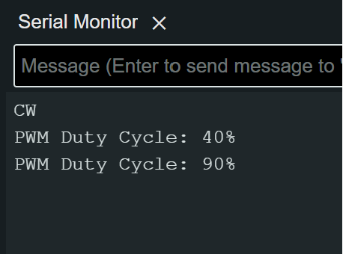
Result and Discussion
Motor at 90% PWM Duty Cycle
Microcontroller
High Side MOSFET VGS
Brushed DC Motor
Low Side MOSFET VGS
Serial Monitor

Slide 22
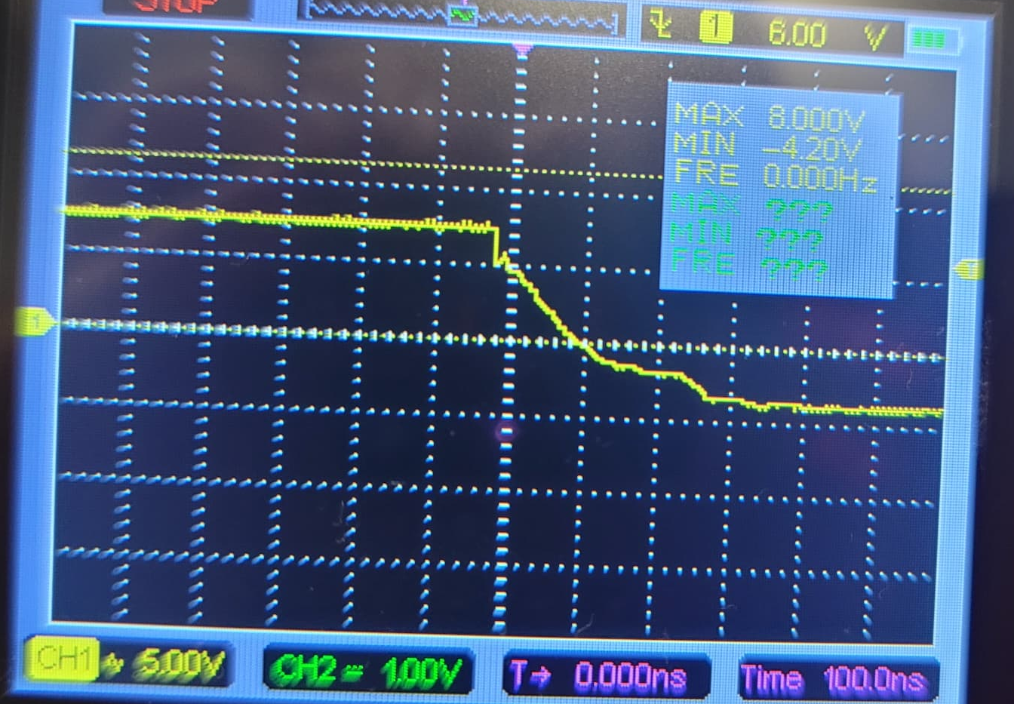
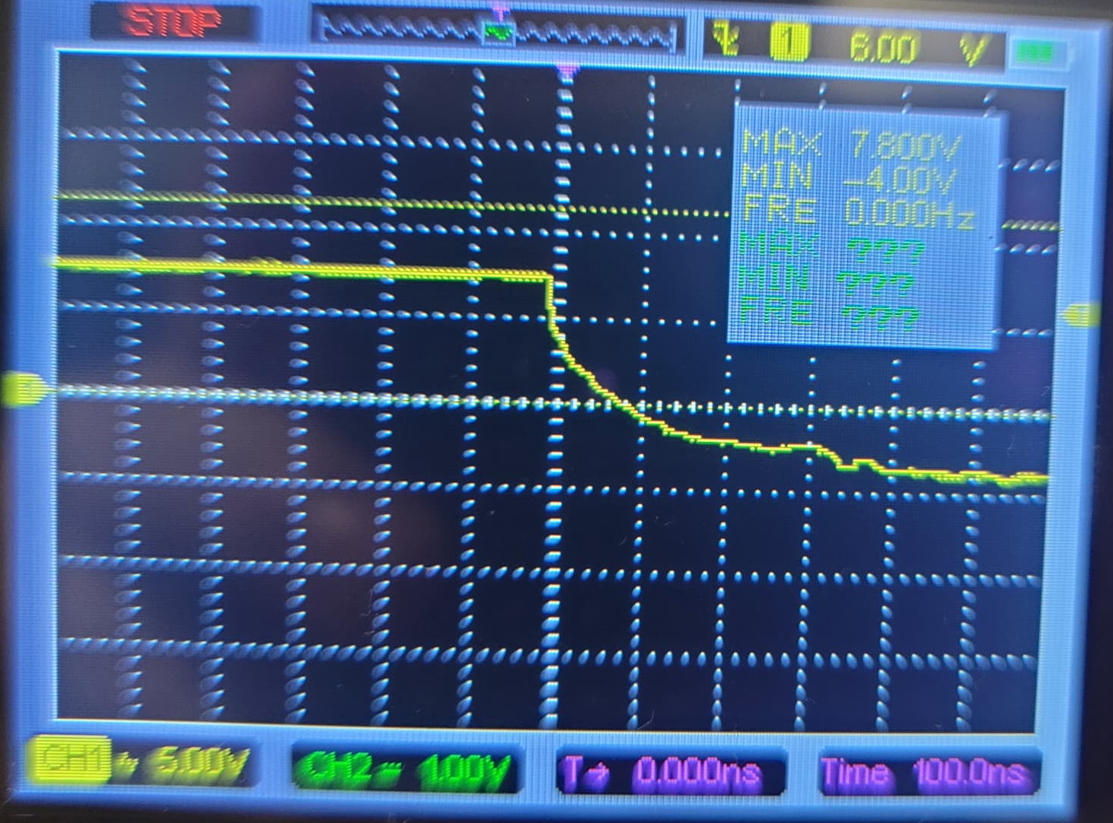
Result and Discussion
Gate Discharge Time with Diode
MOSFET Gate Discharge Time
From the oscilloscope readings, it's evident that incorporating a diode at the MOSFET gate impacts the gate discharge time. With the diode in place, the gate discharges in about 300ns. Conversely, removing the diode results in a longer discharge time of 400ns. Therefore, the inclusion of a diode at the MOSFET gate contributes to a slight improvement in the gate's discharge efficiency.
Gate Discharge Time without Diode

Slide 23

Project Timeline

Slide 24
Project Budget
Part Name | Quantity | Unit Cost (RM)
LM7805 Voltage Regulator | 1 | 0.80
LM7812 Voltage Regulator | 1 | 0.80
IR2110 MOSFET Gate Driver | 2 | 3.59
IRF3205 Power MOSFET | 4 | 3.50
STM32F103C8T6 Blue Pill Board | 1 | 16.90
Metal Film Resistors | 8 | 0.10
1N5819 Diode | 6 | 0.20
2.2uF 50V Capacitor | 2 | 0.10
10uF 50V Capacitor | 2 | 0.10
100uF 25V Capacitor | 2 | 0.10
100nF Ceramic Capacitor | 4 | 0.10
Breadboard | 3 | 3.60
Total |  | 53.48

Slide 25
Summary
In conclusion, the project effectively developed a servo controller for Brushed DC motors, significantly enhancing the precision in speed. Key accomplishments include integrating a PWM-controlled circuit with a microcontroller for robust speed control. Notably, the PID control aspect is planned for FYP part 2, promising to further refine motor operation. Future directions involve enhancing real-time control mechanisms, advancing the motor driver circuit design, and integrating optical encoder feedback for superior precision and performance.

Slide 26
References
[1] Ayyanathan, Mariyammal. "DC Motor Speed Control Using PWM." 2018, vol. 3, pp. 2456-2165. [Online]. Available: https://www.researchgate.net/publication/338116979_DC_Motor_Speed_Control_Using_PWM
[2] V. Gupta, "Working and analysis of the H - bridge motor driver circuit designed for wheeled mobile robots," 2010 2nd International Conference on Advanced Computer Control, Shenyang, China, 2010, pp. 441-444, [Online]. Available: https://ieeexplore.ieee.org/document/5486818
[3] X. Zhang, "Design and implementation of fuzzy PID DC motor control system based on STM32," in 2023 IEEE International Conference on Control, Electronics and Computer Technology (ICCECT), Jilin, China, 2023, pp. 1129-1131, [Online]. Available: https://ieeexplore.ieee.org/document/10141000
[4] Z. Adel, A. A. Hamou and S. Abdellatif, "Design of Real-time PID tracking controller using Arduino Mega 2560for a permanent magnet DC motor under real disturbances," 2018 International Conference on Electrical Sciences and Technologies in Maghreb (CISTEM), Algiers, Algeria, 2018, pp. 1-5, [Online]. Available: https://ieeexplore.ieee.org/document/8613560

Slide 27
Thank You

