Slide 1
Entra ID Protection Proof of Concept (PoC) in a Box
Through partner execution

Slide 2



Top Scenarios For Identity Protection
Monitor and analyze risk events
Investigate risk
Remediate risk
Monitor the volume of risky users, sign-ins and detections to identify any anomalies and ensure timely actions to prevent compromises.
Investigate risks using Identity Protection reports and sign-in logs to catch any compromises.
Require password reset or dismiss the risk to ensure that users are no longer at risk to be compromised.
Setup risk-based CA policies for access control and auto risk remediation to reduce admin burden while ensure secure access.
Notes:
ID Protection provides organizations with reporting they can use to investigate identity risks in their environment. These reports include risky users, risky sign-ins, risky workload identities, and risk detections. Investigation of events is key to better understanding and identifying any weak points in your security strategy. All of these reports allow for downloading of events in .CSV format or integration with other security solutions like a dedicated SIEM tool for further analysis. Organizations can alsIo take advantage of the Microsoft Graph API integrations to aggregate data with other sources.

Slide 3
What can partners do?
Drive Conversations
Introduce Microsoft Entra Identity Protection – Explain what is offered, how could a customer start
Deliver the message that the risks identified and remediated with tools like Conditional Access to make access decisions or fed to a security information and event management (SIEM) tool for further investigation
Explain Benefits
Unique insights powered by trillions of signals and build detection algorithms
Assess Risk Levels via real-time and offline evaluation engine
Secure Access via policy enforcement and unified investigation experience
Target The Audience
Customers: All Entra ID customers for large enterprises and small businesses, who have P2 (example: M365 E5) have full access, free/P1 has limited access
Personas:
SOC Team: Investigate and remediate security risks detected by Identity Protection
IAM Team: Manage risk-based access policies
Notes:
n

Slide 4
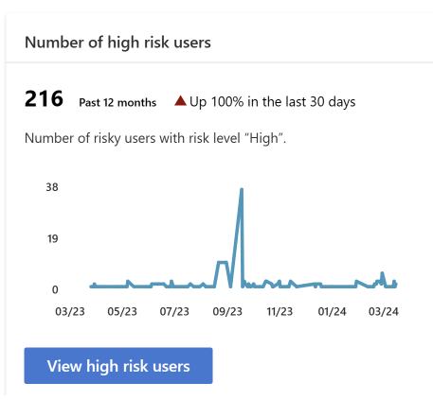
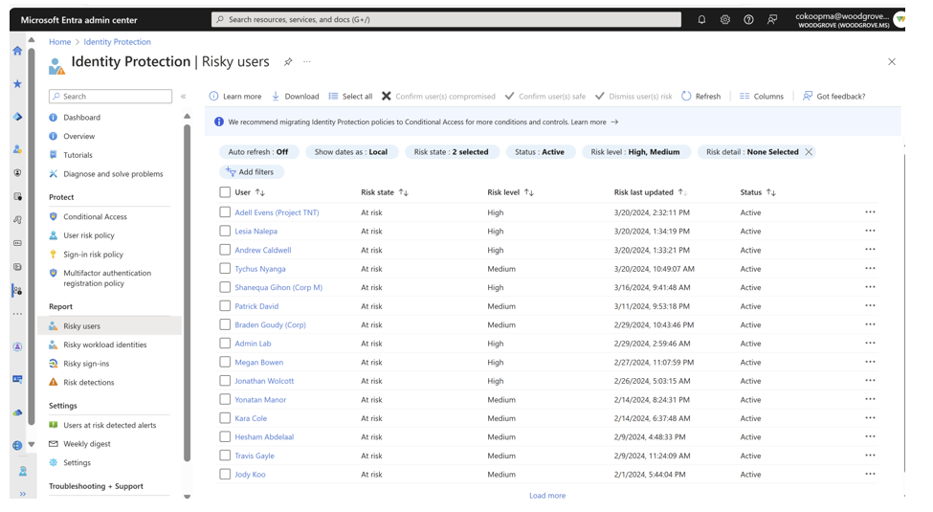
How To Investigate A Risk
1
2
Navigating The Reports
Risky Users
Risky Sign-Ins: 1 or More
Leaked Credential (User Account): 1 or More
Admin Actions: View report & choose remediation path
MDI: If customers have MDI, follow guidance
Reports are in Microsoft Entra Admin Center
Navigate & View Dashboard
Report provides list of detections

Slide 5
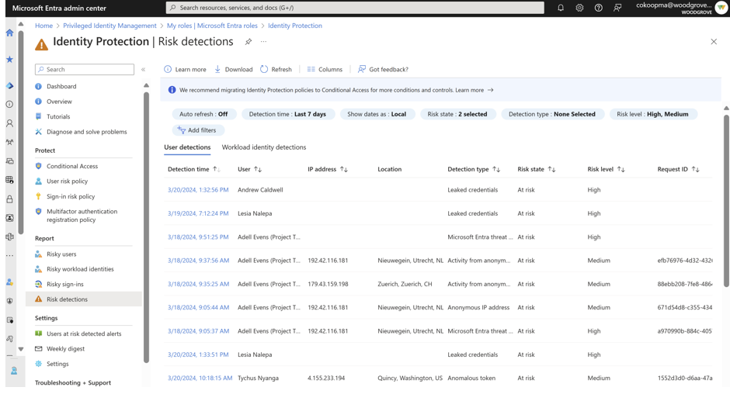
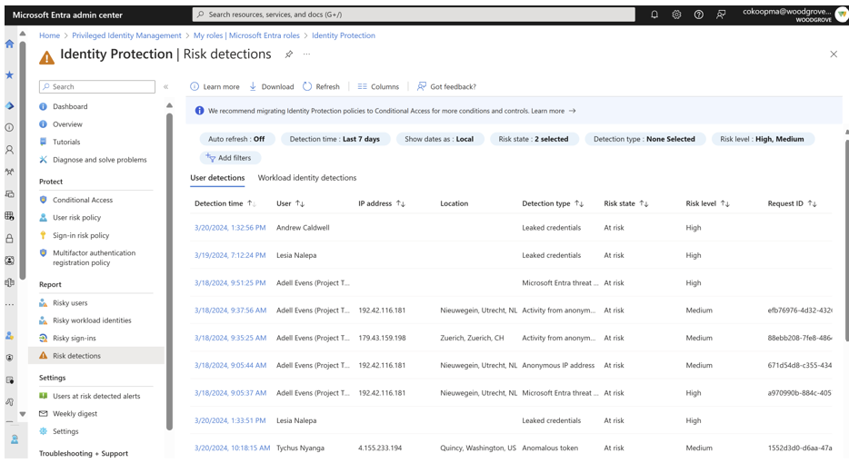
How To Investigate A Risk
3
4
Risky Sign-Ins
Risk Detections
Reports has filterable data for past 90 days
View attack type (MITRE Attack) or other risks
Explore more with Microsoft Defender for Cloud Apps
Reports are available for past 30 days
View risky sign-in report that shows both interactive and non-interactive sign-ins.
Admin takes action to Remediate

Slide 6
Microsoft Entra Identity Protection Workshop & PoC engagement
Pre-
engagement
L100 Workshop Delivery
PoC
Reporting session
PoC engagement closure
½ Hour
Introductions
Engagement walk-through
Expectations
What’s next
Customer’s agreement?
YES - Pre-engagement preparations like sharing the agenda, identifying the stakeholders
NO - We need your feedback – WHY?
1 hour
Microsoft Entra Identity Protection Overview
Discovery of customer’s use case and how this helps organizations detect, investigate, and remediate identity-based risks.
Drafting the storyboard for POC
Discussion on PoC next steps and pre-requisites
3½ hours
Pre-requisites review
Seek access to customer tenant (Admin)
Get access to data
Investigate Risks
Test users onboarding and targeting for test use cases
½ hour
Walk through configuration & risk level
Agreement on next steps
½ hour
PoC review, closure and sign-off
Consult if customer would like to be highlighted as a reference in Microsoft’s public marketing platforms
Agreement on next steps kick off date
Complete PoC survey at
4 hours or less

Slide 7
PoC | Stages | Timeline
Pre-requisites | Overview of Identity Protection | Investigate current risky users and events | Understand impact of risk-based policies | Configure Risk based CA policy | Update IR playbooks | Re-evaluate risk metrics | Close-out & next steps
License: Microsoft Entra P2 Enabled
Roles Assignment: Administrators (E.g: Security Administrator
Screenshot: Take the screenshot of dashboard before start of project
Explore: What are the different types of risk events generated Gather Insights: How is risk calculated and the difference between sign-in risk, user risk, and application risk.
Investigate Identity Protection Dashboard signals
Start with high-risk users especially those with privilege or access to sensitive info.
Risk Management: Understand the recommended configuration of risk policies and how to scope them based on Microsoft Recommendation
Start the Workbook to see the impact analysis of risk-based access policies
Configure:
Sign-in risk
User risk
SIEM: Configure Risk Alerts consumption in SIEM
(Optional): If smaller set is configured to have enforced, configure broader scope in Report Only mode if needed
Leverage Microsoft recommended playbooks
Simulate risk as needed
Use Identity protection dashboard to validate metrics are trending in correct direction
Dashboard: Show the difference of start and current state of dashboard
Document: Document the analysis
Create: Remediation Plan
~20 min
~20 min
~90 min
~30 min
~30 min
~20 min
~10 min
~20 min
4 hours or less

Slide 8
How Do We Enable You
DOCUMENTS
VIDEO GUIDE
READINESS:
Documentation By PoC Stages:
Overview of Identity Protection
Investigate current risky users and events
Understand impact of risk-based policies
Configure Risk based CA policy
Configure Risk Alerts consumption in SIEM
ID Protection Videos:
What is Microsoft Entra ID Protection? - Overview of the product, risk detection types, benefits and types of risk-based policies, and how to get started with our dashboard.
How to set up Microsoft Entra ID Protection - Dive deep into the ID Protection dashboard to learn how to identify threats in your environment and review the risk reports to pinpoint threats.
How to Deploy Risk-Based Policies with Microsoft Entra ID Protection - Walk through creating risk-based policies in Conditional Access step by step and learn how Microsoft is helping you deploy policies with confidence through Microsoft Managed Policies and our Impact Analysis workbook.
Deep Dive Readiness:
Manage Microsoft Entra Identity Protection - Training
Microsoft Certified: Identity and Access Administrator Associate - Certifications
Identify and remediate risk by using identity protection APIs - Microsoft Graph
Investigate Risks: https://learn.microsoft.com/en-us/entra/id-protection/howto-export-risk-data-
To get CxE Product Manager advisory support:
Nominate your customers https://forms.office.com/r/NSBAqZbSAc

