Slide 1


Crafting Wicked Domain Models
www.alliontechnologies.com
Notes:
1

Slide 2


Overview of Domain Driven Design(DDD)
Unplanned city
Planned city
Typical System
DDD
2
Notes:
2

Slide 3
What is a domain model?
An Object Model of the domain which incorporates both data and behavior
3
Notes:
3

Slide 4
Why Should I care?
Complex domain, or a long-lived project where behavior gets added piece by piece
Minimum bugs
Efficient (saves time)
4
Notes:
For applications where business logic is being added, added and becoming complex that’s where we should care about moving towards domain models.
4

Slide 5


Current state of the problem
Nexus Member
5
Notes:
5

Slide 6
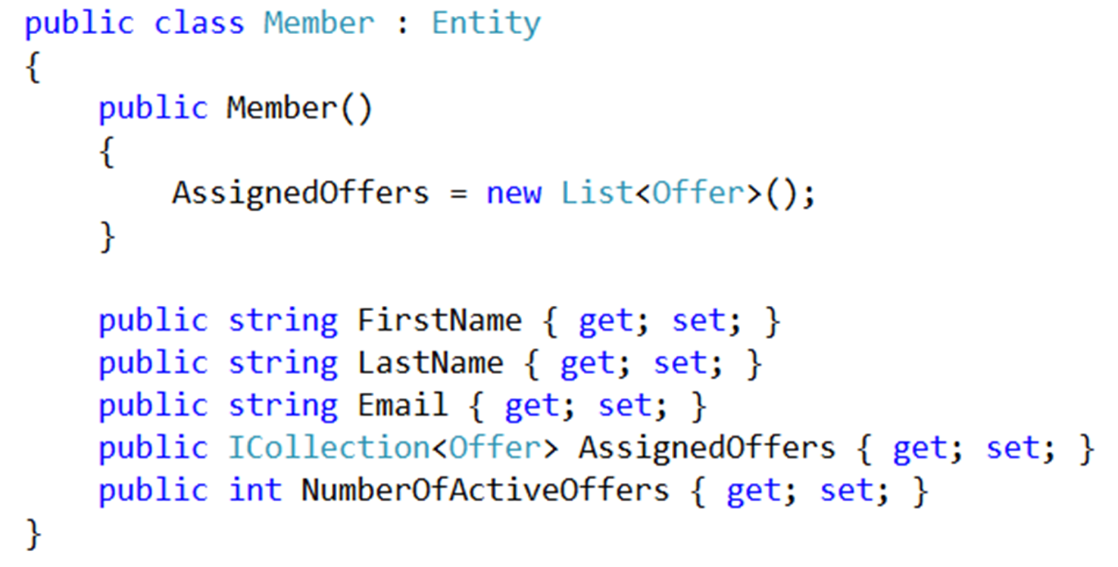
Current state of the problem
6
Notes:
We want to make sure that domain specific names should be used here so that the business user can also understand
6

Slide 7
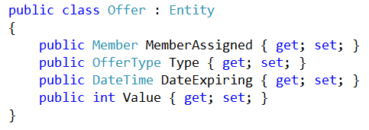
Current state of the problem
7
Notes:
Offer is assigned to only single members.
Differs from another which is assigned to another member
OfferType
7

Slide 8
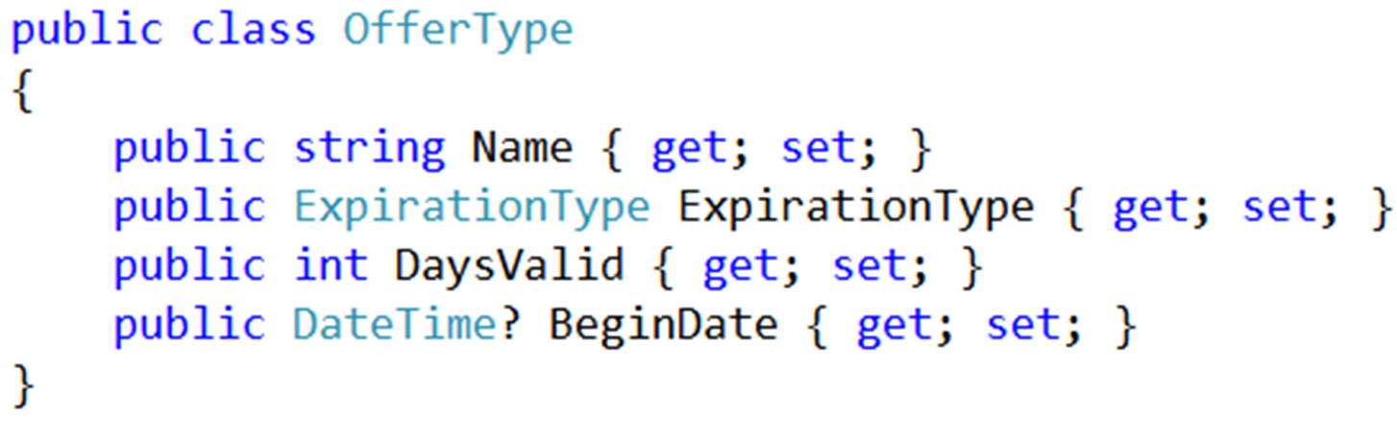
Current state of the problem
8
Notes:
Offer is assigned to only single members.
Differs from another which is assigned to another member
8

Slide 9
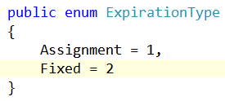
Current state of the problem
9
Notes:
One is Assignment based, which means clock is ticking from the time offer has granted to the member until the no of days valid for that offer type.
The other is Fixed based. Which has a fixed begin date and end date
9

Slide 10
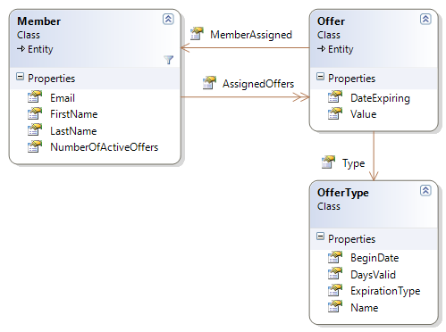
Current state of the problem
10
Notes:
This is the class diagram for the business problem that is going to address.
All the data and associations are matched with the business user.
But one thing is missing. What’s that?
Methods with behaviors of these models.
Then where are these behaviors located at
10

Slide 11
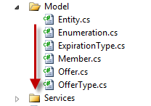
Where is the behavior?
Anemic Domain Models
11
Notes:
In our situation these behaviors are defined down at the services folder.
But it can be in many places like repositories, controllers itself, actions etc.
It’s perfectly okay to keep these services to communicate between these domain models.
But what’s not right is all the behavior of these domain models living inside these services.
These kind of domain models are known as Anemic Domain models.
11

Slide 12
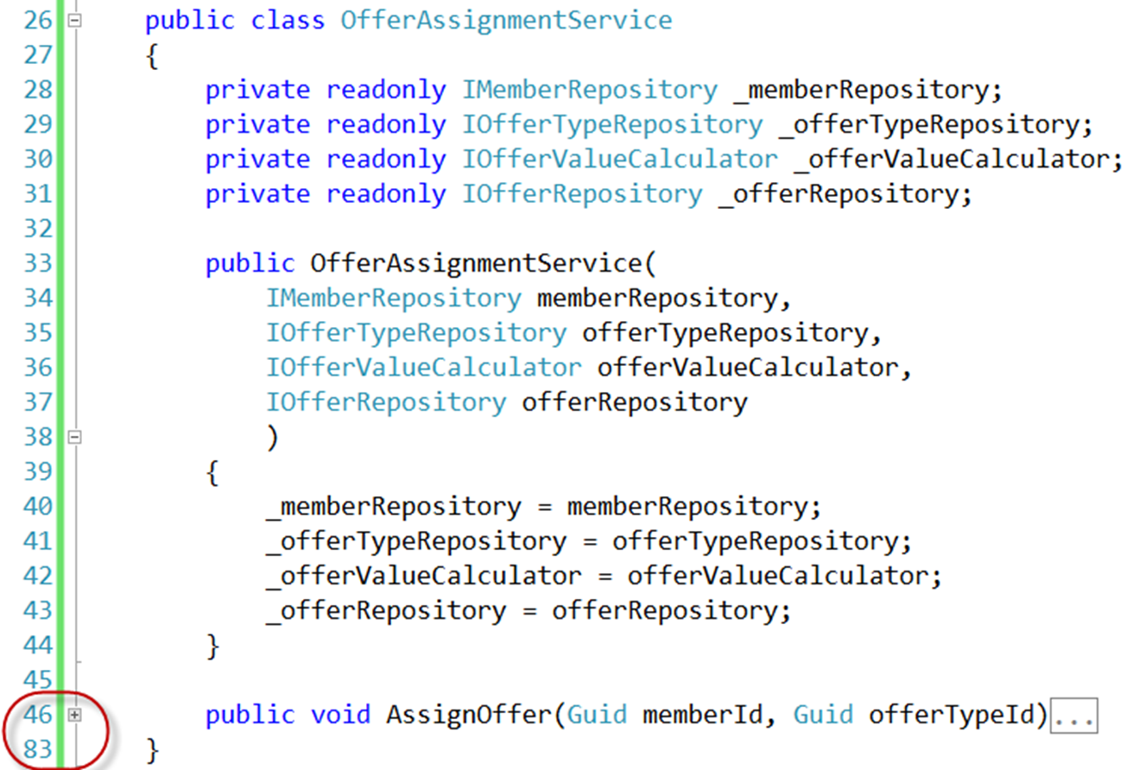
Offer Assignment Service
12
Notes:
Let’s dig into the current state of our service class.
At the moment, all of the behaviors related to assigning an offer to a member is within this AssignOffer method.
As you can see there are several dozens of code lines within this method.
Going forward we will go through each line of code of this method and try to refactor business logics into the domain model.
12

Slide 13
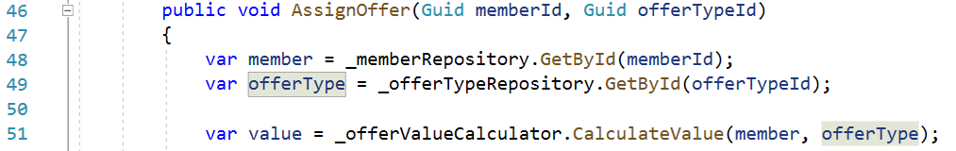
Offer Assignment Service
13
Notes:
First 2 lines of code uses repositories to get data from the database.
To assign an offer to a member we need the member and what kind of offer type going to offer.
Business needs to decide how much amount going to offer for a particular member. May be if he is a regular member then is no need of giving high value offers.
To decide that we need to get help from some another service.
Here we have used offer value calculator class to calculate the value.
13

Slide 14
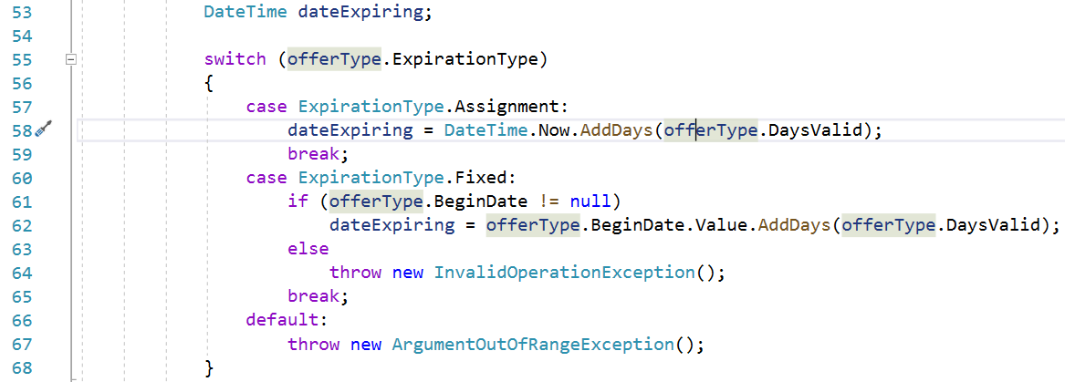
Offer Assignment Service
14
Notes:
Then it comes to calculate the expiration date of the offer.
As I said earlier there can be 2 types of expiration types.
Assignment and Fixed based ones.
This same switch statement can be used in many other places in the system just to calculate expiration date.
14

Slide 15
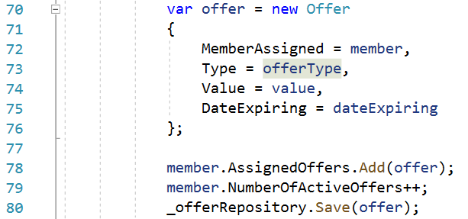
Offer Assignment Service
15
Notes:
Then the offer is created with the calculated values
Add the offer to the AssignedOffers Collection property in the member entity.
Then increment the NumberOfActiveOffers property in the member entity by one.
And save the offer in db.
Everything is okay right?
15

Slide 16
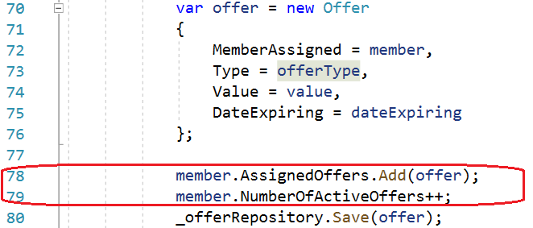
Offer Assignment Service
16
Notes:
But there is a huge vulnerability around these 2 lines of code.
What happens if the developer forget to increment the number of active offers after assigning an offer to a member?
What if by mistake developer clears the member.AssignedOffers collection?
If the member logs into the system and if he sees Number of active offers less than what he actually have the business user will get frustrated right?
To add these 2 lines of code developer requires to remember.
But we can not trust as developers to remember things and write good code all the time.
Even the unit tests might not help at this time.
Because to add a unit test for this case we need to remember that we should check this.
If we don’t remember then we don’t remember to add the unit test also
That’s why we are moving towards domain models.
As we can see there are many domain model specific behaviors that we can move up towards domain model.
16

Slide 17
Solution
17
Notes:
So now we will try to take each line of this method and try to encapsulate the domain specific behaviors to make an anemic domain model to a true domain model.
17

Slide 18
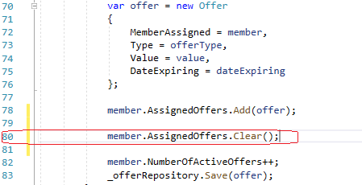
Silly thing!
18
Notes:
Nothing stops me doing this as a developer even though it is a silly thing right?
How can the business user can takes assigned offers back from a member?
Only thing he can do is assign an offer, but can’t take the assigned offer back
18

Slide 19
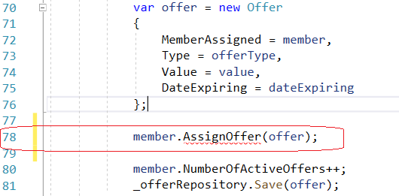
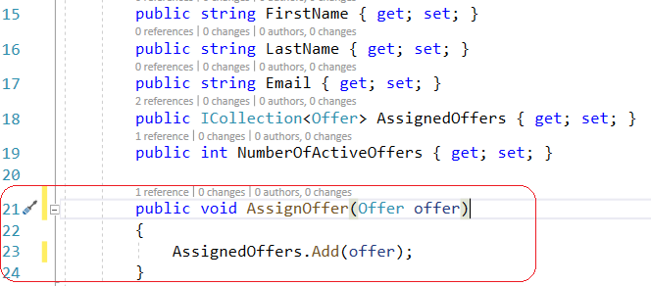
Solution
OfferAssignmentService.cs
Member.cs
19
Notes:
To fix this, refactoring what we are going to do is to create AssignOffer method in the member domain model class and move the adding offer to AssignedOffers collection into that.
19

Slide 20
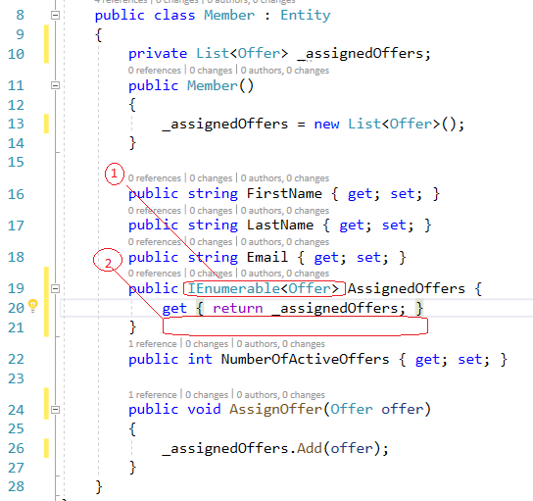
More Refactoring
Member.cs
20
Notes:
Since we previously had an Icollection for the AssignedOffers property developer still had the opportunity to manipulate the collection from outside the Member.cs class.
But through refactoring showed as 1, by changing Icollection to Ienumerable we can restrict that.
To avoid setting a new AssignedOffers object from the outside we have removed setter of the AssignedOffers property.
That is depicted in no 2
You can clearly see that now the outsiders from the domain model can access only the functions that is allowed them to use.
What can not access can not be done.
20

Slide 21
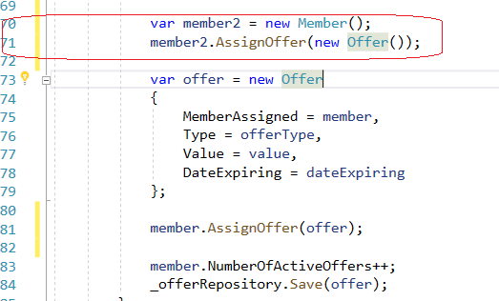
Silly thing!
OfferAssignmentService.cs
21
Notes:
Can we assign an offer with no values to an anonymous member with no name and no email.
We shouldn’t according to the business user.
But here nothing restricting for the developer to do that.
What is the refactoring to avoid this?
21

Slide 22
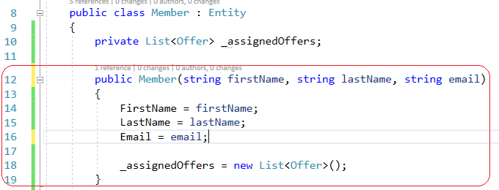
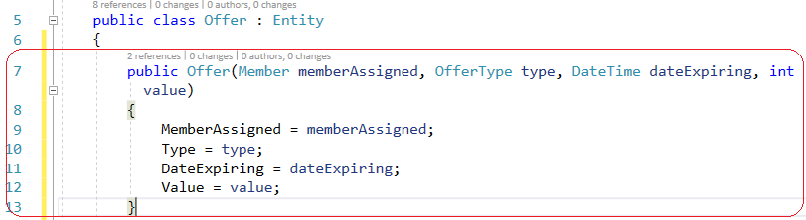
Solution
Member.cs
Offer.cs
22
Notes:
Solution is to generate a parameter constructor with the required fields.
22

Slide 23
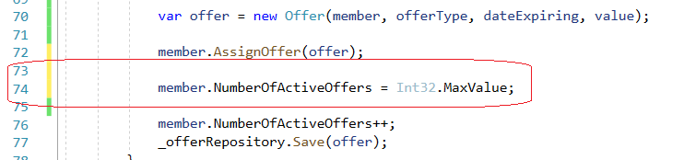
Silly thing!
OfferAssignmentService.cs
23
Notes:
Still We can assign any value to Number Of Active Offers property in the member class
But we shouldn’t.
We should use that property only to increment NumberOfActiveOffers when assigning an offer to a member
23

Slide 24
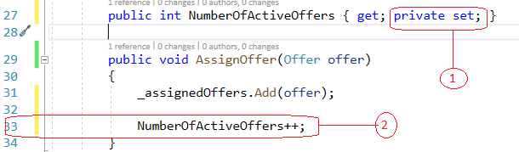
Solution
Member.cs
24
Notes:
To avoid manipulating NumberOfActiveOffers from outside we can encapsulate the property with a private setter
Also only manipulation of the NumberOfActiveOffers happens inside the AssignOffer method.
So now you can see some kind of behavior is going inside the AssignOffer method in Member class.
24

Slide 25
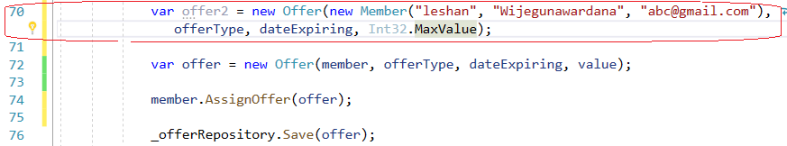
Silly thing!
OfferAssignmentService.cs
25
Notes:
We shouldn’t be able to create an offer accidently with another member who is not supposed to be.
But at the moment we can.
Also we shouldn’t be able to assign any value for the offer.
We should always use the offerValueCalculator service for this
25

Slide 26
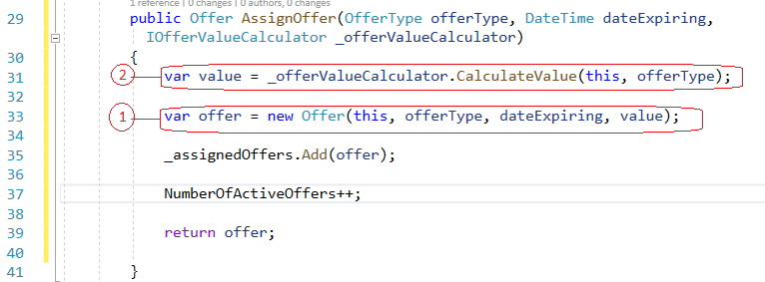

Solution
Member.cs
OfferAssignmentService.cs
26
Notes:
To avoid offer is created accidently to some other member who is not supposed to be we have embedded the offer creation part inside the AssignOffer method in the Member.cs class
As you can see in the no 1 refactoration we can use this keyword for the memberAssigned since we are creating the offer for the current member.
Also to calculate the value of the offer offer value calculator service is passed when calling the AssignOffer method from the OfferAssignmentService.
This is depicted in 2 and 3 refactorations
26

Slide 27
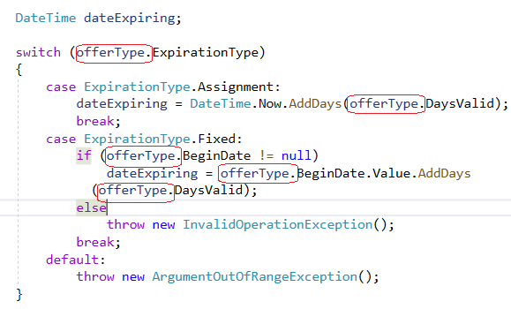
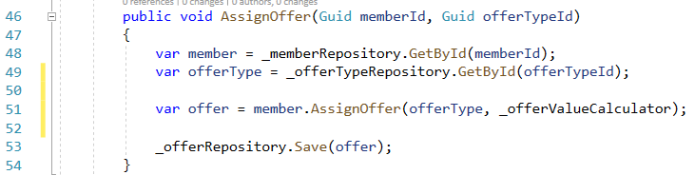
Refactoring Calculate Expiration Date
OfferAssignmentService.cs
Member.cs
27
Notes:
By moving expiration date calculation switch statement inside AssignOffer method in the Member class we now have refactored all the behavior that was in the OfferAssignmentService
Now AssignOffer method in the OfferAssignmentService calls the AssignOffer method in Member model by passing the offerType and offerValueCalculator service.
All the behavior have pushed down towards domain models.
But still we have this ugly version of switch statement inside AssignOffer method in the Member class.
As you can see in red there lot of offerType’s in the switch statement
So we can think of moving the calculate expiration date behavior down towards OfferType domain model
27

Slide 28
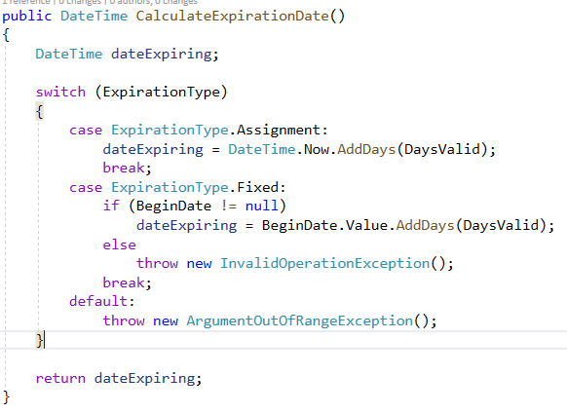
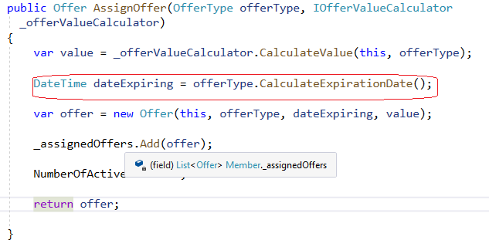
More Refactoring Calculate Expiration Date
Member.cs
OfferType.cs
28
Notes:
By moving expiration date calculation down towards OfferType domain model we have refactored the Member domain model also.
Member domain model has only the behaviors related to the Member domain model
But ideally our intention is to move the expiration date calculation towards ExpirationType domain model.
But unfortunately ExpirationType is a enum
28

Slide 29
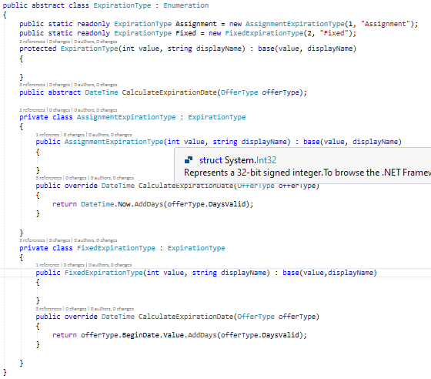
More Refactoring Calculate Expiration Date
ExpirationType.cs
29
Notes:
By modifying ExpirationType enum to an enumeration class we can move the CalculateExpirationDate method towards ExpirationType domain model.
Here through polymorphism and abstraction moved the calculation expiration date logic to specific overrided CalculateExpirationDate method separately.
Through this we can get rid of the switch statement and avoid duplicating that behavior everywhere in the system
29

Slide 30
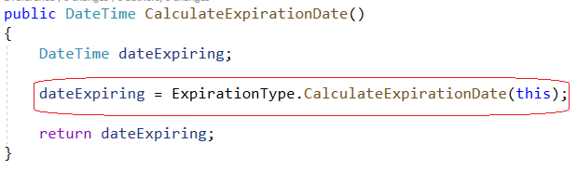
More Refactoring Calculate Expiration Date
OfferType.cs
30
Notes:
By refactoring the ExpirationType class as above we can call the CalculateExpirationDate method specific to particular expirationType.
Now we have refactored all the domain model specific behaviors down towards domain models which was previously located at the OfferAssignmentService
30

Slide 31
Summary
Overview of DDD
What is a domain model?
Why should I care?
Current state of the problem
Anemic Domain Model
Refactoring code from Anemic Domain Model to true Domain Model
31
Notes:
31

Slide 32
Resources
GitHub Repo
Video
32
Notes:
32

Slide 33
Thank You!
33
Notes:
33

