Slide 1

EN2533 - Robot presentation
TEAM HELABOTS
230045X
230140J
230697V
230730T
Anthony C.S.B.
Dharmakeerthi P.K.G.C.L.
Weerasinghe J.A.H.R.
Wijethilaka J.S.

Slide 2

Timeline

Slide 3
September |  |  |  | October
Week 1 | Week 2 | Week 3 | Week 4 | Week 5 | Week 6 | Week 7 | Week 8
Task Identification, Initial Designs | Component selection, Purchasing components | Preparation for assignment and Task evaluation | Initial Assembling | Coding and Testing |  | Finalizing Assembling of the Robot
November |  |  |  | December
Week 9 | Week 10 | Week 11 | Week 12 | Week 13 | Week 14 | Week 15 | Week 16
Preparation for mid evaluation | End Semester Examinations |  |  | Calibration, Testing and Debugging |  |  | Robot Competition

Slide 4

Task 1 - The Labyrinth of Shadows

Slide 5
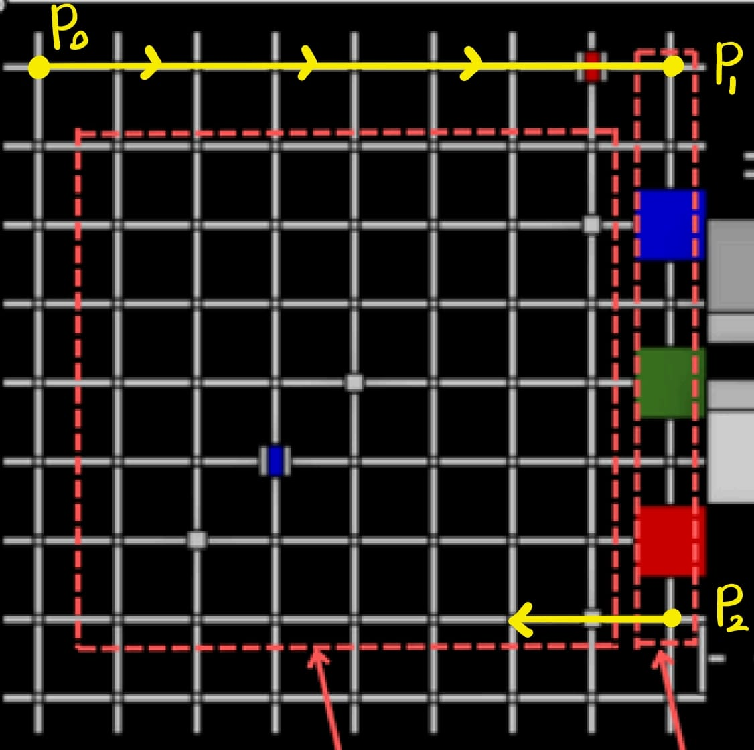
PATH FINDING
The robot will be placed at the position P_{o} and it will start traversing the grid to P₁ avoiding all obstacles it encounter.
Then it will start travelling to P₂ while scanning the destinations where the boxes should be placed and mapping them.
Thereon from P₂ the robot will start solving the grid while avoiding obstacles.
When the robot encounters a box, it will grab it and start travelling to the appropriate destination through shortest available path.
If an obstacle is encountered while travelling to the destination, the robot will map it and start travelling to the destination through the shortest path without the obstacle.
After travelling it will drop the box there and continue travelling the grid until two boxes are placed on their respective destinations.

Slide 6
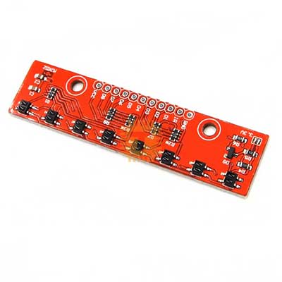
LINE FOLLOWING
We chose the MD0167 8-Bit Line Hunting Sensor Follower Module for line following because of its,
Wide Detection Range
The module has 8 independent IR sensors arranged in a row, which provides much better coverage compared to single-sensor or 3-sensor modules.
High Precision and Stability
With 8 channels, it allows fine resolution in detecting the line’s exact position.
Simple Integration with Arduino
It’s fully compatible with Arduino and other microcontrollers.
Better Performance on Different Surfaces
The MD0167 has built-in sensitivity adjustment, so it works well on surfaces with varying reflectivity.
Cost-Effectiveness
8-Bit Line Hunting Sensor Follower Module for Arduino (MD0167)

Slide 7
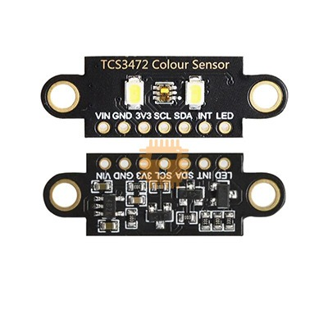
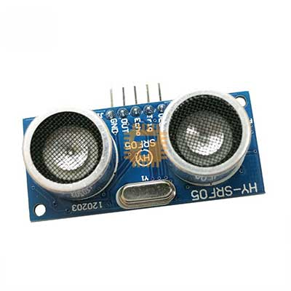
BOX DETECTION
We chose the HY-SRF05 Ultrasonic Sensor for obstacle and box detection and to differentiate between the boxes and the obstacles TCS34725 RGB Colour Recognition Sensor is used as boxes have their specific RGB colours.
The HY-SRF05 Ultrasonic Sensor can measure distances from about 2 cm up to 4–5 meters with good accuracy. Compared to the common HC-SR04 sensor, the HY-SRF05 has better accuracy and stability in distance measurement. So, it provides accurate distance measurements. Also it is easy to interface with Arduino. Since it uses ultrasonic sound waves, it works equally well in dark or bright environments where optical sensors might fail.
The TCS34725 has a high-quality RGB and clear light sensing photodiode array. The sensor includes an IR blocking filter, which removes infrared light interference. This makes color detection more accurate even under different lighting conditions. This also is well supported with Arduino libraries.
TCS34725 RGB colour Recognition sensor
HY-SRF05 HC-SR05 5Pin Ultrasonic Sensor Module

Slide 8
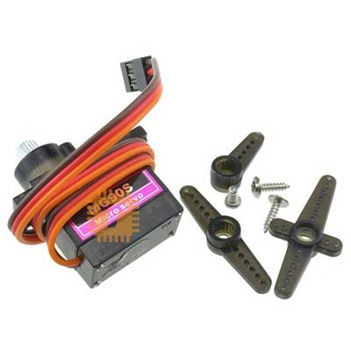
BOX PICKING & PLACING
The boxes are picked from robot arm mechanism powered by MG90 Metal Wheel Servo Motor.
Why We Chose the MG90 Metal Gear Servo Motor
High Torque for Small Size
The MG90 provides around 2.2 kgcm torque, which is enough to move lightweight robotic arms and small payloads.
Metal Gears for Durability
Unlike plastic gear servos (e.g., SG90), the MG90 uses metal gears, making it more durable. This makes it suitable for repeated arm movements without gear damage.
Arduino Friendly
Works easily with Arduino PWM libraries.
Servo Motor Metal Wheel MG90

Slide 9
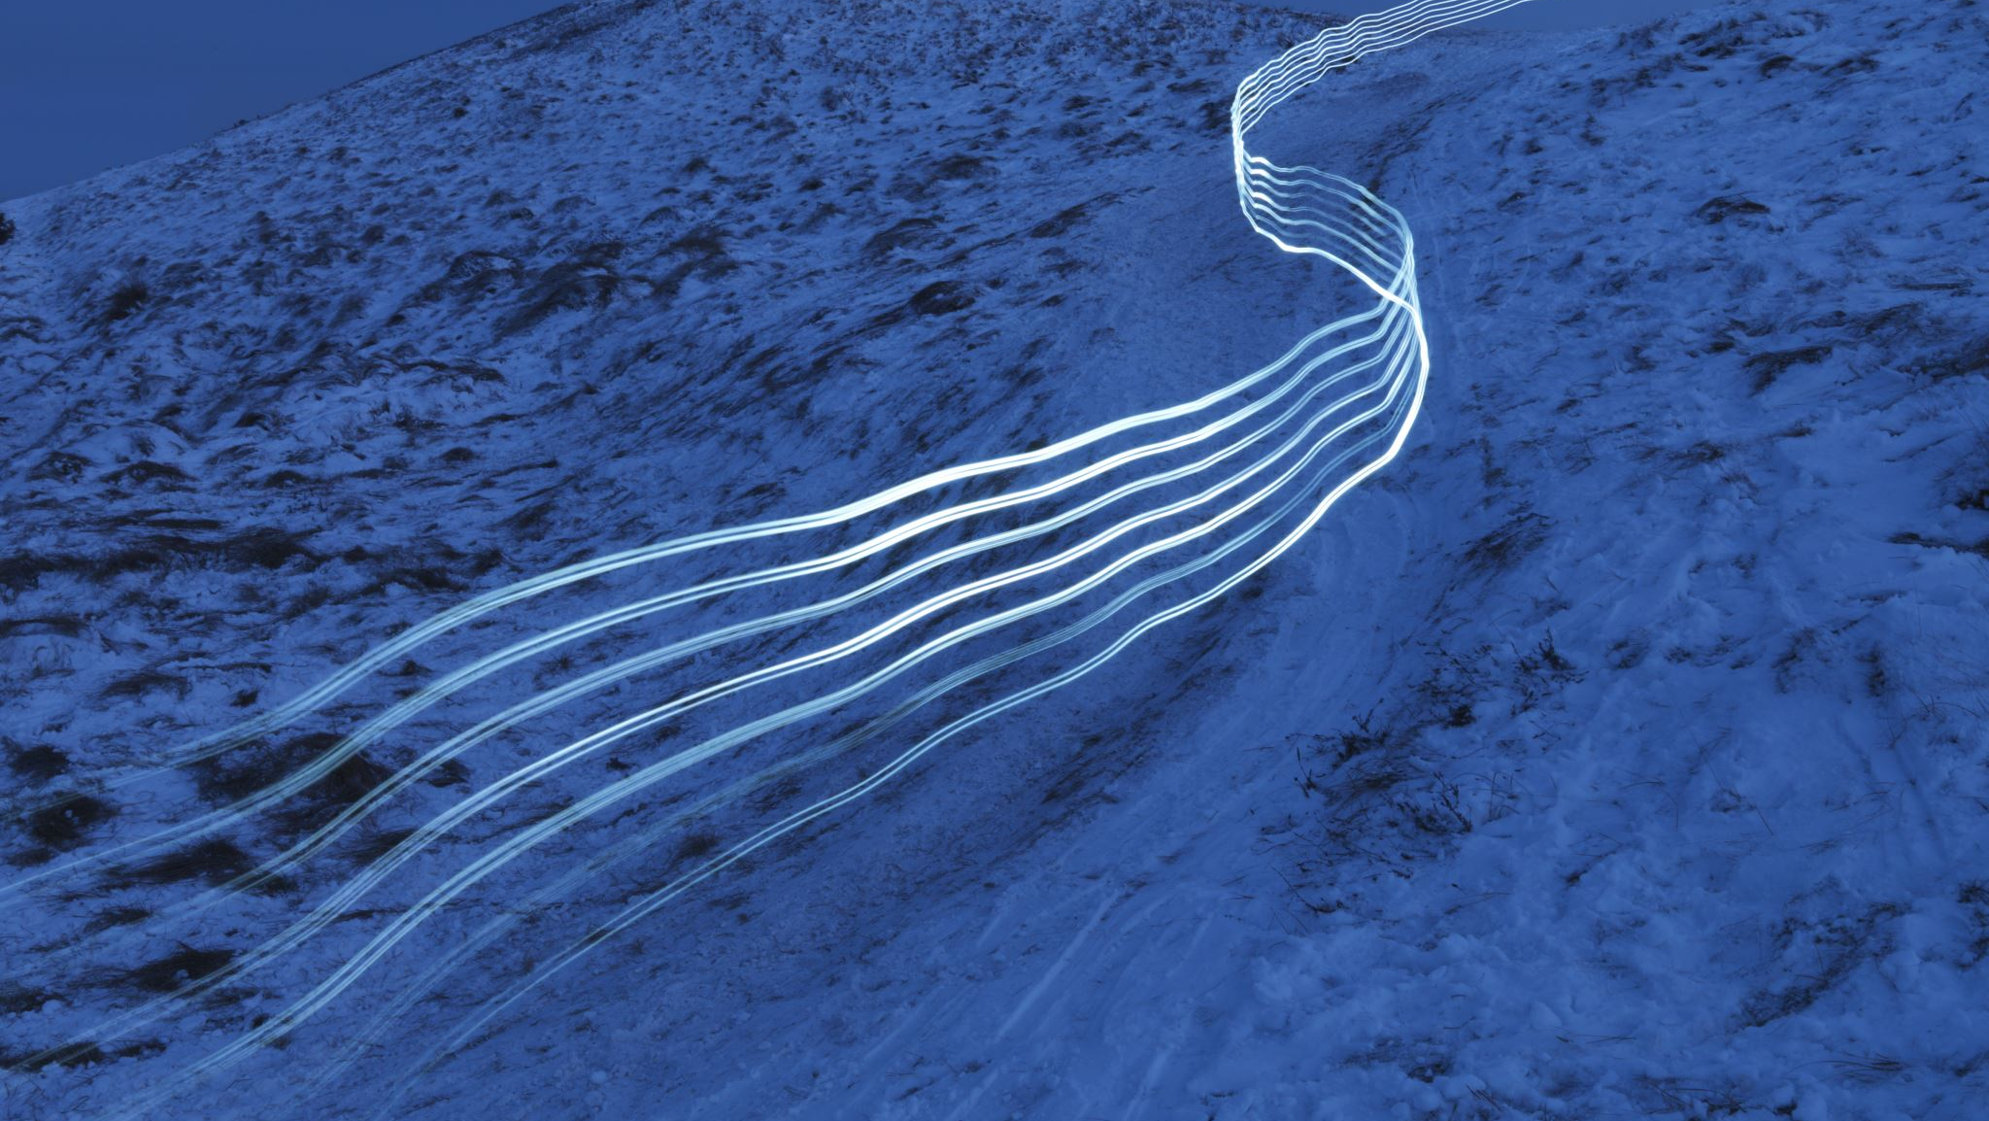
Task 2 – The Ramp of Trials

Slide 10
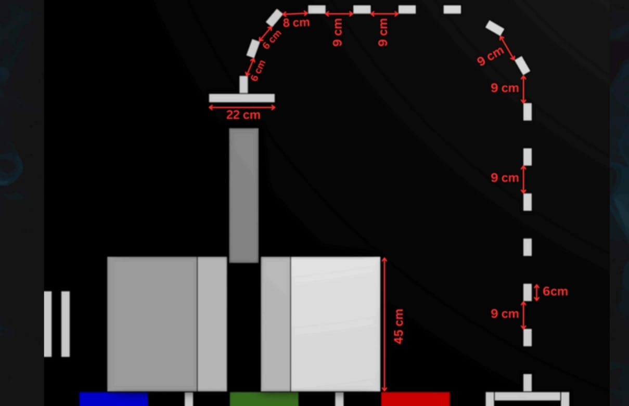
In this task the robot will traverse through the broken lines using the IR sensor array until it finds a horizontal line and stop there.
Using the closed front arms, it will push the box and fill the gap.
Then the robot will comeback to the position of the horizontal line.
After that the robot will traverse back to the starting point of the broken lines following the broken lines.
Then it will approach the ramp and climb up and down the ramp.
When climbing up, robot arm will be stretched towards the frontside of the robot (towards the ramp) and while climbing down, arm will be stretched towards the backside of the robot to keep the center of the gravity at a better position.
Traversing the broken lines:
The robot follow the direction of each line segment until it find the next line segment and then it will adjust the direction again.

Slide 11

Task 3 – the oracle of runes

Slide 12
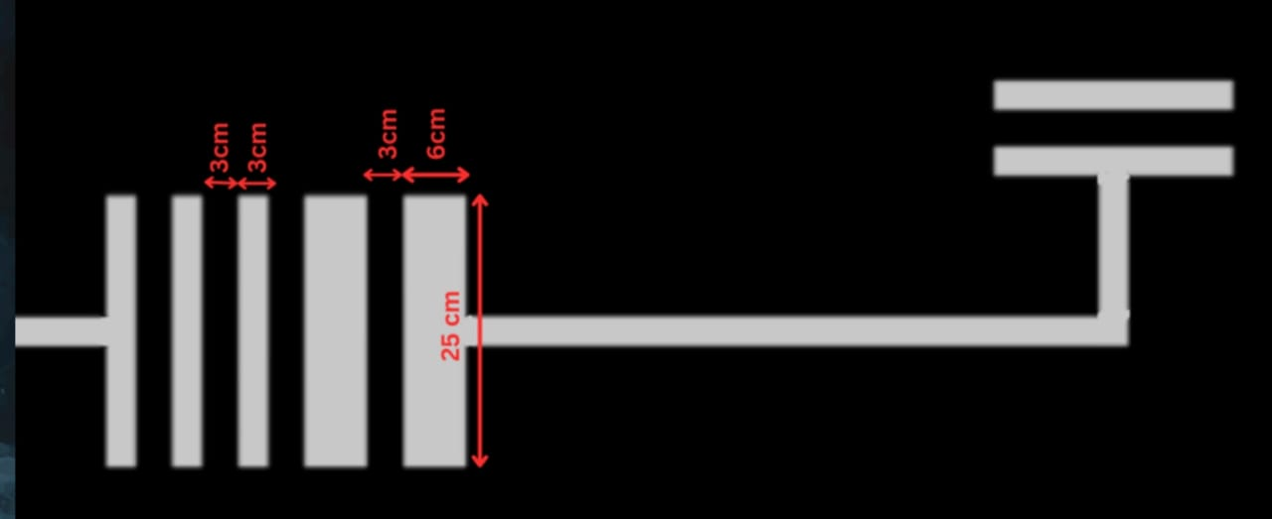
In the oracle of runes, the robot will come to the barcode area, and it will pass through the barcode at a constant speed while measuring the time to pass the white lines separately.
Then it will decode the barcode and read the number and divide it by 3 and take the remainder.
This will tell us the number of spheres we have to collect which will be one of 2,3 or 4 spheres.
The robot will have 4 indicating LEDs to light up accordingly to show the number of spheres it should collect.
Remainder | No. of Spheres | No. of LEDs Turned on
0 | 2 | 2
1 | 3 | 3
2 | 4 | 4

Slide 13

Task 4 – the circular fortress

Slide 14
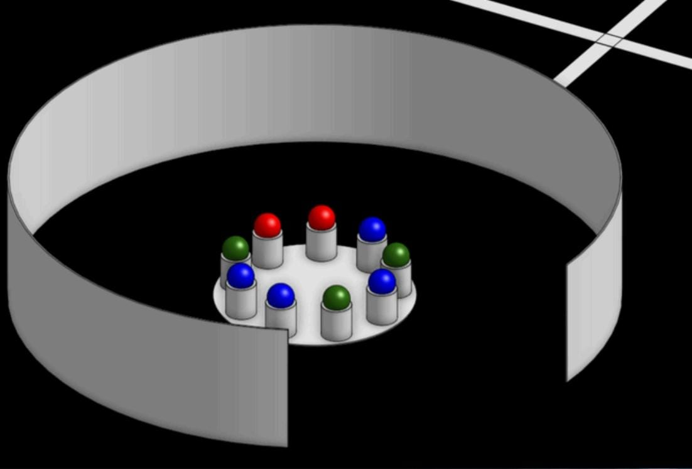
The robot moves forward until it reaches a wall.
Then follows the wall while maintaining a constant distance from it until it detects an opening.
After detecting the opening, the robot makes a 180- degree U turn around the corner of the opening and continues following the wall while using its robotic arm to pick up balls and place them into a container.
Once it reaches the opposite end, it performs another 180-degree turn around the other corner and returns to the starting position by following the wall.

Slide 15
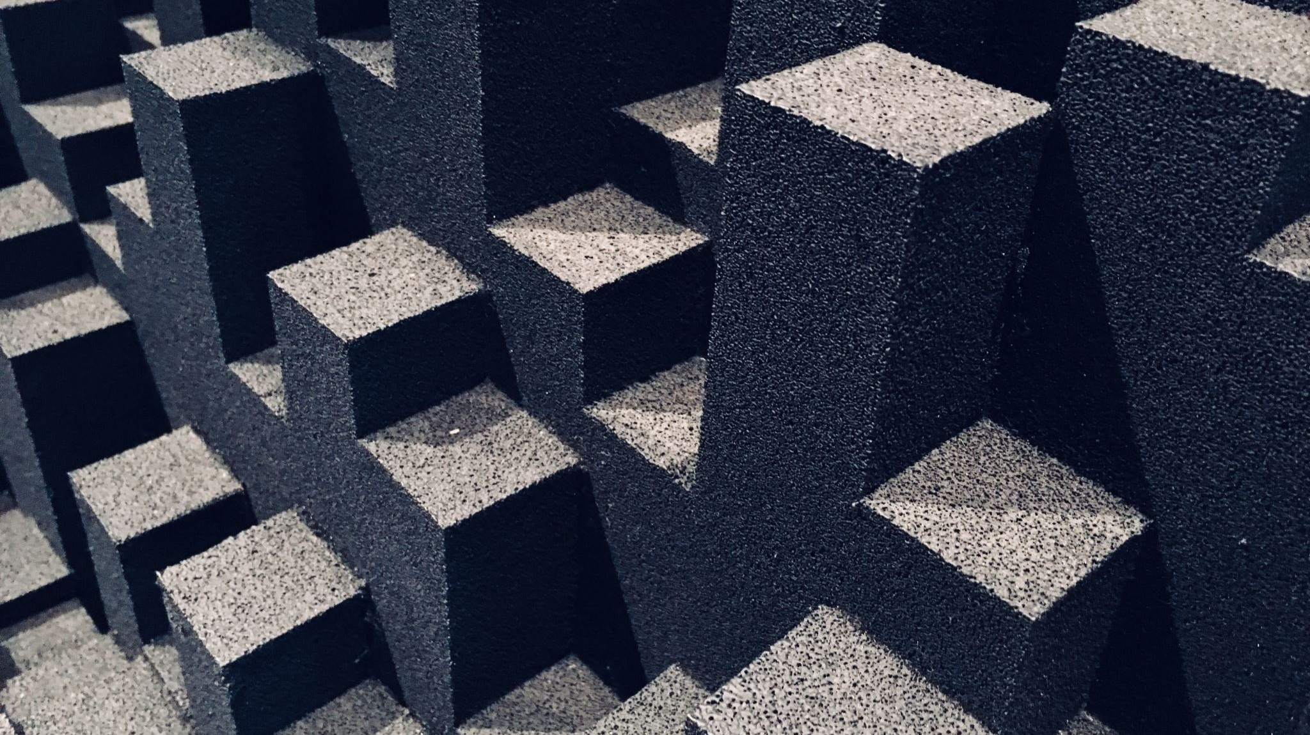
Task 5 – the wall of whispers & pendulum of doom

Slide 16
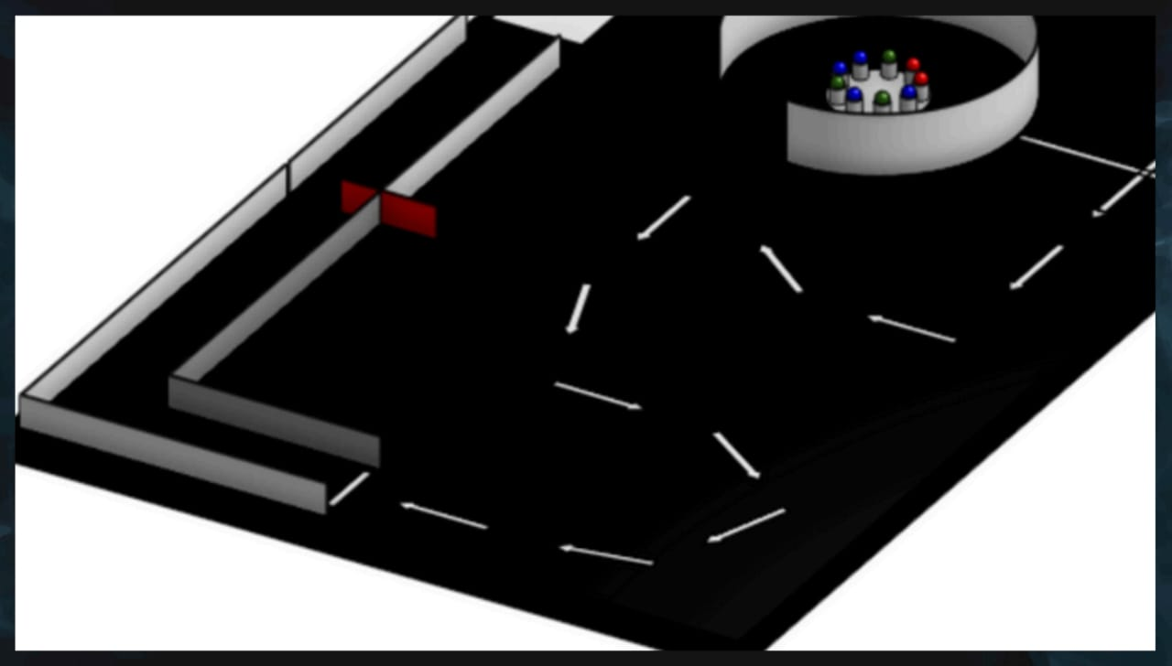
This task consists of 3 major phases.
Traversing the broken lines
THE HIDDEN TASK
Wall following & avoiding the pendulum
1.Traversing the broken
lines using IR sensor array:
Robot follow the direction of each line segment until it find the next line segment and then it will adjust the direction again.

Slide 17
2. Wall Following & Avoiding the Pendulum:
Using 2 Time of Flight sensors at two sides of the robot, it will go through two walls at a medium speed until it reaches the first junction and then it will move little bit slower until it detects the pendulum. Right after pendulum swings away, robot will move fast towards forward direction.
After coming towards the end of two walls, robot will end up staying on the white square with the aid of IR sensors. After correctly positioning the robot on the square, it will turn left towards the ring of triumph.

Slide 18
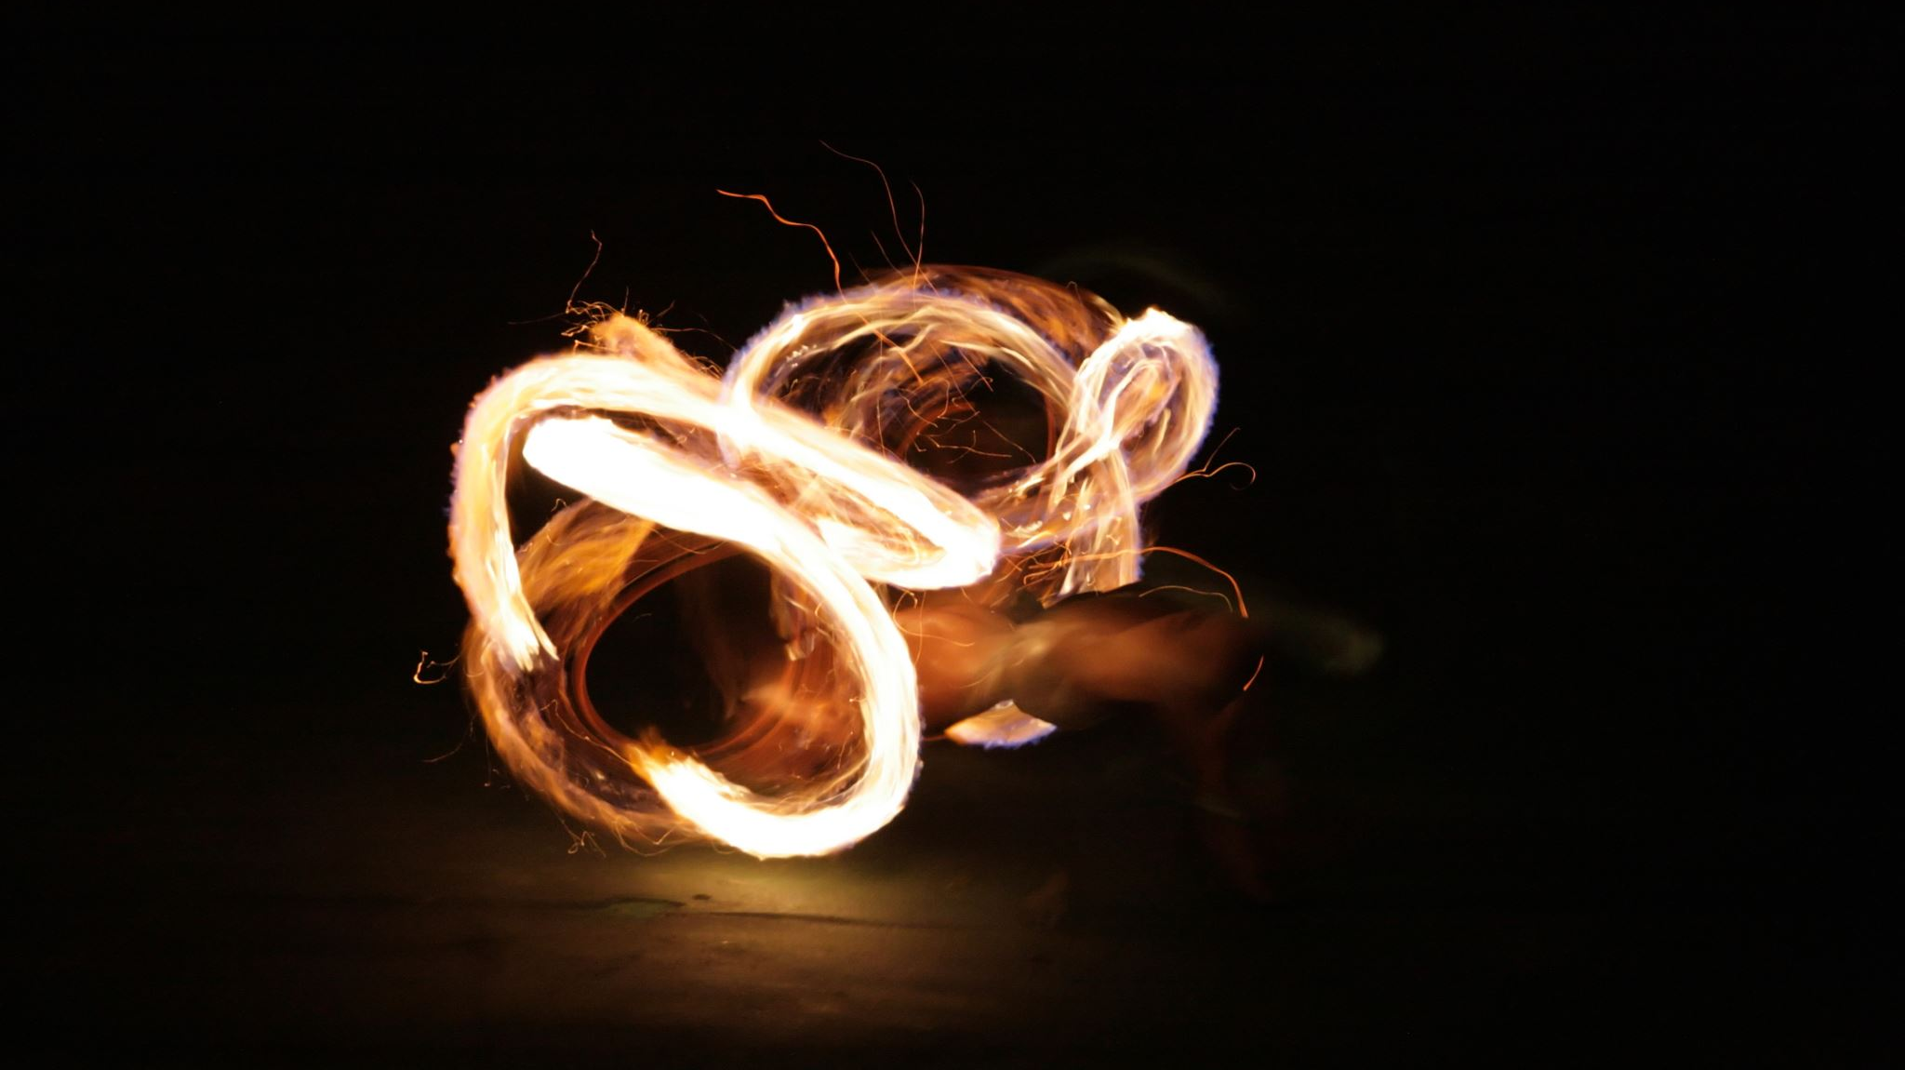
Task 6 – the line of destiny & the ring of triumph

Slide 19
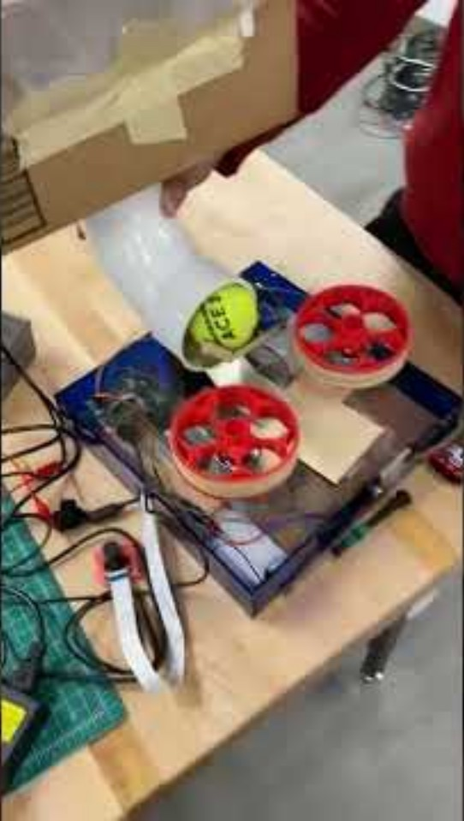
In this task we will try out 2 methods.
Method 01:
Balls will be shot towards the ring using two rotating motors. Using the mechanical arm, balls will be placed right in the middle of two motors.

Slide 20
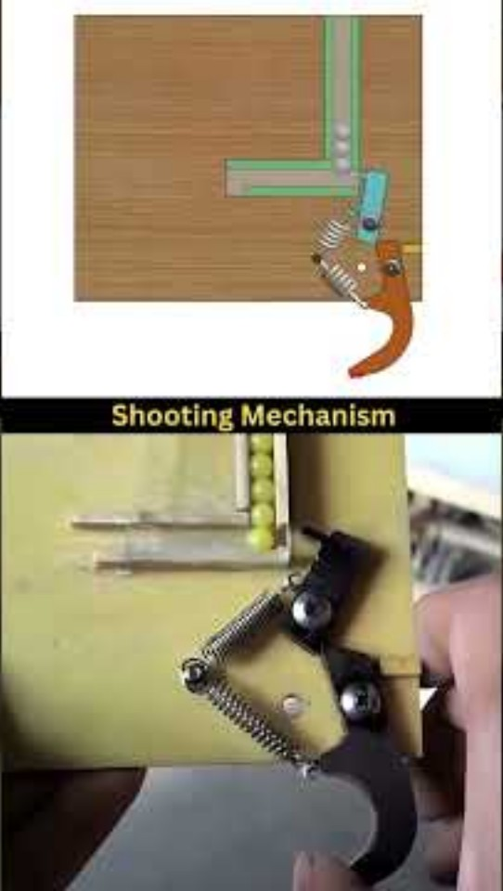
Method 02:
Balls will be shot using a triggering mechanism as follows. In this method, there will not be any need to place the ball again because, after picking balls, they will be stored in the container where the triggering mechanism is connected right beneath the container

Slide 21

The Budget

Slide 22
Component | Quantity | Unit Price (LKR) | Total (LKR)
Encoder motors | 2 | 3400 | 6800
Wheels | 2 | 100 | 200
Encoder motor driver | 1 | 320 | 320
Servo motors | 5 | 480 | 2400
Colour sensors | 3 | 760 | 2280
Buck converter | 1 | 180 | 180
Arduino mega | 1 | 4850 | 4850
Acrylic board | 1 | 1650 | 1650
IR sensor array | 1 | 480 | 480
ToF sensors | 3 | 600 | 1800
11.1V LiPo battery | 1 | 3000 | 3000
11.1V LiPo battery charger | 1 | 2500 | 2500
Ultrasonic sensor | 1 | 390 | 390
Robot arms (Materials, Laser cutting, 3D printing) |  |  | 3500
16 channel analog multiplexer | 1 | 450 | 450
Others |  |  | 750
Total |  |  | 31550

Slide 23
Q&A

