Slide 1
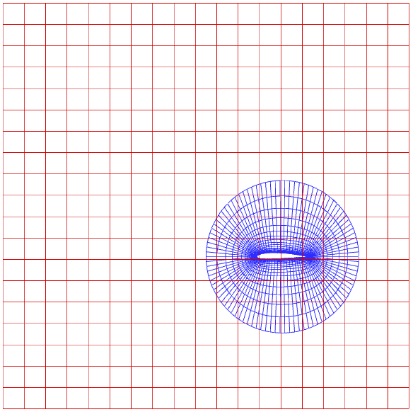
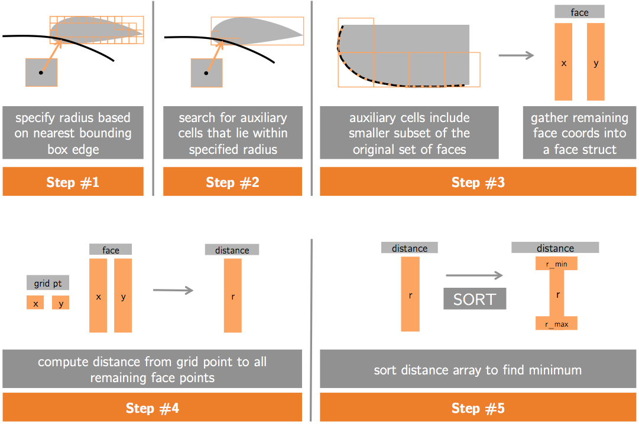
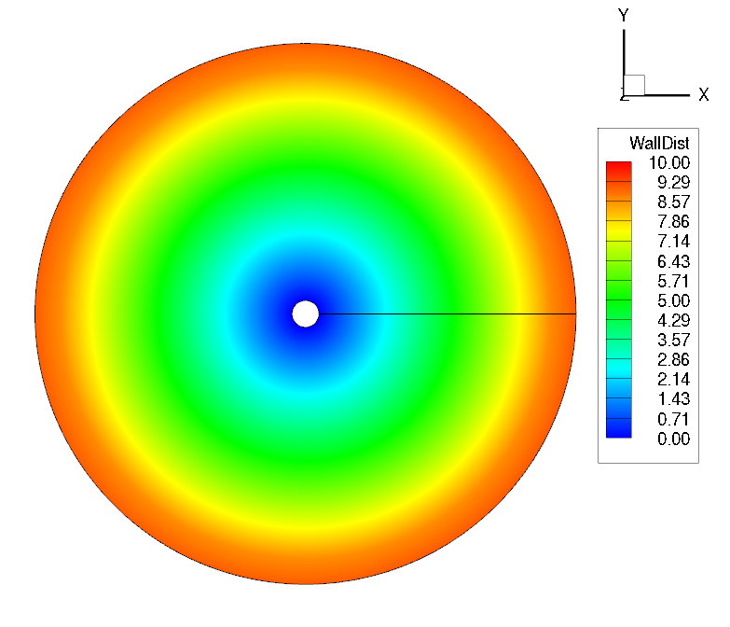
GPU acceleration of wall distance calculation for computational fluid dynamics codes
Nathan Wukie Vasanth Ganapathy Chris Park

Slide 2
Outline
Background
Brute-force algorithm
Advancing boundary algorithm

Slide 3
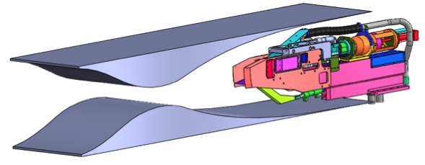
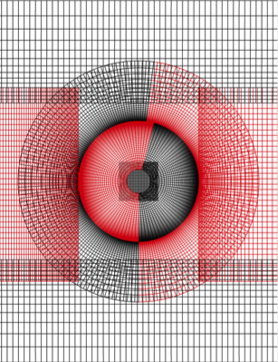
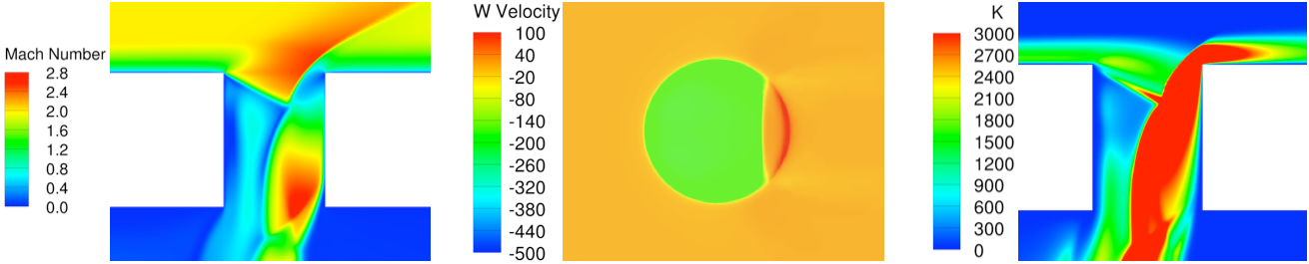
Background
Reynolds-Averaged Navier-Stokes calculation
Conservation of mass
Conservation of momentum
Conservation of energy
Wukie et al. 2012

Slide 4
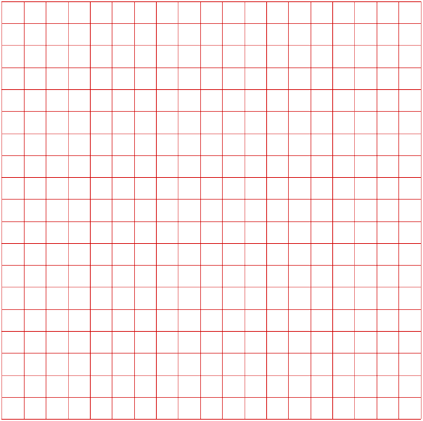
Background
Cell-centered, Finite Volume discretization
Solution variables stored at cell-center

Slide 5
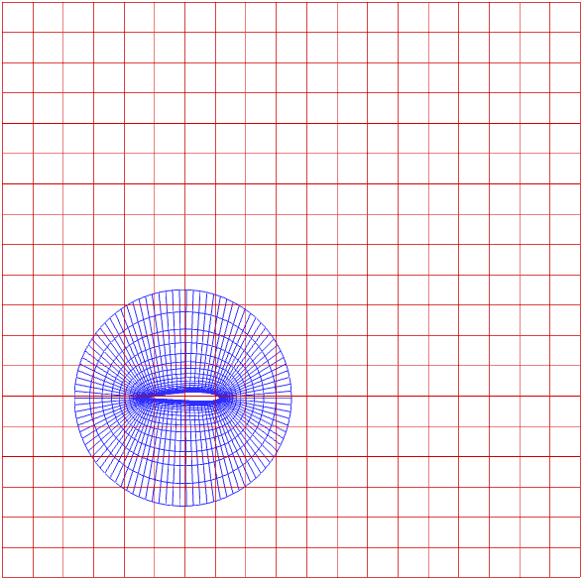
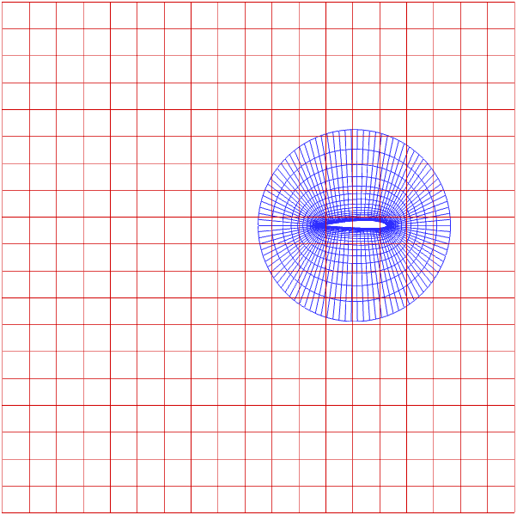
Background
Moving mesh calculation

Slide 6
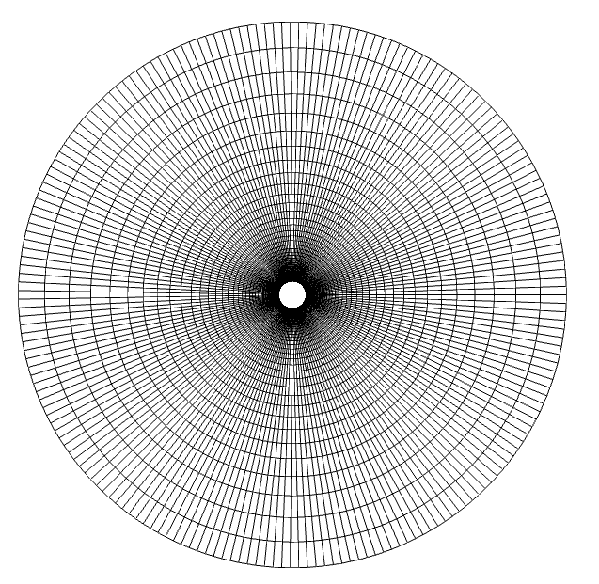
Background
Test case: circle
Computational grid
Wall distance field

Slide 7
Brute-force algorithm

Slide 8

Brute-force Algorithm Outline
For each cell element
Calculate its distance from each of the solid faces
Wall distance is the minimum of these distances
Face centers
$$\sqrt{{\left(xc−xf\right)}^{2}+{\left(yc −yf\right)}^{2}}$$
Cell centers
Wall distance for this cell = minimum distance from faces

Slide 9
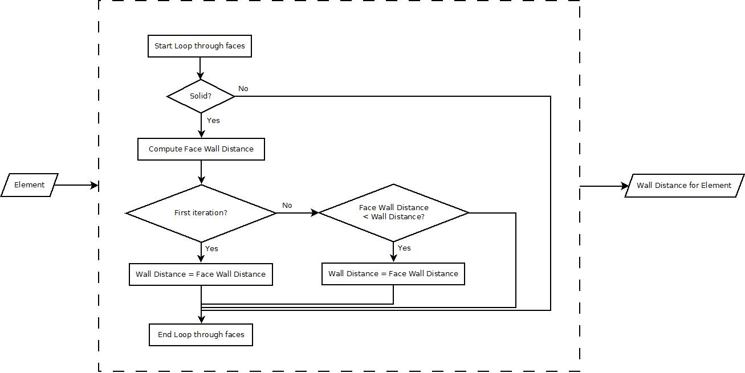
Brute-force – Serial

Slide 10
Brute-force – Parallel (Block Per Cell)
Each block calculates wall distance for a cell
Each thread calculates distance from a face
Reduce minimum to get wall distance
Face centers
Calculated by a thread
Cell centers
Reduce min per block to get wall distance for this cell

Slide 11
Brute-force – Parallel (Block Per Cell)
Implemented 3 variations
(A): Shared memory writes for face distances
(B): (A) + Shared memory reads to face (x, y) arrays
(C): Same as (B) with (x, y) arrays converted to an interspersed array for coalesced shared mem reads
i.e. x0, y0, x1, y1, ....

Slide 12
Brute-force – Parallel (Thread Per Cell)
Each thread calculates wall distance for a cell
Calculates distance from the cell to each of the faces
Keeps “running” min distance value as each faces distance gets calculated
Face centers
Loop within a thread calculates the distance
Cell centers
Running min distance per thread to get wall distance for this cell

Slide 13
Brute-force – Parallel (Thread Per Cell)
Implemented 3 variations
(A): Each thread calculates wall distance for a cell
(B): Shared memory reads to face (x, y) arrays
(C): Same as (A) with (x, y) arrays converted to an interspersed array for coalesced global mem reads
i.e. x0, y0, x1, y1, ....

Slide 14
Brute-force – Verification
Output from serial algorithm visually inspected for correctness
Outputs from parallel algorithms verified by comparing against serial algorithm output

Slide 15
Brute-force – Performance
Algorithm | Small Grid (msec) | Fine Grid (msec) | Extra Fine Grid (msec)
Serial | 33 | 595 | 13636
Block Per Cell (1A) - Shared mem writes | 1 | 28 | -
Block Per Cell (1B) - Shared mem reads | 1 | 30 | -
Block Per Cell (1C) - Coalesced shared mem reads | 1 | 31 | -
Thread Per Cell (2A) | <1 | 7 | 173
Thread Per Cell (2B) - Shared mem reads | 1 | 9 | 293
Thread Per Cell (2C) - Coalesced global mem reads | <1 | 7 | 166
82x speedup vs. serial

Slide 16
Advancing boundary algorithm

Slide 17
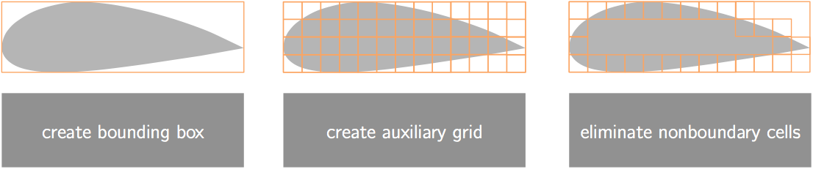
Advancing boundary algorithm
Background: Pre-processor
Goal: create a smaller subset of faces that need searched

Slide 18
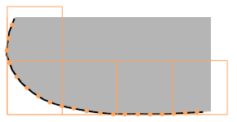
Advancing boundary algorithm
Background: Pre-processor
Goal: create a smaller subset of faces that need searched

Slide 19
Advancing boundary algorithm
Background: GPU-Kernel

Slide 20
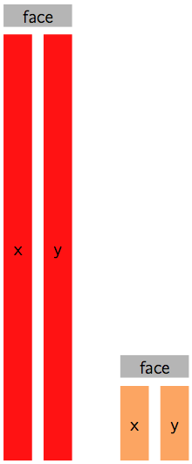
Advancing boundary algorithm
Background: GPU-Kernel
Original
Condensed

Slide 21
Advancing boundary algorithm
Background: GPU-Kernel

Slide 22
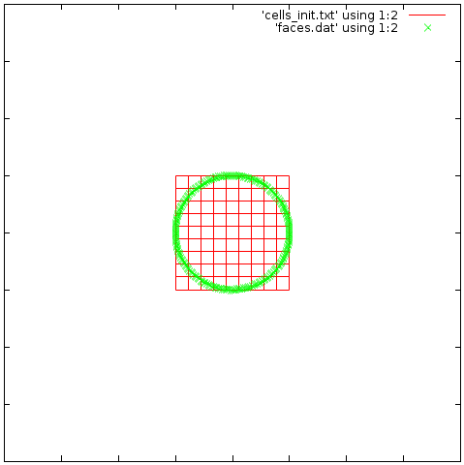
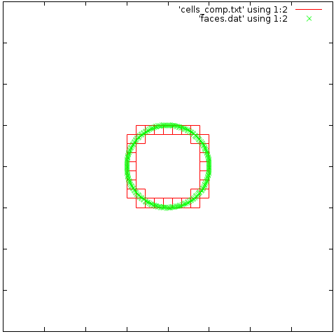
Advancing boundary algorithm
Implementation: Pre-processing

Slide 23
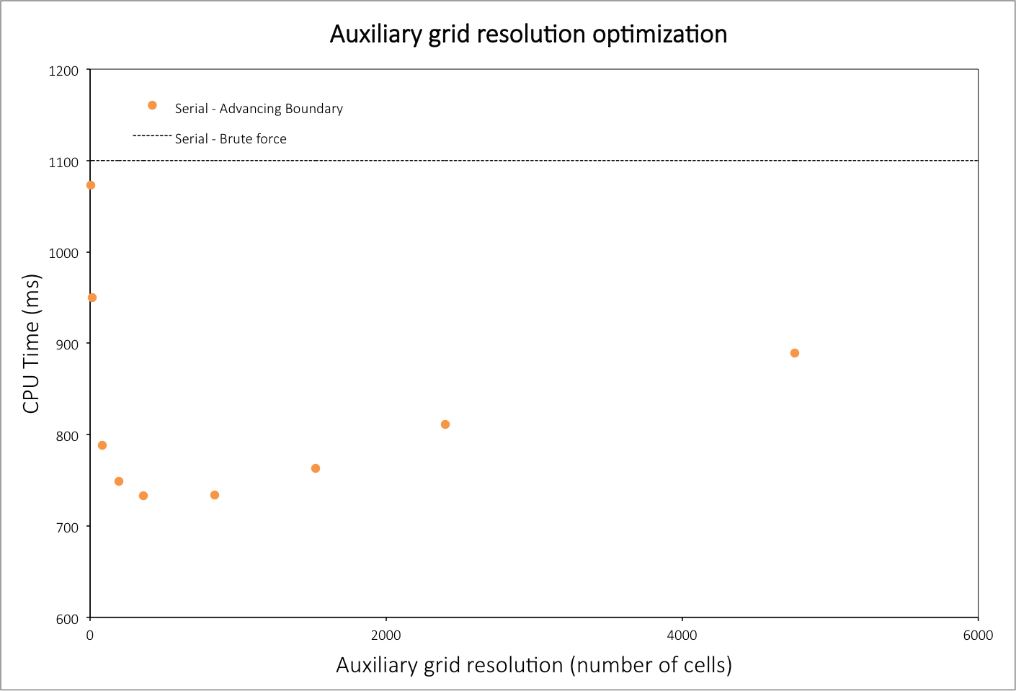

Slide 24
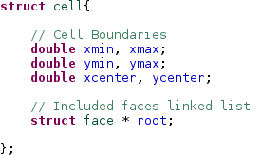
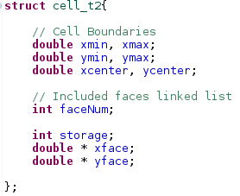
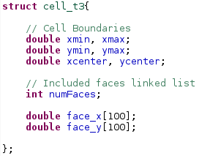
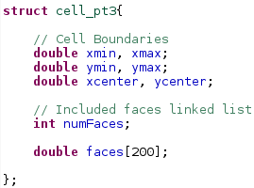
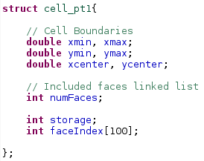
Advancing boundary algorithm
Implementation: Aux Cell Structs

Slide 25
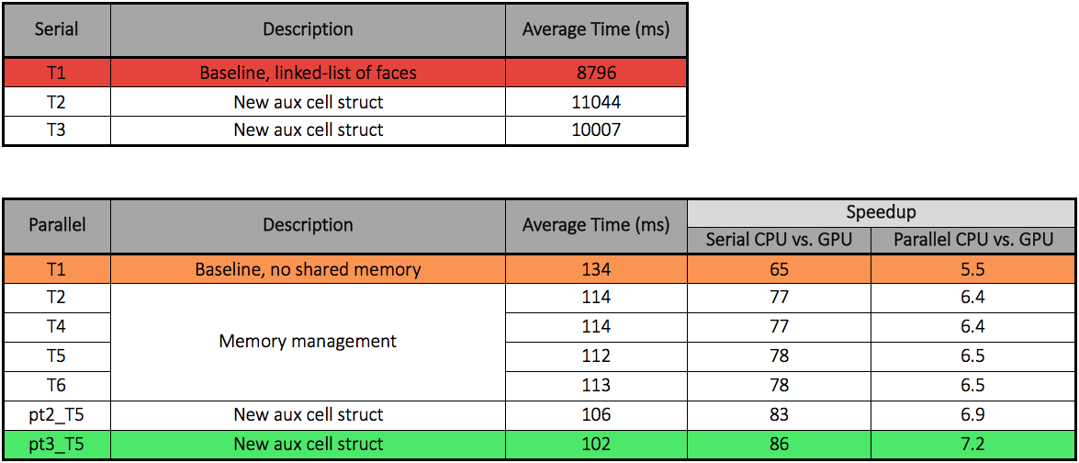
Advancing boundary algorithm

Slide 26
Conclusions
Successful GPU implementation of two wall distance algorithms
Order-of-magnitude type speedups realized

Slide 27
Thank you…

