Slide 1
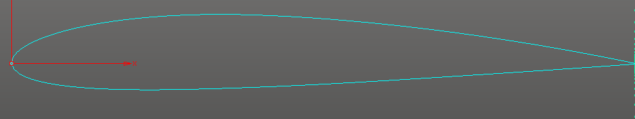

Slide 5
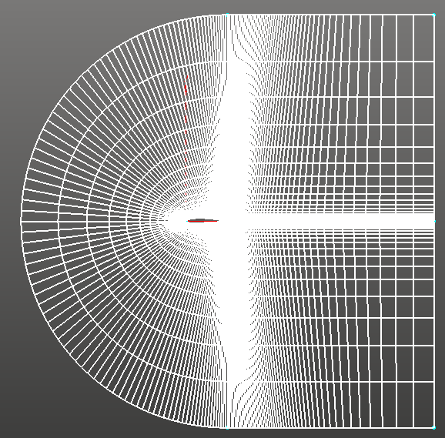
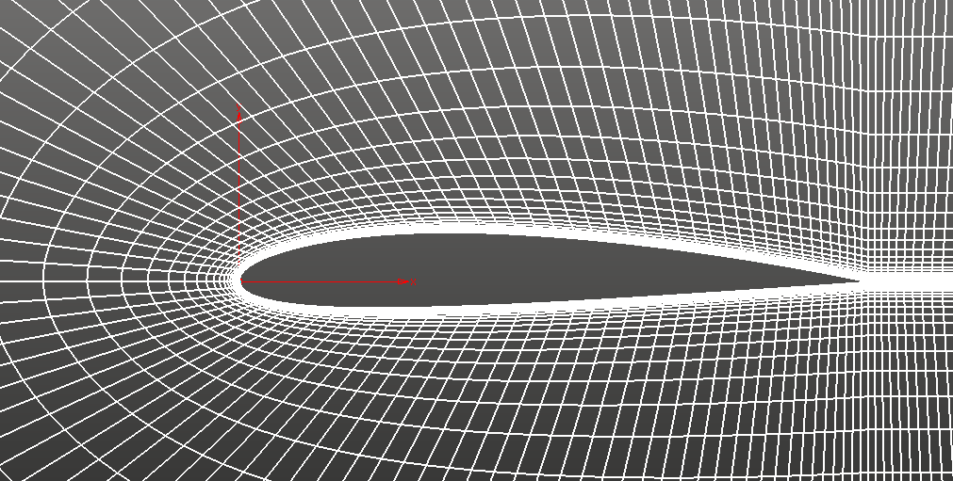

Slide 6
PRE-PROCESSING
Create bounding box
Create auxiliary grid
Eliminate nonboundary cells
min/max kernel on x,y face coords
Serial process
Serial process

Slide 7
For a given computational cell, specify radius based on nearest bounding box edge
Search for auxiliary cells that lie within specified radius
Kernel compact?

Slide 8
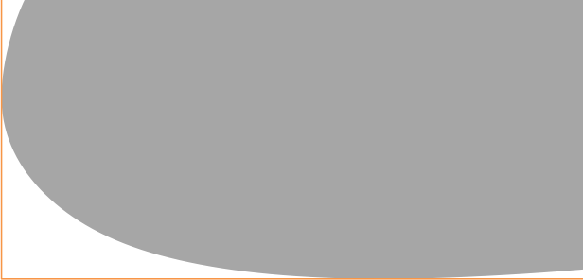
Search for auxiliary cells that lie within specified radius
These auxiliary cells include a smaller subset of the original set of faces that can then be sorted more quickly to find the minimum distance
Kernel reduce?

Slide 9
face
x
y
These auxiliary cells include a smaller subset of the original set of faces that can then be sorted more quickly to find the minimum distance
Gather remaining face coords into a face struct

Slide 10
face
distance
face
x
y
r
x
y
grid pt
x
y
Compute distance from grid point to all remaining face points
Gather remaining face coords into a face struct
map operation

Slide 11
face
distance
distance
x
y
r
r_min
r
grid pt
x
y
r_max
Compute distance from grid point to all remaining face points
Sort distance array to find minimum
map operation
sort kernel

Slide 12
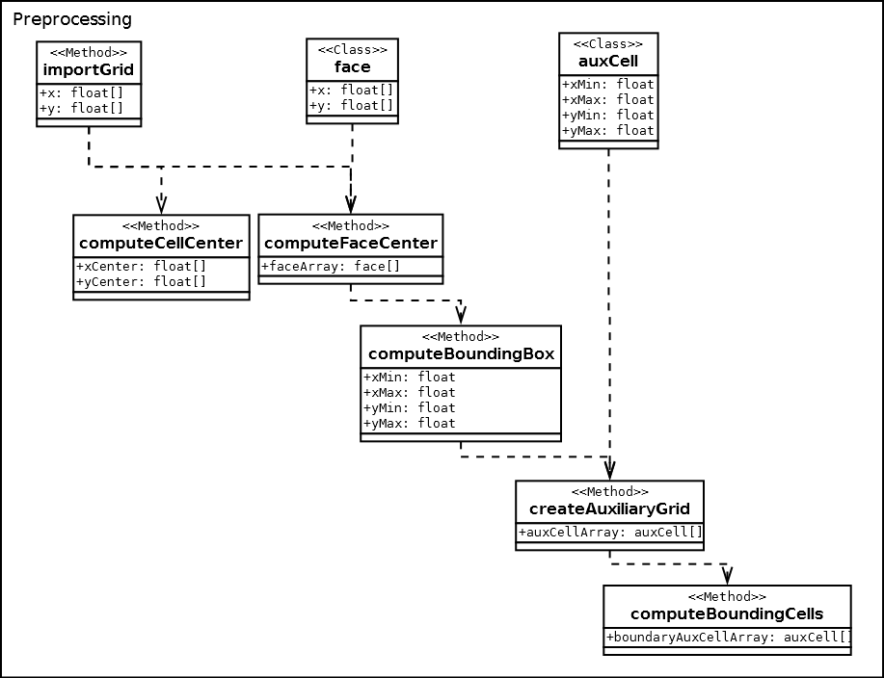

Slide 13
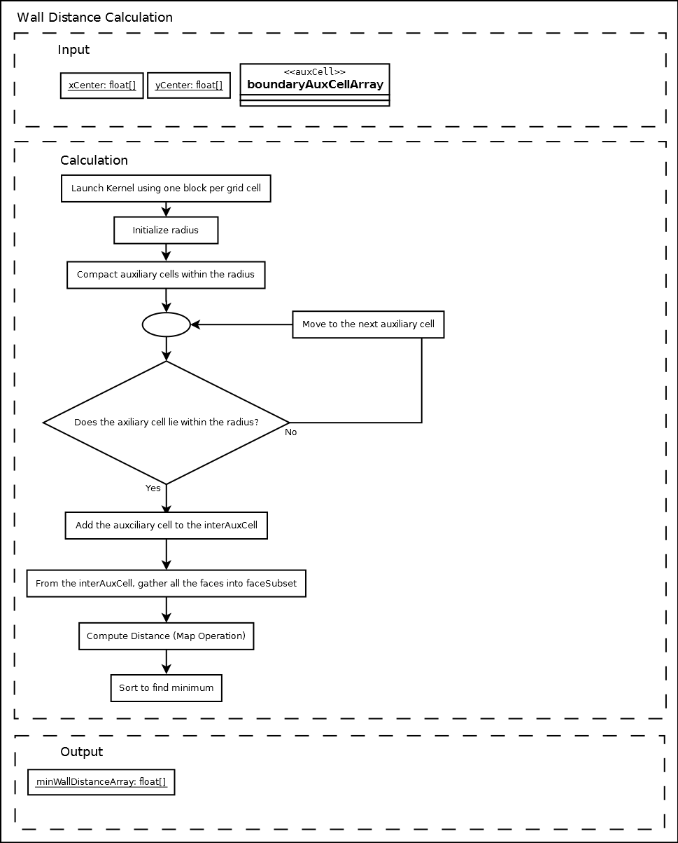
face
x
y
face
distance
x
y
r
grid pt
x
y
distance
distance
r_min
r
r
sort
r_max

