Slide 1
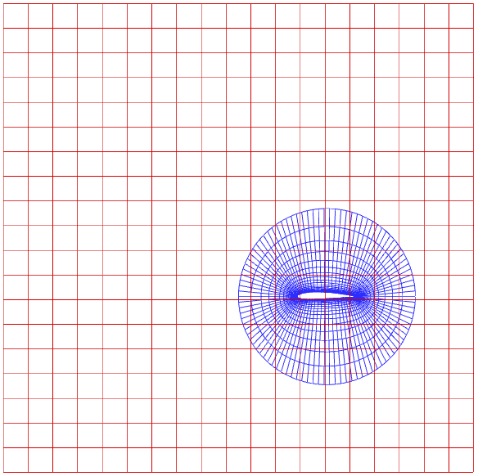
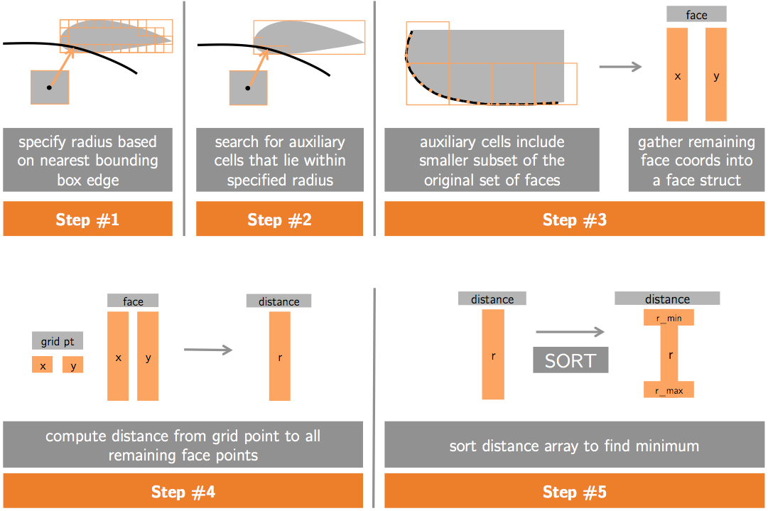
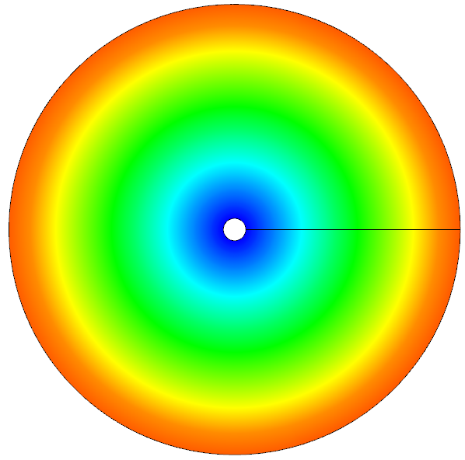
GPU acceleration of wall distance calculation for computational fluid dynamics codes
Nathan Wukie
Vasanth Ganapathy
Chris Park

Slide 2
Outline
Background (Nathan)
Brute-force algorithm (Vasanth)
Advancing boundary algorithm (Nathan)

Slide 3
Thank you…

