Slide 1
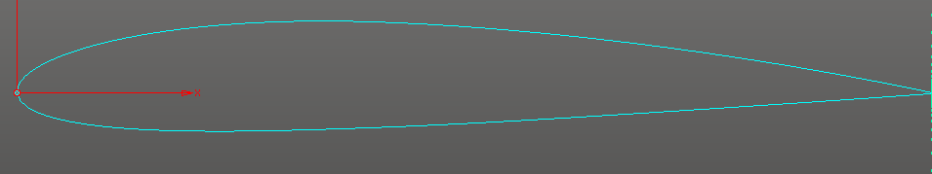

Slide 5
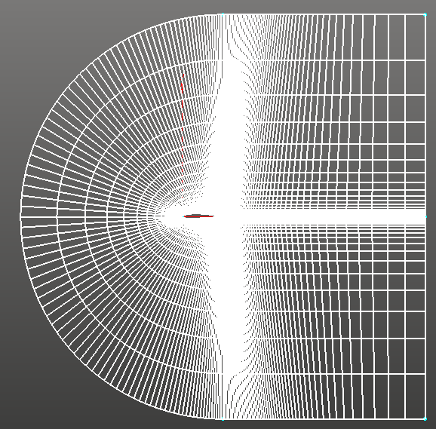
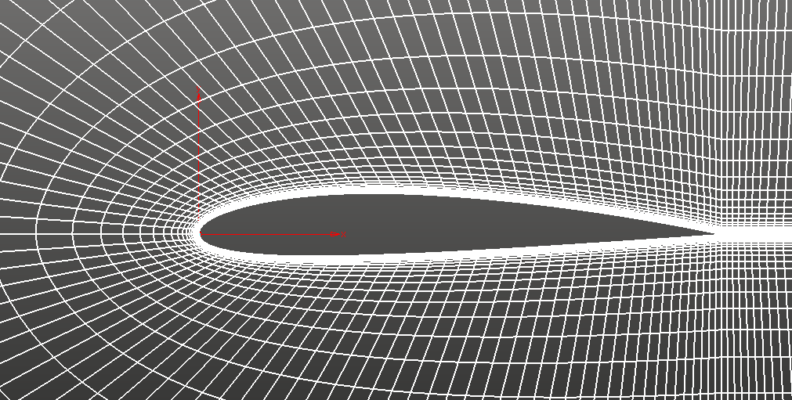

Slide 6
PRE-PROCESSING
create bounding box
create auxiliary grid
eliminate nonboundary cells
min/max sort kernel on x,y face coords
Serial process
Compact kernel

Slide 7
For a given computational cell, specify radius based on nearest bounding box edge
Search for auxiliary cells that lie within specified radius
Kernel compact

Slide 8
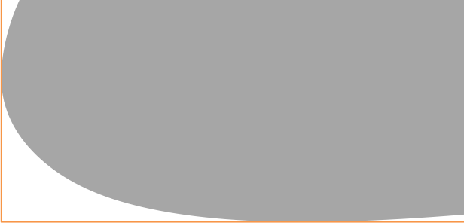
Search for auxiliary cells that lie within specified radius
These auxiliary cells include a smaller subset of the original set of faces that can then be sorted more quickly to find the minimum distance
Kernel compact

Slide 9
face
x
y
These auxiliary cells include a smaller subset of the original set of faces that can then be sorted more quickly to find the minimum distance
Gather remaining face coords into a face struct

Slide 10
face
distance
face
x
y
r
x
y
grid pt
x
y
Compute distance from grid point to all remaining face points
Gather remaining face coords into a face struct
map operation

Slide 11
face
distance
distance
x
y
r
r_min
r
grid pt
x
y
r_max
Compute distance from grid point to all remaining face points
Sort distance array to find minimum
map operation
sort kernel

Slide 12
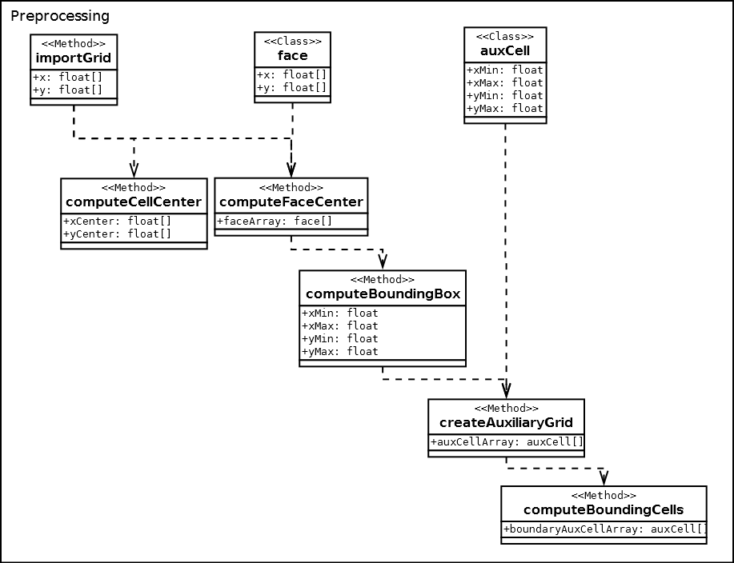

Slide 13
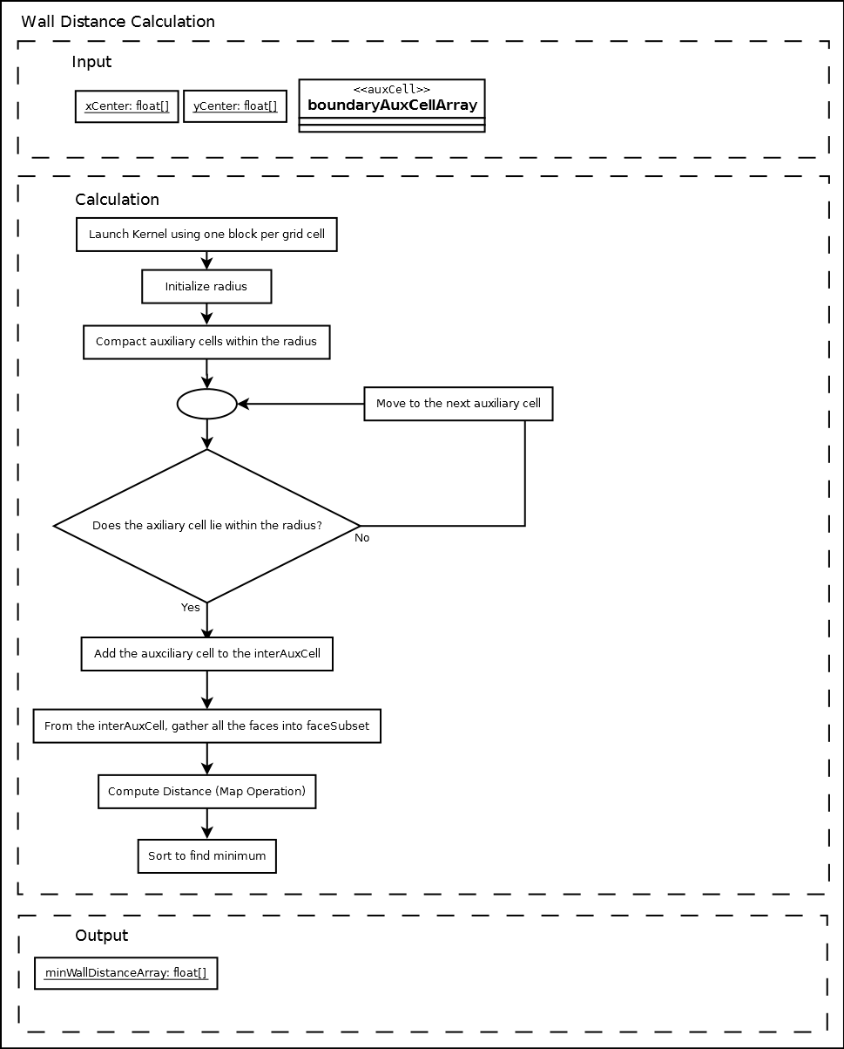
face
x
y
face
distance
x
y
r
grid pt
x
y
distance
distance
r_min
r
r
SORT
r_max

Slide 14
face
x
y
specify radius based on nearest bounding box edge
search for auxiliary cells that lie within specified radius
auxiliary cells include smaller subset of the original set of faces
gather remaining face coords into a face struct
Step #1
Step #2
Step #3
face
distance
distance
distance
r_min
x
y
r
r
r
grid pt
x
y
SORT
r_max
compute distance from grid point to all remaining face points
sort distance array to find minimum
Step #4
Step #5

Slide 15
for a given computational cell, specify radius based on nearest bounding box edge
search for auxiliary cells that lie within specified radius
compact kernel

Slide 16
face
x
y
these auxiliary cells include a smaller subset of the original set of faces that can then be sorted more quickly to find the minimum distance
gather remaining face coords into a face struct

Slide 17
face
distance
distance
x
y
r
r_min
r
grid pt
x
y
r_max
Compute distance from grid point to all remaining face points
Sort distance array to find minimum
map operation
sort kernel

Slide 18
PRE-PROCESSING
create bounding box
create auxiliary grid
eliminate nonboundary cells
min/max sort kernel on x,y face coords
Serial process
Compact kernel

Slide 19
face
x
y
face
x
y

