Slide 1
Photo-Realistic Single Image Super-Resolution Using a Generative Adversarial Network
Christian Ledig, Lucas Theis, Ferenc Husz´ar, Jose Caballero, Andrew Cunningham,
Alejandro Acosta, Andrew Aitken, Alykhan Tejani, Johannes Totz, Zehan Wang, Wenzhe Shi
Twitter
{cledig,ltheis,fhuszar,jcaballero,aacostadiaz,aaitken,atejani,jtotz,zehanw,wshi}@twitter.com
Published in CVPR 2017
汇报人：李文杰 王燕飞

Slide 2
contributions
We set a new state of the art for image SR with high upscaling factors (4×) as
measured by PSNR and structural similarity (SSIM) with our 16 blocks deep
ResNet (SRResNet) optimized for MSE.
We propose SRGAN which is a GAN-based network optimized for a new perceptual loss. Here we replace the MSE-based content loss with a loss calculated on feature maps of the VGG network , which are more invariant to changes in pixel space .
We confirm with an extensive mean opinion score (MOS) test on images from three public benchmark datasets that SRGAN is the new state of the art, by a large margin,for the estimation of photo-realistic SR images with high upscaling factors (4×).

Slide 3
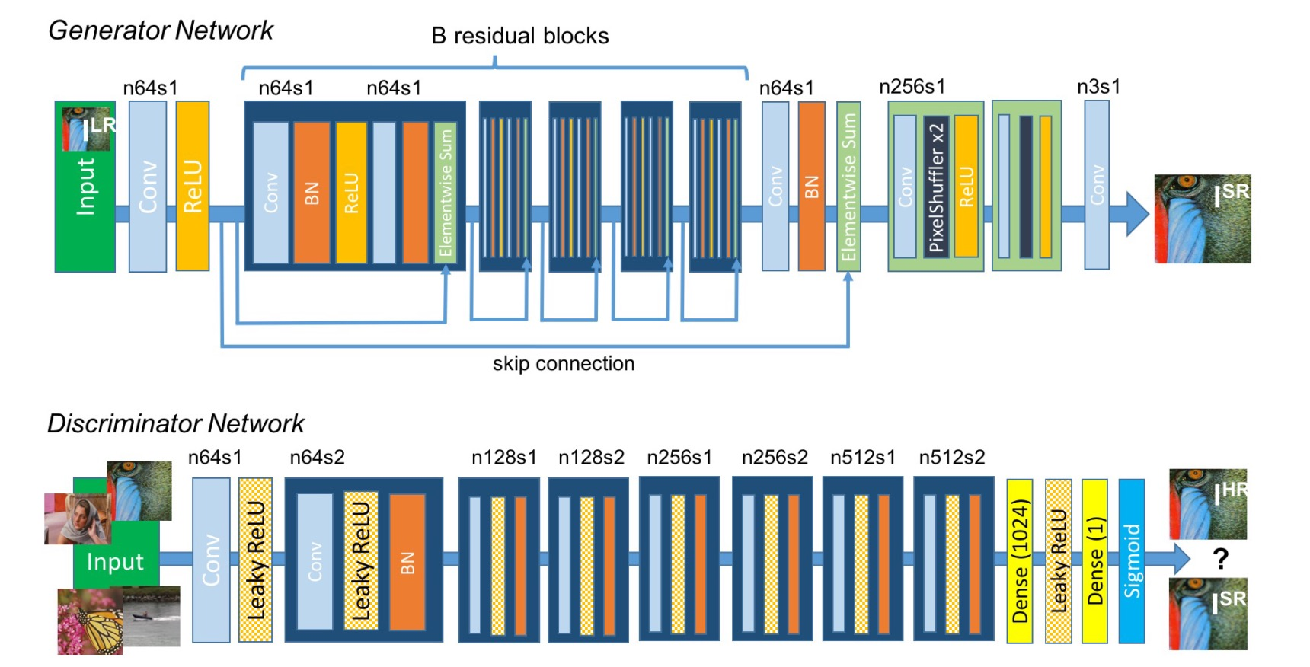
Architecture of Generator and Discriminator Network

Slide 4
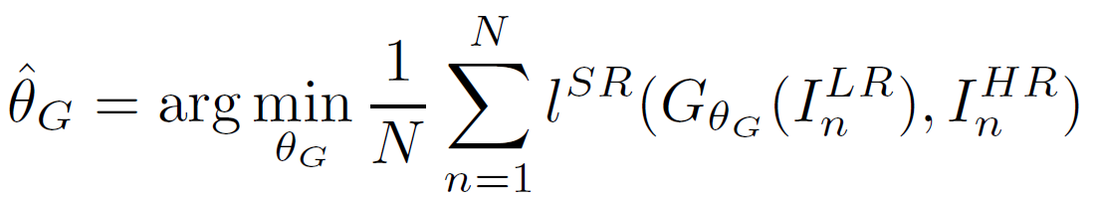
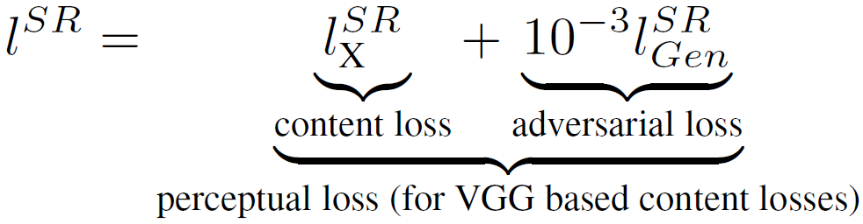

Loss function
Discriminator:
$$l_{D}=−\sum_{n=1}^{N}{(\log{D_{θ_{D}}\left(I^{HR}\right)}+\log{{(1−D}_{θ_{D}}\left(G_{θ_{G}}(I^{LR})\right)}))}$$
Generator:

Slide 5
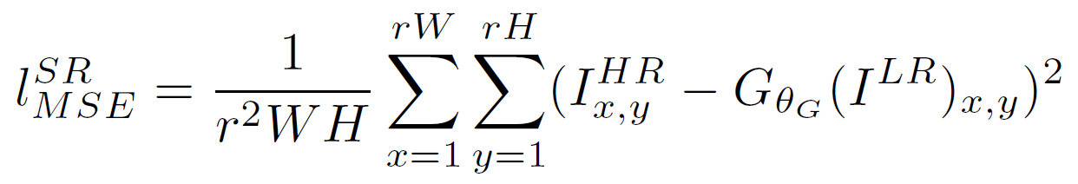
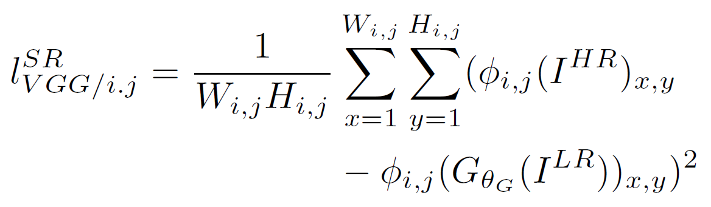
Content loss
The pixel-wise MSE loss:
The VGG loss:

Slide 6
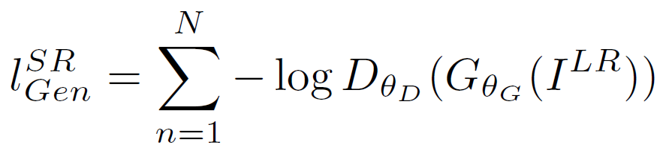
Adversarial loss

Slide 7
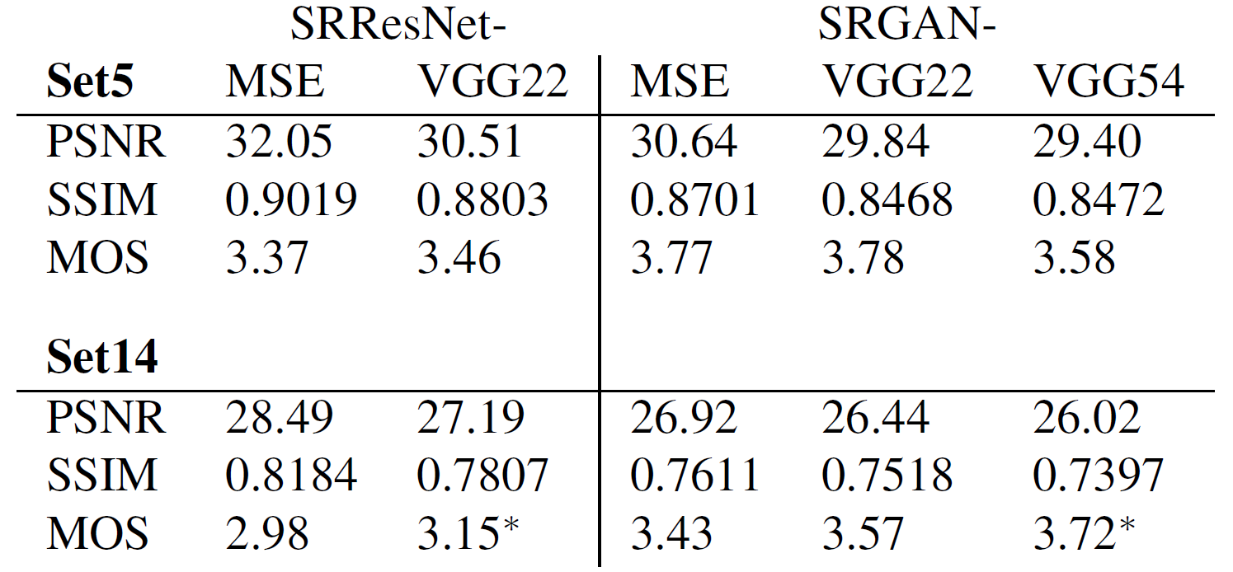
Experiments
Performance of different loss functions for SRResNet and the adversarial networks on Set5 and Set14 benchmark data

Slide 8
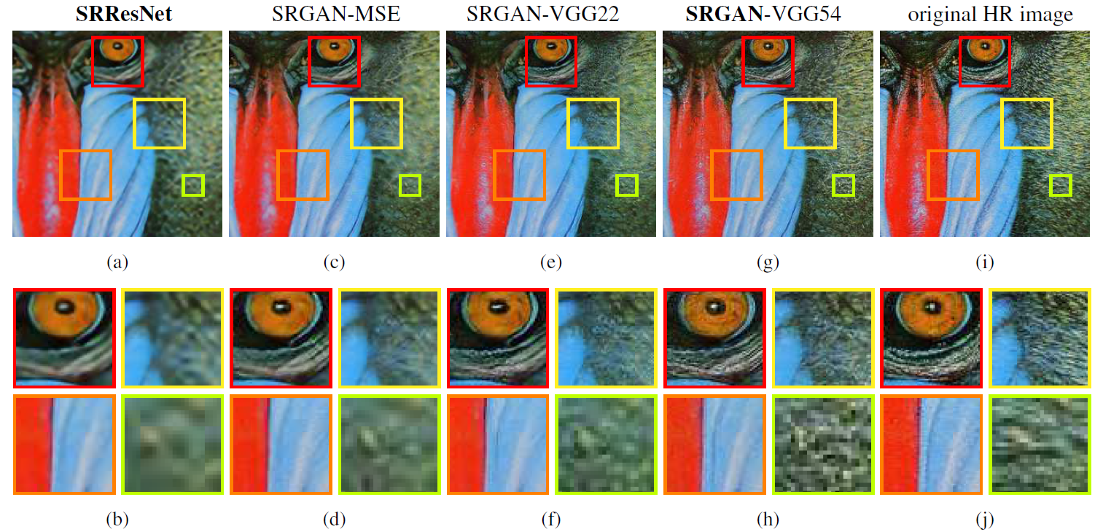
Experiments

Slide 9
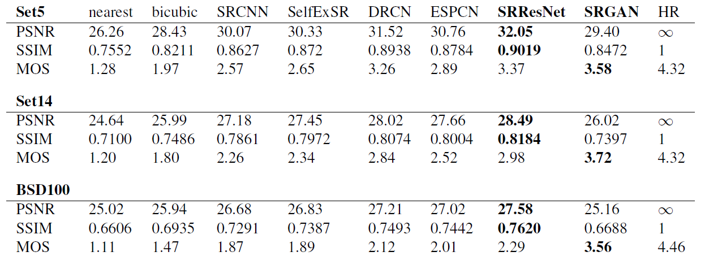
Experiments
Comparison of NN, bicubic, SRCNN, SelfExSR, DRCN, ESPCN, SRResNet, SRGAN-VGG54 and the original HR on benchmark data. Highest measures (PSNR [dB], SSIM, MOS) in bold. [4× upscaling]

Slide 10
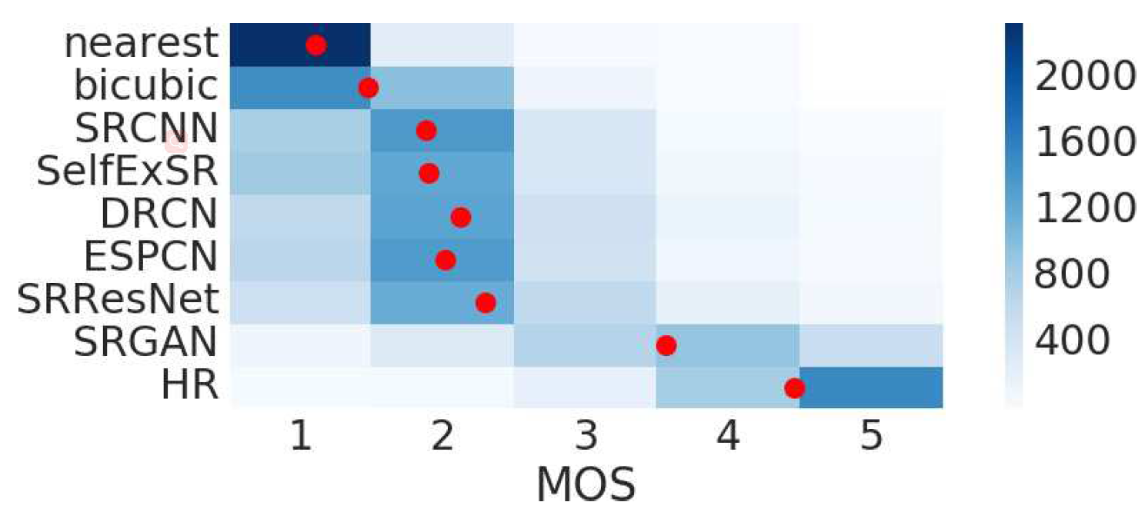
Experiments
Color-coded distribution of MOS scores on BSD100. For each method 2600 samples (100 images ×26 raters) were assessed. Mean shown as red marker, where the bins are centered around value i. [4× upscaling]

Slide 11
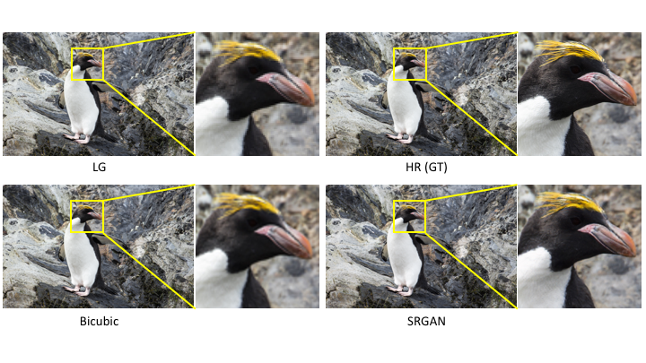
Experiments

Slide 12
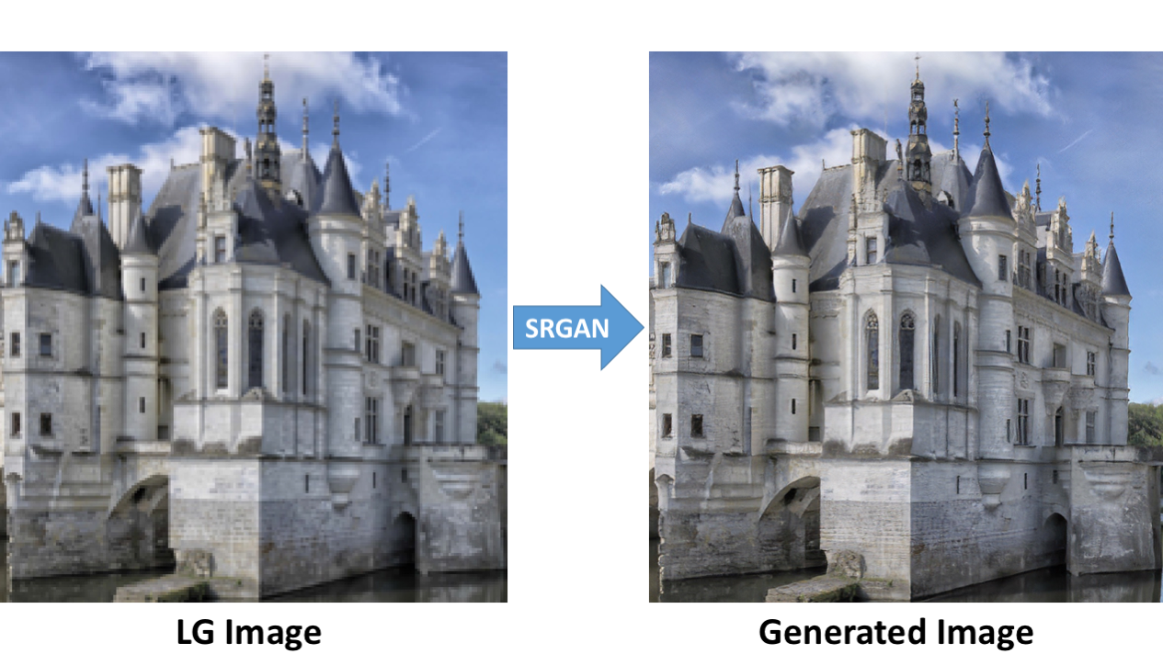
Experiments

