Slide 1
Project Basic Security
Daan Bergmans
Sander Elsen
Brecht Neyens
Maurits Seelen
2TinE

Slide 2
Inhoudsopgave
Appdev aspect
Systems & networks aspect
IT management aspect
1

Slide 3
Appdev aspect
onderdelen
Hybrid cryptografie
File types
Demo
2

Slide 4
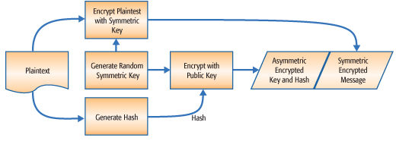
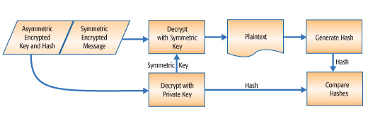
Appdev aspect
Hybrid cryptografie
3

Slide 5
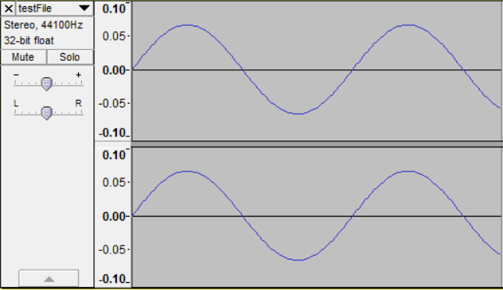
Appdev aspect
File types
Text
Geluid
Afbeelding
4

Slide 6
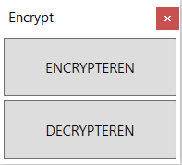
Appdev aspect
demo
5

Slide 7
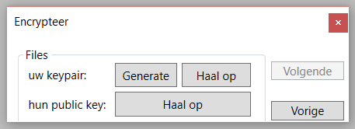
Appdev aspect
demo
6

Slide 8
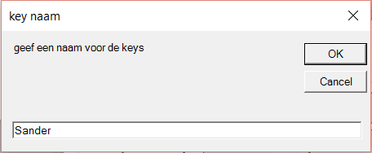
Appdev aspect
demo
7

Slide 9
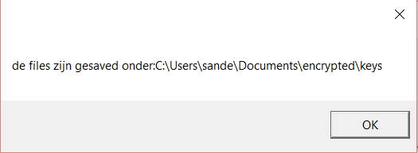
Appdev aspect
demo
8

Slide 10
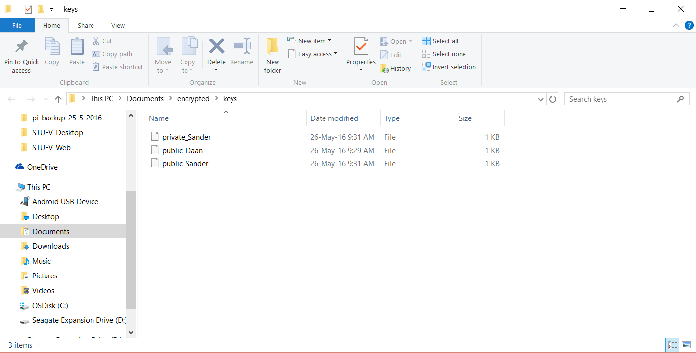

Appdev aspect
demo
9

Slide 11
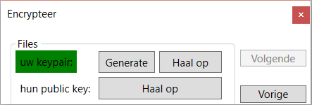
Appdev aspect
demo
10

Slide 12
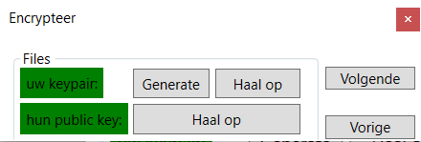
Appdev aspect
demo
11

Slide 13
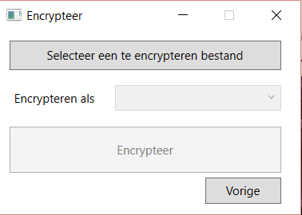
Appdev aspect
demo
12

Slide 14
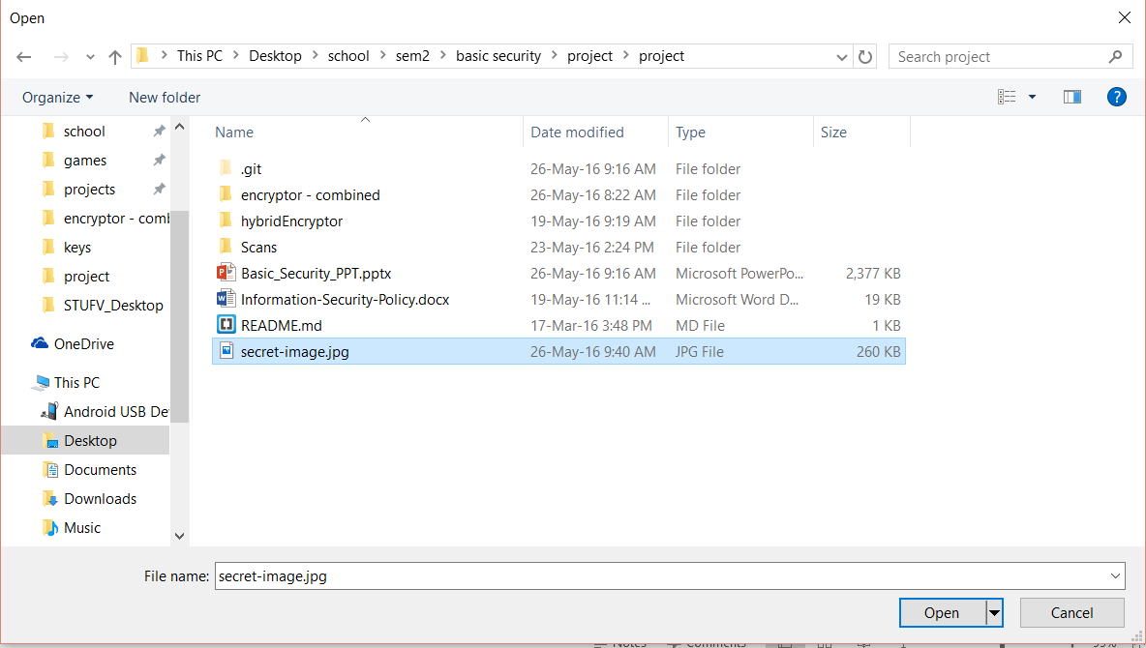
Appdev aspect
demo
13

Slide 15
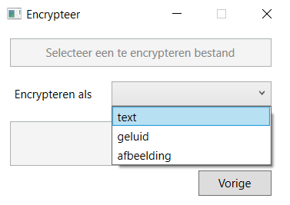
Appdev aspect
demo
14

Slide 16
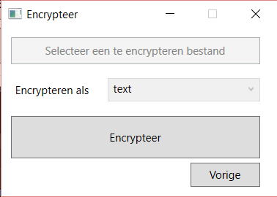
Appdev aspect
demo
15

Slide 17
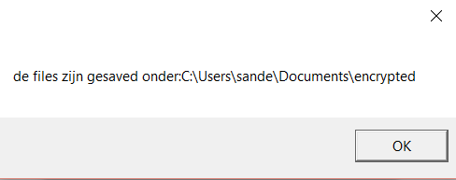
Appdev aspect
demo
16

Slide 18
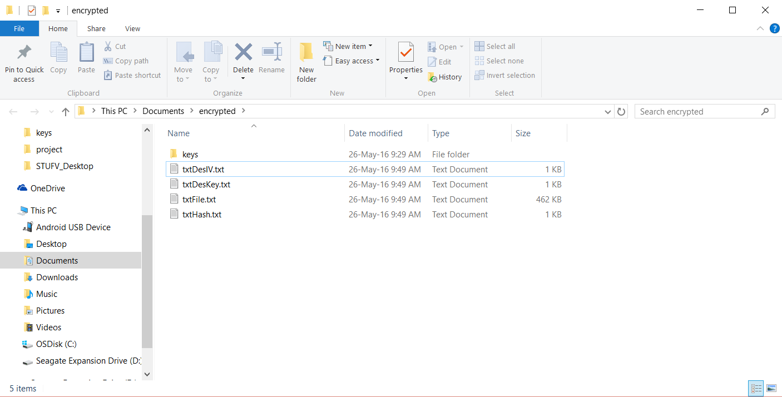
Appdev aspect
demo
17

Slide 19
Appdev aspect
demo
18

Slide 20
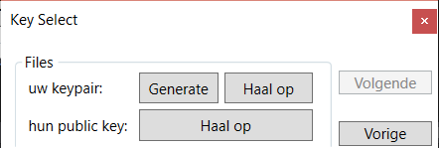
Appdev aspect
demo
19

Slide 21
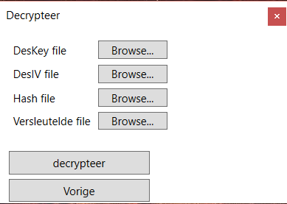
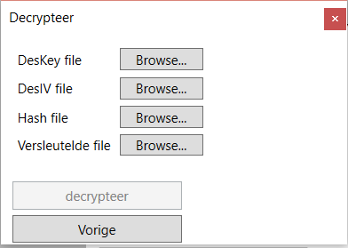
Appdev aspect
demo
20

Slide 22
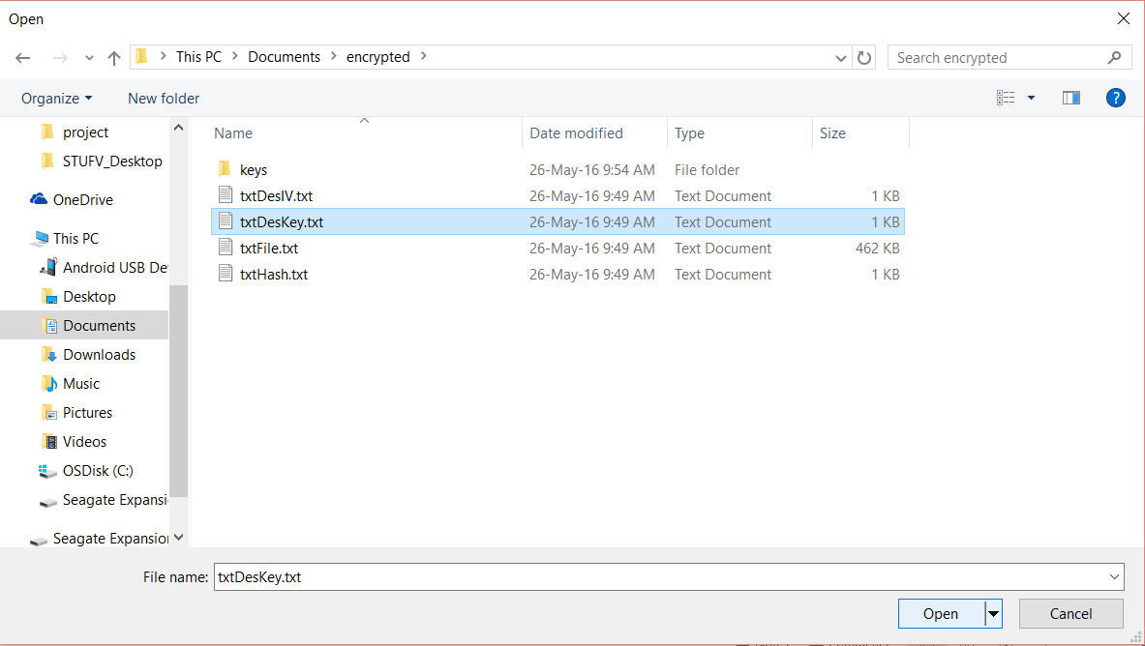
Appdev aspect
demo
21

Slide 23
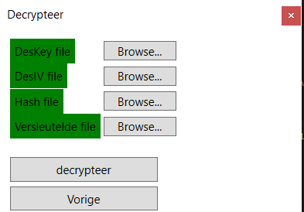
Appdev aspect
demo
22

Slide 24
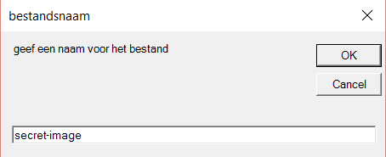
Appdev aspect
demo
23

Slide 25
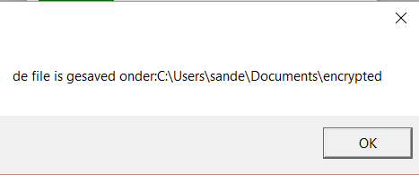
Appdev aspect
demo
24

Slide 26
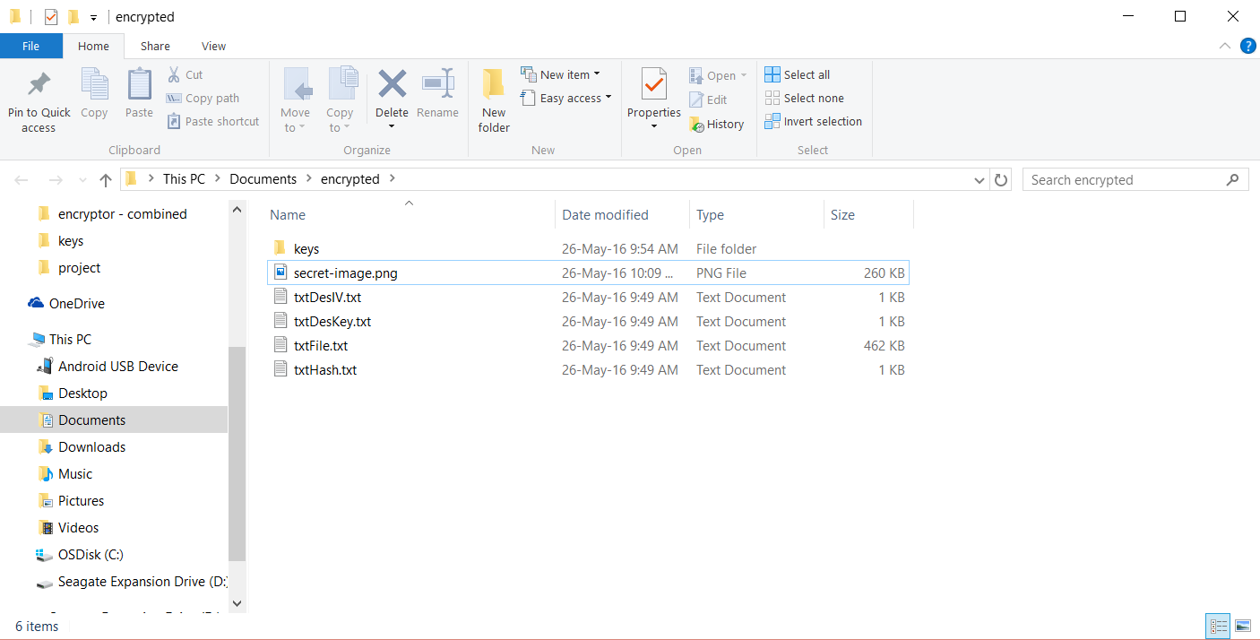
Appdev aspect
demo
25

Slide 27

Appdev aspect
demo
26

Slide 28
Systems & networks aspect
onderdelen
Nessus:
Windows
Metasploitable
OpenVas:
Windows
Metasploitable
Armitage:
Windows
Metasploitable
Conclusie
27

Slide 29
Systems & networks aspect
Nessus: Windows
Met firewall:
geen vulnerabilities
Zonder firewall:
1 kritiek
2 gemiddeld
1 laag
28
Notes:
4 vulnerabilities bespreken!
blauw is info (zoals DNS server detection, VMware Virtual Machine Detection

Slide 30
Systems & networks aspect
Nessus: Windows: Vulnerability 1
Vulnerability 1:
Microsoft Windows XP Unsupported Installation Detection
Kritiek
Upgraden
29
Notes:
4 vulnerabilities bespreken!
blauw is info (zoals DNS server detection, VMware Virtual Machine Detection

Slide 31
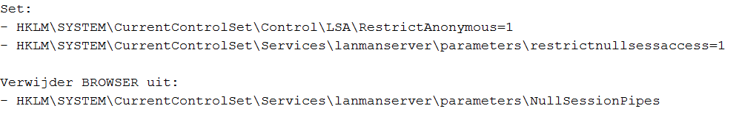
Systems & networks aspect
Nessus: Windows: Vulnerability 2
Vulnerability 2:
Microsoft Windows SMB NULL Session Authenticator
Gemiddeld
Registry veranderingen uitvoeren
30
Notes:
4 vulnerabilities bespreken!
blauw is info (zoals DNS server detection, VMware Virtual Machine Detection

Slide 32
Systems & networks aspect
Nessus: Windows: Vulnerability 3
Vulnerability 3:
SMB Signing Disabled
Gemiddeld
Berichtondertekening afdwingen (policy)
31
Notes:
4 vulnerabilities bespreken!
blauw is info (zoals DNS server detection, VMware Virtual Machine Detection

Slide 33
Systems & networks aspect
Nessus: Windows: Vulnerability 4
Vulnerability 4:
Multiple Ethernet Driver Frame Padding Information Disclosure
Laag
Verkoper contacteren
32
Notes:
4 vulnerabilities bespreken!
blauw is info (zoals DNS server detection, VMware Virtual Machine Detection

Slide 34
Systems & networks aspect
Nessus: Metasploitable
Vulnerabilities:
5 kritiek
4 hoog
22 gemiddeld
4 laag
110 info
33
Notes:
5 vulnerabilities bespreken

Slide 35
Systems & networks aspect
Nessus: Metasploitable: Vulnerability 1
Vulnerability 1:
Debian OpenSSH Package Random Number Generator Weakness
Kritiek
SSH, SSL en OpenVPN sleutels hergenereren
34
Notes:
5 vulnerabilities bespreken

Slide 36
Systems & networks aspect
Nessus: Metasploitable: Vulnerability 2
Vulnerability 2:
Rexecd Service Detection
Kritiek
'exec' regel in /etc/inetd.conf in commentaar zetten en inetd proces herstarten
35
Notes:
5 vulnerabilities bespreken

Slide 37
Systems & networks aspect
Nessus: Metasploitable: Vulnerability 3
Vulnerability 3:
Rogue Shell Backdoor Detection
Kritiek
Remote host gecompromitteerd => systeem herinstalleren
36
Notes:
5 vulnerabilities bespreken

Slide 38
Systems & networks aspect
Nessus: Metasploitable: Vulnerability 4
Vulnerability 4:
Unsupported Unix Operating System
Kritiek
Versie upgraden
37
Notes:
5 vulnerabilities bespreken

Slide 39
Systems & networks aspect
Nessus: Metasploitable: Vulnerability 5
Vulnerability 5:
VNC Server 'password' Password
Kritiek
Wachtwoord veranderen
38
Notes:
5 vulnerabilities bespreken

Slide 40

Systems & networks aspect
Openvas: Windows
Vulnerabilities:
2 kritiek
1 gemiddeld
39
Notes:
3 vulnerabilities bespreken

Slide 41
Systems & networks aspect
Openvas: Windows: Vulnerability 1
Vulnerability 1:
Vulnerabilities in SMB Could Allow Remote Code Execution
Kritiek
Windows update
40
Notes:
3 vulnerabilities bespreken

Slide 42
Systems & networks aspect
Openvas: Windows: Vulnerability 2
Vulnerability 2:
Microsoft Windows SMG Server NTLM Multiple vulnerabilities
Kritiek
Windows update
41
Notes:
3 vulnerabilities bespreken

Slide 43
Systems & networks aspect
Openvas: Windows: Vulnerability 3
Vulnerability 3:
DCE Services Enumeration
Gemiddeld
Traffic op de poort filteren
42
Notes:
3 vulnerabilities bespreken

Slide 44

Systems & networks aspect
Openvas: Metasploitable
Met firewall:
geen vulnerabilities
Zonder firewall:
21 kritiek
36 gemiddeld
6 laag
77 info
43
Notes:
4 vulnerabilities bespreken

Slide 45
Systems & networks aspect
Openvas: Metasploitable: Vulnerability 1
Vulnerability 1:
X Server
Kritiek
Connecties op poort 6000-6009 filteren
44
Notes:
4 vulnerabilities bespreken

Slide 46
Systems & networks aspect
Openvas: Metasploitable: Vulnerability 2
Vulnerability 2:
ProFTPD Multiple Remote Vulnerabilities
Kritiek
Upgrade naar ProFTPD version 1.3.3c
45
Notes:
4 vulnerabilities bespreken

Slide 47
Systems & networks aspect
Openvas: Metasploitable: Vulnerability 3
Vulnerability 3:
Possible Backdoor: ingreslock
Kritiek
/etc/inetd.conf restoren
Ongeauthorizeerde configuratie files verwijderen (bvb /tmp/bob)
Inetd proces herstarten
46
Notes:
4 vulnerabilities bespreken

Slide 48
Systems & networks aspect
Openvas: Metasploitable: Vulnerability 4
Vulnerability 4:
Distcc Remote Code Execution Vulnerability
Kritiek
Updates van verkoper uitvoeren
47
Notes:
4 vulnerabilities bespreken

Slide 49
Systems & networks aspect
Armitage: Windows
Exploits:
dcerpc/ms03_023_dcom
smb/ms08_067_netapi
48

Slide 50
Systems & networks aspect
Armitage: Windows: Exploit 1
Exploit 1:
dcerpc/ms03_023_dcom
Stack buffer overflow
Updates uitvoeren
49

Slide 51
Systems & networks aspect
Armitage: Windows: Exploit 2
Exploit 2:
smb/ms08_067_netapi
Parsing flaw in pad standaardisatie in netapi32.dll
Updates uitvoeren
50

Slide 52
Systems & networks aspect
Armitage: Metasploitable
Exploits:
ftp/vsftpd_234_backdoor
ssh/symantec_smg_ssh
php/cakephp_cache_corruption
misc/legend_bot_exec
wyse/hagent_untrusted_hsdata
51

Slide 53
Systems & networks aspect
Armitage: Metasploitable: Exploit 1
Exploit 1:
ftp/vsftpd_234_backdoor
Backdoor
VSFTPD updaten
52

Slide 54
Systems & networks aspect
Armitage: Metasploitable: Exploit 2
Exploit 2:
ssh/symantec_smg_ssh
Default configuratie => wachtwoord bekend
Symantec Messaging Gateway updaten
53

Slide 55
Systems & networks aspect
Armitage: Metasploitable: Exploit 3
Exploit 3:
php/cakephp_cache_corruption
Aanvallen uitvoeren met permissies van webserver zelf
CakePHP updaten
54

Slide 56
Systems & networks aspect
Armitage: Metasploitable: Exploit 4
Exploit 4:
misc/legend_bot_exec
Exploiteert een perl IRC bot
Geen code remote laten uitvoeren door ongeauthorizeerde users
55

Slide 57
Systems & networks aspect
Armitage: Metasploitable: Exploit 5
Exploit 5:
wyse/hagent_untrusted_hsdata
Doet zich voor als server en bied update met payload aan
Wyse Rapport Agent updaten (= nu Dell)
56

Slide 58

Systems & networks aspect
Armitage: Metasploitable
57

Slide 59
Systems & networks aspect
Armitage: Metasploitable: Hail Mary
58

Slide 60
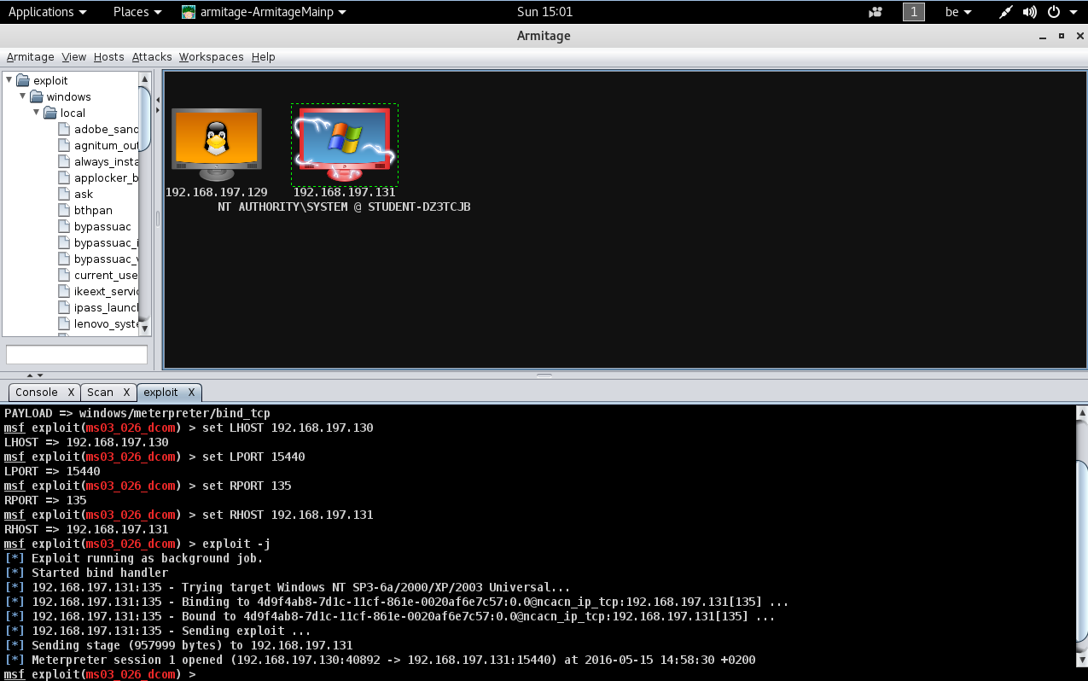
Systems & networks aspect
Armitage: Metasploitable
56

Slide 61
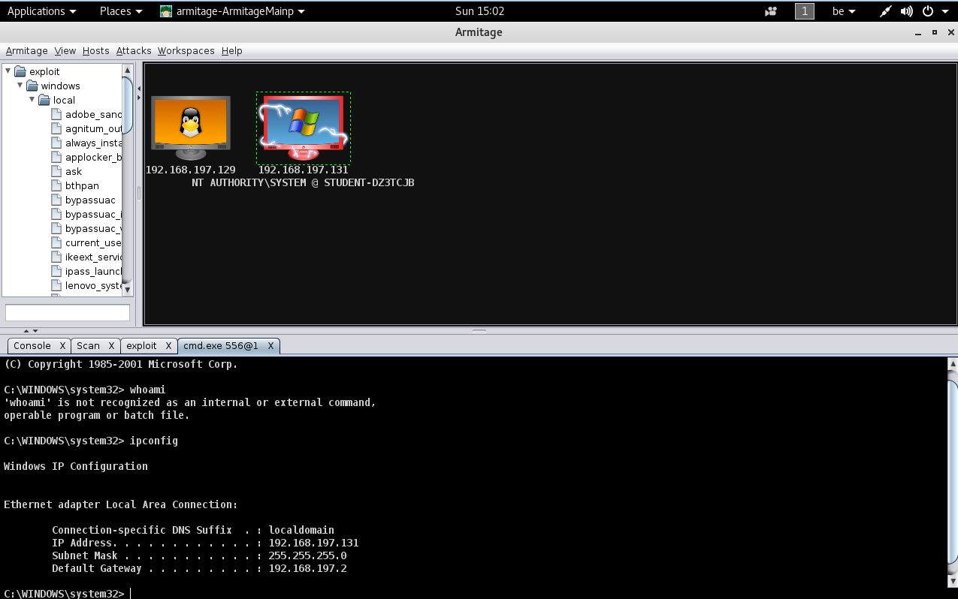
Systems & networks aspect
Armitage: Metasploitable
56

Slide 62
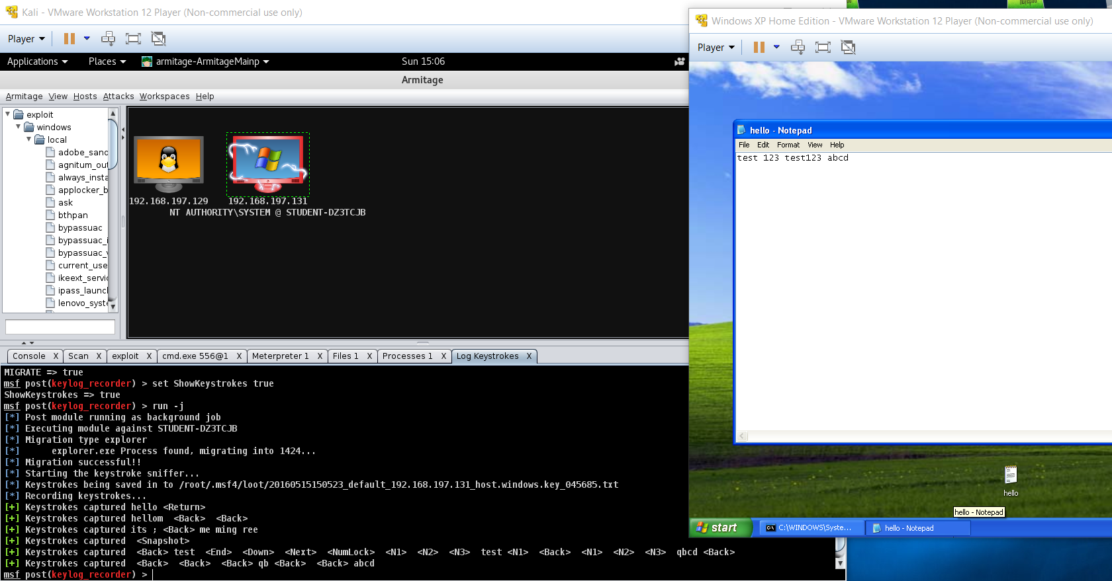
Systems & networks aspect
Armitage: Metasploitable
56

Slide 63

Systems & networks aspect
Armitage: Metasploitable
56

Slide 64
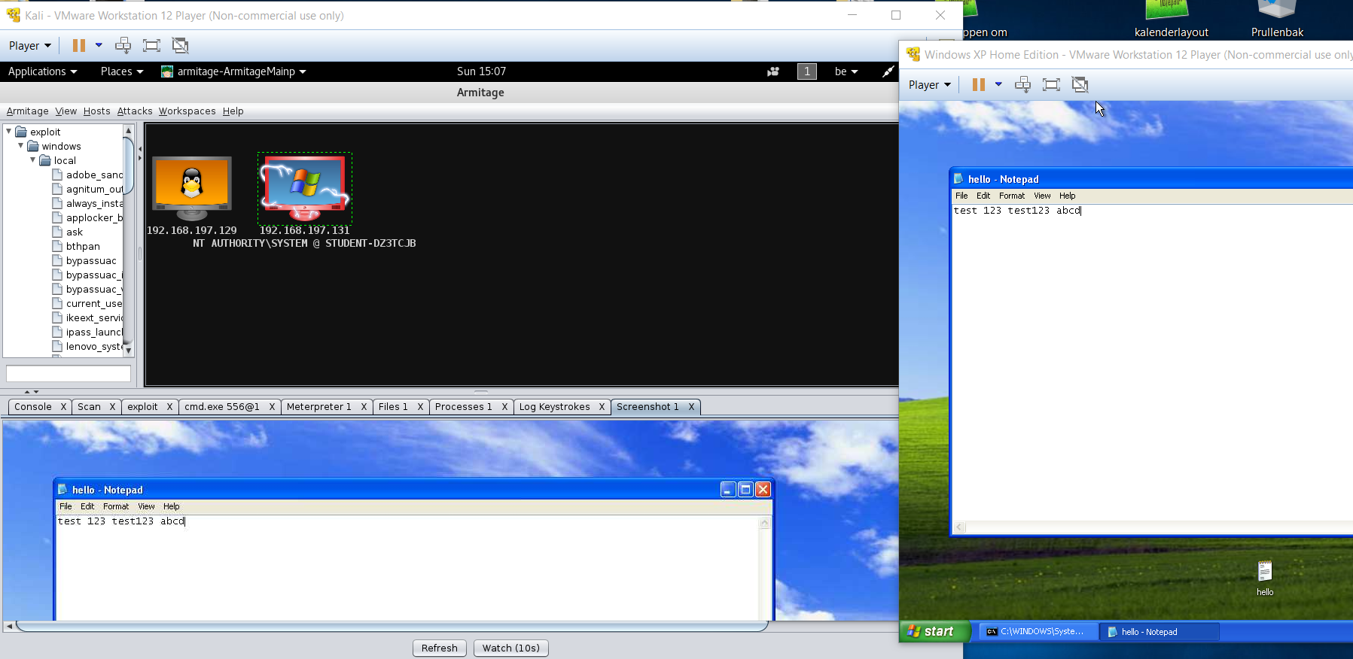
Systems & networks aspect
Armitage: Metasploitable
56

Slide 65
Systems & networks aspect
Conclusie
Efficiëntste scanner:
Windows: Nessus
Metasploitable: Nessus
Efficiëntste manier om vulnerabilities te counteren:
Upgraden en updaten
Firewall
64

Slide 66
IT Management aspect
onderdelen
Wireless communication policy
Remote access policy
Email policy
Password construction guidelines
65

Slide 67
IT Management aspect
wireless communication policy
Wireless Communication Policy:
Overview
Purpose
Scope
Policy
66

Slide 68
IT Management aspect
remote access policy
Remote Access Policy:
Overview
Purpose
Scope
Policy
67

Slide 69
IT Management aspect
email policy
Email Policy:
Overview
Purpose
Scope
Policy
68

Slide 70
IT Management aspect
password construction guidelines
Password Construction Guidelines:
Overview
Purpose
Scope
Policy
69

Slide 71
Bedankt voor uw aandacht!

