Slide 1
E-Commerce Application: Extra Endpoints
Detailed Overview of Implemented Endpoints

Slide 2
Agenda
1. User Return Order
2. Suggestion by Product Category
3. Suggestion by Merchant
4. User Purchase with Coupon Validation
5. Admin Transfer Balance

Slide 3
Endpoint 1: User Return Order
URL: /user-return-order/{userId}/{productId}/{merchantId}
HTTP Method: PUT
Functionality:
- Restocks merchant inventory for returned product.
- Refunds product price to user balance.
- Validates user, product, and merchant existence.
Key Benefits:
- Simplifies returns for better customer experience.

Slide 4
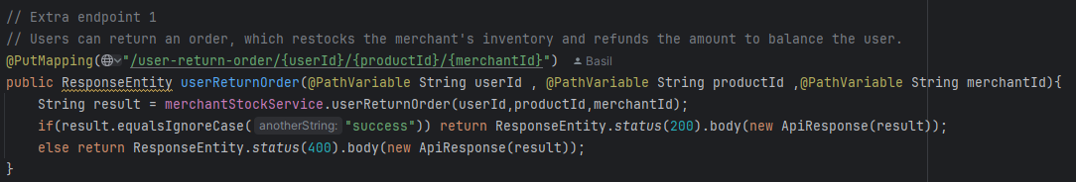
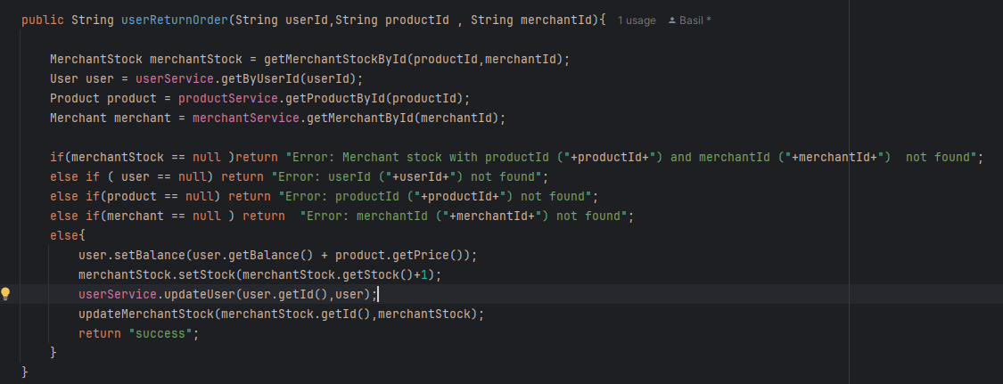
Endpoint 1: User Return Order

Slide 5
Endpoint 2: Suggest Products by Category
URL: /get-suggestion-product-by-category/{productId}
HTTP Method: GET
Functionality:
- Recommends products within the same category as the selected product.
- Validates product existence before proceeding.
Key Benefits:
- Enhances user experience by offering personalized recommendations.

Slide 6

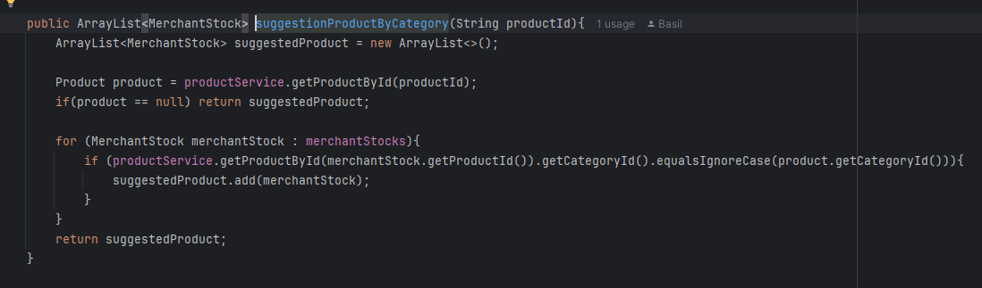
Endpoint 2: Suggest Products by Category

Slide 7
Endpoint 3: Suggest Products by Merchant
URL: /get-suggestion-product-by-merchant/{merchantId}
HTTP Method: GET
Functionality:
- Lists products from the same merchant.
- Ensures merchant exists before fetching recommendations.
Key Benefits:
- Enhances user experience by offering personalized recommendations.

Slide 8

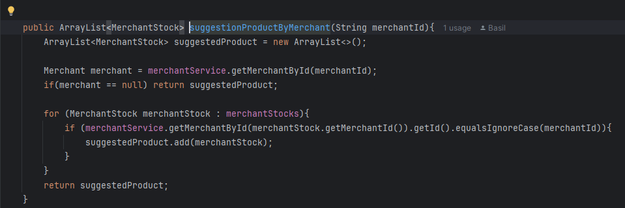
Endpoint 3: Suggest Products by Merchant

Slide 9
Endpoint 4: User Purchase with Coupon Validation
URL: /user-buy-product/{userId}/{productId}/{merchantId}/{coupon}
HTTP Method: PUT
Functionality:
- Validates coupon and applies discount to product price.
- Deducts discounted price from user balance.
- Updates merchant stock upon successful purchase.
Key Benefits:
- Encourages coupon usage and boosts customer loyalty.

Slide 10
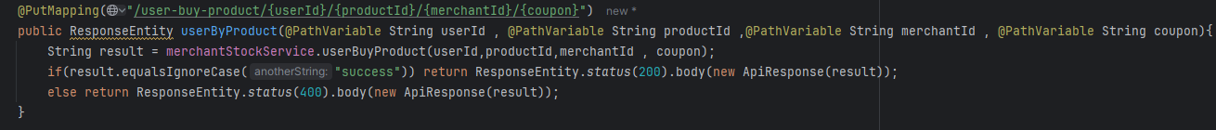
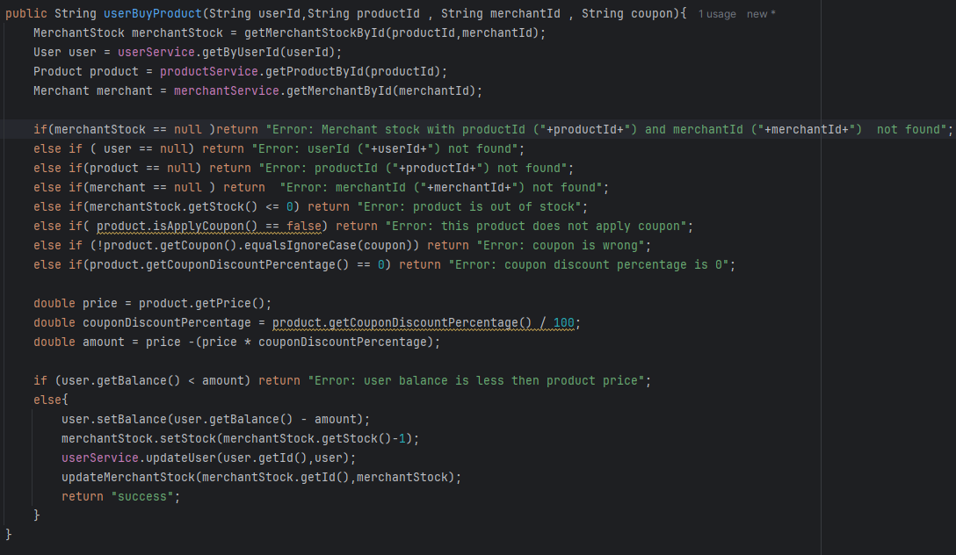
Endpoint 4: User Purchase with Coupon Validation

Slide 11
Endpoint 5: Admin Transfer Balance
URL: /transfer-balance/{adminId}/{userIdFrom}/{userIdTo}/{amount}
HTTP Method: PUT
Functionality:
- Transfers specified balance from one user to another.
- Ensures admin privileges for the operation.
- Validates user balances before transaction.
Key Benefits:
- Facilitates secure fund transfers with admin control.

Slide 12
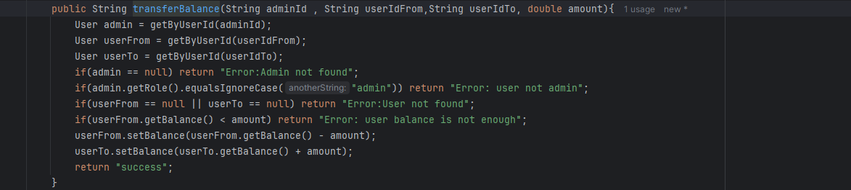
Endpoint 5: Admin Transfer Balance

Slide 13
Thanks

