Slide 1
FAK-DET: Fake Review Detection
Presented By
BASIL JASHEEM
LMCT18MCA013

Slide 2
My thanks
Prof. Jayanthi T (My Project Guide)
Prof. Sreeja K (Our HOD)
Prof. Bing Liu Department of Computer Science University of Illinois at Chicago (DataSet)
Assistant Professor. Naveed Hussain The University of Lahore(DataSet)

Slide 3
ABSTRACT
People are relying on e-commerce more than before. With e-commerce comes a huge amount of user feedback based on the products they buy.
people are relying more on product reviews to get a clear view and user experience
But there is no convincing way to authenticate the reviews posted on products on e-commerce websites
The idea proposed here is to create application capable of identifying these reviews by employing 4 different classification algorithms.

Slide 4
EXISTING SYSTEM
Existence of a system is inevitable.
There are web-pages with modules trained with pseudo labelled reviews
There are web pages that verify amazon reviews of a product by giving its URL

Slide 5
PROPOSED SYSTEM
A Real-time automated module that Detect the reviews during its providing or Reviewing
With the help of a Manually labelled Dataset.(by liu bing and Naveed Hussain )
With employing Multiple classifications

Slide 6
HARDWARE REQUIREMENTS
Processor | : processor of 2.0 GHz or more
RAM | : 2 GB of RAM or above
Cache Memory | : 1 MB or above
Hard Disk | : 10.2 GB or above

Slide 7
SOFTWARE REQUREMENTS
OPERATING SYSTEM | : Windows 7 or above
LANGUAGE (Back-End) | : Python
DATABASE (ORM) | : SQLAlchemy
SERVER | : CMD (localhost:5000- FLASK)-Python 3.7.3 or above
IDE(or TextEditor) | : Sublime_Text3
FRAMEWORK | : FLASK
FRONT-END | : Bootstrap (HTML, CSS, JavaScript)

Slide 8
USECASE DIAGRAM
ADMIN
LOGIN
PRODUCT MANAGER
REVIEW MANAGER
USER
REGISTER
LOGIN
MANAGE PROFILE
POST REVIEW

Slide 9
DATABASE
ADMIN
Column Name | Datatype | Desc | Comment
username | VARCHAR | Primary Key
email | VARCHAR | unique
password | VARCHAR |  | encrypted
USER
Column Name | Datatype | Desc | Comment
username | VARCHAR | Primary Key
email | VARCHAR | unique
password | VARCHAR |  | encrypted
Image_file |  |  | Name encrypt

Slide 10
Column Name | Datatype | Desc | Com
item_id | INT | Primary Key
item_name | VARCHAR | Unique
details | TEXT
photo | LONG_BLOB
platform | VARCHAR
category | VARCHAR
COLUMN NAME | DATATYPE | DESC | COM
rev_id | INT | Primary Key
rev_name | VARCHAR
date | DATETIME
item_id | INT | Foreign Key
rev_text | TEXT

Slide 11
status | INT | Fake or Not
rate | FLOAT
lr | INT | Logical regression
dt | INT | Decision tree
rfc | INT | Random forest
gbc | INT | Gradient Boosting
mark | INT | label
ip | VARCHAR | Jp address
i_mark | INT | Mark IP
i_ignore | INT | IP status

Slide 12
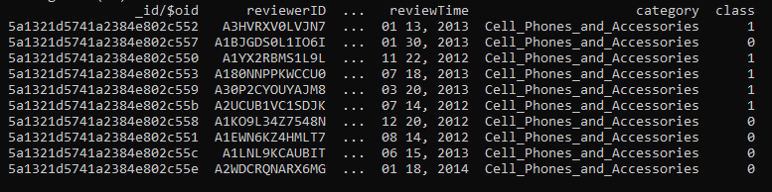
DATASET

Slide 13



CLASSIFIRES
LOGICAL REGRESSION:
It computes the probability of an event occurrence.
It is a special case of linear regression where the target variable is categorical in nature. It uses a log of odds as the dependent variable. Logistic Regression predicts the probability of occurrence of a binary event utilizing a logit function.
Linear Regression Equation:
Where, y is dependent variable and x1, x2 ... and Xn are explanatory variables.
Sigmoid Function:
Apply Sigmoid function on linear regression:

Slide 14
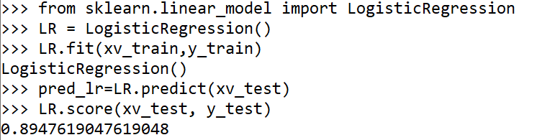
Model Development and Prediction

Slide 15


DECISION TREE
The basic idea behind any decision tree algorithm is as follows:
Select the best attribute using Attribute Selection Measures(ASM) to split the records.
Make that attribute a decision node and breaks the dataset into smaller subsets.
Starts tree building by repeating this process recursively for each child until one of the condition will match
Attribute Selection Measures(ASM)
Information Gain
Gini Index

Slide 16
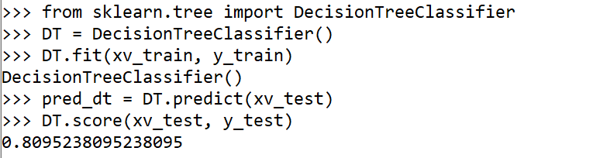
Model Development and Prediction

Slide 17
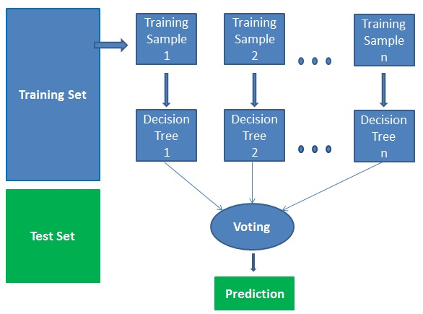
RANDOM FOREST
It works in four steps:
Select random samples from a given dataset.
Construct a decision tree for each sample and get a prediction result from each decision tree.
Perform a vote for each predicted result.
Select the prediction result with the most votes as the final prediction.

Slide 18
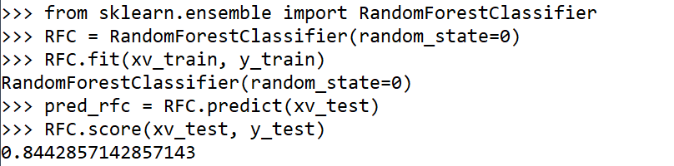
Model Development and Prediction

Slide 19
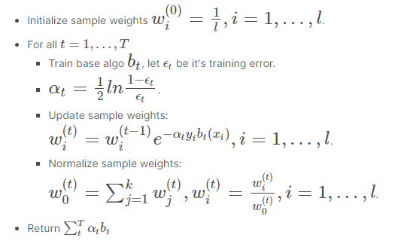
GRADIENT BOOSTING
It produces a prediction model in the form of an ensemble of weak prediction models, typically decision trees. When a decision tree is the weak learner, the resulting algorithm is called gradient boosted trees.

Slide 20
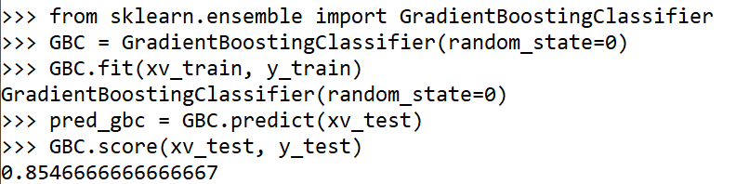
Model Development and Prediction

Slide 21

PRINCIPAL COMPONENT ANALYSIS(PCA)
PCA is Employed to reduce Dimensionality of the Datasets before classification
Removes Correlated Features:
Improves Algorithm Performance:
Reduces Overfitting:
SparcePCA is employed due to the existence of string

Slide 22
ADDITIONAL FEATURES
Review Scoring based on a Dictionary
IP recognition
Speech to text Review
Password and Image encryption

Slide 23
PRODUCT BACKLOG
SPRINT BACKLOG
SCRUM BOARD

Slide 24
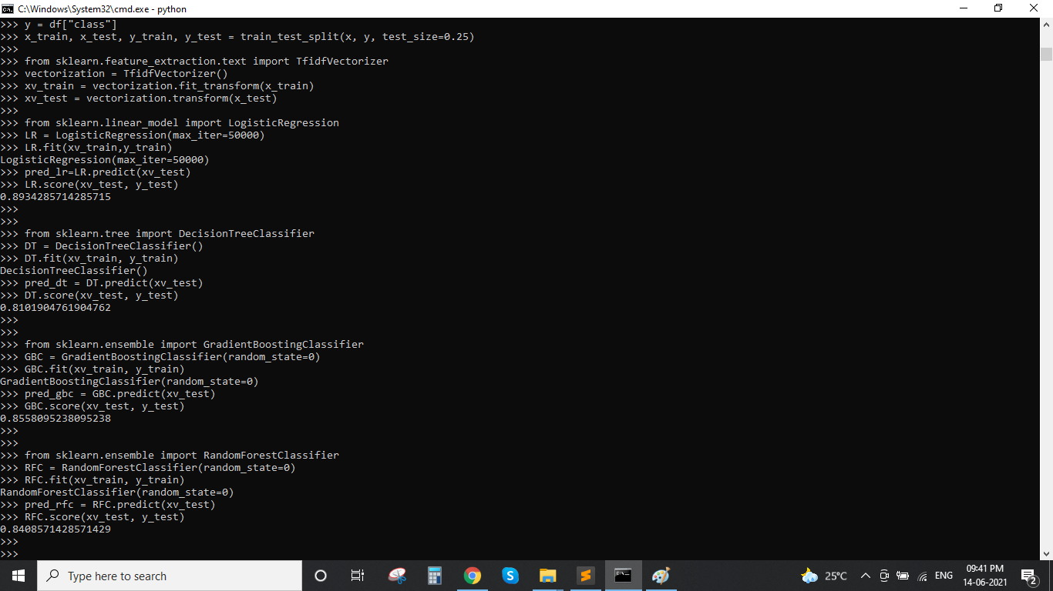

Slide 25
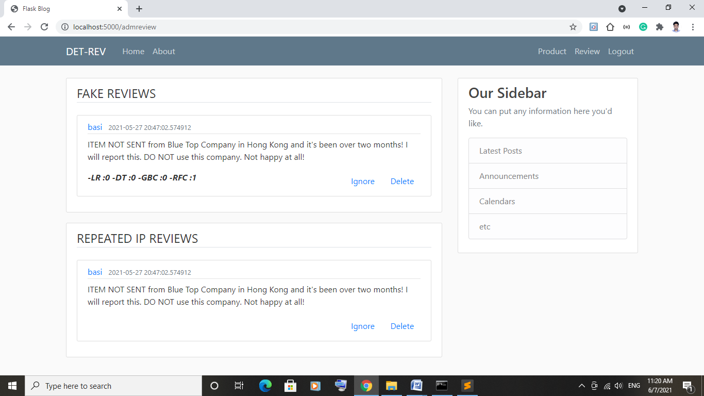

Slide 26
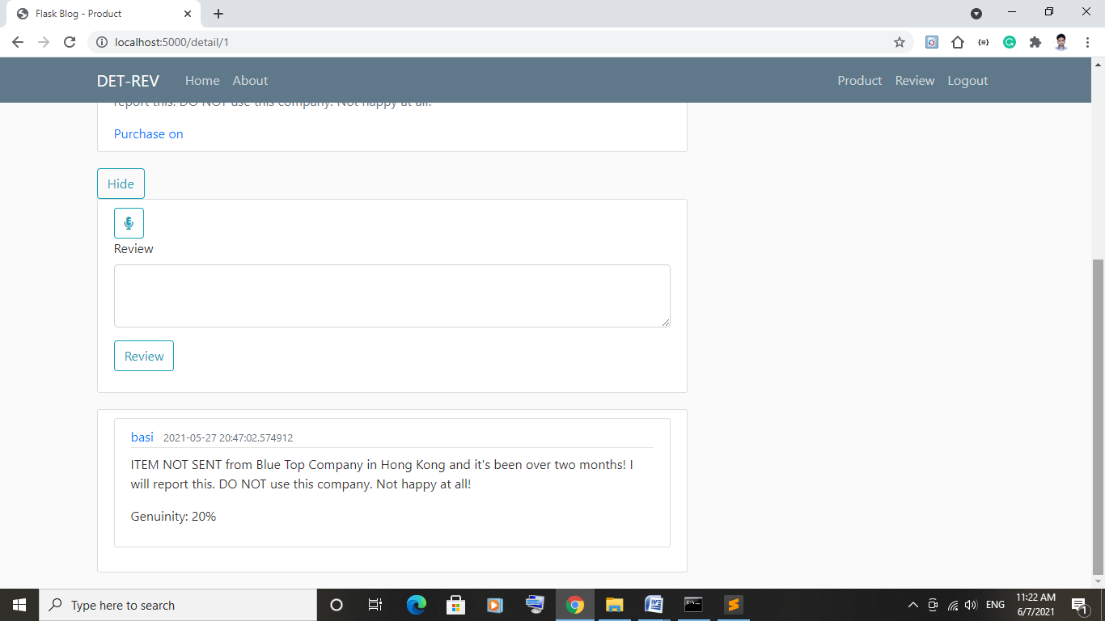

Slide 27
THANK YOU

