Slide 1
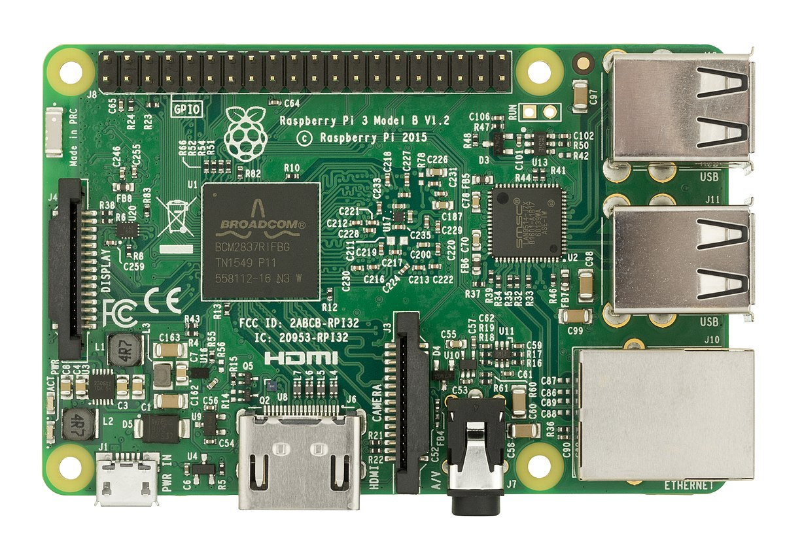
How to Write Your Code
How to Write Your Code
How to connect Modules
How Setup Your Pi
How to write a Module

Slide 2
How to write your code!
Code block format: A code block is a piece of code that can be executed as a unit (e.g., script or function).
Why code block?
Easier to read your code
Easier to change/edit parameters
Currently, the only way to distribute the algorithm over the Pi’s
For more information about code blocks in python https://docs.python.org/2.0/ref/execframes.html

Slide 3
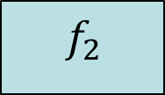
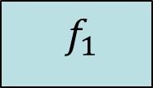


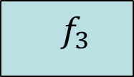
Code Block: Examples
input
${ f}_{1}$
$x$
${ f}_{2}$
$y$
${ f}_{3}$
output
Blocks
def f1(i):
#x = some operation on i return x
def f2(x):
#y = some operation on x return y
def f3(x,y):
#z = some operation on x,y return z
connections
x = f1 (input)
y = f2(x)
output = f3(y,x)

Slide 4
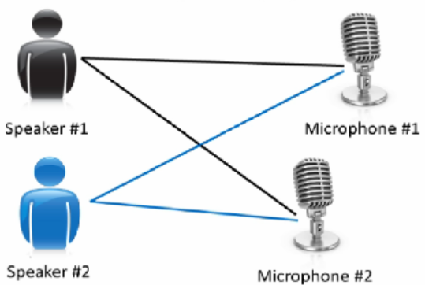


Code block: Your code!!
Let’s check your code to be in code block format
If you do not have a code, check the ICA example for source separation
p1\blindSeparation
Mixed signal 1
$$√$$
$${\left|\right|}_{2}$$
Cov1
+SVD
Cov2
+SVD
Whitening
Mixed signal 2
Signal 1
Dot product
Signal 2

Slide 5
How to Write Your Code
How to connect Modules
How Setup Your Pi
How to write a Module
How to write a Module

Slide 6



Code Block on your Pi
When a block (aka Algorithm) run on a Pi, we call it module
A module: encapsulates the block code to bundle network parameters as well as signal processing parameters
${ f}_{3}$
output ports
Input ports
Block configuration
logs

Slide 7








Code Block on your Pi
Revisit Example 1
input
${ f}_{1}$
$x$
${ f}_{2}$
$y$
${ f}_{3}$
output
InputParam
${ f}_{1}$
1
1
${ f}_{2}$
2
2
${ f}_{3}$
output
1

Slide 8
Definitions 1/2
Input ports :
Network ports that pass the received data as an input to the block
Characterized by source Pi’s IP address and stream no. (Pipe)
Output ports:
Network ports that send the block’s output data to the next Pi
Characterized by destination Pi’s IP address and stream no. (Pipe)
The stream number (or Pipe) between source(s) and destination(s) should be the same
A module should have at least one input or output port

Slide 9
Definitions 2/2
Logs:
An optional parameter to record the output of the block
It has to be manually configured to set which output will be recorded
Configuration:
A module can optionally take a parameter to pass it to the block
Could be helpful to change number of samples or switch between different algorithms
It can also specify certain files to read or write

Slide 10
How to write a Module in Python
import argparse
def parse_arguments(): parser = argparse.ArgumentParser(description='arguments') parser.add_argument("--inputs", "-i", action="append") parser.add_argument("--outputs", "-o", action="append")
parser.add_argument("--FFTSize", type=int, default=8192) parser.add_argument("--WindowType", default="Hann")
parser.add_argument("--logfiles", "-l", action="append")
return parser.parse_args()
Network ports (only pipe numbers)
Configuration (optional)
Log file (optional)

Slide 11
How to access Module parameters
args = parse_arguments()

Slide 12
How to access Module parameters
Input data:
inputs = [os.fdopen(int(f), 'rb') for f in args.inputs]
Data = np.fromfile(inputs[0], dtype='i2', count=dataSize) #stream data
Or
data = inputs[1].readline() # string data
Output Data:
outputs = [os.fdopen(int(f), 'wb') for f in args.outputs]
outputs[0].write(DataResult) outputs[0].flush()
For more information, please check numpy.fromfile() and readline() in python

Slide 13
[Update] How to access Module parameters
Input data [Python3]:
inputs = [os.read(int(f), dataSize ) for f in args.inputs] Data = np.fromstring(inputs[0], dtype=np.float)
Or
data = inputs[1].readline() # string data
Note: try not to overflow the pipes with large dataSize (sinful examples could be 4KB or 8KB). But of course this is dependent on the type

Slide 14
How to access Module parameters
Configuration parameters:
psd_params = {"FFTSize": args.FFTSize, "WindowType": args.WindowType}
Log files:
for f in logfiles: f.write(someData + "\n")
To avoid system overload, please close the pipes
(do not close them if you rely on live stream)
for pipe in inputs: pipe.close() for pipe in outputs: pipe.close()

Slide 15
Let’s write a Module for your code
import argparse
import numpy as np
def parse_arguments(): parser = argparse.ArgumentParser(description='arguments') parser.add_argument("--inputs", "-i", action="append") parser.add_argument("--outputs", "-o", action="append") parser.add_argument("--FFTSize", type=int, default=8192) parser.add_argument("--logfiles", "-l", action="append") return parser.parse_args()
args = parse_arguments()
inputs = [os.fdopen(int(f), 'rb') for f in args.inputs]
Data = np.fromfile(inputs[0], dtype='i2', count=40960) #stream data
DataResult = Data*2 #some operation on data
outputs = [os.fdopen(int(f), 'wb') for f in args.outputs]
outputs[0].write(DataResult)
for f in logfiles: f.write(someData + "\n")

Slide 16
How to Write Your Code
How to connect Modules
How to connect Modules
How Setup Your Pi
How to write a Module

Slide 17
How to write XML to connect Modules
Network
Node-1
Block-A
Input ports
Output ports
Configuration
Log files
Block-B
Input ports
Output ports
Configuration
Log files
Node-2
Block-C
Input ports
Output ports
Configuration
Log files
Notes:
Topology is written in hierarchical format

Slide 18
Network
Node
Node
Algorithm
Algorithm
Algorithm
Ports
Params
Ports
Params
Ports
Params
I/P
O/P
Logs
Configuration
I/P
O/P
Logs
Configuration
I/P
O/P
Logs
Configuration

Slide 19
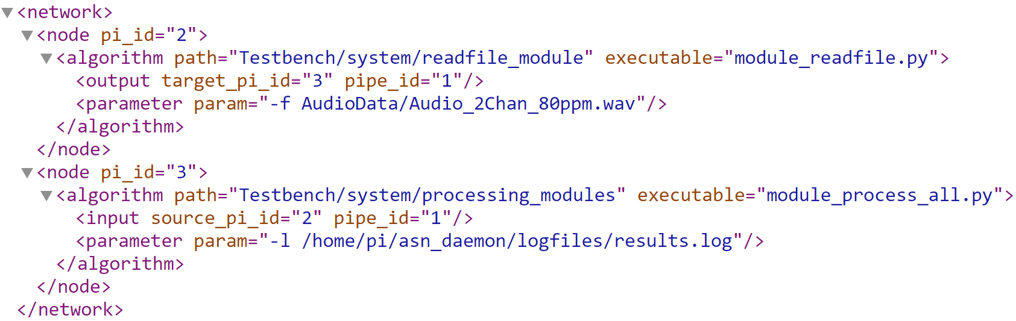
How to write XML to connect Modules
IP of the node
block code (could be python, java, C, or any exec)
Path of executable block code
Notes:
All files in the Path are copied to the node. However, only the specified executable file is executed

Slide 20
How to write XML to connect Modules
source/destination nodes
Input parameters for the blocks
Pipe number of input/output

Slide 21
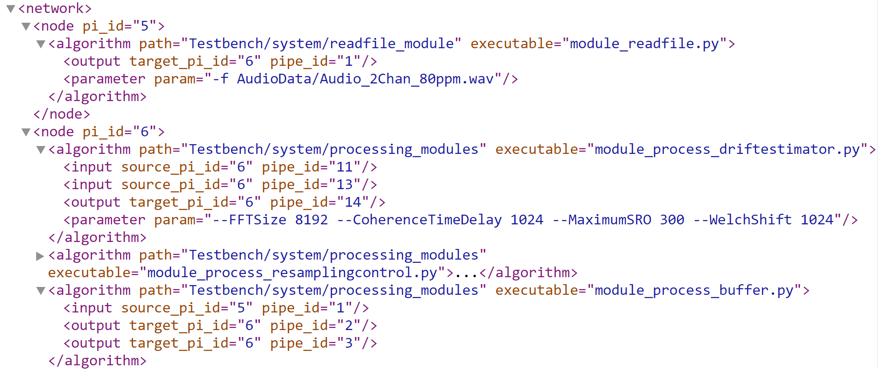
How to write XML to connect Modules
Pi-5
Read_file
1
Buffer
Drift estimator
Pi-6

Slide 22
How to write XML to connect Modules
Pi-5
Read_file
1
Buffer
Drift estimator
Pi-6

Slide 23
Let’s write an XML for your Topology

Slide 24
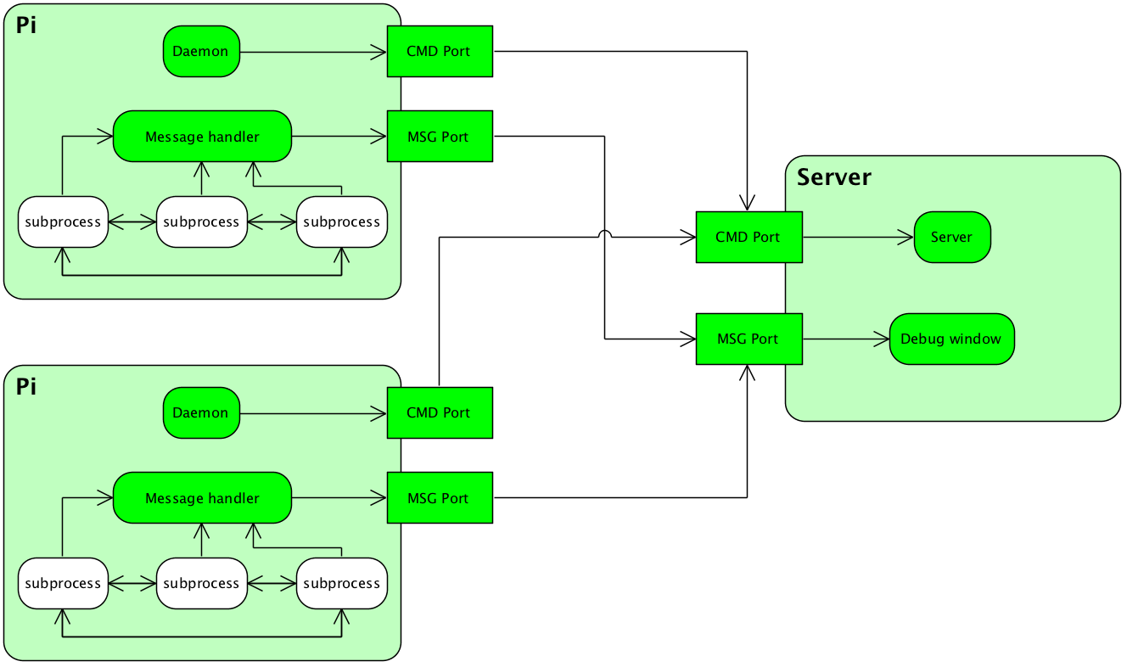
Summary: Framework Overview

