Slide 1
Assemblers
System Software
by Leland L. Beck
Chapter 2

Slide 2
Role of Assembler
Assembler
Object
Code
Linker
Source
Program
Executable
Code
Loader

Slide 3
Chapter 2 -- Outline
Basic Assembler Functions
Machine-dependent Assembler Features

Slide 4
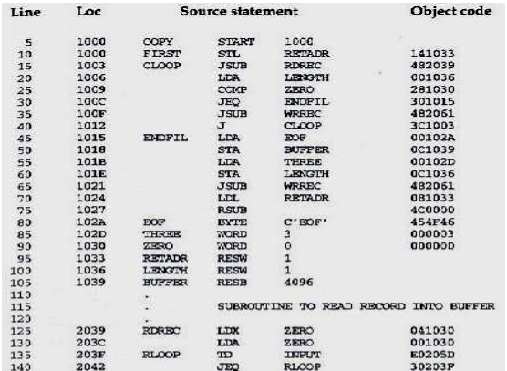

Slide 5
Assembler Directives
Pseudo-Instructions
  Not translated into machine instructions
  Providing information to the assembler
Basic assembler directives
  START
  END
  BYTE
  WORD
  RESB
  RESW

Slide 6
1. Assembler’s functions
Convert mnemonic operation codes to their machine language equivalents(eg:Translate STL to 14(line 10))
Convert symbolic operands to their equivalent machine addresses ✓(translate RETADR to 1033(line 10))
Convert the data constants to internal machine representations(eg: translate EOF to 454F46(line 80))
Build the machine instructions in the proper format
Write the object program and the assembly listing

Slide 7
Object Program Format
Header
  Col. 1 H
  Col. 2~7 Program name
  Col. 8~13 Starting address (hex)
  Col. 14-19 Length of object program in bytes (hex)
Text
  Col.1 T
  Col.2~7 Starting address in this record (hex)
  Col. 8~9 Length of object code in this record in bytes (hex)
  Col. 10~69 Object code (69-10+1)/6=10 instructions
End
  Col.1 E
  Col.2~7 Address of first executable instruction (hex)
  (END program_name)

Slide 8
Object Code
H COPY 001000 00107A
T 001000 1E 141033 482039 001036 281030 301015 482061 ...
T 00101E 15 0C1036 482061 081044 4C0000 454F46 000003 000000
T 002039 1E 041030 001030 E0205D 30203F D8205D 281030 …
T 002057 1C 101036 4C0000 F1 001000 041030 E02079 302064 …
T 002073 07 382064 4C0000 05
E 001000

Slide 9
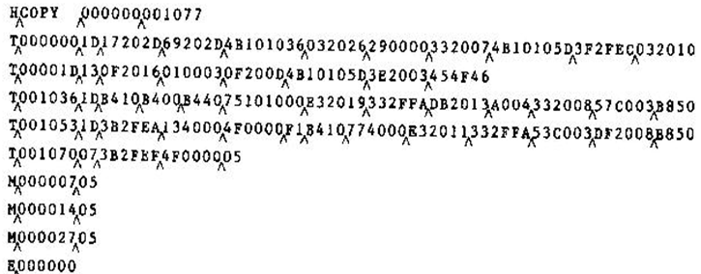
Object Code

Slide 10
Assemblers
One pass assembler
All the assembler functions are done in a single pass
Two pass assembler
All the assembler functions are done in two passes (Pass 1 & Pass 2)

Slide 11
Assembler’s functions
Convert mnemonic operation codes to their machine language equivalents(eg:Translate STL to 14(line 10))
Convert symbolic operands to their equivalent machine addresses ✓(translate RETADR to 1033(line 10))
Convert the data constants to internal machine representations(eg: translate EOF to 454F46(line 80))
Build the machine instructions in the proper format
Write the object program and the assembly listing

Slide 12
Two Pass Assembler
Pass 1(define symbols)
  Assign addresses to all statements in the program
  Save the values assigned to all labels for use in Pass 2
  Perform some processing of assembler directives
Pass 2(assemble instructions & generate object program)
  Assemble instructions
  Generate data values defined by BYTE, WORD
  Perform processing of assembler directives not done in Pass 1
  Write the object program and the assembly listing

Slide 13
Two Pass Assembler
Source
program
Intermediate
file
Object
codes
Pass 1
Pass 2
OPTAB
SYMTAB
OPTAB
SYMTAB

Slide 14
Data Structures
Location Counter(LOCCTR)
Operation Code Table (OPTAB)
Symbol Table (SYMTAB)

Slide 15
LOCCTR(Location Counter)
It is a variable used to help in address assignment
Initialized with the address of START statement
Value is incremented according to the length of the assembled instruction/data area to be generated
Current value of LOCCTR gives the address assigned to that label

Slide 16
OPTAB (Operation code table)
Contains
  Mnemonic operation code and its machine code
Characteristic
  Static table with mnemonic operation code as the key
Implementation
  Array or hash table, easy for search

Slide 17
  During PASS 1,OPTAB is used to look up and validate operation codes in the source program.
  During PASS 2,OPTAB is used to translate operation codes to machine language.
Sample OPTAB
START *
LDA 00
STA 0C
LDCH 50
STCH 54
END *

Slide 18
SYMTAB (symbol table)
Contains
  Name and address of each label together with flags to indicate error(repetition of label names)
Characteristics
  Dynamic table (insert, delete, search)
Implementation
  Hash table, non-random keys, hashing function

Slide 19
  During Pass 1 labels are entered into the SYMTAB as they are encountered in the source program along with their assigned addresses(from LOCCTR)
  During Pass 2 symbols used as operands are looked up in SYMTAB to obtain the addresses to be inserted in the assembled instructions.
  Sample SYMTAB
COPY 1000
FIRST 1000
CLOOP 1003
ENDFIL 1015
EOF 1024
THREE 102D
ZERO 1030
RETADR 1033
LENGTH 1036
BUFFER 1039
RDREC 2039

Slide 20
Algorithm Pass 1
Figure 2.4(a) Algorithm for Pass 1

Slide 21
Algorithm Pass 2
Figure 2.4(a) Algorithm for Pass 2

Slide 22
Assembler Design
Machine Dependent Assembler Features
  instruction formats and addressing modes
  program relocation
Machine Independent Assembler Features
  literals
  symbol-defining statements
  expressions
  program blocks
  control sections and program linking

Slide 23
2. Machine-dependent
Assembler Features
Instruction formats and addressing modes
Program relocation

Slide 24
Introduction
SIC/XE
  PC-relative or Base-relative addressing: op m
  Indirect addressing: op @m
  Immediate addressing: op #c
  Extended format: +op m
  Index addressing: op m,x
Example program
  Figure 2.5(Leland)

Slide 25
Advantages of SIC/XE
  Register-to-register instructions improves the execution speed
  Immediate addressing avoids fetching from memory
  Larger memory -> multi-programming (Program Relocation)
NB:Page 58(2nd & 3rd paragraphs)

Slide 26
2.1 Instruction formats & addressing modes
Focuses on the differences required in assembler by the addition of new addressing mode
These changes are direct consequences of extended hardware functions.

Slide 27
Translation
Register translation
  register name (A, X, L, B, S, T, F, PC, SW) and their values (0,1, 2, 3, 4, 5, 6, 8, 9)
  preloaded in SYMTAB
Address translation
  Most register-memory instructions use program counter relative or base relative addressing
  Format 3: 12-bit address field
    base-relative: 0~4095
    pc-relative: -2048~2047
  Format 4: 20-bit address field

Slide 28
PC-Relative Addressing Modes
PC-relative
  10 0000 FIRST STL RETADR 17202D
  (14)₁₆ 1 1 0 0 1 0 (02D) ₁₆
    displacement= RETADR - PC = 30-3 = 2D
  40 0017 J CLOOP 3F2FEC
    (3C)₁₆ 1 1 0 0 1 0 (FEC) ₁₆
    displacement= CLOOP-PC= 6 - 1A= -14= FEC

Slide 29
Base-Relative Addressing Modes
Base-relative
  base register is under the control of the programmer
  12 LDB #LENGTH
  13 BASE LENGTH
  160 104E STCH BUFFER, X 57C003
  ( 54 )₁₆ 1 1 1 1 0 0 ( 003 ) ₁₆
  (54) 1 1 1 0 1 0 0036-1051= -101B₁₆
    displacement= BUFFER - B = 0036 - 0033 = 3
  NOBASE is used to inform the assembler that the contents of the base register no longer be relied upon for addressing

Slide 30
Immediate Address Translation
Immediate addressing
  55 0020 LDA #3 010003
  ( 00 )₁₆ 0 1 0 0 0 0 ( 003 ) ₁₆
  133 103C +LDT #4096 75101000
  ( 74 )₁₆ 0 1 0 0 0 1 ( 01000 ) ₁₆

Slide 31
Immediate Address Translation (Cont.)
Immediate addressing
  12 0003 LDB #LENGTH 69202D
  ( 68)₁₆ 0 1 0 0 1 0 ( 02D ) ₁₆
  ( 68)₁₆ 0 1 0 0 0 0 ( 033)₁₆ 690033
    the immediate operand is the symbol LENGTH
    the address of this symbol LENGTH is loaded into register B
    LENGTH=0033=PC+displacement=0006+02D
    if immediate mode is specified, the target address becomes the operand

Slide 32
Indirect Address Translation
Indirect addressing
  target addressing is computed as usual (PC-relative or BASE-relative)
  only the n bit is set to 1
  70 002A J @RETADR 3E2003
  ( 3C )₁₆ 1 0 0 0 1 0 ( 003 ) ₁₆
    TA=RETADR=0030
    TA=(PC)+disp=002D+0003

Slide 33
2.2 Program Relocation
  Program relocation is done to support the concept of multiprogramming.
  Program relocation is needed when ,it is desirable to load a program into memory when ever there is a room for it.
  In this situation the actual starting address of the program is not known until load time.
  Indirect consequence of extended hardware

Slide 34
Solution
When the assembler generates the object code, it will insert the address relative to the start of the program.
The assembler will also produce a command for the loader, instructing it to add the beginning address of the program to the address field in the instruction at the load time.

Slide 35
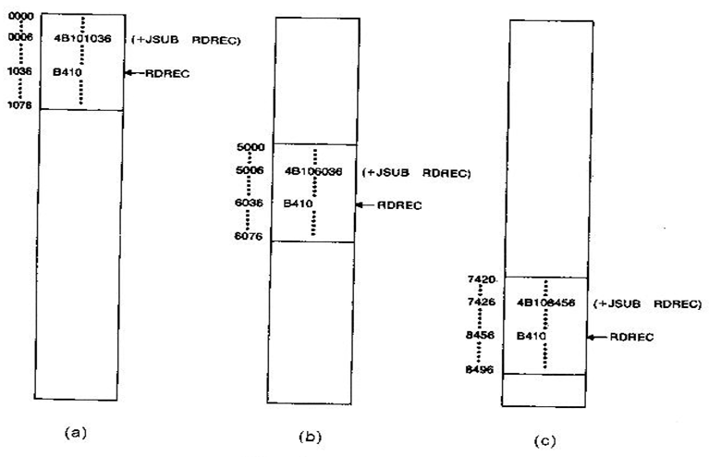
Example

Slide 36
Modification record Format
  Col 1 M
  Col 2-7 Starting location of the address field to be
  modified, relative to the beginning of the program
  Col 8-9 Length of the address field to be modified, in half-
  bytes
NB:Modification record is a command to the loader.

Slide 37
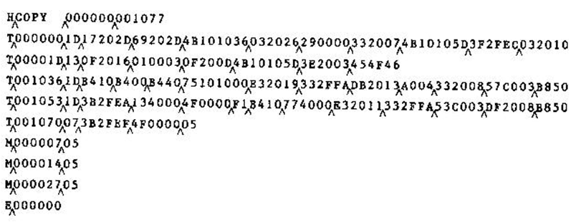
Object Code

Slide 38
  Except for absolute address, the rest of the instructions need not be modified
    not a memory address (immediate addressing)
    PC-relative, Base-relative
  The only parts of the program that require modification at load time are those that specify direct addresses.

