Slide 1
System Programming
System Software:
An Introduction to Systems Programming
Leland L. Beck
3rd Edition
Addison-Wesley, 1997

Slide 2
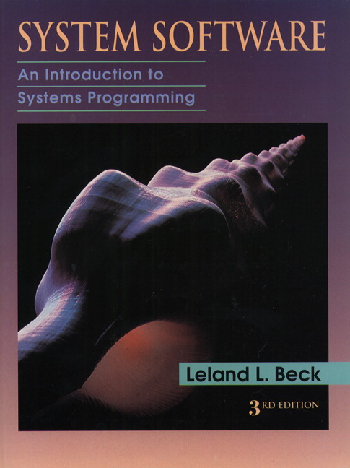
TextBook

Slide 3
System Programming
Chapter 1: Introduction
Chapter 2,3: Assemblers
Chapter 4: Loaders and Linkers
Chapter 5: Macro Processors
Chapter 6: Device Drivers, Text Editors Debuggers

Slide 4
Chapter 1
Background

Slide 5
Outline
Introduction
System Software and Machine Architecture
The Simplified Instructional Computer (SIC)
  SIC Machine Architecture
  SIC/XE Machine Architecture
  SIC Programming Examples

Slide 6
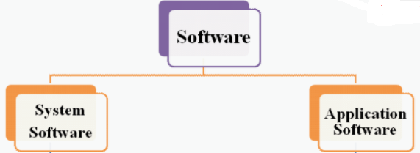
1. Introduction
Software : Computer Instruction or Data

Slide 7
1.1System Software ？
  System Software consists of a variety of programs that support the operation of a computer.
  The software makes it possible for the users to focus on an application or other problem to be solved, without needing to know the details of how the machine works internally.
Examples of system software
  Text editor, assembler, compiler, loader or linker, debugger, macro processors, operating system,…

Slide 8
1.2 Application software
Computer software designed to help the user to perform specific tasks.
Examples of Application software
Browsers,Databases,Computer games

Slide 9
1.3 System Software vs Application
  One characteristic in which most system software differs from application software is machine dependency.
  System programs are intended to support the operation and use of the computer itself, rather than any particular application.

Slide 10
1.4 System Software Concept
Users
Application Program
Debugger
Macro Processor
Text Editor
Utility Program (Library)
Complier
Assembler
Load and Linker
OS
Memory Management
Process Management
Device Management
Information Management
Bare Machine (Computer)

Slide 11
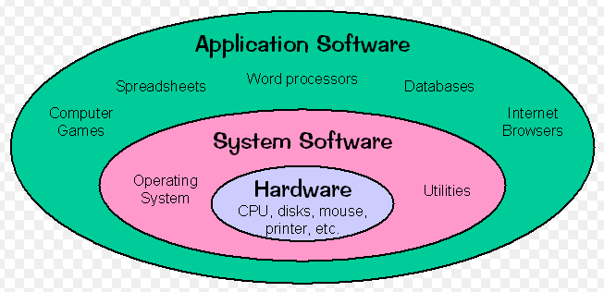
System Software Concept

Slide 12
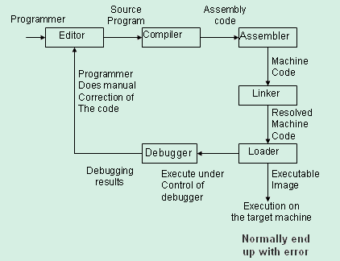
System Software Concept

Slide 13
System Software
Text editor
  To create and modify the program
Compiler or Interpreter
  Translates these programs into assembly language
Assembler
  Translates these programs into machine language
Linker
  Generates the executable file of a program after linking library functions.
Loader
  The resulting machine program was loaded into memory and prepared for execution

Slide 14
System Software
Debugger
  To help detect errors in the program
Macro Processor
  Substitutes one group of characters or lines for another.
Device Driver
  Controls a particular type of device that is attached to your computer.
Operating System
  Interface between user and computer

Slide 15
2. System Software and Machine Architecture
Machine dependent
  Instruction Set, Instruction Format, Addressing Mode, Assembly language …
Machine independent
  General design logic/strategy, Two passes assembler…
Machine independent
Machine Dependent
Computer

Slide 16
3. The Simplified Instructional Computer
Hypothetical computer which has been designed to include hardware features most often found.
Like many other products, SIC comes in two versions
  The standard model
  An XE version
    “extra equipments”, “extra expensive”
The two versions has been designed to be upward compatible
SIC (Simplified Instructional Computer)
SIC/XE (Extra Equipment)

Slide 17
Features of SIC
Memory
Register
Data Formats
Instruction Formats
Addressing Modes
Instruction Set
Input & Output

Slide 18
Memory
  Memory consists of 8-bit bytes, 3 consecutive bytes form a word (24 bits)
  There are a total of 32768 bytes (32 KB) in the computer memory.

Slide 19
Register
  Registers are a small set of data holding places which is a part of computer processor.
  Registers may hold instruction, a storage address or any kind of data(eg: bit sequence, individual characters)
  Registers are storage devices/Primary memory devices
  5 registers, 24 bits in length
    A 0 Accumulator
    X 1 Index register
    L 2 Linkage register (JSUB)
    PC 8 Program counter
    SW 9 Status word (Condition Code)

Slide 20
Conti..
A used for performing arithmetic operations
X used for specifying the addressing mode
L stores addresses(return addresses)
PC contains the address of the instruction being executed at the current time.
SW contains condition code which is a code generated when a condition is set up.
  Also known as Status register, flag register or condition code register
  Set Flag Register - 01 (if true)
  10 (if false)

Slide 21
Data Formats
  Integers are stored as 24-bit binary number
    Integer Size 3 byte
  2’s complement representation for negative values
  Characters are stored using 8-bit ASCII codes
  No floating-point hardware on the standard version of SIC

Slide 22
Instruction Cycle
CPU
  Control Unit (CU)
  Arithmetic and Logic Unit (ALU)
  Register
Instruction Cycle
  Fetch Cycle
  Execution Cycle
Fetch Instruction
Computation
Store Result
Decoder
Fetch Operand

Slide 23
Instruction format
  24-bit format(8+1+15)
  The flag bit x is used to indicate indexed-addressing mode
  Format 3
8
1
15
opcode
x
address

Slide 24
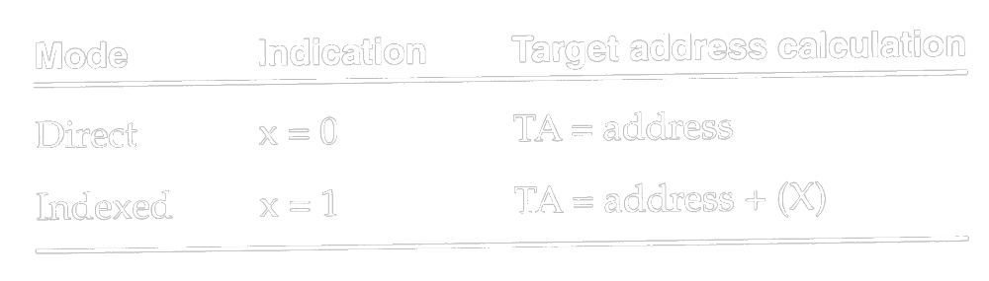
Addressing Modes
  There are two addressing modes available
    Indicated by x bit in the instruction
    (X) represents the contents of reg. X
8
1
15
opcode
x
address

Slide 25
Instruction set
  Basic set of instructions that are sufficient for the most simple tasks.
  Load and store registers (LDA, LDX, STA, STX, etc.)
  Integer arithmetic operations (ADD, SUB, MUL, DIV)
  Compare instruction (COMP)
  Conditional jump instructions (JLT, JEQ, JGT)
  JSUB jumps to the subroutine, placing the return address in register L.
  RSUB returns by jumping to the address contained in register L.

Slide 26
Input & Output
  I/O are performed by transferring 1 byte at a time to or from the rightmost 8 bits of register A.
  Each device is assigned a unique 8-bit code as an operand.
  There are three I/O instructions
  Test Device (TD): tests whether the addressed device is ready to send or receive
    < ready = not ready
  Read Data (RD)
  Write Data (WD)

Slide 27
SIC/XE Machine Architecture
1 megabytes (1024 KB) in memory
3 additional registers, 24 bits in length
  B 3 Base register; used for addressing
  S 4 General working register
  T 5 General working register
1 additional register, 48 bits in length
  F 6 Floating-point accumulator (48 bits)

Slide 28
Data format
  24-bit binary number for integer, 2’s complement for negative values
  48-bit floating-point data type
  The exponent is between 0 and 2047
  f*2^{(e-1024)}
  0: set all bits to 0
1
11
36
S
exponent
fraction

Slide 29
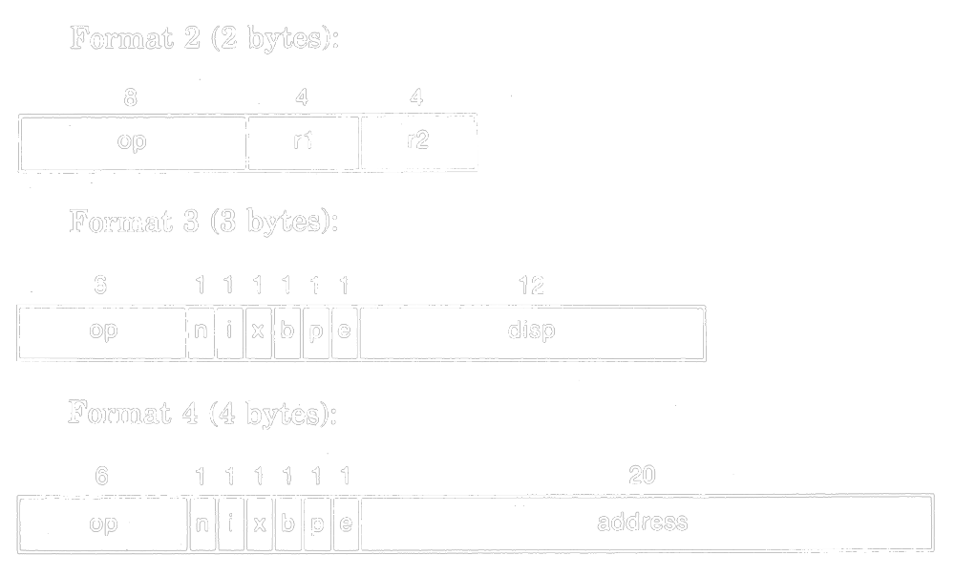
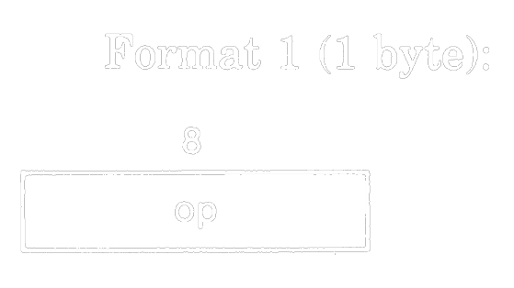
SIC/XE Machine Architecture
Instruction formats
  Relative addressing - format 3 (e=0)
  Extend the address to 20 bits - format 4 (e=1)
  Don’t refer memory at all - formats 1 and 2

Slide 30
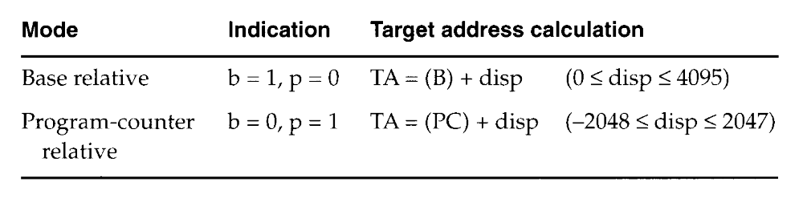
Addressing modes
  n i x b p e
  Simple n=0, i=0 (SIC) or n=1, i=1
  Immediate n=0, i=1 TA=Values
  Indirect n=1, i=0 TA=(Operand)
  Base relative b=1, p=0 TA=(B)+disp
  0 <= disp <= 4095
  PC relative b=0, p=1 TA=(PC)+disp
  -2048 <= disp <= 2047

Slide 31
Addressing mode
  Direct b=0, p=0 TA=disp
  Index x=1 TA_{new}=TA_{old}+(X)
  Index+Base relative x=1, b=1, p=0 TA=(B)+disp+(X)
  Index+PC relative x=1, b=0, p=1
  TA=(PC)+disp+(X)
  Index+Direct x=1, b=0, p=0
  Format 4 e=1
Appendix and Fig. 1.1 Example

Slide 32
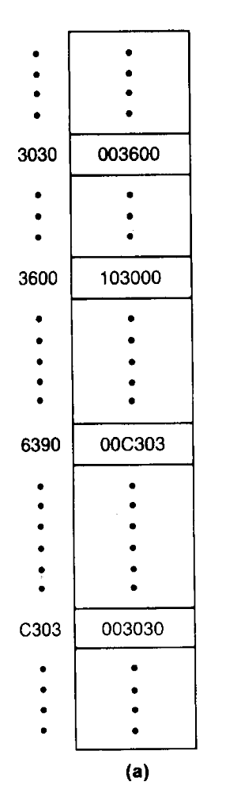
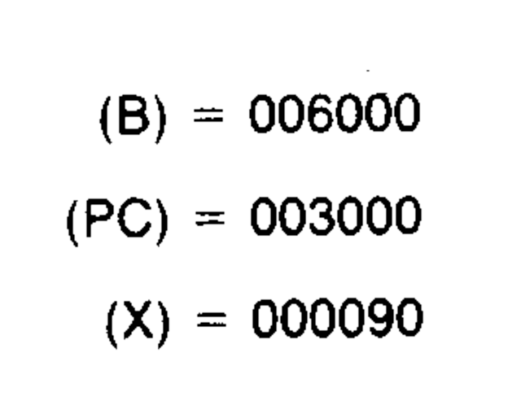
Figure 1.1
Memory address
  00000
  (0000 0000 0000 0000 0000)
  ~FFFFF (Byte)
  (1111 1111 1111 1111 1111)

Slide 33
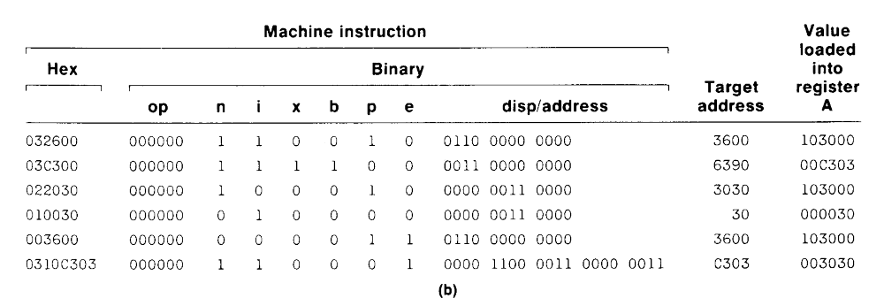

Slide 34
Instruction set
  Format 1, 2, 3, or 4
  Load and store registers (LDB, STB, etc.)
  Floating-point arithmetic operations (ADDF, SUBF, MULF, DIVF)
  Register-to-register arithmetic operations (ADDR, SUBR, MULR, DIVR)
  A special supervisor call instruction (SVC) is provided
I/O
  1 byte at a time, TD, RD, and WD
  SIO, TIO, and HIO are used to start, test, and halt the operation of I/O channels.

Slide 35
4. Basic assembler directives
  Assembler directives are instructions that direct the assembler to do something.
  START : Specify name and starting address of program
  END : Indicate end of the program
  BYTE :Generate character or hexadecimal constant
  WORD :Generate one word integer constant
  RESB : Reserve the indicated number of bytes for a data area
  RESW : Reserve the indicated number of bytes for a data area

Slide 36
Example
SUM START 4000
FIRST LDX ZERO
LDA ZERO
LOOP ADD TABLE,X
TIX COUNT
JLT LOOP
STA TOTAL
RSUB
TABLE RESW 2000
COUNT RESW 1
ZERO WORD 0
TOTAL RESW 1
END

Slide 37
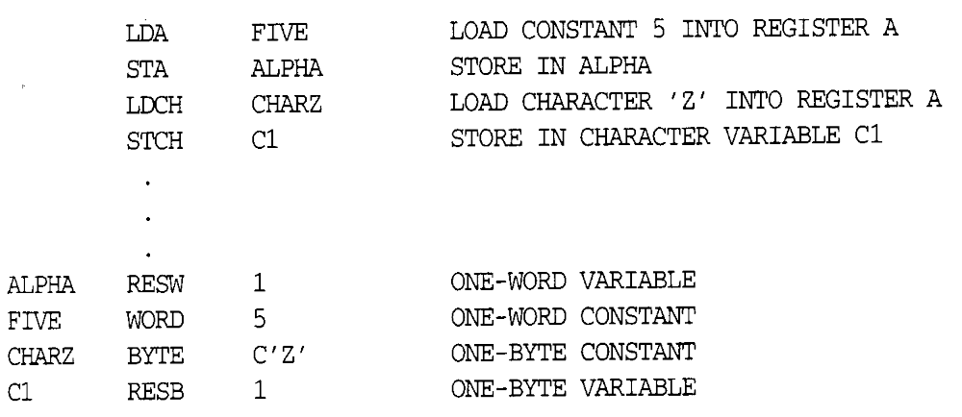
5. SIC Programming Examples
Sample data movement operations
  No memory-to-memory move instructions
Fig (a)

Slide 38
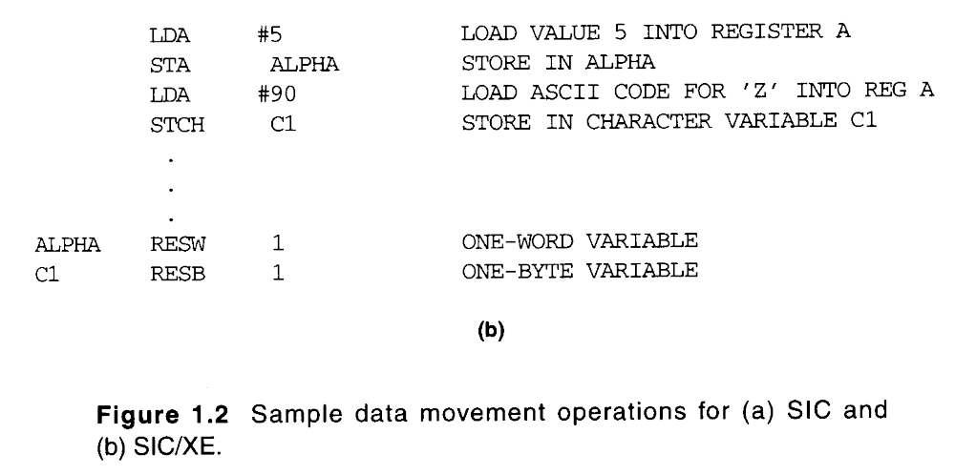

Slide 39
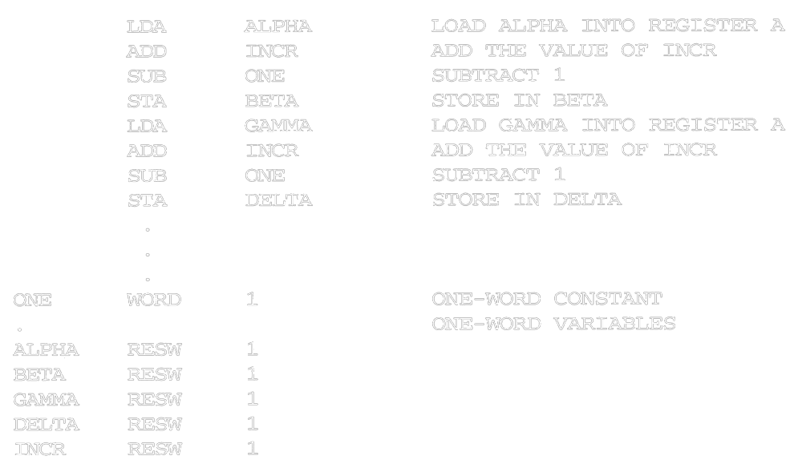
1.3.3 SIC Programming Examples
Sample arithmetic operations
  (ALPHA+INCR-1) assign to BETA
  (GAMMA+INCR-1) assign to DELTA
Fig (a)

Slide 40
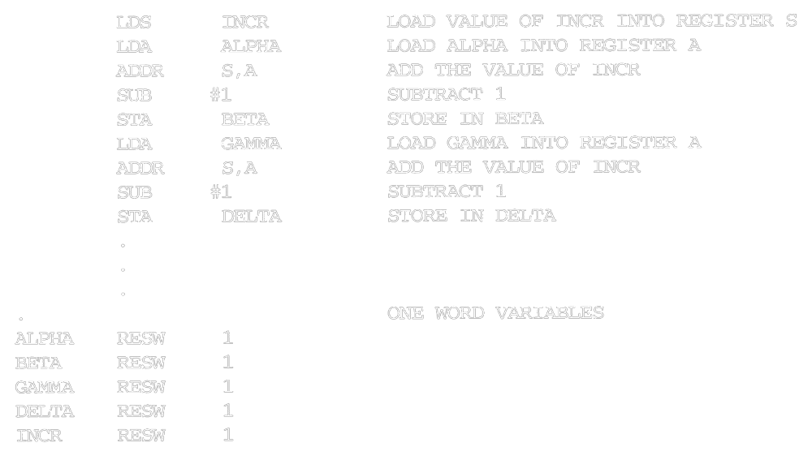
Fig (b)

Slide 41
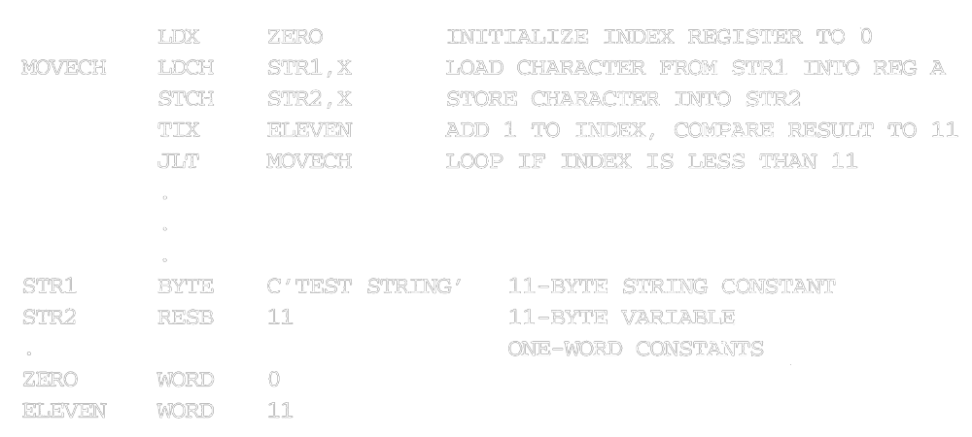
String copy
Fig (a)

Slide 42
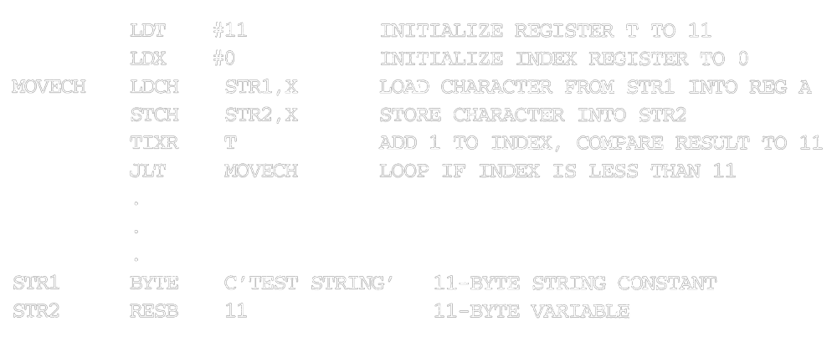
Fig(b)

Slide 43
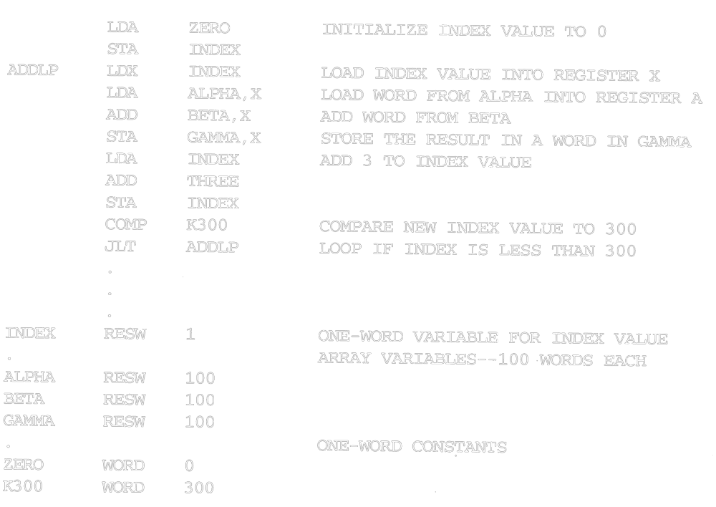
Indexing & Looping
Fig (a)

Slide 44
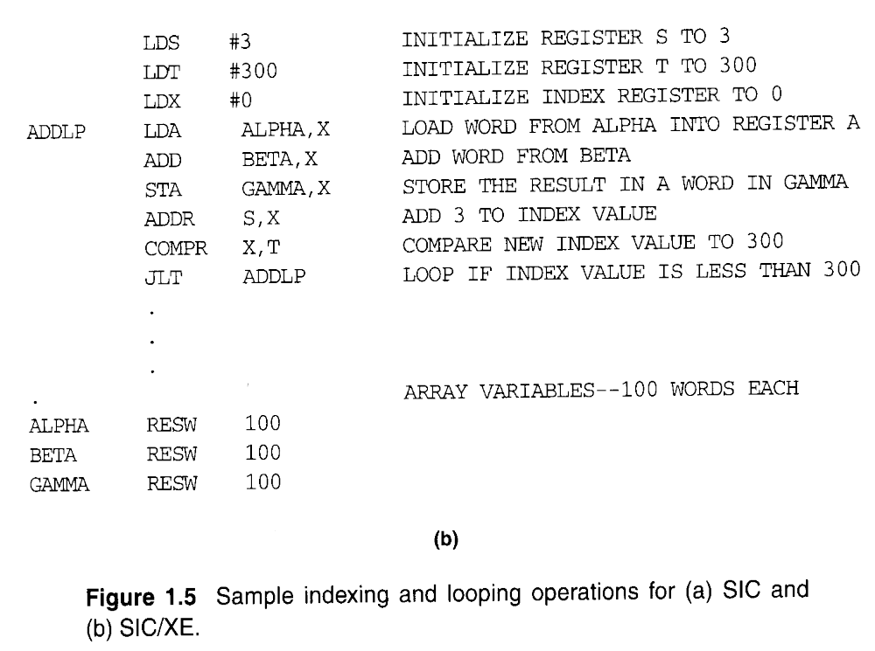

Slide 45
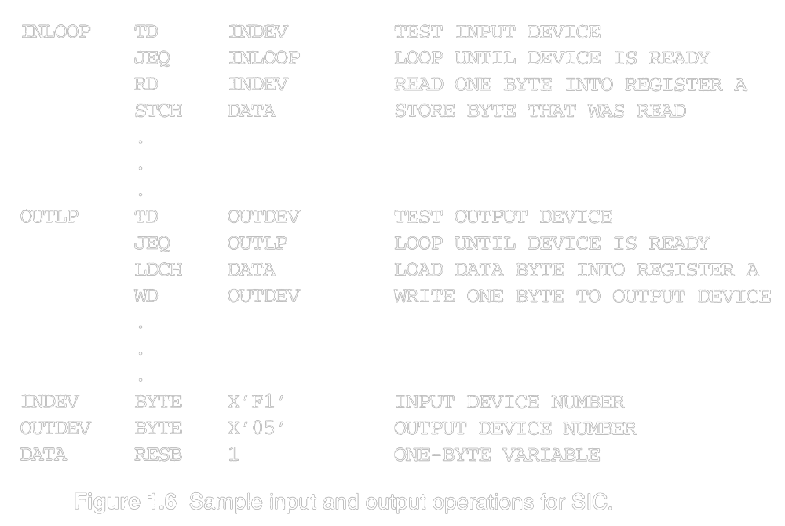
Input /Output

Slide 46
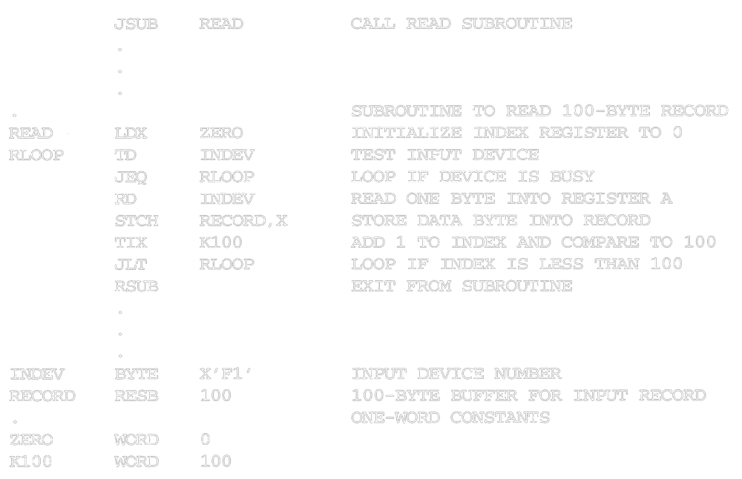
Subroutine call and record
Fig(b)

Slide 47
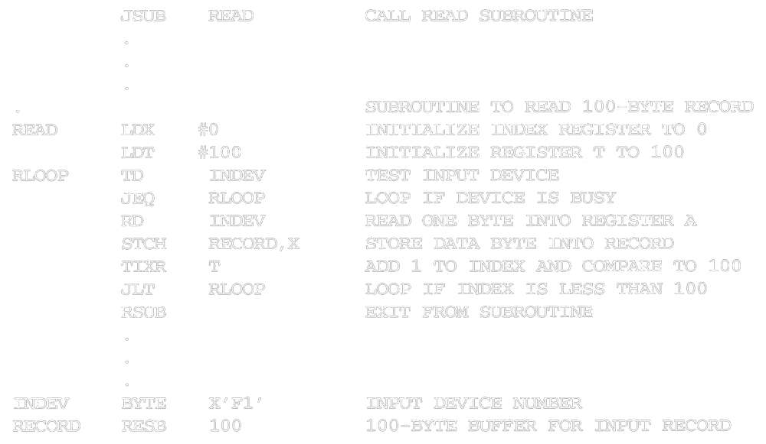
Fig (b)

