Slide 1
JOB SEEKING
Project Guide : Ms. Nisha P K
Presented By
Basil Babu
S3 MCA
Roll No:18

Slide 2
OVERVIEW
Introduction
Abstract
Problem statement
Existing System
Proposed System
Modules
Sample Outputs
Advantages and Disadvantages
Conclusion

Slide 3
ABSTRACT
‘Job Seeking’ is an online web application for creating and searching jobs for all kind of users. Major component of this web application are the user’s company and college including processes like creating, updating an event and can view applications of students those who have registered it. Student’s in various places can register in this application and they can manage their profile by updating and managing education details and certifications. This will be helpful for them in enrolling in Events. All the companies can register in this and they can manage events in their account. When students register in the events created by companies and college, they get notified and are forwarded by the verification of the profiles of students. The students can view only the registered colleges events in this online web application. The registered students are approved by the college, the company and colleges are approved by the admin. It provides a platform for students to enroll in events and download the admit card for the registered event. The main objective of this application is to provide safety and security to students by not providing their details directly to registered companies. The privacy for students are provided in this platform. In this, students can get easily notified of events according to their priority in the preffered module. This enables students to be notified of new events according to their preference which is a key feature of this project.The messaging section’s are useful for various user’s so that they can communicate each other.
Front end : ASP.net
Back end : MySQL

Slide 4
INTRODUCTION
online web application for creating and searching jobs for all kind of users.
Major component of this web application are the user’s company and college including processes like creating, updating an event and can view applications of students those who have registered it.
It provides a platform for students to enroll in events and download the admit card for the registered event. The main objective of this application is to provide safety and security to students by not providing their details directly to registered companies. The privacy for students are provided in this platform.

Slide 5
students can get easily notified of events according to their priority in the preffered module. This enables students to be notified of new events according to their preference which is a key feature of this project.
The future implementation of employment exchange concept of posting govt. jobs by authorised users can be done.

Slide 6
PROBLEM STATEMENT
The project aims at designing a system that is capable of of providing placement oppurtunities to students with enough security and privacy.They can enroll in Events as well as sending messages to authorities. To avoid difficulties for the users to handle all these facilities using different software and switching softwares for campus, off campus placements.

Slide 7
EXISTING SYSTEM
There are many software that provide some of the functionality of this project. But each of these systems not provides all the functionality of this software. i.e., some software may provide the facility for online recruiting in events of private companies and some may provide the facility for applying in college placements. So it is difficult for the users to handle all these facilities using different software. That means they have to switch in to different sites to handle their various requirement. So we need a system to complete their requirement using only single software.

Slide 8
Disadvantages of Existing System
•Maintenance is a huge problem
Updating, changes in details is a tedious task
•Limited resources
•Time consuming and expensive.
•Limited information only conveyed.

Slide 9
PROPOSED SYSTEM
The proposed software ‘JOB SEEKING’ is an online web application for creating and searching jobs for all kind of users. This system enables the user’s company and college to create processes like creating, updating an event and can view applications of students those who have registered it. Student’s in various places can register in this application and they can manage their profile by updating and managing education details and certifications. This will be helpful for them in enrolling in Events. All the companies can register in this and they can manage events in their account. When students register in the events created by companies and colleges, they get notified and are forwarded by the verification of the profiles of students. The students can view only the registered colleges events in this online web application. The registered students are approved by the college, the company and colleges are approved by the admin. It provides a platform for students to enroll in events and download the admit card for the registered event. The main objective of this application is to provide safety and security to students by not providing their details directly to registered companies. The privacy for students are provided in this platform. In this, students can get easily notified of events according to their priority in the preffered module. This enables students to be notified of new events according to their preference which is a key feature of this project.The messaging section’s are useful for various user’s so that they can communicate to each other.

Slide 10
Advantages of proposed System
The various functionalities of the system are divided into three modules. All these three modules perform different functions but all these functionalities performed on the data provided by the users.
Students who are registered in the site can ensure their privacy. The admin will approve the colleges and companies that registers in this system. Students can login the system and manages their information. The proposed system can be viewed in multiple perspectives in case of college user and employment office in the future. In this all the students can register in the employment center. They can register for events based on its types. The student can download their admit card through this platform. The messaging module is provided. Using this single software the requirements for searching a job is satisfied.The students get easily notified by various events, placements in various colleges.The preffered module helps students to be notified of events according to their preferences.
•

Slide 11
A flexible, scalable infrastructure management platform has been architected and a prototype implemented
•Easy to handle
•Making transactions easily
•Stable of cost structure
•Applying for jobs in private and government sector

Slide 12
Product modules:
1. College
•Management, approval of Students
•Registration
•Create events
•Messaging
2. student
•Manage profile
•student registration
•View and enroll events
•Notifications according to their preferences
•Messaging

Slide 13
•Download Admit card
3.Admin
• Manages colleges and companies
•Manage places
4. Company
•Registration
•Create Events
•View Applications of those who registered and Approving
•Messaging

Slide 14
Module Description
a)Registration Module
Students, Companies, Colleges can register in to this application. Students are approved by college. Other users, college and companies are managed by admin. At the time of registration, individual profiles are created for each user and notifications are updated in their profile.
b)Creating Events by user
The Company and College can create and manage the Events. They can view applications and approve it.
c)Messaging

Slide 15
This application provide the concept of messages that enables the user to ask any queries related to any topics to other users and also can reply for any queries ask by others.
d)Event enrolling
This application enable the users to view all the events and enroll for the events.After approval, they can download admitcard

Slide 16
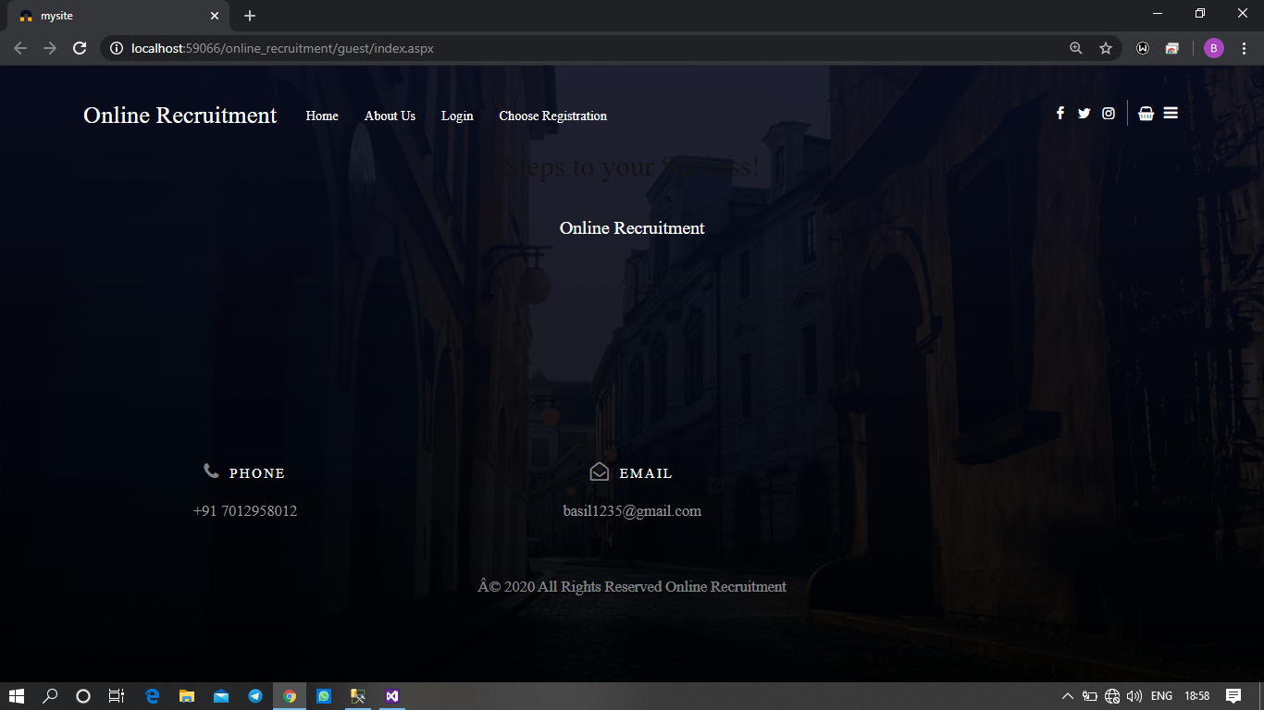
HOME PAGE
Expected Output

Slide 17
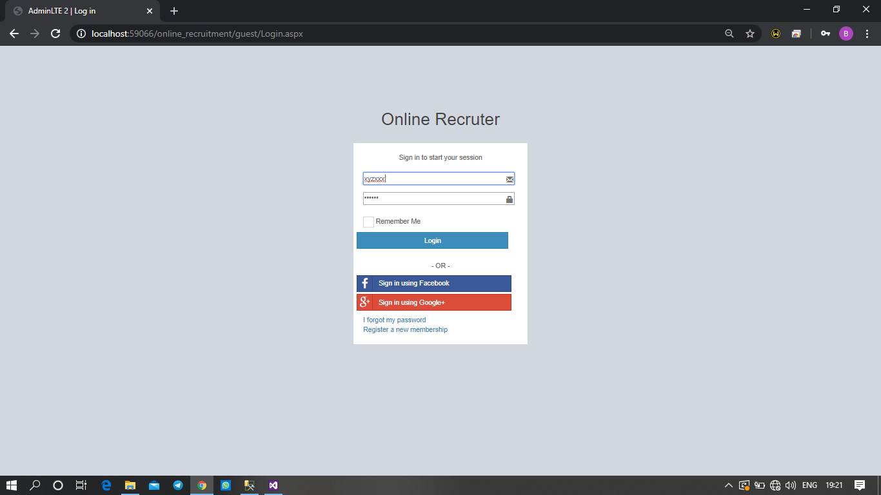
Login

Slide 18
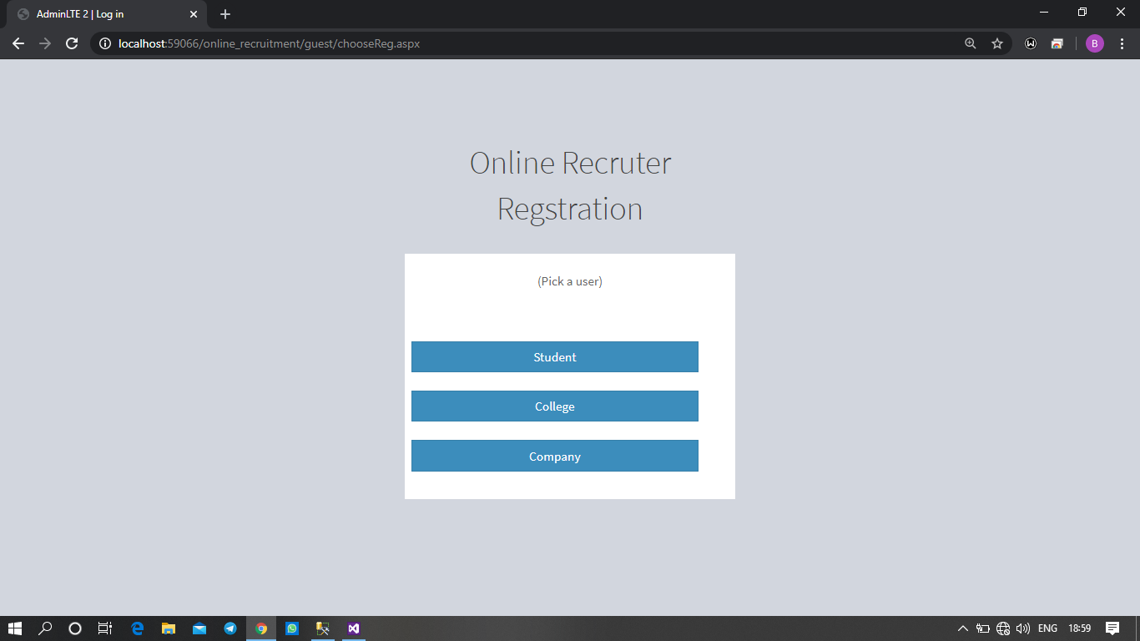
Registration type of User

Slide 19
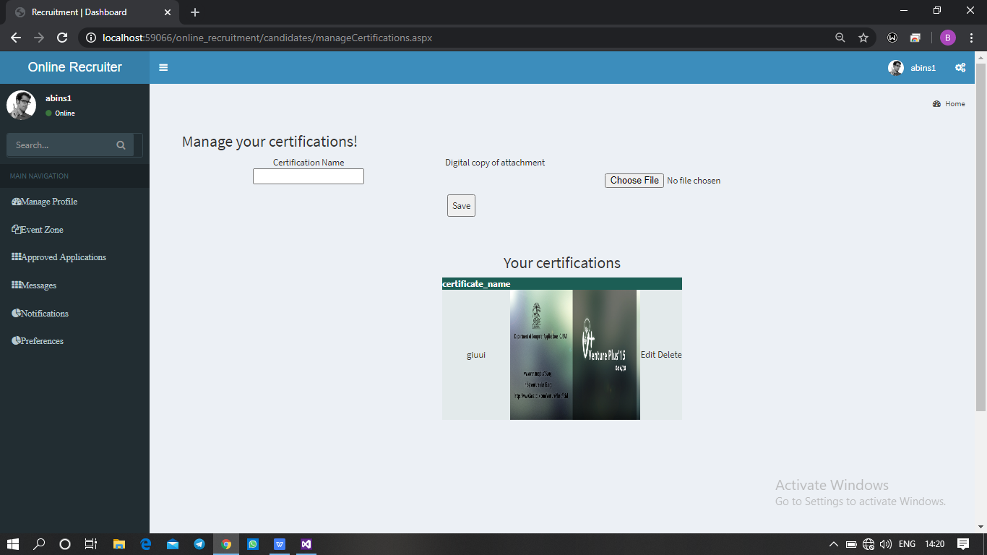
Student Interface

Slide 20
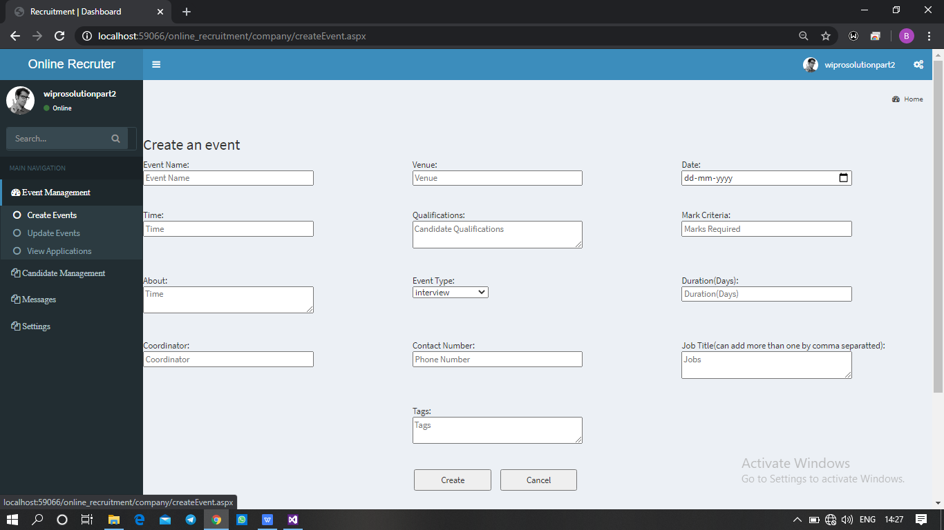
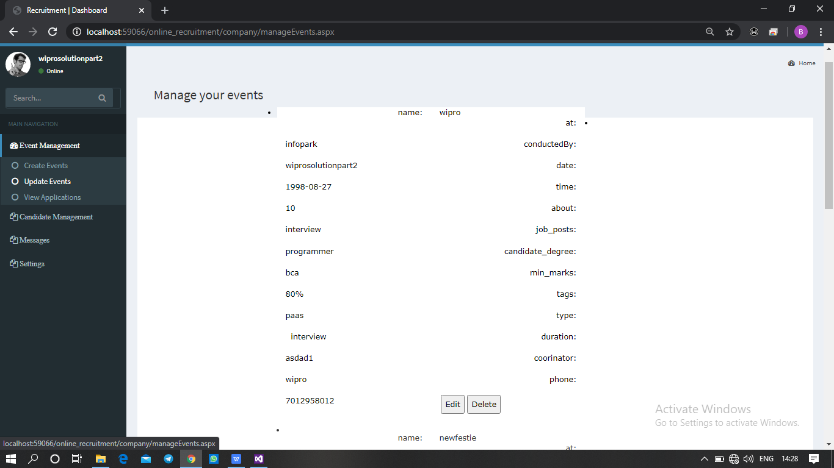
Event Management

Slide 21
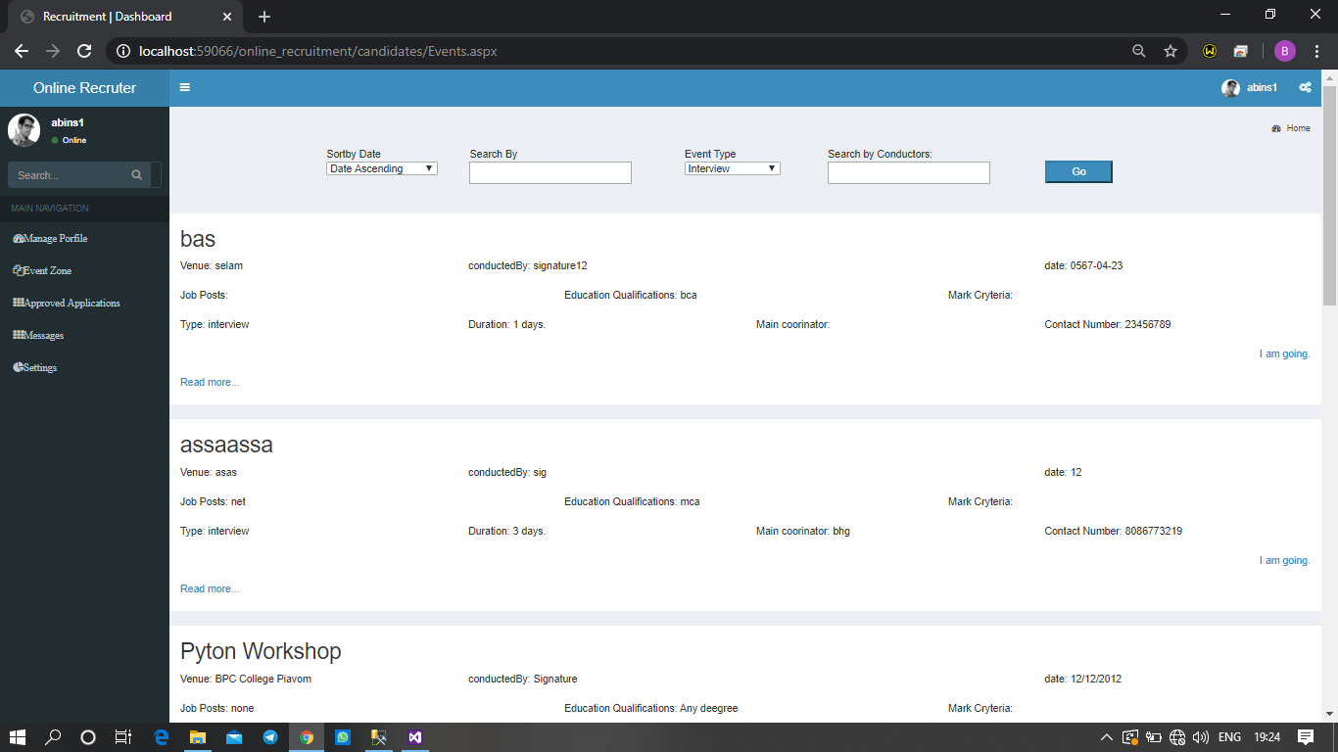
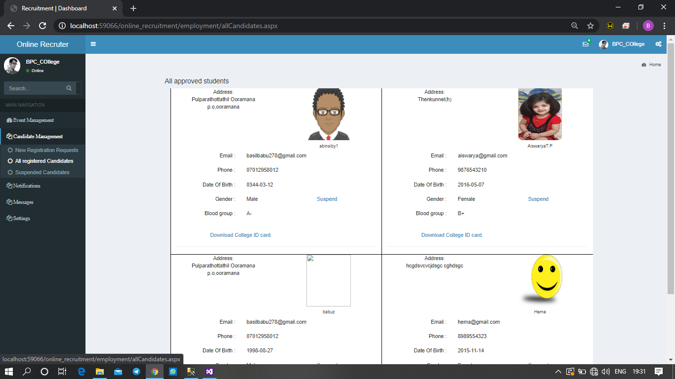

Slide 22
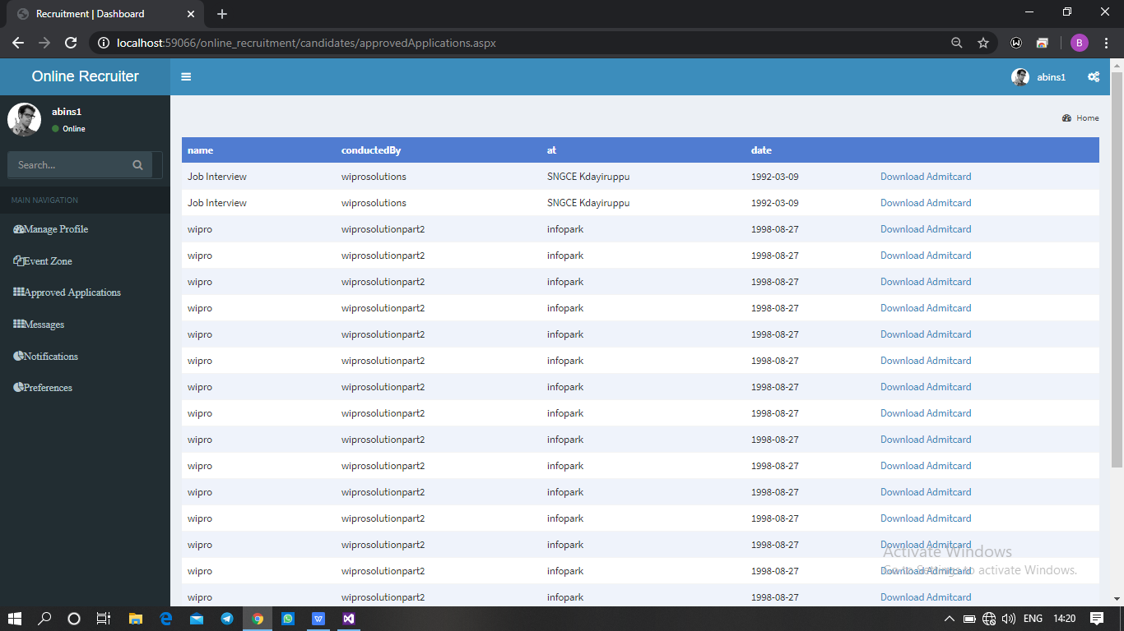
Download AdmitCard

Slide 23
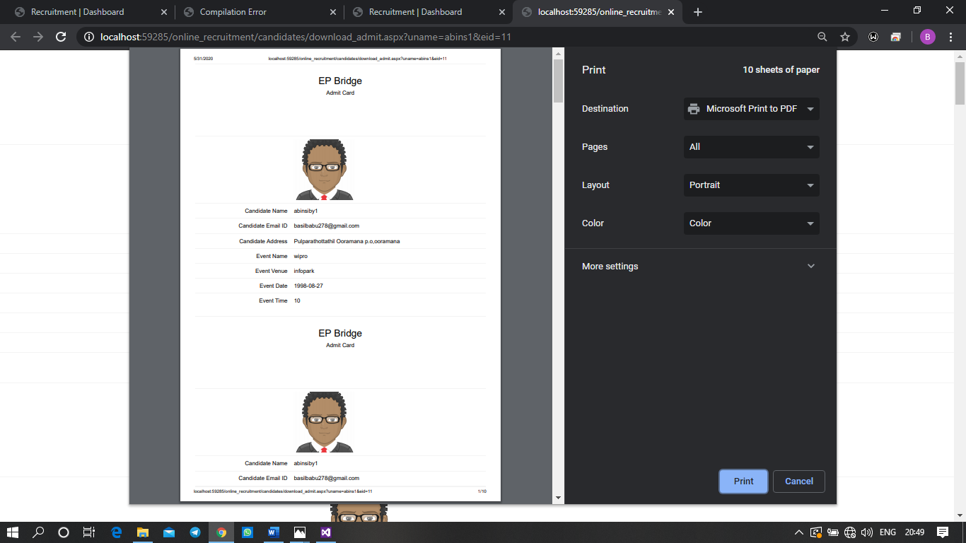

Slide 24
CONCLUSION
‘Job Seeking’ is an online web application for creating and searching jobs for all kind of users. Major components of this web application is college including processes like creating, updating an event and can view applications of students those who have registered it.
The registered students are approved by the college, the other user’s company and colleges are approved by the admin. It provides a platform for students to enroll in events and download the admit card for the registered event. The main objective of this application is to provide privacy to students by not providing details directly to companies and student’s can download their admit card for enrolling the event..

Slide 25
THANK YOU

