Slide 1

CONNECTTEL CUSTOMER CHURN PREDICTION
Basil B. Duwa
10alytics
Cohort 15

Slide 2

Company Overview:
ConnectTel is a global telecommunications leader, offering innovative and dependable voice, data, and Internet services to both individuals and businesses. With a strong commitment to customers and modern technology, ConnectTel is reshaping the industry, empowering users worldwide to remain connected and flourish in the digital age.

Slide 3


Problem
Customer churn, poses a significant risk to its long-term business sustainability and expansion.
The company's existing strategies for retaining customers lack accuracy and effectiveness, leading to the loss of valuable customers to competitors

Slide 4

Aim
The aim is to create a robust customer churn prediction system by harnessing advanced analytics and machine learning techniques using available customer data.
To predict customer churn and execute targeted retention efforts.

Slide 5
ADVANTAGES OF THE PREDICTION
Minimize customer attrition.
Strengthen customer loyalty.
Maintain a competitive advantage in the telecom industry.

Slide 6
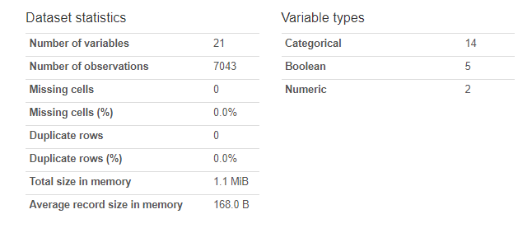
Dataset Overview

Slide 7
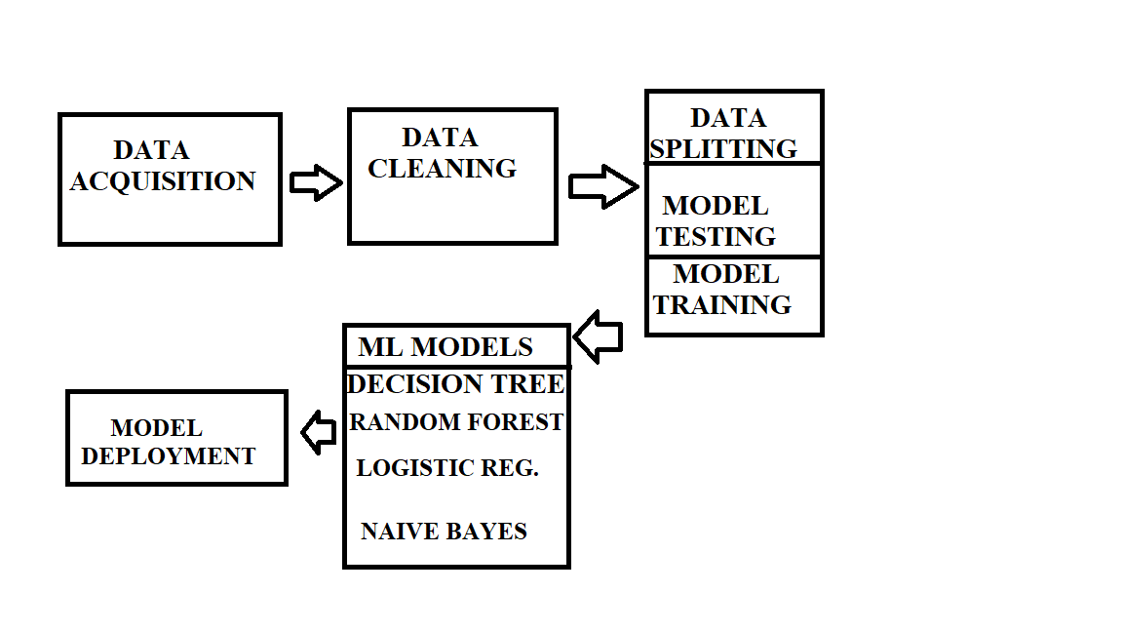
Machine learning Pipeline

Slide 8
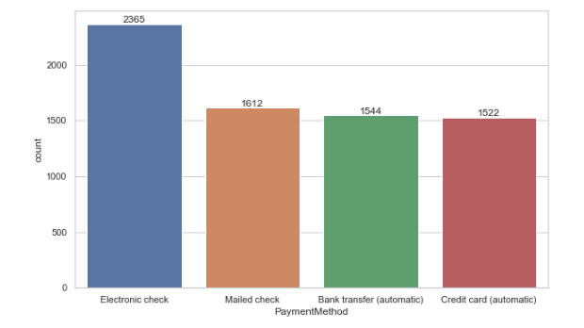
Exploratory Data Analysis
Univariate Analysis

Slide 9
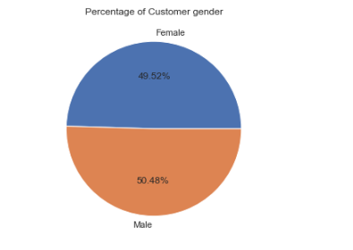
Univariate Analysis

Slide 10
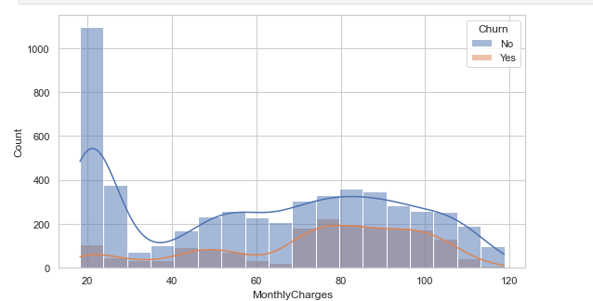
Bivariate

Slide 11
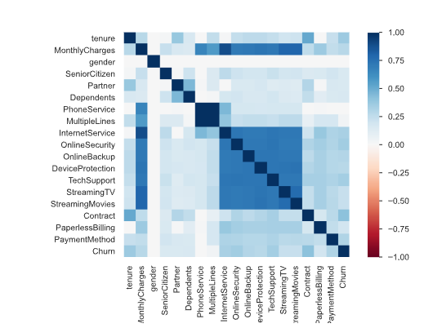
Correlation Matrix

Slide 12



Data Pre-processing
Feature Engineering
Churn as the dependent variable was dropped.
Encoding
One-hot-encoding was applied to change the categorical dataset to numerical dataset.
Scaling/Normalization
The dataset underwent data normalization using the Min-Max Scaling technique.

Slide 13
Model Building.
Data splitting
67% Training
33% Testing
Models:
Decision Tree
Random Forest
Logistic regression

Slide 14
Model Evaluation
MODEL | ACCURACY | PRECISION | RECALL | F1SCORE
logistic regression | 0.81 | 0.77 | 0.74 | 0.75
Random Forest | 0.80 | 0.79 | 0.69 | 0.71
Decision Tree | 0.77 | 0.77 | 0.78 | 0.77

Slide 15
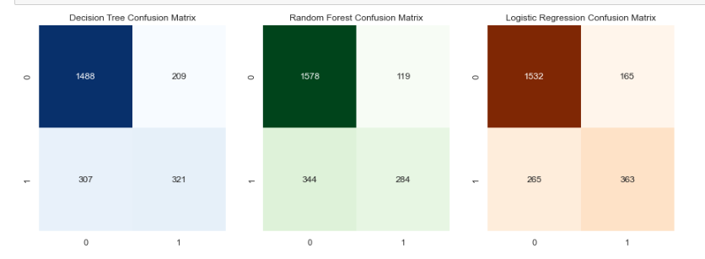
Confusion Matrix

Slide 16


Summary
In this project, an effective customer churn prediction system using advanced analytics and machine learning techniques was built.
Three models, including Logistic Regression, Random Forest, and Decision Tree, were developed and evaluated.
Logistic Regression proved to be the most accurate with an 81.51% accuracy rate, followed by Random Forest at 80.04%, and Decision Tree at 77.63%.
A detailed classification report provided insights into precision, recall, and F1-score for both churn and non-churn categories.
Confusion matrices were employed to visualize model performance. Overall, this project equips ConnectTel with the means to proactively address customer churn, enhance loyalty, and stay competitive in the telecommunications industry.

Slide 17




Thank you
Basil B. Duwa
10alytics 15 cohort
https://www.linkedin.com/feed/

