Slide 1
Today’s Goal
Deepen our understanding of C# by diving into strings and characters

Slide 2
Goal Breakdown
Become more familiar with C# syntax and semantics
Understand the concepts introduced using real examples
How using Unit tests can help your understanding
Learn about how text and characters are represented

Slide 3
Advice
Consider each line of code
What is it doing?
Why is each symbol or element there?
What parts are confusing?
Why does the program do what it is doing?

Slide 4
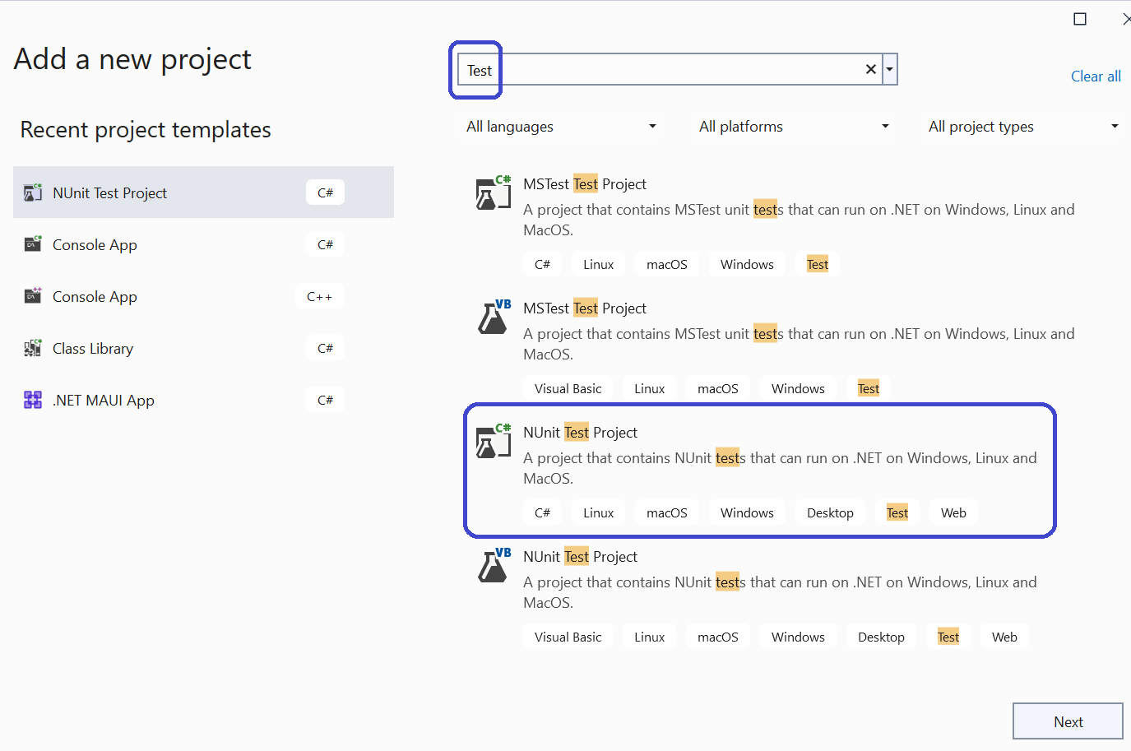
Test Projects: A special kind of library

Slide 5
Test Projects
They provide tool support for running tests in the IDE
We will be creating test projects in the lab
Useful for exploratory coding and … well … testing

Slide 6
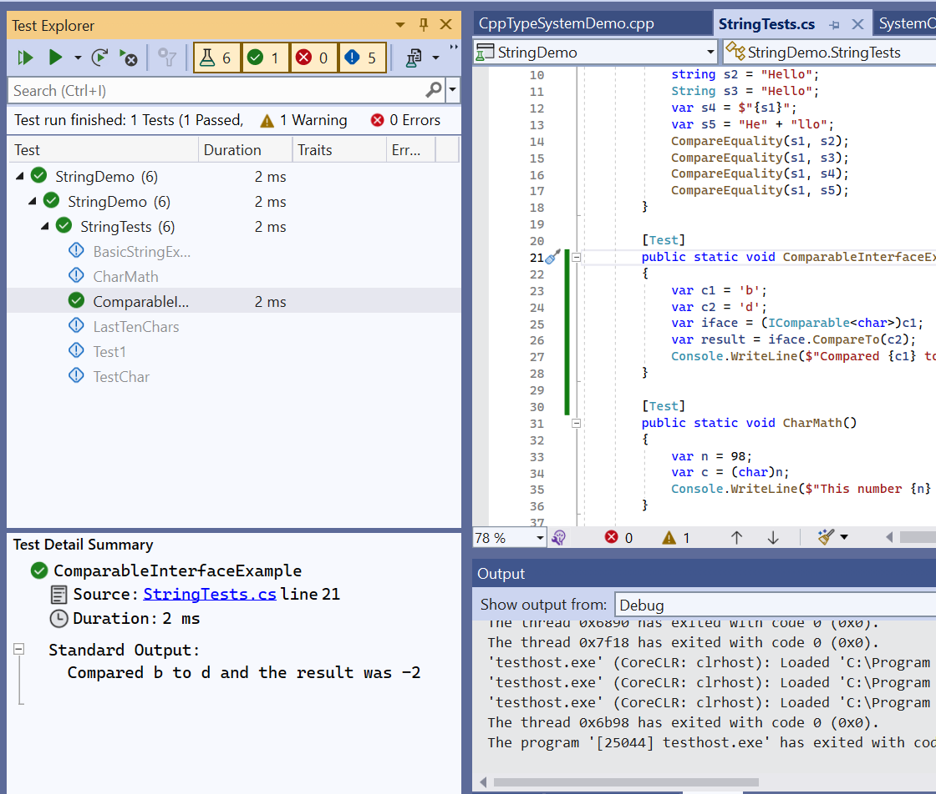
The Test Explorer Window

Slide 7
What is a String?
A representation of text values as sequences of characters

Slide 8
Consider the Following
Are strings value types (“structs”) and allocated on the stack?
Or are they reference types (“classes”) and allocated on the heap?
What about chars?
Why?

Slide 9
Strings
https://learn.microsoft.com/en-us/dotnet/csharp/programming-guide/strings/
A string is an object of type System.String whose value represents text.
Internally, the text is stored as a sequential read-only collection of char objects
The keyword “string” is an alias for the type “System.String”

Slide 10
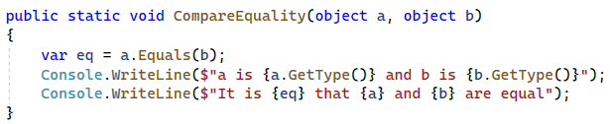
A Helper Function for Today

Slide 11
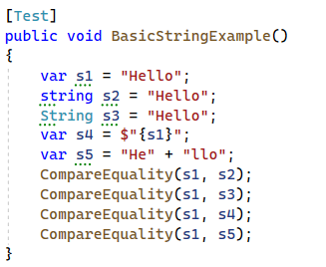
String VARiable DECLARATION

Slide 12
The Take-away
No observable difference between “string” and “System.String”
Local variable declarations can (and should) use var
Use the “string” alias in your code
See the Microsoft coding guidelines

Slide 13
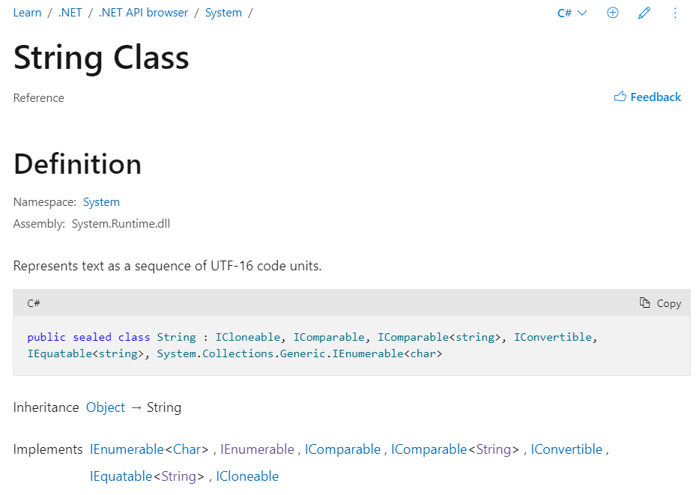
System.String Documentation

Slide 14
Reading the documentation
It said that it was a “class” (so it is a reference type)
It said that it derives from “System.Object”
This means that it shares the methods (functions) of System.Object
We already know that everything derives from System.Object
What is a UTF-16 Code Unit?
What does it mean that it “implements interfaces”?

Slide 15

Why is string a class?

Slide 16
So What’s a Char
A Char is primitive value type
It has two bytes, and represents a Unicode UTF-16 character.
It is classified as an integral type by the specification:
The char keywords is an alias for the type System.Char
See the language reference and the type documentation

Slide 17
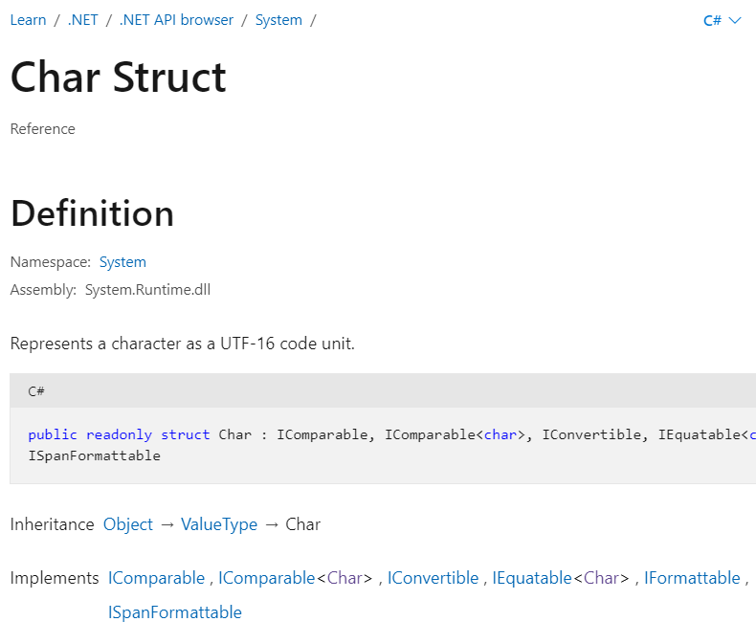
The System.Char Documentation

Slide 18
Salient Points from Documentation
It’s a struct
It derives from ValueType
All structs derive from ValueType automatically
It implements a number of interfaces like IComparable

Slide 19
What “Implementing Interfaces” means
An interface is a kind of contract
It states a set of methods and properties that a class or struct may implement
An interface is also a type

Slide 20
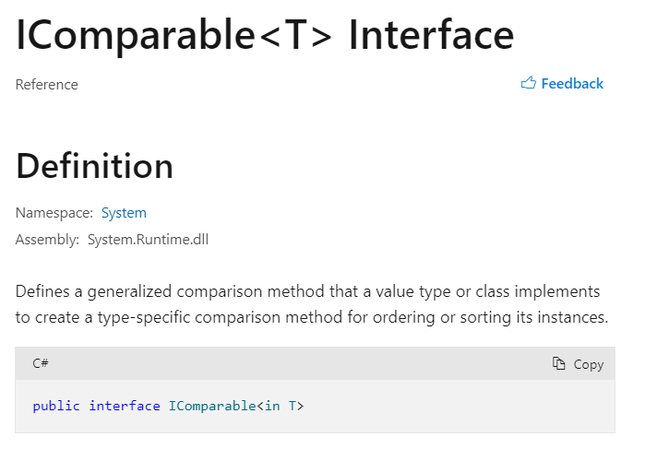
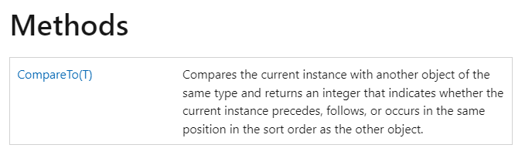
Interface Example

Slide 21
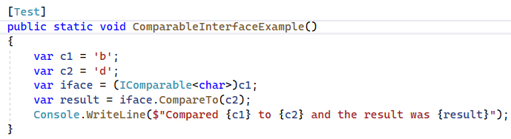
Code Example of IComparable

Slide 22
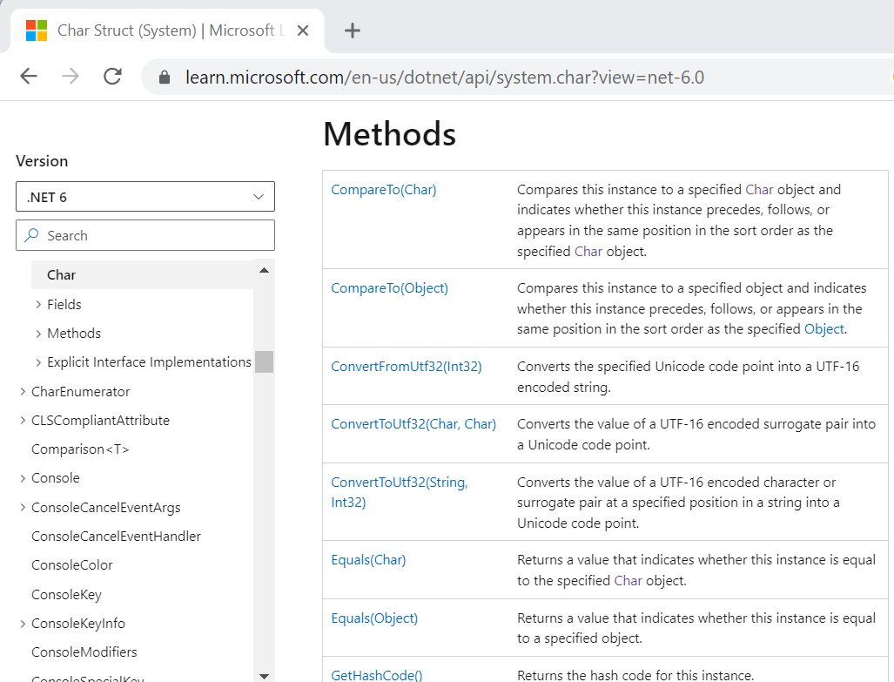
The Interface Methods are on the Type

Slide 23
Chars are Numbers
Each one corresponds to either a Unicode code point or a

Slide 24
A Char is a Code Point not a Characters
A

Slide 25
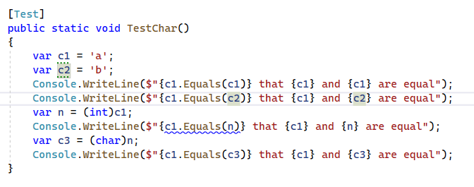

Slide 26
Comparing Characters

Slide 27
Converting to Strings

Slide 28
Glyph
A graphic symbol that represents a character
An element of a typeface (aka font fontamily)
Letters (e.g., ‘e’) and diacritics (e.g., accents) are separate glyphys

Slide 29
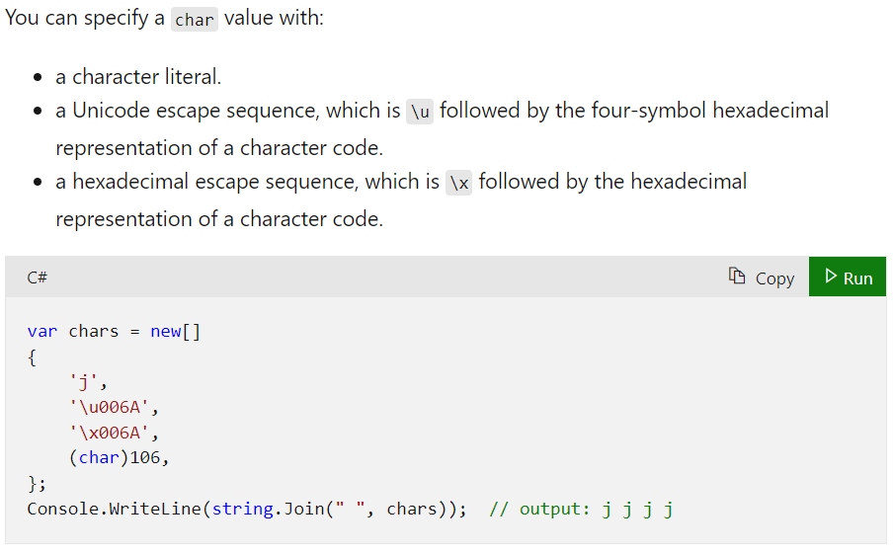
Char Literals

Slide 30
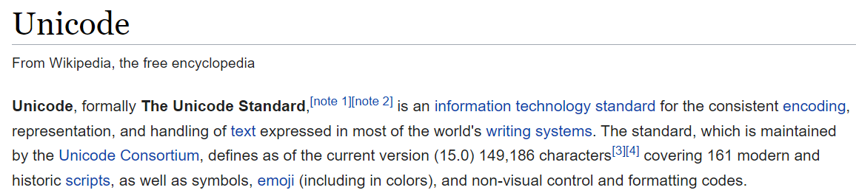
What’s Unicode?

Slide 31
What’s Utf-16
One of multiple Unicode encodings (e.g., Utf-8, Utf-16, Utf-32, GB18030)
It is variable length: Characters use either one or two 16-bit code units
Not as widely used on the web as Utf-8

Slide 32
What’s an Encoding
An assignment of numbers to characters

Slide 33
Did you see that!
Two “Chars” in a row are sometimes needed to properly display characters
This is why we disambiguate code units and code points
Code points are made up of code units
In C# a char instance is a code unit in the Utf-16 encoding

Slide 34
ASCII
ASCII is a character encoding first published as a standard in 1963
Only 128 Characters
95 are printable
33 are control codes
One byte per code point

Slide 35
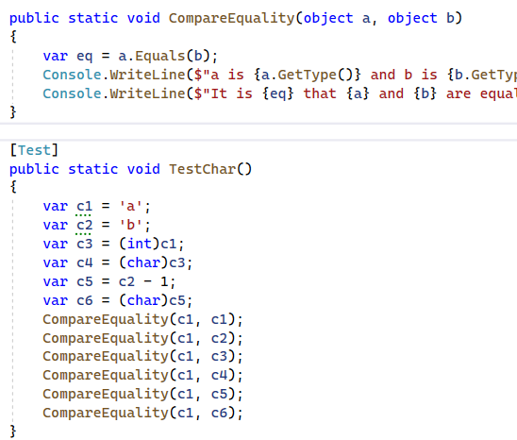
Comparing Character Equality

Slide 36
Let’s Convert it to Bytes
Use “BitConverter.ToBytes”
https://learn.microsoft.com/en-us/dotnet/api/system.bitconverter.getbytes?view=net-7.0

Slide 37
Escape Sequences
How do you write the character used to delimit char literals?
Or the character that represents a newline or tab?
Or an unprintable control code like the bell
Answer: use an escape sequence (backslash followed by code).

Slide 38
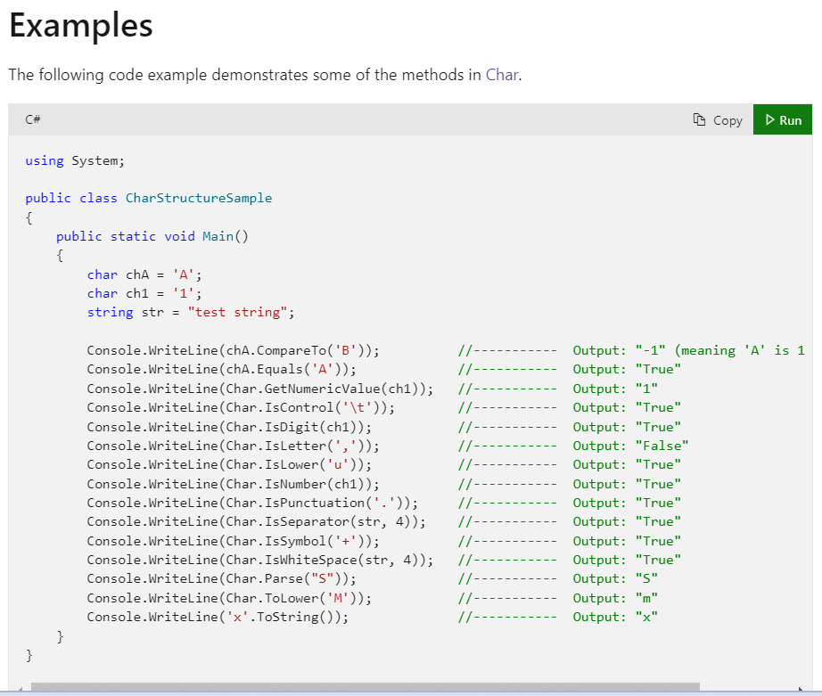
Some Char Methods

Slide 39
From String to Char
A string (s) with one character can be converted to a char in two ways:
One is to use “String.Parse”
The other is to use the indexing property.

Slide 40
Invoking Instance versus Static Methods
Some methods have the form “expression.FunctionName(<args>)”
While others have the form “typename.FunctionName(<args>)”

Slide 41

Char is not an expression
The word “Char” is the name of a type
More specifically a class within the namespace
You cannot use it where you would an expression:

Slide 42
But you can use it to call static methods

Slide 43
Back to Strings

Slide 44
When working with text
We usually

Slide 45
String Literals
Regular string literals
Verbatim string literals
Interpolated string expressions
Raw string literals

Slide 46
Verbatim String Literals
A verbatim string literal is preceded by the “@” character
See: https://learn.microsoft.com/en-us/dotnet/csharp/language-reference/tokens/verbatim.

Slide 47
Null Characters
A C# string can contain any number of embedded null characters ('\0’).
This differs from C/C++ which uses null to indicate termination

Slide 48
Useful String Functions
String.Join
String.IndexOf
String.LastIndexOf
String.Substring
String.Split
String.Format

Slide 49
Useful String Operations not on String
Int32.ParseInt
Double.TryParse()
Object.ToString();
Convertible?

Slide 50
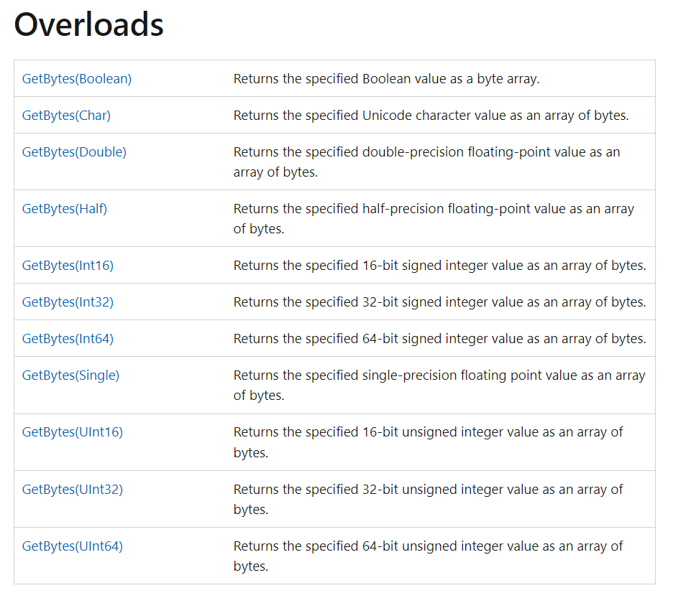
Bit Converter does not work on Strings?!

Slide 51
Remember Encodings?
We have to use one of those

Slide 52
Converting a String to Bytes

Slide 53
Converting Bytes to Strings

Slide 54
String Immutability
String objects are immutable: they can't be changed after they've been created
Methods and C# operators either query a string or create a new string object

Slide 55
So how do you build them?
StringBuilder class
String.Format
String interpolation expression
Concatenation
From an array of chars

Slide 56
String Operators
+ String concatenation
+= String concatenation and assignment
== Equality
!= Inequality

Slide 57
String Interning

Slide 58
Strings are Like Arrays
They have a Length property
They support indexing

Slide 59
Wait, what is a property?
A property is a type member that resembles a field (data member)
It may redirect to a field or to a function under the hood
It may be read-only, read-write, or write-only (rare)
An example is the “Length” property of arrays and strings
Like other members it may be static or instance based

Slide 60
Indexers
An indexer allows a type instance to be indexed like an array or dictionary
An indexer can accept any type of parameters (like an int, string, object.)

Slide 61
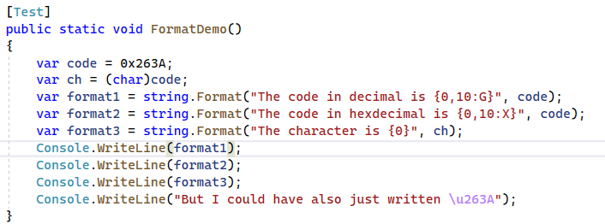
String Formatting

Slide 62
String Formatting
Before string interpolation we had string formatting routines
Like a safe and powerful version of the C function sprintf().
https://learn.microsoft.com/en-us/dotnet/api/system.string.format?view=net-7.0

Slide 63
The Null Literal
The null keyword represents a reference that does not refer to an object.
It has a special type (called the null type) but can be cast to any reference type
Reference variables are assigned null by default
In other words it means “no value”

Slide 64
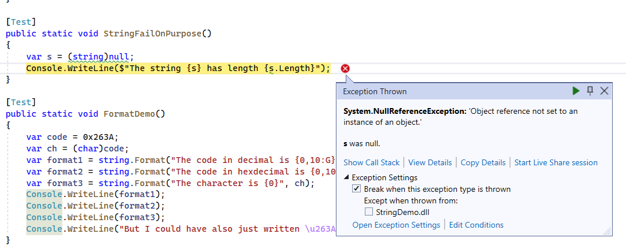
NullReferenceException

Slide 65
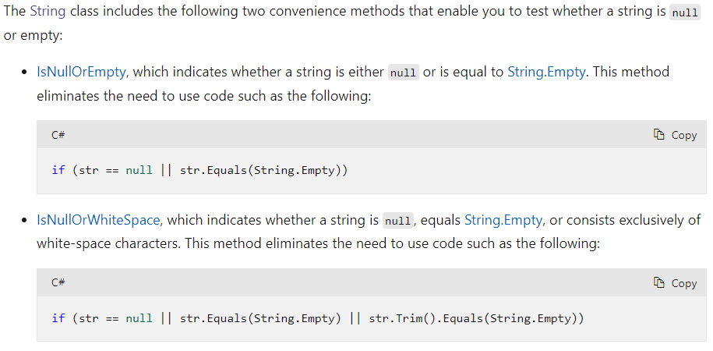
Checking if Strings are Null or Empty

Slide 66
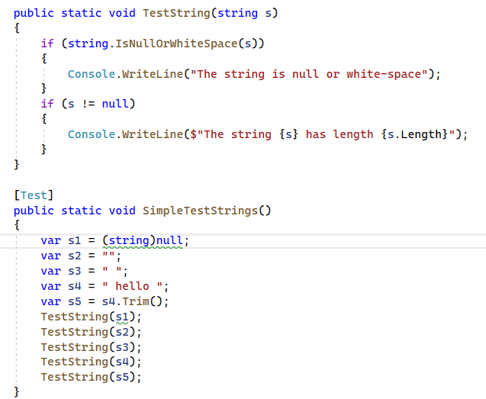
String Queries

Slide 67
Strings are Enumerable
Strings implement “IEnumerable”
This means you can loop through the characters with a foreach

Slide 68
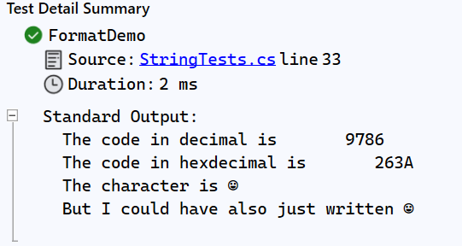

Slide 69
Review
What does “char” mean?
What does “string” mean?
What is an encoding?

