Slide 1
Today’s Goal
Deepen our understanding of Object-Oriented Programming and Strings

Slide 2
What is an object in OOP?
An object is an instance of a class

Slide 3
What is a class in OOP?
A data type definition
A template for creating objects
Describes methods and data

Slide 4

Classes in C#
System.String is a class
System.Object is also a class
So is System.Type
A class is a kind of data type
Classes describe the data and methods contained by “instances” of the class
Instances of a class are values, known as objects
Classes can derive from (inherit) another class (maximum one)

Slide 5
The Class Hierarchy
System.Object
System.String

Slide 6

Variables
All variables have a fixed type determined at compile-time
A variable refers to an instance of a type (or null)
Variables may be initialized when declared (best practice)
Variables may be reassigned (use sparingly)
Variables cannot be assigned a value of an incorrect type

Slide 7
Parameters and Arguments
Function parameters are a special kind of variable (also called “formal arguments”)
When a function is invoked the function parameters are bound to values
Values provided during invocation to parameters are called arguments

Slide 8
This is indeed confusing!
The keyword “object” is a synonym for the type “System.Object”
Indicates that the accepted type of parameters, local variables, and return types is treated as a System.Object
In an object-oriented programming, all, or most, values are called objects.

Slide 9
Objects and Values
Consider: var s = “hello”;
This is an implicitly typed variable declaration statement.
Implicitly typed because it uses the “var” keyword
The variable declared is named “s”
The following is equivalent:
string s = “hello”.

Slide 10
Implicitly Typed Variables
A local variable declared with the “var” keyword is implicitly typed
Requires initialization upon declaration
The variable takes the precise type of the expression

Slide 11
Casting to Object
Everything can be cast to an object:
var x = (object)”Hello”;
This is equivalent to:
object x = “Hello”;

Slide 12
Upcast
System.String dervives from System.Object
System.Object is called the base class
System.String is called the derived class
Any cast to a base class is called an upcast
Upcasts are implicit: no conversion operator is required
They are always successful

Slide 13
Downcast
Casting from a base class to a derived class is called a downcast
System.Object to System.String is a downcast
var o = (object)”hello”; var s = (string)o; var n = (int)o;
Downcasts are always explicit
They may fail at run-time

Slide 14
The “runtime” type of an object
This is the value returned when I call “<expression>.GetType()”
The run-time type of a value is unaffected by any casts
It never changes

Slide 15
What happens when I write?
var x = (object)”Hello”; var s = (string)”World”; Console.WriteLine($”{x.GetType()}”); Console.WriteLine($”{s.GetType()}”);

Slide 16
What if I write the following instead?
object x = ”Hello”; string s = ”World”; Console.WriteLine($”{x.GetType()}”); Console.WriteLine($”{s.GetType()}”);

Slide 17
Did you expect that?
Why not?

Slide 18
What does the following do?
var x = (object)”Hello”; var s = (string)”World”; Console.WriteLine($”{x.Length}”); Console.WriteLine($”{s.Length}”);

Slide 19
Remember that it is the same as
object x = ”Hello”; string s = ”World”; Console.WriteLine($”{x.Length}”); Console.WriteLine($”{s.Length}”);

Slide 20
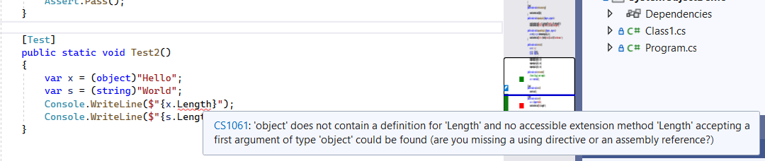
Either way we get an error!
Why? Because objects don’t have “Length” properties

Slide 21
Variable Types Restrict Methods
A variable or expression of type “T” only allows you to access the methods and properties of T.
Regardless of the type of the run-time type of T

Slide 22
What are Literals
They are expressions that cannot be reduced
You can think of them like values embedded in code

Slide 23
What does “.” mean?
When calling a function it usually looks like “Console.WriteLine”
What is the “.”
What is to the left?
What is to the right?
Called a member access expression

Slide 24
The left side might be
A type
An expression
A namespace

Slide 25
The right side might be
A nested type
A nested namespace
A static or non-static member (function, property, more)

Slide 26
Invoking Instance versus Static Methods
Some methods have the form “expression.FunctionName(<args>)”
While others have the form “typename.FunctionName(<args>)”

Slide 27

Char is not an expression
The word “Char” is the name of a type
More specifically a class within the namespace
You cannot use it where you would an expression:

Slide 28
But you can use it to call static methods
Char.IsControl
Char.IsLetterOrDigit
Char.IsUpper
Char.IsWhitespace
Etc.

Slide 29
String Literals
Regular string literals
Verbatim string literals
Interpolated string expressions
Raw string literals (C# 11)

Slide 30
Verbatim String Literals
A verbatim string literal is preceded by the “@” character
Used to eliminate the need for escape characters (e.g., file path)
Can span multiple lines
See: https://learn.microsoft.com/en-us/dotnet/csharp/language-reference/tokens/verbatim.

Slide 31
Nul Characters
A C# string can contain any number of embedded nul characters ('\0’).
This differs from C/C++ which uses null to indicate termination
Not to be confused with the null keyword, this is a char that encodes zero

Slide 32
Useful String Functions
String.Join
01
String.IndexOf
02
String.LastIndexOf
03
String.Substring
04
String.Split
05

Slide 33
Useful String Operations not on String
Int32.ParseInt
Double.TryParse()
Object.ToString();
Convertible?

Slide 34
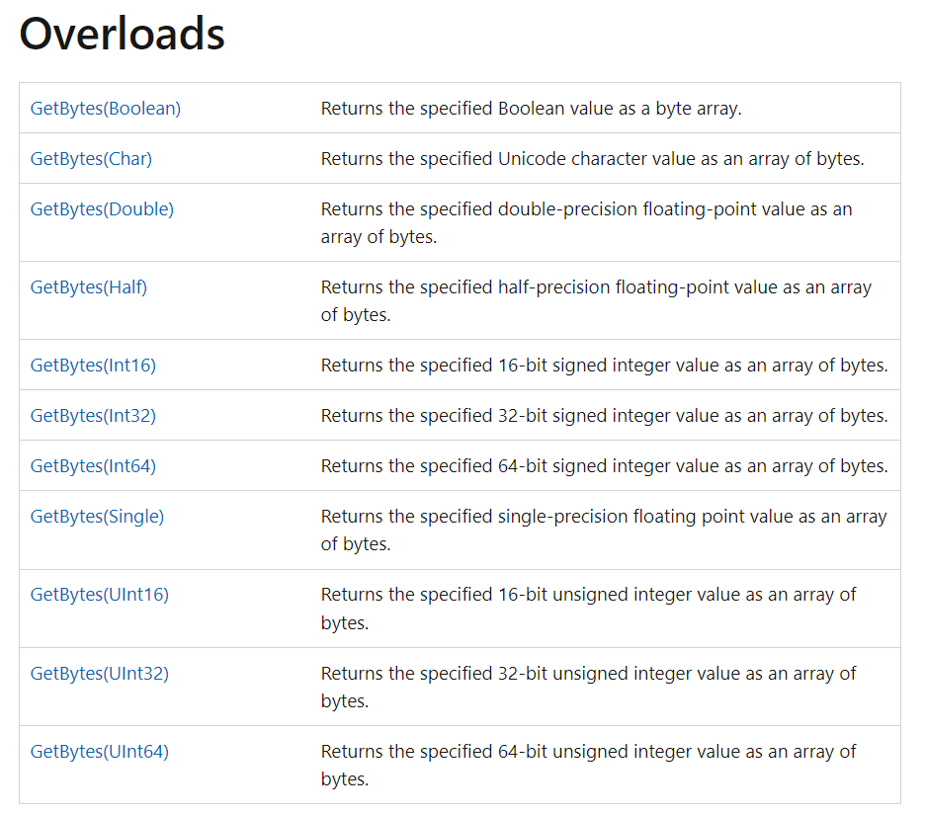
Bit Converter does not work on Strings?!

Slide 35

Remember Encodings?
string value = "\u00C4 \uD802\u0033 \u00AE"; byte[] bytes= System.Text.Encoding.UTF8.GetBytes(value);
System.Text.Encoding.UTF8.GetBytes(value);
We need to choose one, such as
System.Text.Encoding.UTF8.GetBytes()
System.Text.Encoding.UTF16.GetBytes()
System.Text.Encoding.ASCIIEncoding.GetBytes()

Slide 36
String Operators
+ String concatenation
+= String concatenation and assignment
== Equality
!= Inequality

Slide 37
String Immutability
String objects are immutable: they can't be changed after they've been created
Methods and C# operators either query a string or create a new string object

Slide 38
So how do you build strings?
StringBuilder class
String.Format
String interpolation expression
Concatenation
From an array of chars

Slide 40
Strings are Like Arrays
They have a Length property
They support indexing using an integer index
In other words you can get the nth character using a subscript

Slide 41
Wait, what is a property?
A property is a type member that resembles a field (data member)
It may redirect to a field or to a function under the hood
It may be read-only, read-write, or write-only (rare)
An example is the “Length” property of arrays and strings, or “Count” property of Lists
Like other members it may be static or instance based

Slide 42
Indexers
An indexer allows a type instance to be indexed like an array or dictionary
An indexer can accept any type of parameters (like an int, string, object.)

Slide 43

String Formatting
Before string interpolation we had string formatting routines
Like a safe and powerful version of the C function sprintf().
String.Format()

Slide 44
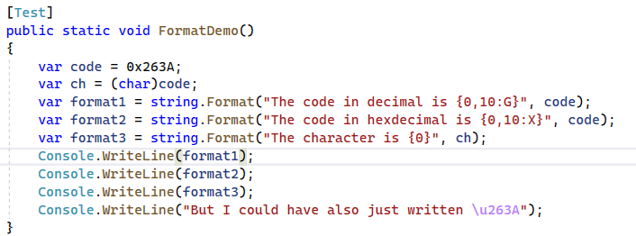
String Formatting

Slide 45
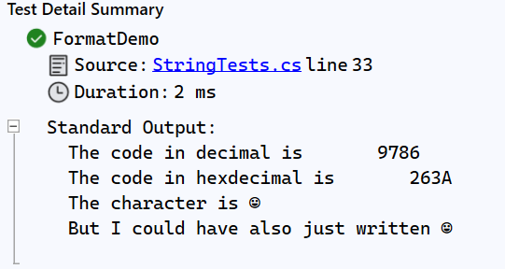

Slide 46
The Null Literal
The null keyword represents a reference that does not refer to an object.
It has a special type (called the null type) but can be cast to any reference type
Reference variables are assigned null by default
In other words it means “no value”

Slide 47
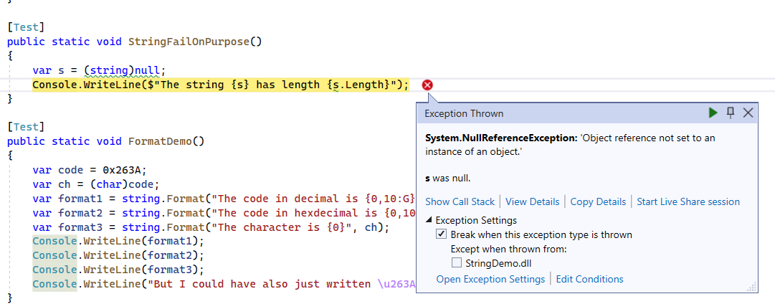
NullReferenceException

Slide 48
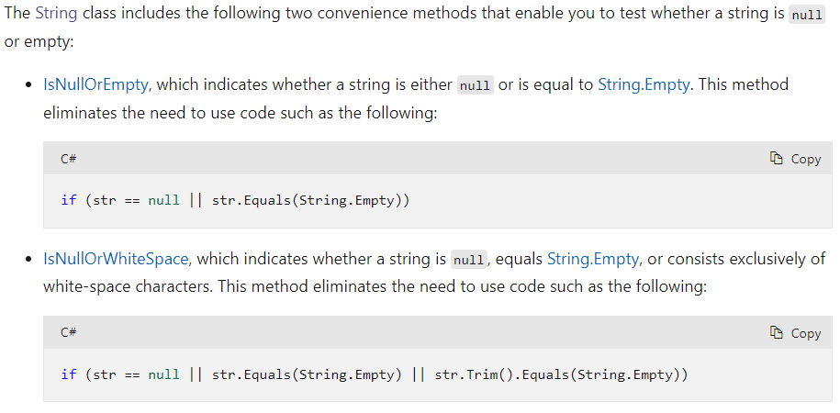
Checking if Strings are Null or Empty

Slide 49
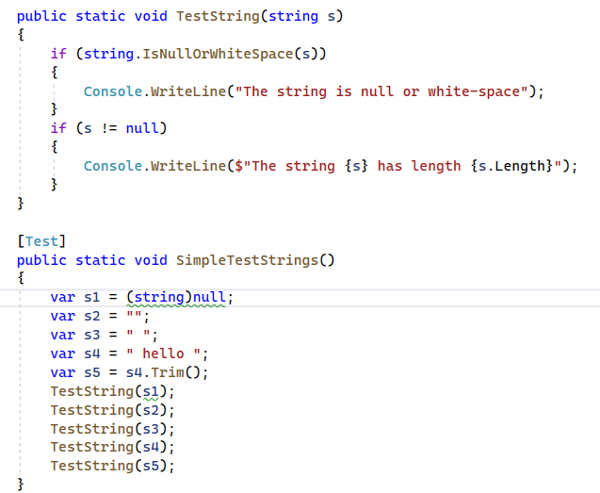
String Queries

Slide 50
String Implemented Interfaces
IEnumerable
IComparable

Slide 51
Strings implement IEnumerable
Strings implement “IEnumerable”
This means you can loop through the characters with a foreach

Slide 52
Foreach
Var s = “HelloWorld”; Foreach (var c in s) {
Console.WriteLine($“The character {c} has code {(int)c}”);
}

Slide 53
Foreach is a For Loop
Var s = “HelloWorld”; For (var e = s.GetEnumerator(); e.MoveNext(); )
{
var c = e.CurrentValue; Console.WriteLine($“The character {c} has code {(int)c}”);
}
https://learn.microsoft.com/en-us/dotnet/api/system.collections.ienumerable.getenumerator?view=net-7.0

Slide 54
Review
Do all variables have types?
How is the type of an implicitly typed variable declaration determined?
What does the “var” keyword indicate?
Can I access methods specific to a string (like Length) on a variable of type “object”?
Can a variable of type “object” refer to a “string” object?
How can I determine the run-time type of an object?
What is an instance of a class called?
What does System.String inherit from?
Casting from System.String to System.Object is an upcast or downcast?
Are upcasts explicit or implicit?
Can I change the type of a value?
Are types valid expressions?

Slide 55

Next Class
Collections
Foreach loops
Interfaces in a more depth
Indexers in more depth
Iterators

