Slide 1
Command Line Interface

Slide 2
Command Line Interface
Go into any explorer window and type “cmd.exe”
It will open a command prompt (in the current folder)
This is also called a console or terminal window
The command prompt is a text-based interfaces for interacting with the OS
I recommend reading the following for some background:
https://en.wikipedia.org/wiki/Command-line_interface

Slide 3

Command Prompt Shortcut Keys
“tab” - auto-complete a file name in local directory
“tab” - next auto-complete option
“shift-tab” - previous auto-complete option
“up arrow” - show previous command in history
“down arrow” to show next command in history
“enter” - copy selected to clipboard
Right-click to paste from clipboard

Slide 4
Common Useful Commands
cd – change directory, or current directory
call – calls a batch command
echo – outputs command-line arguments
more – outputs input interactively screen by screen
type – outputs the contents of a file
dir – lists the contents of directory
find – finds pattern in standard input
sort – sort standard input line by line
findstr – finds a string in files
fc – file compare
set – retrieves or assigns environment variables
assoc – list file extension associations
tasklist – gets the list of active processes
help – displays help on a command
cls – clears the command prompt buffer
cmd – opens a new command prompt
where – finds a program or file
xcopy – copies files and directory trees

Slide 5
Most Commands are Executables
Most commands are console programs
Also called character-mode applications
Accept input in three primary ways
Standard input
Command-line arguments
Environment variables
Provide output via three primary ways
Standard output
Standard error
Exit codes
See documentation on consoles

Slide 6
Standard In and Standard Output
A stream is a read-only or write-only sequence of data
Usually either characters or bytes
StreamWriter writes characters in a particular encoding
StreamReader reads characters in a particular encoding
Console.WriteLine() writes to standard output
Console.ReadLine() reads from standard input
Streams are opened or closed
Usually unidirectional (can’t back up unless buffered)
Will be covered in more depth in later sessions

Slide 7
Filters and Pipelines
Any program that processes an input stream and produces an output stream
Usually a console application (no GUI)
Most commands are filters
Multiple filters can be chained together in a pipeline using the pipe (‘|’) operator

Slide 8
Command Line Arguments
A set of values following a command name
They are space delimited
File paths that have spaces are surrounded in quotes
Quoted file paths are treated as one input
Switches (options) are command-line options by convention written as “/option”
Options control program behavior, or how other arguments are interpreted
Varies between program to program, and operating system to operating system
Almost all support “/?”

Slide 9
Retrieving Command Line Arguments
Passed to the main function as an array of strings
Can also use Environment.GetCommandLineArgs()
Note: GetCommandLineArgs() passes the executable path as the first argument

Slide 10
Process Exit Codes
A process exit code of zero indicates success
Any non-zero value indicates failure
No agreed-upon convention for error codes
You can return it from Main
You can call Environment.Exit()
You can assign to Environment.ExitCode

Slide 11
Redirect (<, >) and Pipe (|)
command < file - Redirects the file contents into the standard input of a command
command > file – Redirects the standard output of a command into a file
command | command – redirects the output of a command to the input of another
More commands: https://ss64.com/nt/syntax-redirection.html

Slide 12
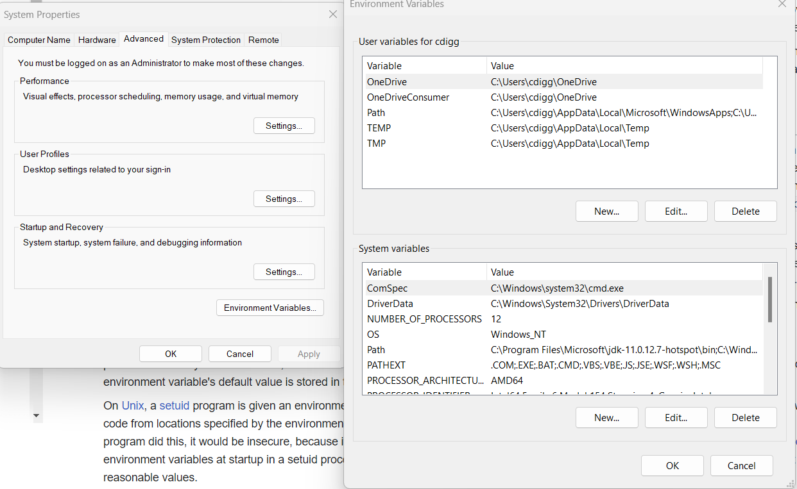
Environment Variable Editor in Windows

Slide 13
Environment Variables
A set of named string values managed by operating system
Each running process has access to its own copy
Process may modify its own values during execution
Used to parameterize behavior without using command-line
You can see them by writing “set” from command line

Slide 14
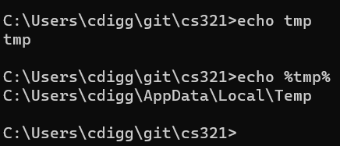
Environment Variable Expansion
On the command-line environment variables are expanded if delimited with %

Slide 15

Pseudo-Environment Variables
Pseudo-environment variables cannot be set, and are computed when requested
%DATE% - Current date
%TIME% - Current time
%CD% - Current directory
%RANDOM% - Random variable between 0 and 32767 inclusive

Slide 16
Aborting Process or Ending Input
Ctrl+C – terminates a process
Ctrl-Break – also terminates a process
Ctrl+Z – signals end of input (Console.WriteLine() returns null)

Slide 17
C# Launching a Process and Redirection
Launching a process
Redirect standard-input of process
Redirect standard-output of process
Redirect standard-output of current program

