Slide 1

CS321
Advanced Programming Techniques, Bishop’s University, Winter 2023 https://github.com/cdiggins/cs321

Slide 2
About
This class is a follow-up to CS211, Introduction to Programming.
We will be using C# 7 as the language of instruction.
Emphasis on hands-on assignments culminating in a final project.

Slide 3
Goals
Introduce you to the craft of software development
Deepen your knowledge of various programming approaches
Build a solid proficiency in reading and writing C#

Slide 4
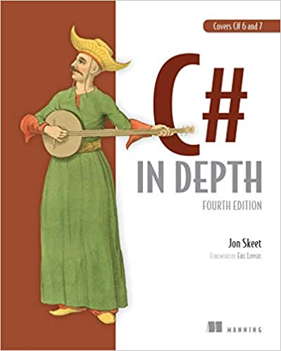
Reference Materials
Official C# Language Reference: https://learn.microsoft.com/en-us/dotnet/csharp/language-reference
Supplemental reading: “C# In Depth Fourth Edition” by Jon Skeet
Notes posted to GitHub at: https://github.com/cdiggins/cs321

Slide 5
Course Evaluation
20% = 5 Assignments
25% = 8 Labs
15% = Midterm (closed book)
40% = Final Project (individual)

Slide 6

Course Progression and Division
Labs focus on smaller tasks and tools
Assignments focus on concepts, design, ideas, planning
Best practices become more important later
Midterm will be closed book
Projects to be done individually
Helping each other out is encouraged, be careful to do your own work
Class will become more challenging towards the end

Slide 7
Plagiarism
Plagiarism is a kind of academic dishonesty in which an individual uses the work of another without appropriate acknowledgement.
Plagiarism includes but is not limited to the following practices:
Using another’s work without acknowledgement
Copying material without quotation marks
Paraphrasing too closely the exact words of the originating author
Submitting work written in whole or in part as one’s own by another individual.

Slide 8

Academic Integrity
Using an AI tool for help is okay (like GitHub Copilot)
Using StackOverflow.com is fine
Asking friends for help is fine
Plagiarism is not acceptable!
Credit all of your sources: friends, internet, or AI
Do the work yourself, use other sources as tools

Slide 9
Before and After Midterm
Part one focuses on:
Become comfortable and confident with C#
learning a range of techniques
Improving programming skills
Developing a solid foundation
Part two focuses on:
Building larger pieces of software
Advanced features of the C# language
Putting complex things together
Learning best practices and patterns

Slide 10
Course Outline – Part 1
About Class and Overview
Introduction to C#
System Library
Functions as Data
Reflection and Introspection
Testing, Debugging, and Error Handling
Introduction to Object Oriented Programming

Slide 11
Course Outline – Part 2
Coding Style and Principles
Advanced features of C#
Advanced topics in Object Oriented Programming
Concurrency and Asynchronous Programming
Common Software Patterns
GUI Programming
Foreign Function Interfaces and Marshaling

Slide 12
About Midterm
Closed book
Verify a basic proficiency in C#
Assess understanding of key concepts
Covers content taught in Part 1
Covers material only in notes and authoritative source

Slide 13
Final Project
Put together a robust piece of non-trivial software
Details will be provided later in the semester
Leverages concepts learned in part 2

Slide 14
Craft of Software Development

Slide 15

What is a Craft
From Wikipedia: A craft or trade is a pastime or an occupation that requires particular skills and knowledge of skilled work. In a historical sense, particularly the Middle Ages and earlier, the term is usually applied to people occupied in small scale production of goods, or their maintenance, for example by tinkers.
Seems to be a good definition!

Slide 16
Software Development is Exciting
We don’t know very much yet
Ideas and approaches are evolving rapidly
Continuously informed by mathematics and science
We will eventually be able to do practically anything

Slide 17
Four Steps to Software Development
Understand
Plan
Implement
Measure

Slide 18
About C#
An overview of the language and run-time

Slide 19
About C#
C# is a mature and efficient general-purpose high-level language with good support for object-oriented and functional programming techniques.
C# programs are usually compiled to IL (intermediate language) byte-code and executed within the .NET execution environment.
https://learn.microsoft.com/en-us/dotnet/csharp/tour-of-csharp/

Slide 20
Some places where C# is Used
Windows application programming
Linux and Mac application development
Mobile app development (Xamarin and Maui)
Unity scripting
Plug-in Development for Windows applications
Server-Side scripting (ASP.NET)
Limited usage Web Client (Blazor)

Slide 21
Assemblies and JIT Compilation
Typically, .NET apps are compiled to intermediate language (IL) and is contained in assemblies.
At run time, the just-in-time (JIT) compiler of the CLR (Common Language Runtime) translates IL to native code
Assemblies take the form of executables (.exe) or dynamically linked libraries (.dll)
An assembly is a collection of types and resources that are built to work together and form a logical unit of functionality
https://learn.microsoft.com/en-us/dotnet/standard/assembly/

Slide 22

Ahead of Time (AOT) Compilation
.NET Native compiles UWP apps directly to native code.
See : https://learn.microsoft.com/en-us/dotnet/core/deploying/native-aot/
The Unity IL2CPP (Intermediate Language To C++) scripting backend converts IL code into C++ code, then uses the C++ code to create a native binary file.
See: https://docs.unity3d.com/Manual/IL2CPP.html

Slide 23
Some Limitations of AOT Compilation
No dynamic loading (for example, Assembly.LoadFile)
No runtime code generation (for example, System.Reflection.Emit)
No built-in COM (only applies to Windows)
Some reflection APIs don’t work as expected
Implies compilation into a single file
Apps include required runtime libraries increasing their size
Limited diagnostic support (debugging and profiling).

Slide 24
C# REPL
Tools exists for interpreting C# in a Read-Eval-Print Loop (REPL)
See the C# Interactive Window in Visual Studio for Windows
Or use the CSI.exe tool installed with Mono for Mac

Slide 25
Execution Environment
.NET provides a run-time environment called the common language runtime that runs the code and provides services that make the development process easier. Code that that targets the runtime is called managed code.
https://learn.microsoft.com/en-us/dotnet/standard/clr

Slide 26

Unsafe Code and Pointers
By default C# generates code that is verifiable
C# supports pointers within unsafe contexts
Unsafe code can only be used within unsafe blocks within unsafe projects.
Best to only use within projects designed for interfacing with low-level code.
Not necessary for high-performance code.

Slide 27
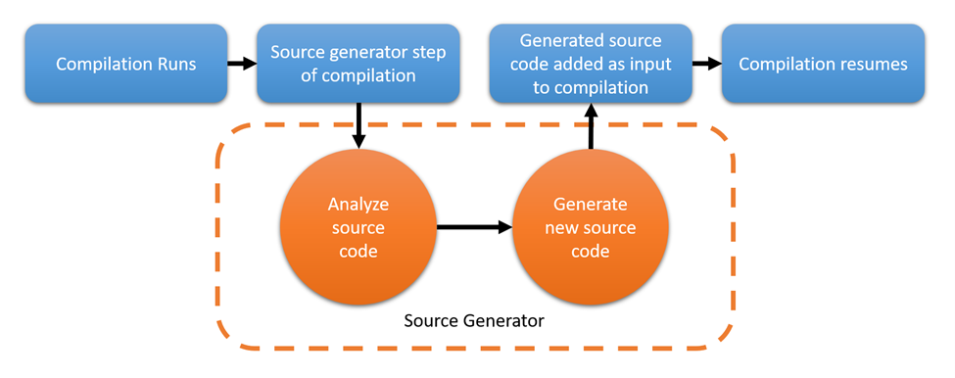
Source Code Generation
C# doesn’t have a macro pre-processor but supports a few directives for conditional compilation
Tool-chain supports compile-time source generators

Slide 28
C# Versions: a new one every 2-3 years
C# 1.0 – 2002 a nice little language
C# 2.0 – 2005 generics: now we are talking
C# 3.0 – 2007 lambda: WOW!
C# 4.0 – 2010 dynamic keyword
C# 5.0 – 2012 async / await (important, but took awhile to Grok)
C# 6.0 – 2015 lots of syntactic sugar
C# 7.0 – 2017 tuples and deconstruction
Notes:
https://learn.microsoft.com/en-us/dotnet/csharp/whats-new/csharp-version-history

Slide 29

Wait, what??
C# 7.1 – 2017
C# 7.2 – 2017
C# 7.3 – 2018
C# 8.0 – 2018
C# 9.0 – 2020
C# 10.0 – 2021
C# 11.0 – 2022

Slide 30
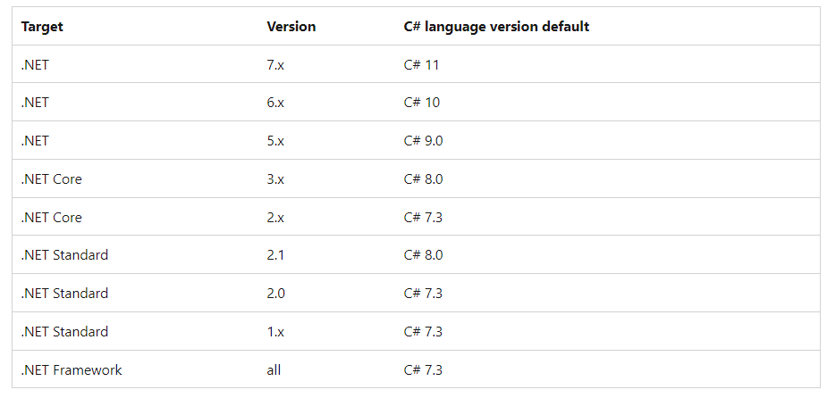
.NET Runtime and Default C# Language

Slide 31
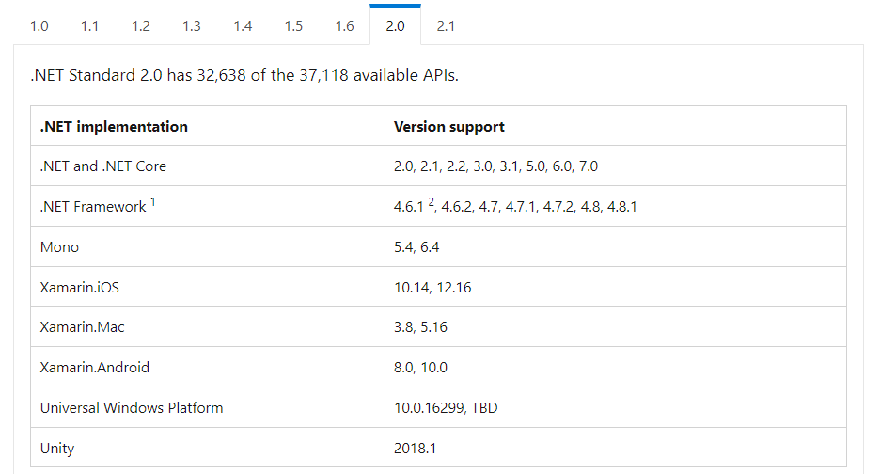
.NET Standard 2.0 (Most Portable)
Targets .NET Framework since 4.6.2 and Unity 2018.1, as well as other .NET implementations.

Slide 32
Some C# and C++ Differences
C# is garbage collected
C# produced verifiable byte code which is compiled “just in time” (JIT)
C# supports introspection, reflection, and run-time code generation
In C# classes have different semantics than structs
C# pointer types and operations are allowed, but only in unsafe contexts
C# strings and arrays are classes
C# supports only single inheritance, but has interfaces

Slide 33
Things I like about C# as a Language
Statically typed
Interfaces with extension methods
Safe and well-defined
Garbage collected
Good interoperability
High quality libraries
Excellent tooling
Good performance

Slide 34
Elements of CODE
A refresher using C#

Slide 35
Key Elements of a Program
Data types
Functions
Statements
Expressions
Variables

Slide 36
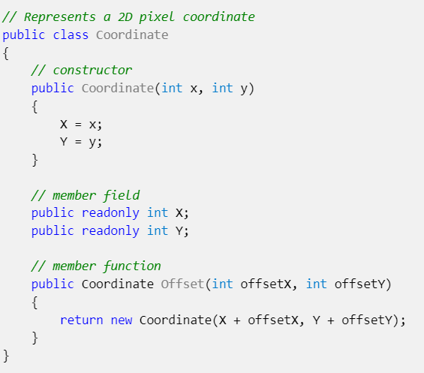
Data Types
A data type is a category of data values. As a programmer you can define new types using class, struct, interface, and enum declarations.
Data type declarations define operations, member functions, and member variables.

Slide 37
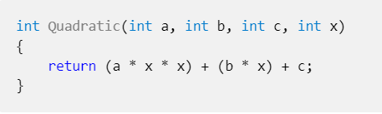
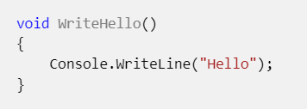
Functions
A function in programming is a code block that has zero or more input values (parameters), and an optional output.
Unlike functions in mathematics, they don't have to have a return value and may cause side-effects to happen

Slide 38
Statements
A statement is a unit of code that conceptually represents a single action. Statements may be compound, consisting of embedded statements, or are simple and terminated with the ';' character.
Some common examples of simple statements include:
Return statement - return (a * x * x) + (b * x) + c;
Variable declaration - var a = 42;
Assignment statement - x = Quadratic(1,2,3,4);
Function call statement - Debug.Log("hello");

Slide 39
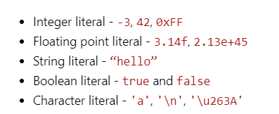
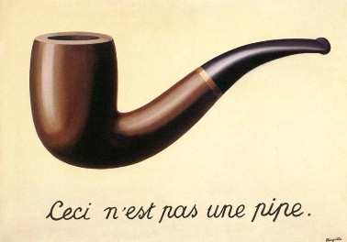
Literal Expressions
A literal expression is a representation of a value directly in code.

Slide 40
Values
A value is a piece of data such as a number or Boolean or object.
Values are created by a computer program by evaluating expressions.
Every value has a type.
Values never change, but variables might change which value they refer to.
Values are sometimes, but not always, stored in memory.
Pretend they are, it makes it easier.

Slide 41
Types
A type is a category of values. C# comes with a few types built in (primitives).
int – a whole number (integer) between approx. -2 billion and +2 billion
char – a text character, such as 'a' or '9' or '/n'
string – a sequence of zero or more text characters.
bool – a Boolean logic value representing true or false
double – a numerical value with a decimal point (e.g., 3.141)
byte – an unsigned whole number between 0 and 255.

Slide 42
User Defined Types
New types can be defined using class, struct, interface, and enum declarations.
Types can be placed in a library to be reused.
Types may contain:
Member variable (Fields)
Member functions (Method)
Operations
Constructors
Types may have per-instance data, or static shared data.
Types can inherit behavior or data from other types

Slide 43
Class
The most common kind of user defined type is a class.
A class is a set of data elements (fields) that can be treated as a single entity along with functions and operations for this type.
Instances of a class are called objects.
Class instances are created using the “new” keywords
Class instances are initialized using the constructor special method.

Slide 44
Control Flow
The order in which the statements, functions, and expressions are executed or evaluated at run-time by a thread of execution.
Some statements affect control flow by choosing which statement is executed next, or the number of times a statement is executed
Some expressions also affect control flow (e.g., short-circuiting)

Slide 45
Common Statement Types
Branching statements - branch statements affect control flow by determining what statement is executed next
Loop Statements – loops affect control flow by executing an embedded statement, repeatedly while a condition evaluates to true.
Variable declarations - declares a new variable and optionally initializes it
Expression statements – either assign a value to a variable or execute a function
Block statements - a set of zero more statements delimited by curly braces {} and that creates a new variable declaration space

Slide 46
C# Language
High-Level Details

Slide 47
Organization of a C# Program
Assemblies
Compiled from one or more source files
Source files
Using declarations
Zero or one namespace
Namespaces
Contain types
Types
Contain static and/or instance members
Always in one namespace
But may be split across files
May be split across files
May be a .exe or a .dll
Notes:
https://learn.microsoft.com/en-us/dotnet/csharp/fundamentals/program-structure/

Slide 48
Kinds of Types
Classes
Structs
Interfaces
Enums
Delegates

Slide 49

Reference Types
In C# classes are always allocated on the heap
Unlike C++ their memory address can change.
Means that in unsafe mode you have to “pin” pointers
This prevents the GC from moving or reclaiming the memory
Interfaces are also reference types
All reference types inherit from System.Object

Slide 50
Value Types
Most built-in types in C# are value types.
Value types are defined in C# using the “struct” keyword
This means that they are defined on the stack and have copy-by-value semantics
Value types cannot inherit from other types

Slide 51
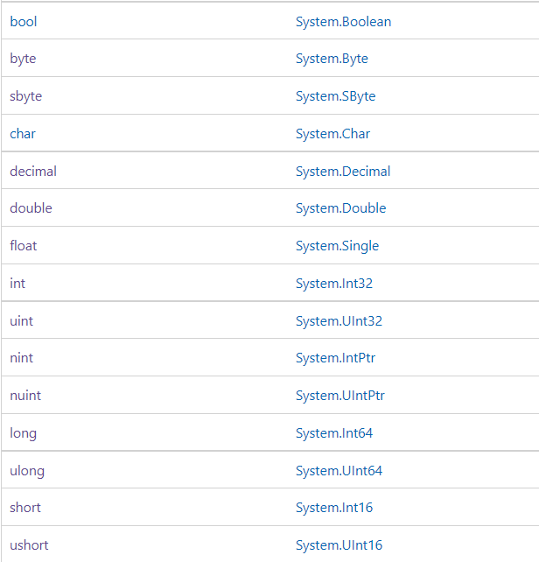
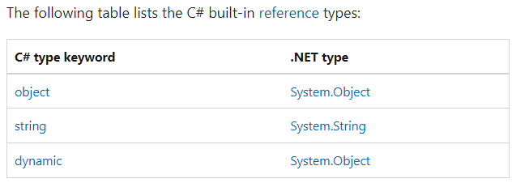
Built-in Types
https://learn.microsoft.com/en-us/dotnet/csharp/language-reference/builtin-types/built-in-types

Slide 52

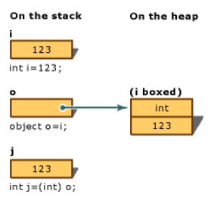
Boxing
Value types can be implicitly cast into a System.Object reference type
This process is called boxing
Explicitly casting from a boxed value type to a value type is called unboxing
https://learn.microsoft.com/en-us/dotnet/csharp/programming-guide/types/boxing-and-unboxing
We will review this in practice

