Slide 1
Interfaces
LINQ, Extension Methods, Exceptions, and Using Statements

Slide 2
Interfaces
A set of methods and properties that a class or struct must implement
Like a contract
It’s a kind of type that can refer to a category of types
Similar to a base class

Slide 3
Interfaces can be used
As the return type of a function
As the type of a parameter
As the type of a field or property
As the type of a variable

Slide 4
You can’t create an interface using new
You can only create classes or structs
Therefore values never have a run-time type of an interface
The run-time type is based on the type a value was created with
In other words the type passed to the “new” operator

Slide 5
Interface Segregation Principle
https://en.wikipedia.org/wiki/Interface_segregation_principle
Don’t require service to implement unnecessary methods
Don’t require clients to depend on non-critical methods
In summary: keep interfaces as small as possible

Slide 6
Querying Interfaces at Run-time
They have the run-time type that is associated with the “new” operation
You can query the run-time type and see if I can assign it to the interface
https://learn.microsoft.com/en-us/dotnet/api/system.type.isassignablefrom

Slide 7
Abstract Base Class vs Interfaces
You can only have one base class but multiple interfaces
Abstract base class can have fields and constructor
Abstract base class can specify static members
Structs can not inherit from classes, but can implement interfaces

Slide 8
What’s wrong with abstract base class?
Nothing really, they are just very permissive
Can increase dependency on implementation details

Slide 9
Extension Methods
Allow you to add functions to classes or interfaces without modifying code
Can be called as if they were defined in the class or interface

Slide 10
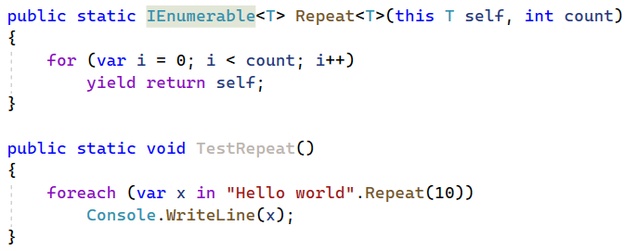
Example of Extension Method

Slide 11
Extension Method Syntax and Rules
Extension methods can only be placed in a static class
They are applied to any type: class, struct, interface
The first argument must be prefixed with the “this” keyword
It can be invoked as a regular static method, or using object syntax

Slide 12
LINQ
Language Integrated Natural Query (pronounced “Link”)
It is a key part of the systems library
Functions work on all collections and sequences
Including iterator methods
Fun and easy

Slide 13
LINQ Implementation
It is implemented as a library of extension methods
Works with any class that implements IEnumerable<T>
Including your own
Easy to write using iterator methods

Slide 14
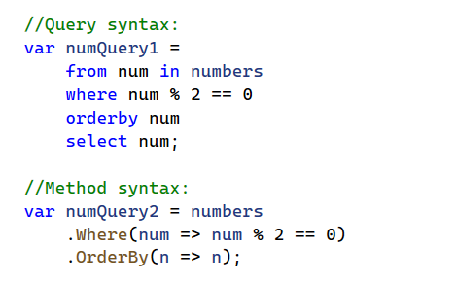
Alternative Query Syntax (not recommended)

Slide 15

Throw Statements
Throw statements say … get me out of this function now.
More than just a return
Also exits the function that called the current function
Does this recursively until it reaches a “catch” block

Slide 16

When to use Throw Statements
Something happened that makes continuing a process complicated or pointless
For example:
A file no longer exists or is inaccessible
A value passed as an argument to a function is invalid
Something unexpected happened
Detected a corrupted intermediate result
Sometimes people use it to represent “canceling” a user operation

Slide 17

Exception
Throw statements may be associated with an exception
An exception is an object that has extra associated information
Including where the exception was thrown (i.e., stack trace)

Slide 18
Call Stack
A list of functions that have been called, but not returned yet
Technically a stack of “frames”
We step in and out of stack frames using the debugger

Slide 19
Stack Frame
Records state of a function when invoking another function
Stores value of local variables
Pointer to next instruction to be executed when function returned

Slide 20

Garbage Collection
Non-deterministic
Sometime object refer to unmanaged resources
Examples might include a file stream
When it is no longer required we must “release” it
In C++ this would be done in the destructor
C# has destructors, but they might not be called for a long time

Slide 21
IDisposable.Dispose
Provides a mechanism for releasing unmanaged resources
For example: closing a file
Or deleting an object in a C++ library

Slide 22
Using Statements
Simplifies deterministic clean-up of unmanaged resource
Usually this is things created by the operating system
Or maybe something created in an external library
Don’t confuse them with using directives: not related to namespaces

Slide 23
Two Forms of the Using Statement
With a block statement
Without a block statement

Slide 24
How using statement works
Assign an expression to a variable
That expression implements “IDisposable“
When the variable goes out of scope the Dispose function is called
Called the “RAII”

Slide 25
Evaluation on Demand
Also called “lazy evaluation”.
Values in an IEnumerable are retrieved only when requested
This is why an IEnumerable can represent infinite sequences

Slide 26
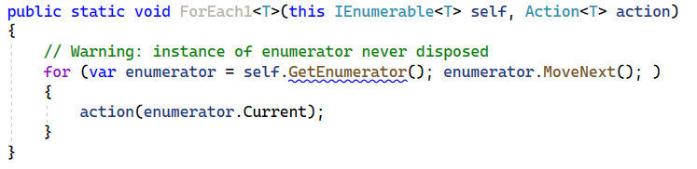
Implementing Foreach: Attempt #1

Slide 27
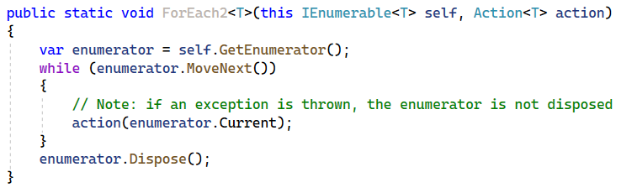
Implementing Foreach: Attempt #2

Slide 28
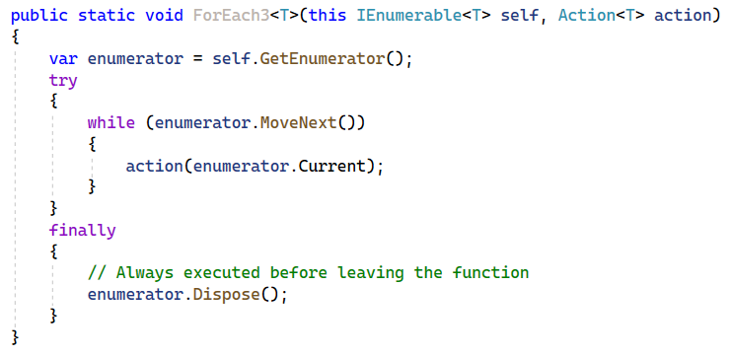
Implementing Foreach: Attempt #3

Slide 29
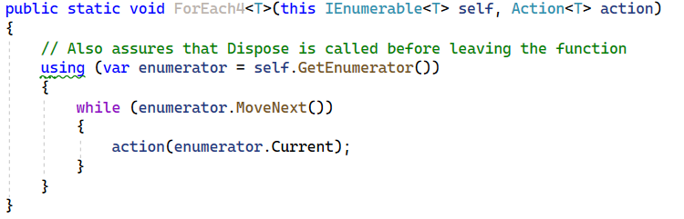
Implementing Foreach: Attempt #4

Slide 30
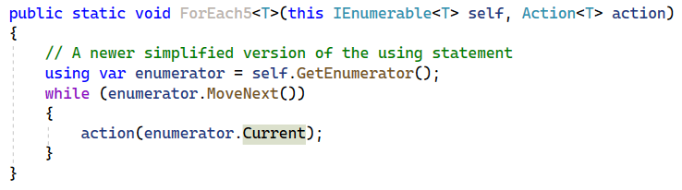
Implementing Foreach: Attempt #5

Slide 31

Select
Creates a sequence from a sequence by applying a transform function to each element while respecting the order. Also called a “map”.

Slide 32
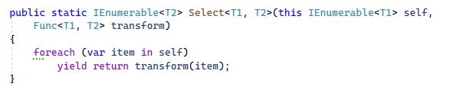
Select implementation

Slide 33

Where
Creates a new sequence of values from another but keeping only elements for which a predicate returns true. Also called a “filter”.

Slide 34
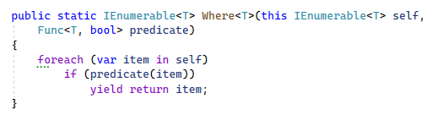
Where implementation

Slide 35

Aggregate
Applies an accumulator function combining each elements with the accumulated value. A generalization of the “sum” function. Also known as “fold”.

Slide 36
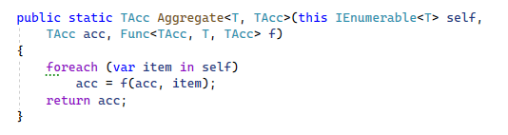
Aggregate Implementation

Slide 37
Concat, Append, Prepend
Take a sequence and an element, or another sequence and create a new sequence.
No container is created and the original sequence is not iterated.
Very efficient when used once or twice.
Using them repeatedly to create a sequence from scratch would be very slow
Each function call creates a complex object

Slide 38
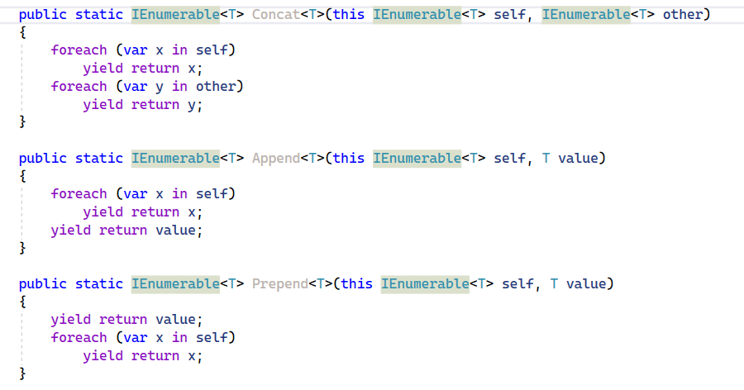
Concat, Append, Prepend

Slide 39
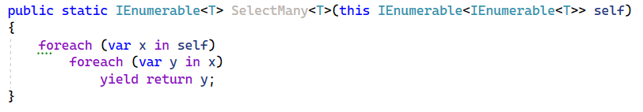
SelectMany
Given a sequence of sequences, converts it into a single sequence.
Also called “flat map”.

Slide 40

SelectMany using Aggregate

Slide 41
Creating Sequences
Empty
Range
Repeat

Slide 42
What is an Iterator Method
Any method that has a yield statement
Creates an object under the hood
This object stores all local variables
Also stores the next instruction
Just like a stack frame

Slide 43
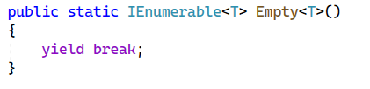
Yield Break and Empty Sequence

Slide 44
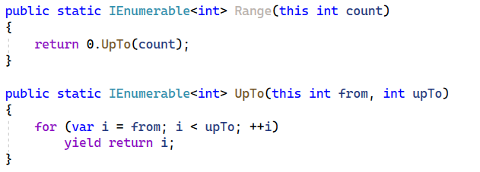
Ranges of Integers (Custom Functions)

Slide 45
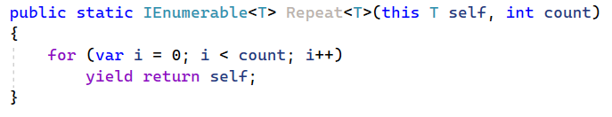
Repeat

Slide 46
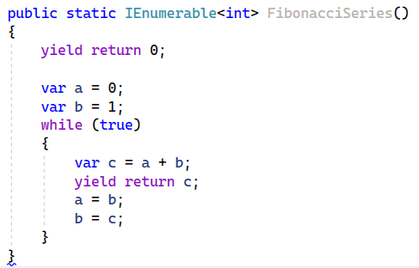
Fibonacci Series as an Iterator Method

Slide 47
Infinite Sequences
You never finish enumerating
Therefore you cannot put it in memory
You can however take a finite part of it
You can also transform or filter it

Slide 48
I can call the following
Select
Where
Prepend
Take
Skip
First
Zip

Slide 49
The following will loop forever
Count
Aggregate
ToArray
ToList
Any
All
OrderBy
Last

Slide 50
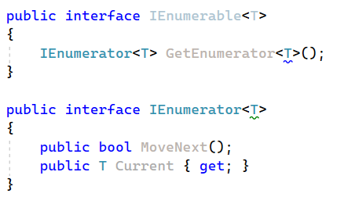
IEnumerable and IEnumerator

Slide 51

Why you shouldn’t enumerate twice
A sequence might be infinite
A sequence might be transient – e.g. values read from keyboard
Inefficient, but this is a minor concern

Slide 52
What is an Array?
A mapping from integers to values
Can retrieve count, and elements, in constant time
It may or may not be mutable (i.e., allow updates)
If not mutable, things can get interesting!

Slide 53
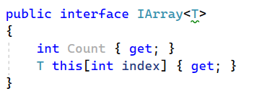
IArray

Slide 54
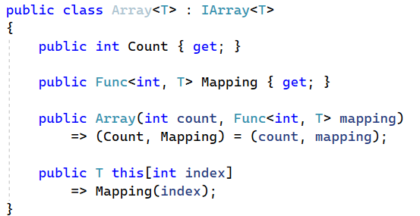
A Concrete Implementation of IArray

Slide 55
Why is this relevant?
LINQ style operations on this class take O(1) memory and O(1) time
In other words you don’t have to iterate over the entire list
And you don’t have to allocate a block of memory

Slide 56
A Helper Function to Create IArrays

Slide 57
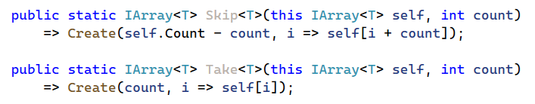
Skip and Take

Slide 58
Select

Slide 59
Reverse

Slide 60
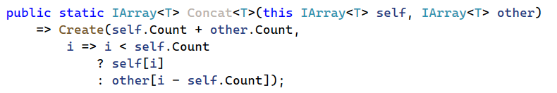
Concatenation

Slide 61
Where is where?
Must enumerate a filtered array before you can get count
We lose constant time indexing and constant time count
Either: create a new collection
Or: treat the result as an IEnumerable

