Slide 1

Saving and READING DATA
Serialization, Deserialization, and Reflection

Slide 2
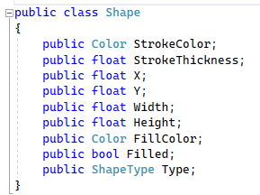
Some Classes are Just Data
In general classes should be immutable
But sometimes it is just data
Consider the shape class
We may want to edit it
We may want to save / load it to disk
Yes we can make it immutable
Too much work, too little ROI

Slide 3
Every time you change a field if immutable
You have to construct a new object
And copy all of the previous fields over
This is a lot of superfluous code
The advantages of immutability are insufficient

Slide 4
An Aside: Modern C# has a Solution
They are called records and with expressions

Slide 5
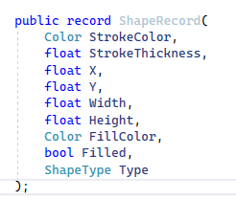
Record EXAMPLE

Slide 6
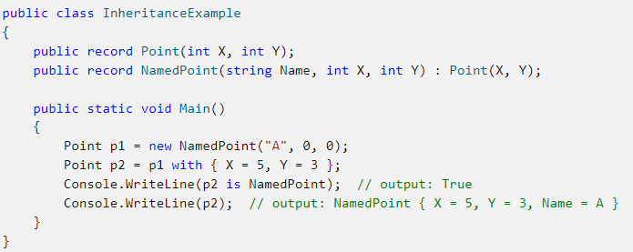

Slide 7
Either way, we still a have a problem
We still need to solve the problem of notification
When data models change the application must react
We will talk about this in a separate lecture

Slide 8
How do you save data to disk?
Low level libraries write bytes or characters to disk
You need to convert your classes into bytes or characters
A process known as serialization

Slide 9
Serialization / Deserialization
Serialization is the process of converting objects into bytes (or characters) so that they can save to disk or transmitted over a network.
Deserialization is the process of reconstituting byte or character streams back into the original objects

Slide 10
How Serializers work
By querying or setting fields at runtime
This is called reflection (aka introspection)

Slide 11

Reflection
Reflection allow objects to query information about objects
For example: what are the names and types of the fields?
What values does each field hold?
In C# we can query this kind of information about any object
We can also change the values of fields at run-time
We can even invoke methods on an object at run-time

Slide 12
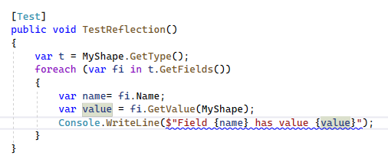
Example Reflection Code

Slide 13
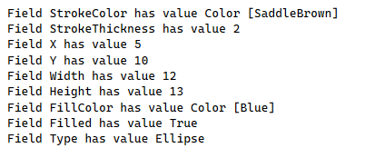
Output of Reflection Demo

Slide 14
How do you read data from disk?
You need to convert from a stream of characters or bytes
Doing this in a robust manner is very hard
How do you put the values in the right place?

Slide 15
The solution
Use a standardized format like XML or JSON
These are formats designed specifically for this purpose
Also, they can be read as plain text!

Slide 16
Serializer Libraries Exist
XmlSerializer
JsonSerializer
BinarySerializer

Slide 17
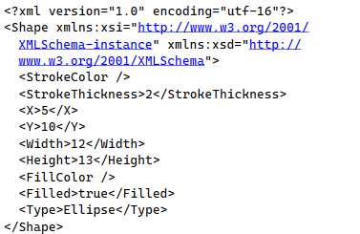
Example XML

