Slide 1
Final Project
GUI, Events, SVG, Patterns

Slide 2

Final Project
Create a drawing program
Use the C# Windows Forms library
Export SVG files.
User can use mouse and keyboard
Provide a visual representation of the document
Submit as a link to a Github repository

Slide 3
Brief Review of SVG
An XML based format for describing vector graphics
Stands for “Scalable Vector Graphics”
https://www.w3schools.com/graphics/svg_intro.asp
https://developer.mozilla.org/en-US/docs/Web/SVG

Slide 4

Covered Today
Learn to create a GUI using Windows Forms
Event handling
Design patterns
Installing 3rd party libraries via Nuget
Respond to mouse and keyboard events

Slide 5
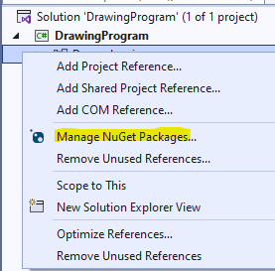
Adding NUGET PACKAGE

Slide 6
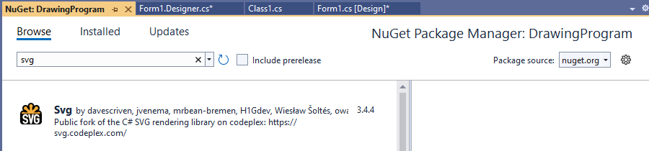
A Sample Nuget Package

Slide 7
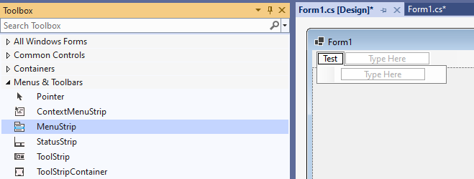
Add a Menu to the Window

Slide 8
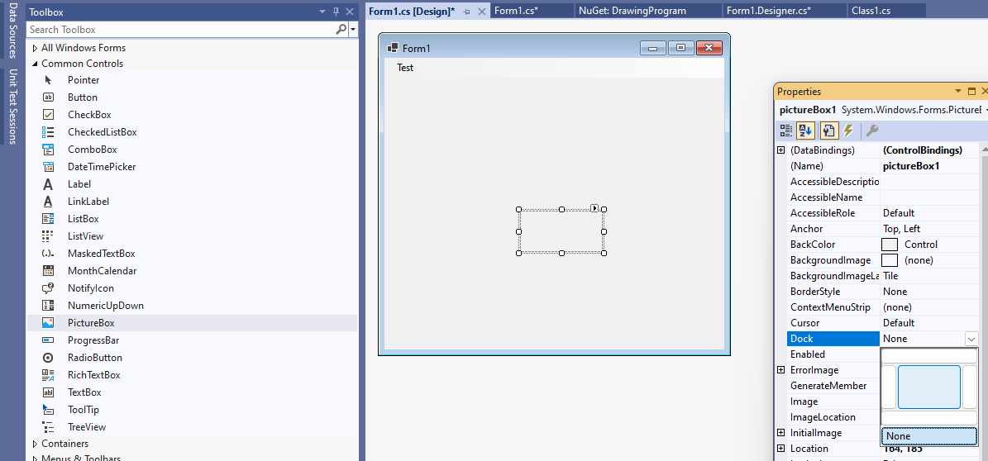
Add a Picture Box (and set the dock property)

Slide 9
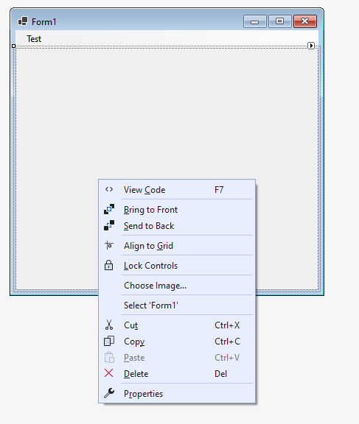
Switch to the Code Behind View

Slide 10
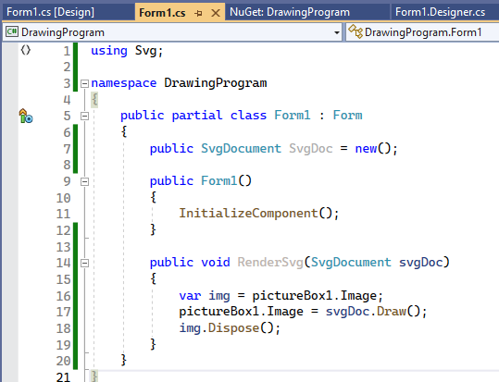
Write Some Code

Slide 11
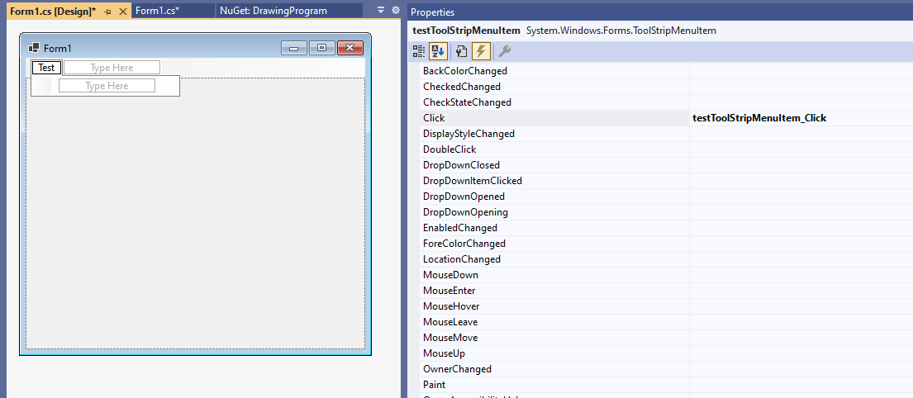
Add an Event for Menu Item

Slide 12

An Event Handler is Generated

Slide 13
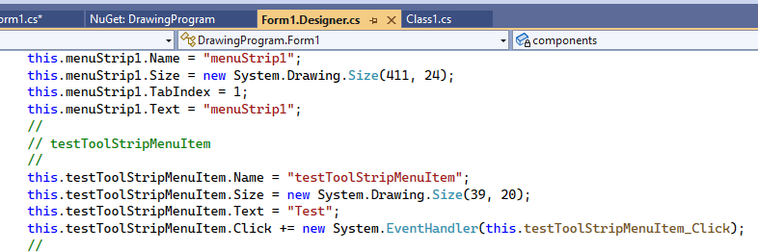
Behind the Scenes Code is add to the “Designer.cs” file

Slide 14
How Events Work:
An event is just a list of functions with the same signature
These functions are called “event handlers”
Event handlers can be added or removed from an event using += or -=
Event handlers can be methods (static or instance) or lambdas
Events are raised using the “Invoke” function
When an event is raised all event handlers are called

Slide 15

Recommended Reading
https://learn.microsoft.com/en-us/dotnet/standard/events/
https://learn.microsoft.com/en-us/dotnet/csharp/language-reference/keywords/event
https://learn.microsoft.com/en-us/dotnet/csharp/programming-guide/delegates/

Slide 16
What the Heck are Delegates
A delegate is a type that refers to a function as data
Instances of delegates might be methods or lambdas
They are like Func<…> types but named

Slide 17
Observer Pattern
Events are an example of the observer pattern
In the observer software design pattern – an object, called the subject, maintains a list of its dependents, called observers, and notifies them automatically of any state changes.
https://en.wikipedia.org/wiki/Observer_pattern

Slide 18
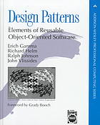
What is a “Software Design Pattern”
In theory it is a general, reusable solution to a commonly occurring problem within a given context in software design.
However, much of the industry uses the term to refer to what remains a largely unchanged set of object-oriented patterns that were first published in 1993

Slide 19
Other Patterns for GUI Applications
Data Binding (MVVM)
Use a message queue (aka Publisher Subscriber Pattern)
Model View Update (MVU Pattern)
Reactive Programming

Slide 20
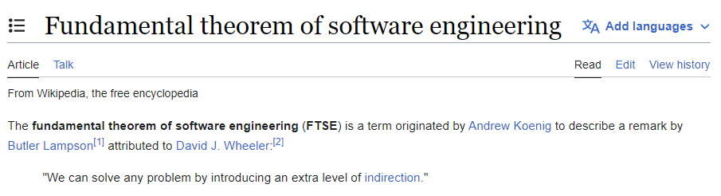

Slide 21
Back to ouR PROGRAM

Slide 22
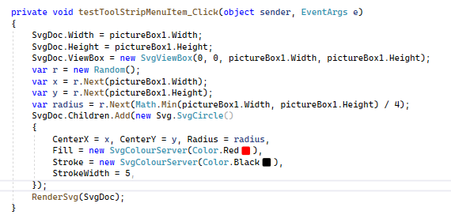
Adding some Code

Slide 23
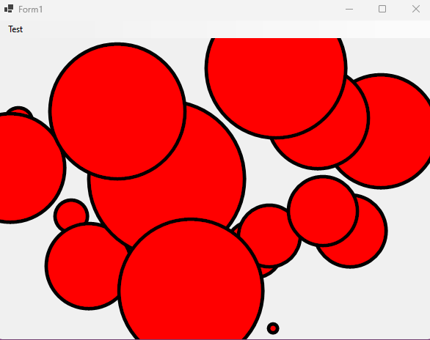
It begins!

Slide 24

DiscusS Feature Ideas

Slide 25
Recommended Exercise for Lab
Try implementing a basic drawing feature.
1
Click on the mouse once to start drawing a rectangle
2
Move mouse: update rectangle
3
Click again to commit drawing (moving no longer does anything)
4
Press escape to cancel
5

Slide 26

Click and Move to Draw
The simplest approach
Add variables to form: “bool IsDragging”, “Vector2 MouseStart”
Add handlers for “MouseClick”: start drawing, complete drawing
“KeyPressed” look for escape key to cancel drawing

Slide 27
Coordinate Spaces: Tricky!
Every time we get coordinates
It is relative to a frame of reference
The window, control, or screen

Slide 28
SVG Coordinates
An SVG Element has Width and Height
It also has a “Viewbox”
Viewbox provides a virtual coordinate space

Slide 29
SVG .NET Package, Repo and Demos
Constructing valid SVG documents
Rendering SVG documents
Provides sample programs
To compile and run use: https://github.com/cdiggins/SVG-Forked
I made it work on .NET 6 only

Slide 30
How do you …
Select a shape once it is created?
Click and create a shape?
Support undo / redo?
Update the currently created item?
Change properties of existing shape?

Slide 31
Command Pattern
A pattern where an object is used to encapsulate information to perform, undo, redo, and log action.
Like a function but with meta-information.
Useful for undo/redo, logging, and scripting.
https://en.wikipedia.org/wiki/Command_pattern

