Slide 1
Midterm
Review

Slide 2
Code Structure
Class Declaration
Property
Field
Constructor
Method
Enum Declaration
Public / Private
Virtual / Override

Slide 3

Enum

Slide 4
An Enum is a type
Represents a small set of distinct values
Each value is a constant
Each value corresponds to a unique integer value and a unique name

Slide 5
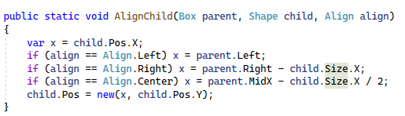
How to use an Enum

Slide 6
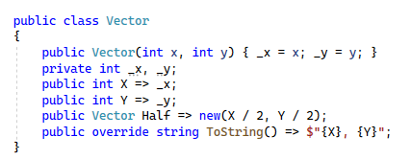
Simple Class Declaration

Slide 7
Understanding Member Declarations
Are there parentheses? If yes, then it is a method, otherwise, a field or property.
Does it have an “=>”? If so, then it is a method or property.
Does it have an “=“? If so, then it is a field or property.
Does it have a “get” or “set”? If so then it is a property.
Is it a method with same name as class: then it is a constructor

Slide 8
Constructor: like a method but no return type, and same name as class

Slide 9
Private Fields (should always start with _underscore)

Slide 10

Public fields (any field may be initialized in declaration)

Slide 11

These are Properties (with auto-generated backing fields)

Slide 12

These are also Properties (they are computed)

Slide 13
Mutability
Fields can be changed after construction
Includes inherited fields
Includes private fields changed by functions
Immutability means field values can never change after construction

Slide 14
Generic Types
Types and Functions may have type arguments
That means they are generic
A List<T> is generic, an IEnumerable<T> is generic
It requires a type argument
Primitive types, other than array are not generic (int, string, float, etc.)

Slide 15
Writing Code

Slide 16
Reading Code
Reading the flow.

Slide 17
Misc
C# is a compiled language
It is compiled into byte-code
Assemblies (DLLs and EXEs) contain byte code
The debugger executes compiled code
No type of any value can ever change: you create new values.
Everything has a type (including void and null)

Slide 18
Understanding Casts
Casts are implicit or explicit
Whenever I say: (X)x it invokes an explicit
https://learn.microsoft.com/en-us/dotnet/csharp/programming-guide/types/casting-and-type-conversions

Slide 19
Types of Expressions

