Slide 1
Today’s Goal
Deepen our understanding of Object-Oriented Programming and Strings

Slide 2
What is an object in OOP?
An object is an instance of a class

Slide 3
What is a class in OOP?
A data type definition
A template for creating objects
Describes methods and data

Slide 4

Classes in C#
System.String is a class
System.Object is also a class
So is System.Type
A class is a kind of data type
Classes describe the data and methods contained by “instances” of the class
Instances of a class are values, known as objects
Classes can derive from (inherit) another class (maximum one)

Slide 5

Variables
All variables have a fixed type determined at compile-time
A variable refers to an instance of a type (or null)
Variables may be initialized when declared (best practice)
Variables may be reassigned (use sparingly)
Variables cannot be assigned a value of an incorrect type

Slide 6
Parameters and Arguments
Function parameters are a special kind of variable (also called “formal arguments”)
When a function is invoked the function parameters are bound to values
Values provided during invocation to parameters are called arguments

Slide 7
This is indeed confusing!
The keyword “object” is a synonym for the type “System.Object”
Indicates that the accepted type of parameters, local variables, and return types is treated as a System.Object
In an object-oriented programming, all, or most, values are called objects.

Slide 8
Objects and Values
Consider: var s = “hello”;
This is an implicitly typed variable declaration statement.
Implicitly typed because it uses the “var” keyword
The variable declared is named “s”
The following is equivalent:
string s = “hello”.

Slide 9
Implicitly Typed Variables
A local variable declared with the “var” keyword is implicitly typed
Requires initialization upon declaration
The variable takes the precise type of the expression

Slide 10
The Class Hierarchy
System.Object
System.String

Slide 11
Casting to Object
Everything can be cast to an object:
var x = (object)”Hello”;
This is equivalent to:
object x = “Hello”;

Slide 12

Upcast
System.String derives from System.Object
System.Object is called the base class
System.String is called the derived class
Any cast to a base class is called an upcast
Upcasts are implicit: no conversion operator is required
They are always successful (think about why)

Slide 13
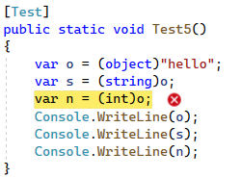
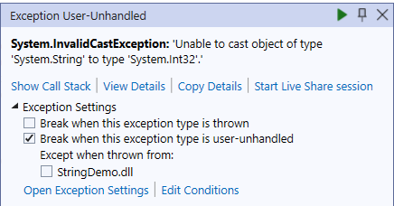
Downcast
Casting from a base class to a derived class
System.Object to System.String is a downcast
Downcasts are always explicit
They may fail at run-time

Slide 14
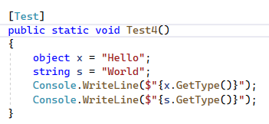

The runtime type of an object
This is the value returned by calling “GetType()”
The run-time type of a value is unaffected by any casts
it never changes.

Slide 15
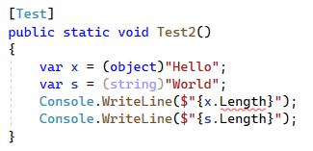
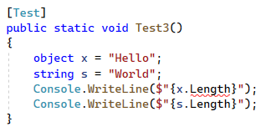
What does the following do?
Note: they are both equivalent

Slide 16
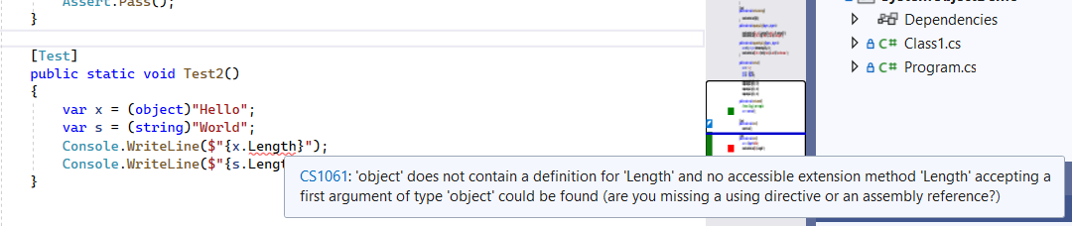
Either way we get an error!
Why? Because objects don’t have “Length” properties

Slide 17
Types Restrict Methods & Properties
A variable or expression of type “T” only provides access to methods and properties of T.
Regardless of the type of the run-time type of T

Slide 18
What does “.” mean?
When calling a function it usually looks like “Console.WriteLine”
What is the “.”
What is to the left?
What is to the right?

Slide 19
Member Access Expression (“.”)
Getting a member associated with a type, namespace, or object
That member might be a field, method, property, event, type, namespace
Left-hand side might be an expression, type, namespace
The member might be static or not

Slide 20
What are Literals
Expressions that cannot be reduced
Like values embedded in code

Slide 21
Escape Characters
Escape characters are specially encoding characters in string and character literals.
\t – Tab
\n – Newline
\f – Form feed
\” – Double Quotes
\\ - Backslash

Slide 22
String Literals
Regular string literals
You need to
Verbatim string literals

Slide 23
Verbatim String Literals
A verbatim string literal is preceded by the “@” character
Used to eliminate the need for escape characters (e.g., file path)
Can span multiple lines
See: https://learn.microsoft.com/en-us/dotnet/csharp/language-reference/tokens/verbatim.

Slide 24
Nul Characters
A C# string can contain any number of embedded nul characters ('\0’).
The nul character has the ASCII code (and Unicode) of zero.
This differs from C/C++ which uses null to indicate termination
Not to be confused with the null keyword, this is a char.

Slide 25
Useful String Functions
String.Join
01
String.IndexOf
02
String.Substring
03
String.Split
04

Slide 26
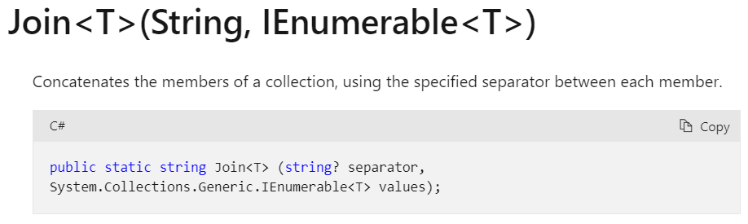
String.Join

Slide 27
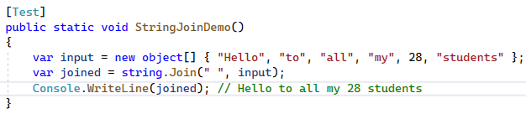
String.Join Demo

Slide 28
Invoking Instance versus Static Methods
Instance methods have the form “expression.FunctionName(args)”
Static method have the form “typename.FunctionName(args)”

Slide 29
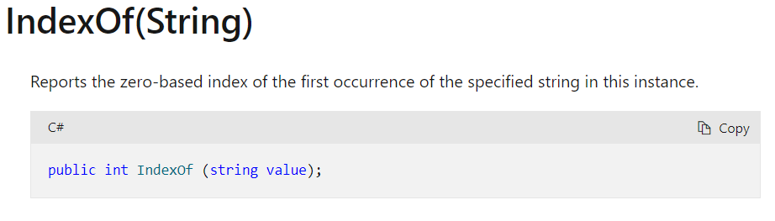
String.IndexOf()

Slide 30
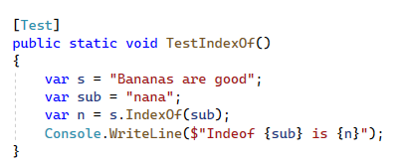
String.IndexOf Demo

Slide 31
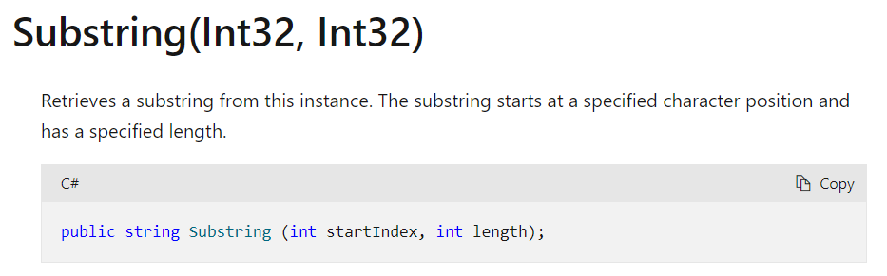
String.Substring

Slide 32
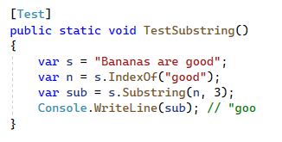
String.Substring Demo

Slide 33

Why is String.Join Static?

Slide 34
Converting from String to Bytes and Back

Slide 35
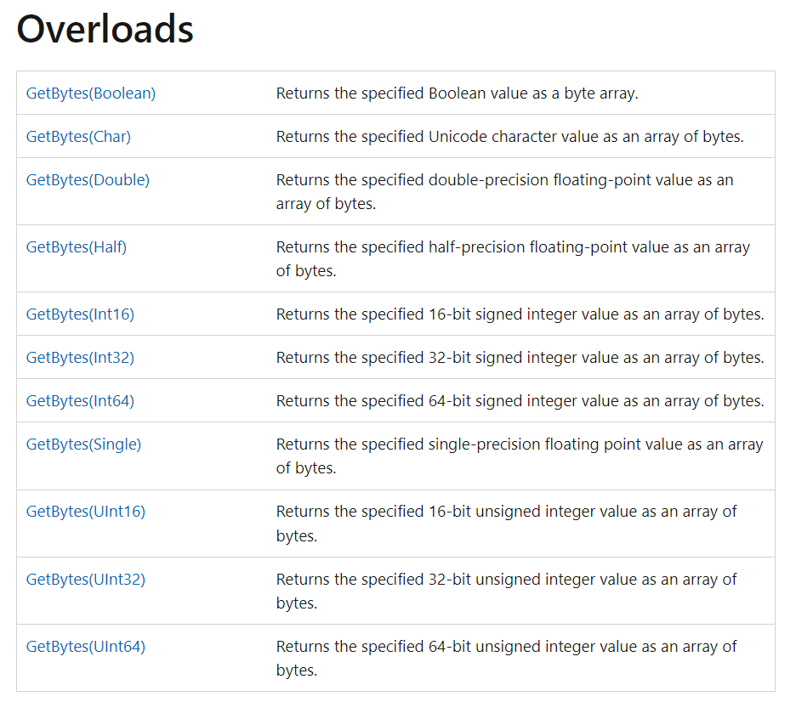
Bit Converter does not work on Strings?!

Slide 36

Remember Encodings?
string value = "\u00C4 \uD802\u0033 \u00AE"; byte[] bytes= System.Text.Encoding.UTF8.GetBytes(value);
System.Text.Encoding.UTF8.GetBytes(value);
We need to choose one, such as
System.Text.Encoding.UTF8.GetBytes()
System.Text.Encoding.UTF16.GetBytes()
System.Text.Encoding.ASCIIEncoding.GetBytes()

Slide 37
String Constructors
String(Char, Int32) - Initializes a new instance of the String class to the value indicated by a specified Unicode character repeated a specified number of times.
String(Char[]) - Initializes a new instance of the String class to the Unicode characters indicated in the specified character array.

Slide 38
String Operators
+ String concatenation
+= String concatenation and assignment
== Equality
!= Inequality

Slide 39
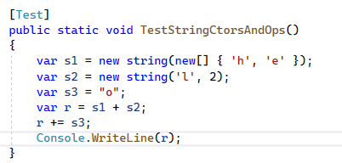

Slide 40
Strings are Like Arrays
They have a Length property
They support indexing using an integer index
In other words you can get the nth character using a subscript

Slide 41
Demo String Length and Indexing

Slide 42
String Immutability
String objects are immutable: they can't be changed after they've been created
Methods and C# operators either query a string or create a new string object

Slide 43
So how do you build strings?
StringBuilder class
String.Format
String interpolation expression
Concatenation
From an array of chars

Slide 44
What about memory?

Slide 45
Wait, what is a property?
A member that resembles a field
May redirect to a field or to a function
May be read-only or read-write
May be static or non-static

Slide 46
Property Examples

Slide 47
Indexers
An indexer allows a type instance to be indexed like an array or dictionary
An indexer can accept any type of parameters (like an int, string, object.)

Slide 48

String Formatting
Before string interpolation we had string formatting routines
Like a safe and powerful version of the C function sprintf().
String.Format()

Slide 49
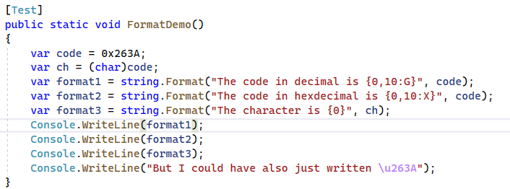
String Formatting

Slide 50
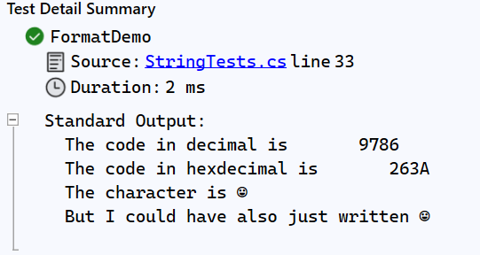

Slide 51
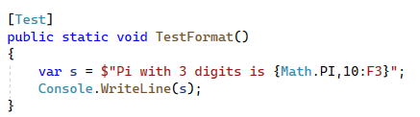

Formatting with String interpolation

Slide 52
The Null Literal
The null keyword represents a reference that does not refer to an object.
It has a special type (called the null type) but can be cast to any reference type
Reference variables are assigned null by default
In other words it means “no value”
Different from the empty string (“”)

Slide 53
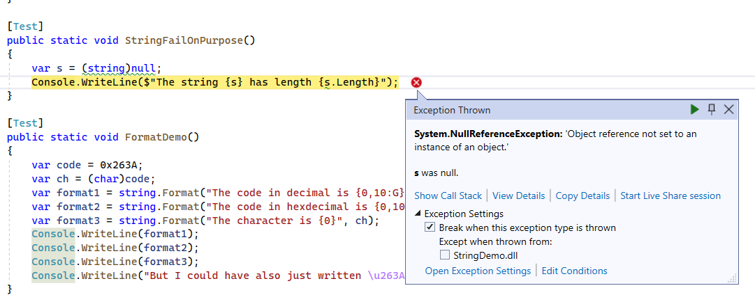
NullReferenceException

Slide 54
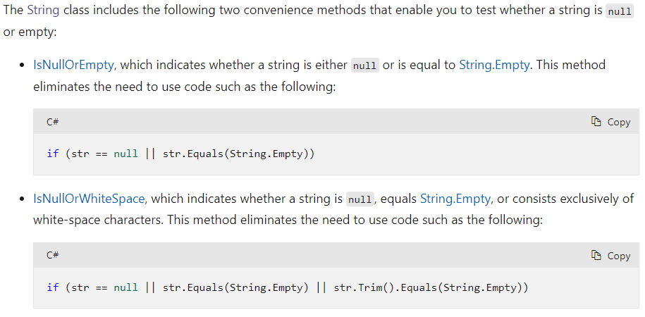
Checking if Strings are Null or Empty

Slide 55
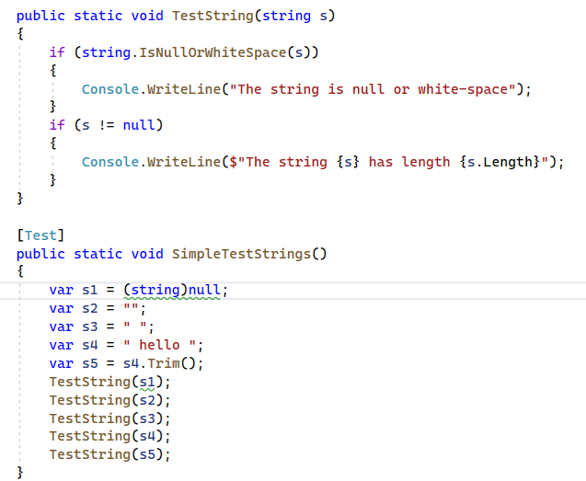
String Queries

Slide 56
Strings implement IEnumerable
Strings implement “IEnumerable”
This means you can loop through the characters with a foreach

Slide 57
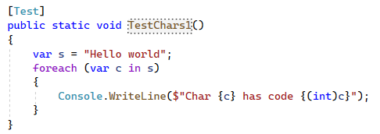
Foreach

Slide 58
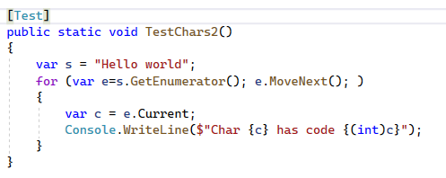
Foreach is a For Loop
https://learn.microsoft.com/en-us/dotnet/api/system.collections.ienumerable.getenumerator?view=net-7.0

Slide 59
Interview Questions with Strings
Get all duplicated characters in a string.
Get all unique characters in a string.
Reverse a string.
Reverse each word in a string
Get the word count in a string
Check if a string is a palindrome or not
Check max occurrence of a character in the string.
Get all possible substring in a string.
Get the first char of each word in capital letter
Check if two strings are anagrams
Remove duplicated characters
Check if a function has all unique characters

Slide 60
Review
Do all variables have types?
How is the type of an implicitly typed variable declaration determined?
What does the “var” keyword indicate?
Can I access methods specific to a string (like Length) on a variable of type “object”?
Can a variable of type “object” refer to a “string” object?
How can I determine the run-time type of an object?
What is an instance of a class called?
What does System.String inherit from?
Casting from System.String to System.Object is an upcast or downcast?
Are upcasts explicit or implicit?
Can I change the type of a value?
Are types valid expressions?

Slide 61

Next Class
Collections
Building our own Class

