Slide 1
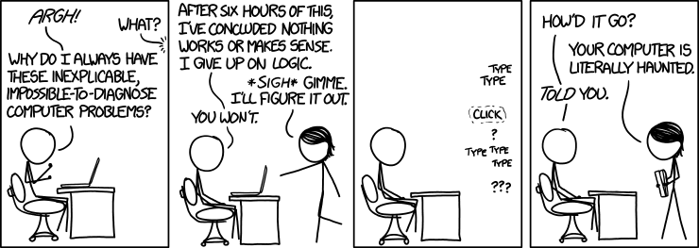
Debugging (and a bit of testing)
https://xkcd.com/1316/
By Randall Munroe

Slide 2
Programs do exactly what we ask!
We just don’t fully understand what the program does under all inputs
We may think we do, but we almost always only have a partial understanding

Slide 3
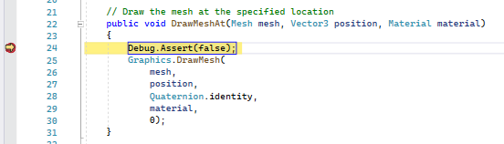
Debugging
Bugs are errors, or unexpected behaviors within code. Debugging is the process of trying to figure out how a computer program working and why it is doing what it is doing.
Some basic tools for debugging are:
Trace Statements
Assertion
Breakpoints
Watches
Tests

Slide 4
Debugger
A debugger is a computer program that can attach itself to a running process, pause it, step through it line by line, and allow you to view the values associated with variables.
Debuggers often provide a console window which displays the result from trace statements.
When running a computer program from within the development environment usually the debugger is already attached.

Slide 5
Debug and Release Mode
Computer programs are often compiled in one of two modes: debug and release. More are possible (e.g., hybrid)
In debug mode a symbol file (.pdb) is generated which links binary executable to source files.
Release mode builds are usually optimized, certain instructions are removed from the executable, and a PDB is not generated.
Another name for a “debug” build is a “development” build.

Slide 6
Code not run during Release Build
Code between #if DEBUG and #endif
Code that is conditional on “Debugger.IsAttached”
Debug.Assert()
Debug.WriteLine()

Slide 7

ONLY Distribute and Measure Release Builds

Slide 8
Tracing
A function call, which outputs information to a console window, is called a trace statement.
Debug.WriteLine() outputs text to the Visual Studio output window.
You can use Console.WriteLine(), but be careful about leaving in debug information during releases
When using Unity, you can use Debug.Log() which outputs to the Unity console.
There is also a Trace class, which is intended for instrumenting release builds
See also the Trace and Debug Topic in C# documentation

Slide 9
Debug Assertions
An assertion statement is a function call to which takes a conditional expression that is expected to be true.
If the condition evaluates to false, and a debugger is attached the program will be paused.
All assert calls will be conditionally included only in a development/debug builds
Assert statements are great ways to document and test your assumptions about code.

Slide 10
Test Assertions
In unit tests we also have assertions
1
These are run during both release builds and debug builds
2
Test assertions should be in a separate test project and not distributed
3
If an assertion fails during a test run, the test is considered non-passing
4
If an uncaught exception occurs, then the test is also considered non-passing
5

Slide 11
Breakpoints
A breakpoint is a marker assigned to an instruction within a computer program that triggers the debugger to pause.
In C# you can also use the Debugger.Break() to programmatically pause any attached debugger.
If no debugger is attached, you can also use the Debugger.Launch() function to launch and attach a debugger.
Once you hit a breakpoint, you can step through code one line at a time.

Slide 12
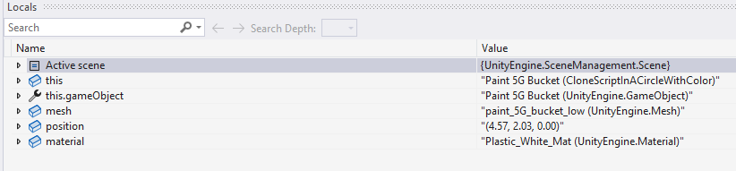
Watches
A watch is a window that shows the value associated with a variable or expression.
We can view all local variables, or specific expressions.
For more information on using watches see this article.

Slide 13

Debugging Advice
Computers and compilers almost never make mistakes.
Virtually of the time, problems arise from an incomplete understanding of what we have asked the computer to do.
When you are stuck, the problem often boils down to unidentified and incorrect assumptions.
You have assumed something about how either the compiler or program works, and you are not aware of what assumptions you have made.
Write out your assumptions as assertion statements or comments

Slide 14
Start Debugging launches Startup Project
A solution can have multiple executables
Pressing F5 (start debugger) launches the start-up project
Uses the current debug profile
You can have multiple profiles per project

Slide 15
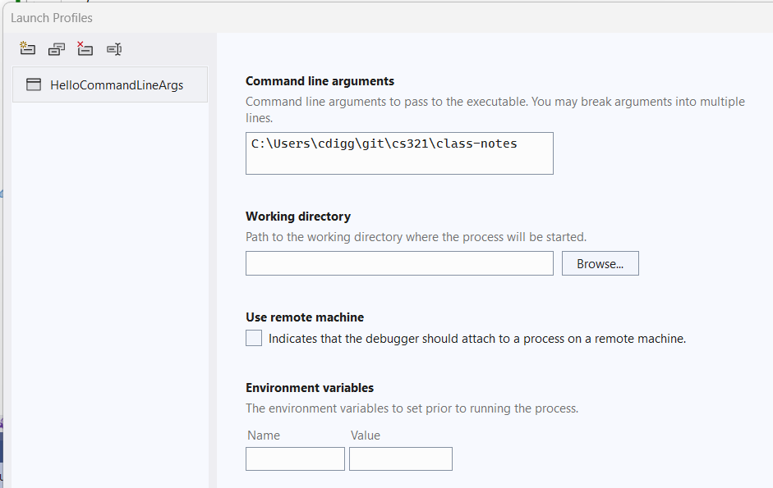
Debug Profiles

Slide 16
Debug Profiles
Set
Command line arguments
Set
Working directory
Set
Environment variables
Launch
Project or executable

Slide 17
Testing
Tests are a kind of debug tool
They help you narrow in on problems and validate assumptions
They fail more often than you might think!
Not all tests have to pass … sometimes they just help you understand limits

Slide 18
Test Driven Development (TDD)
Starting with tests and filling out implementations is a powerful problem-solving technique
I do not recommend it as a complete software development methodology, just a tool

Slide 19
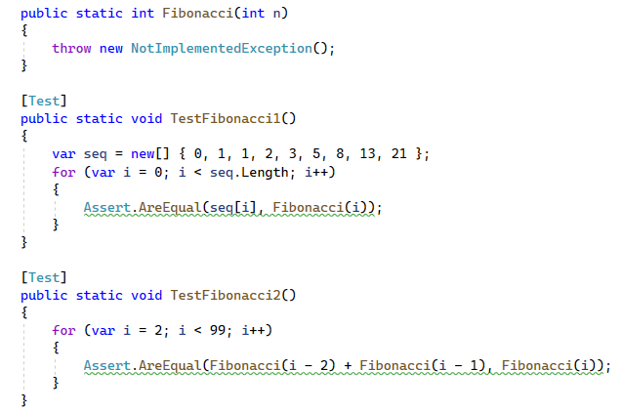

Slide 20
