Slide 1

Software ARCHITECTURE
Serialization, Data Models, Command Patterns

Slide 2
How Windows Applications work

Slide 3
Parts of your application
UI / View
Data Model
Commands
Infrastructure
Tests
Automation

Slide 4
Data Models and Views

Slide 5
Command Pattern

Slide 6
How do you save data to disk?

Slide 7
Serialization / Deserialization
Serialization is the process of converting objects into bytes (or characters) so that they can save to disk or transmitted over a network.
Deserialization is the process of reconstituting byte or character streams back into the original objects

Slide 8
How Serializers work
By querying at runtime the fields of the different types using “GetType()”

Slide 9
Reflection
Reflection allow objects to query information about objects
For example: what are the names and types of the fields?
What values does each field hold?
In C# we can query this kind of information about any object

Slide 10
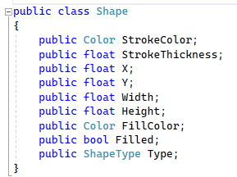
Classes that are just data
In general classes should be immutable
Sometimes it doesn’t make sense
Consider the shape class

Slide 11
Drawing

Slide 12
Useful Events

Slide 13
Designing for Testing

Slide 14
Error Handling

Slide 15
Logging
Performing diagnostics can

Slide 16
Code Organization

Slide 17
All the things an Application can Do

Slide 18
Plugin Systems
What if I want to allow other application to be built onto my program?
I can load assemblies dynamically from disk.

Slide 19
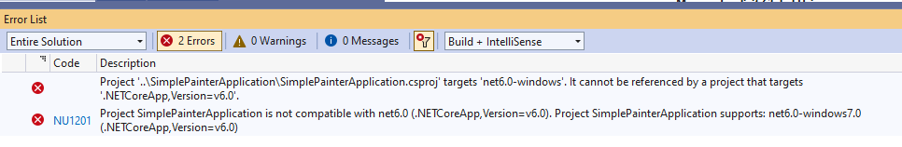
An Error you might see

