Slide 1

Software Architecture
Principles, Data Modeling, and Serialization

Slide 2

analogiES for Software Development
Discuss

Slide 3
The Analogy of Urban Planning
Lots of repetition
Constrained variations
Roads and Access
Need similar materials
Water and Sanitation
Electricity

Slide 4
Need to be Livable
Before it is finished

Slide 5
Needs to Support Future Construction
Plan to extend

Slide 6
Needs to Adjust to Changing Needs
Usage might not be what is expected.

Slide 7
A Balancing Act Between
YAGNI – You Aren’t Going to Need It
Big Ball of Mud - aka Spaghetti Code

Slide 8
Goal of Software Architecture
Reduce cost and time to develop, modify, and extend software

Slide 9
In Concrete Terms
Once a module is completed can be reused
Code is easy to test and debug
Implementation is quick and easy

Slide 10
Architectural Principles
Separation of concerns
Implies - persistence ignorance
Don't repeat yourself (DRY)
No redundancy
Single responsibility
Each module does one thing
Encapsulation
Implies - explicit dependencies

Slide 11
Separating UI from Business Logic
The text-book example of separation of concerns and single responsibility
Let's you concentrate on each aspect of the problem separately—and one complicated thing at a time is enough.
It also lets different people work on the separate pieces, which is useful when people want to hone more specialized skills.
See: https://www.martinfowler.com/ieeeSoftware/separation.pdf

Slide 12
Persistence Ignorance
How data is stored is independent of how it is used

Slide 13
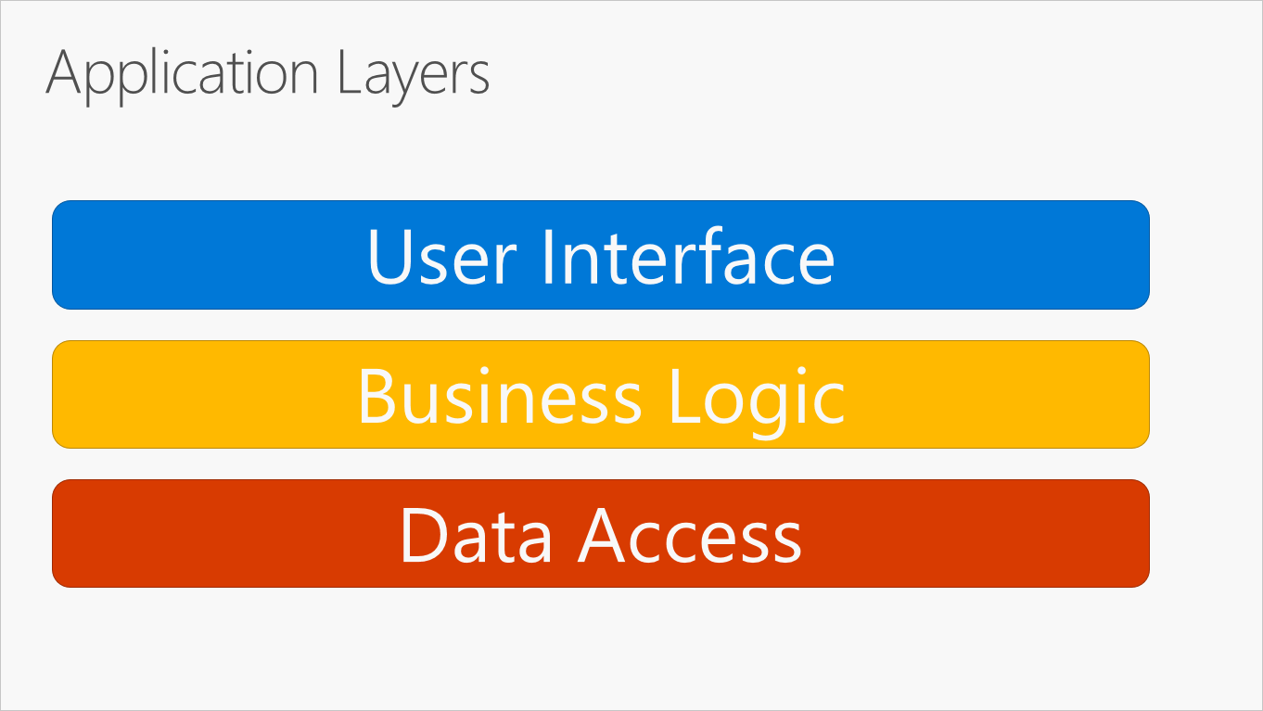
https://learn.microsoft.com/en-us/dotnet/architecture/modern-web-apps-azure/common-web-application-architectures

Slide 14
Breaking up an SVG Editor Program
How do we
Separate UI from Business Logic?
Can it be tested without UI?
Can a new UI library be used?
Make sure that operations can be easily
Logged
Repeated
Debugged

Slide 15
What is a Data Model
An abstract formalization of the objects and relationships found in a particular domain.

Slide 16
What are the primary domains?
Problem domain - the ideas and processes of the user
Solution domain – the ideas and processes of the implementation

Slide 17
Domain Driven Design (DDD)
In DDD structure and language of software code (class names, class methods, class variables) should match the business domain.
For example, if software processes loan applications, it might have classes like loan application, customer, and methods such as accept offer and withdraw.
Very important and influential idea, related to Object Oriented Design (OOD)

Slide 18
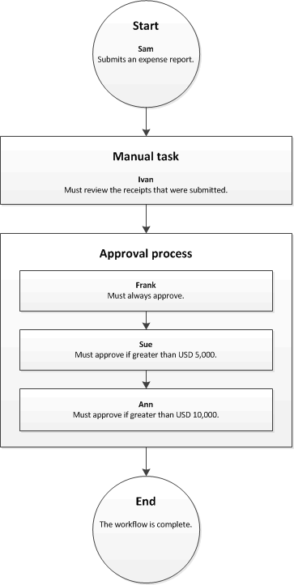
Models can Include WORKFLOWS (Processes)
https://learn.microsoft.com/en-us/dynamics365/fin-ops-core/fin-ops/organization-administration/overview-workflow-system?context=%2Fdynamics365%2Fcontext%2Fcommerce

Slide 19
Software Architecture
Domain Data
Serialization Data
Domain Processes
Application Processes and Data
User Interface and Data

Slide 20
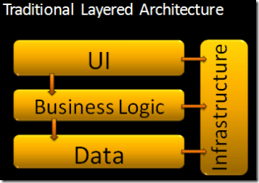
Traditional Layered Architecture
https://jeffreypalermo.com/2008/07/the-onion-architecture-part-1/

Slide 21
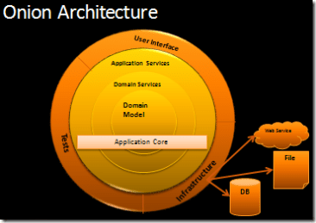
Onion Architecture
https://jeffreypalermo.com/2008/07/the-onion-architecture-part-1/

Slide 22
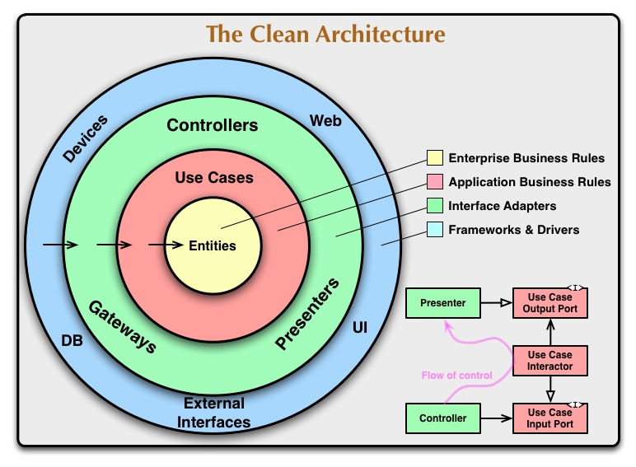
https://blog.cleancoder.com/uncle-bob/2012/08/13/the-clean-architecture.html
Notes:
https://blog.cleancoder.com/uncle-bob/2012/08/13/the-clean-architecture.html

Slide 23
How to Model Data
Look for nouns in the problem domain
Look for groupings
Create a taxonomy
Objects are great at that!

Slide 24
Modeling Domain Data of an SVG Editor
Discuss

Slide 25

Big Ball of Mud
A BIG BALL OF MUD is haphazardly structured, sprawling, sloppy, duct-tape and bailing wire, spaghetti code jungle. We've all seen them. These systems show unmistakable signs of unregulated growth, and repeated, expedient repair. Information is shared promiscuously among distant elements of the system, often to the point where nearly all the important information becomes global or duplicated.
https://blog.codinghorror.com/the-big-ball-of-mud-and-other-architectural-disasters/

Slide 26
Changing the Model
In between the model and the view things are unclear
What responsibilities do what?

Slide 27
The Goal of GUI Architectural Patterns
Make GUI applications more flexible, and reusable.
Can I port the application to a new platform?
Can I change the UI without changing the rest of the code?
Can I run the application without a UI?

Slide 28
Models, View, Controller (MVC)
Model is the state of the application and the rules of its behavior
View is the visual representation of data
Controller communicates user interactions to the model

Slide 29

MVC
The user sees the view
Interactions are sent to the controller
The controller updates the model

Slide 30
MVC in ASP Web Applications
Models:
Classes that represent the data of the app and use validation logic to enforce business rules. Model objects might retrieve and store model state to/from a database.
Views:
Components that display the app's user interface (UI). Generally, this UI displays the model data.
Controllers:
Classes that handle browser requests, retrieve model data, call view templates that return a response.
https://learn.microsoft.com/en-us/aspnet/core/tutorials/first-mvc-app/adding-controller

Slide 31
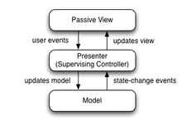
Presentation Model
Back in 2004, Martin Fowler published an article about a pattern named Presentation Model (PM).
The PM pattern is similar to MVP in that it separates a view from its behavior and state. The interesting part of the PM pattern is that an abstraction of a view is created, called the Presentation Model.
A view, then, becomes merely a rendering of a Presentation Model.

Slide 32

MVVM – Model, View, View-Model
Unlike the Presenter in MVP, a ViewModel does not need a reference to a view.
The view binds to properties on a ViewModel, which exposes data contained in model objects and other state specific to the view.
If property values in the ViewModel change, those new values automatically propagate via data binding.
When the user clicks a button in the View, a command on the ViewModel performs the requested action.
The ViewModel, never the View, performs all modifications made to the model data.
https://learn.microsoft.com/en-us/archive/msdn-magazine/2009/february/patterns-wpf-apps-with-the-model-view-viewmodel-design-pattern

Slide 33
Model View Update (MVU)
A very simple idea
Model is changed through a formal “update” process
When the model changes the view is redrawn
Also called the “Elm Architecture”

Slide 34
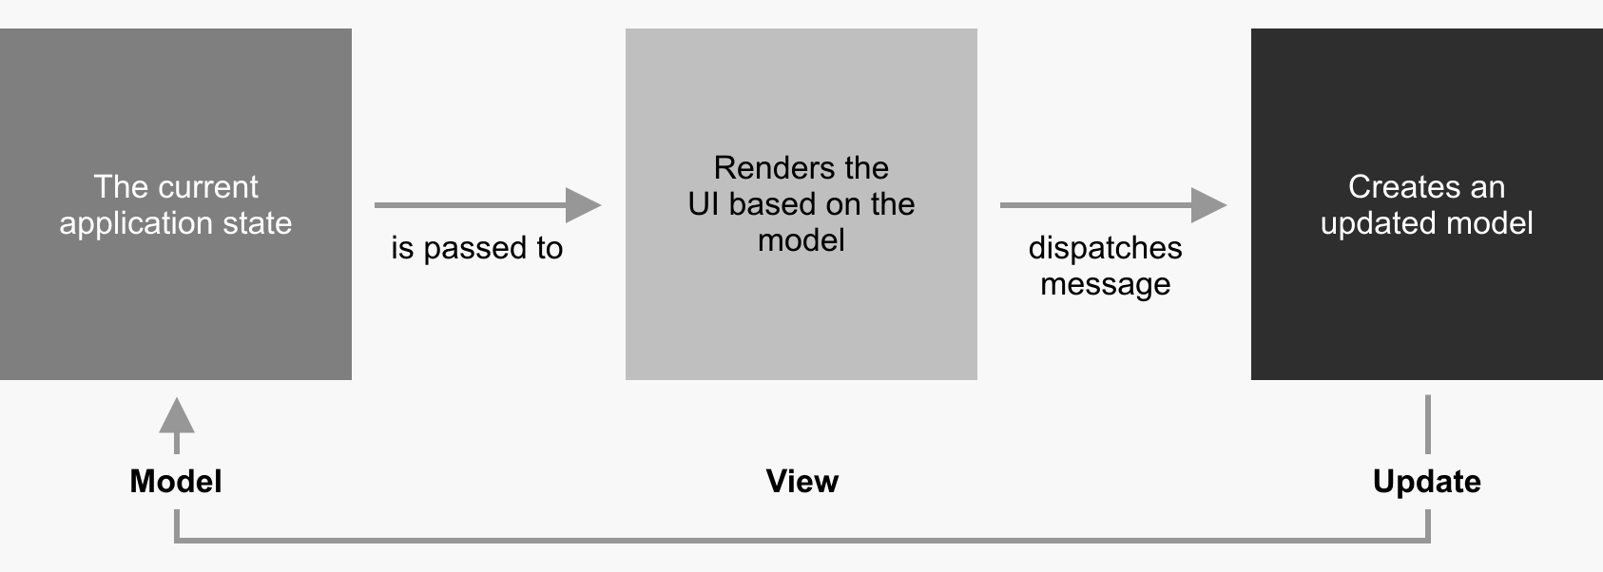
https://thomasbandt.com/model-view-update

Slide 35
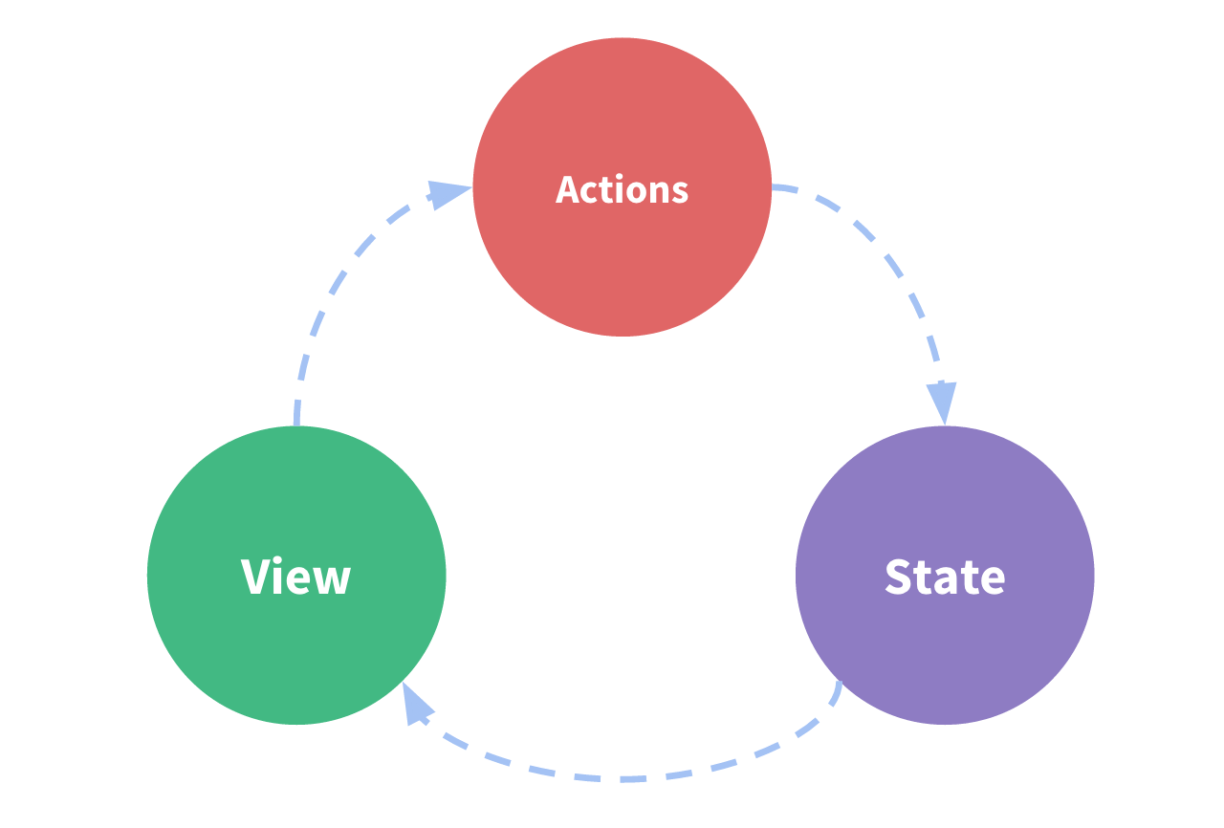
Redux Pattern
https://redux.js.org/tutorials/essentials/part-1-overview-concepts

Slide 36
In a Windows forms application?
The form is both the view and the controller.

